Slide 1
Who would you choose?

Slide 2
Source: Willis, Janine and Todorov, Alexander. “First Impressions: Making Up Your Mind After a 100-Ms Exposure to a Face.” Psychological Science, vol. 17, Issue 7. July 1, 2006.
For Financial Professional Use Only / Not for Distribution to the Public

Slide 4
For Financial Professional Use Only / Not for Distribution to the Public

Slide 5
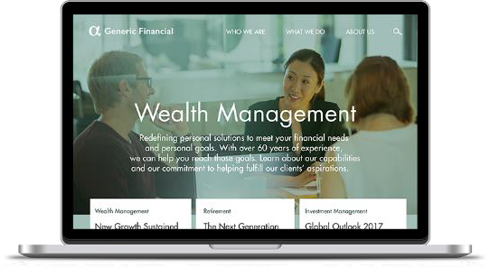

Slide 6
Mastering first impressions
Understanding what the client sees in you
For Financial Professional Use Only / Not for Distribution to the Public
Not FDIC Insured | May Lose Value | No Bank Guarantee

Slide 7
Agenda
The science of first impressions
Managing zero-second impressions
Polishing your presence

Slide 8
The science of first impressions
For Financial Professional Use Only / Not for Distribution to the Public

Slide 9
Judgments are fueled by instinct
Attractiveness
Trustworthiness
Competence
Likability
Aggressiveness
Source: Todorov, A. and Willis, J. First Impressions: Making Up Your Mind After a 100-Ms Exposure to a Face, Psychological Science, 2006.
Source: Cuddy, Amy. Presence: Bringing Your Boldest Self to Your Biggest Challenges, 2015.

Slide 10
The importance of being trustworthy
You are the product
Relationships = your assets
Your business is making things possible
For Financial Professional Use Only / Not for Distribution to the Public
10
For Financial Professional Use Only / Not for Distribution to the Public

Slide 11
7%
What does the client see?
actual words
38%
tone of voice
55%
body language
attire
The following research studies, combined, were utilized to determine the numbers pictured:
Mehrabian & Wiener, 1967 and Mehrabian & Ferris, 1967 & Mehrabian, A. (1972). Nonverbal Communication. New Brunswick: Aldine Transaction. Source: https://www.psychologytoday.com/blog/beyond-words/201109/is-nonverbal-communication-numbers-game
For Financial Professional Use Only / Not for Distribution to the Public

Slide 12
Managing zero-second impressions
For Financial Professional Use Only / Not for Distribution to the Public

Slide 13
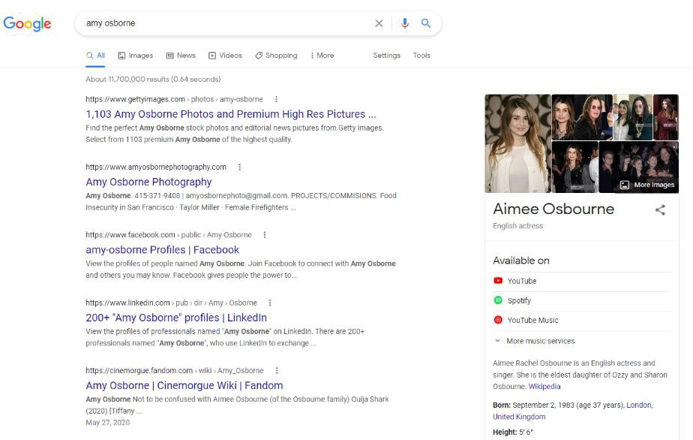
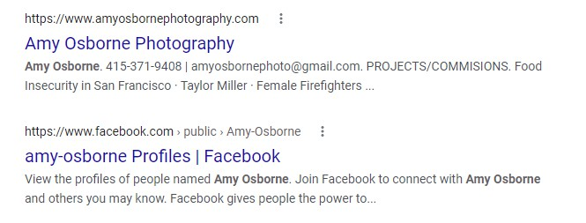
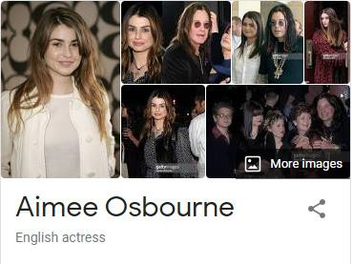
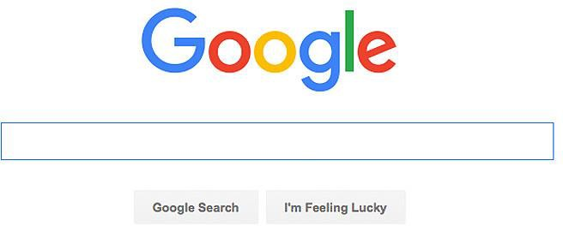
Start with search engines
amy osborne
Source: Google AdWords, Average Monthly Volume, July 2019 - July 2020.

Slide 14
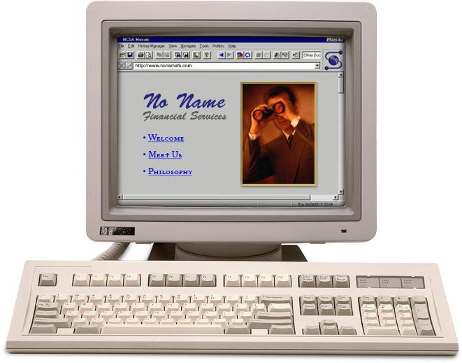
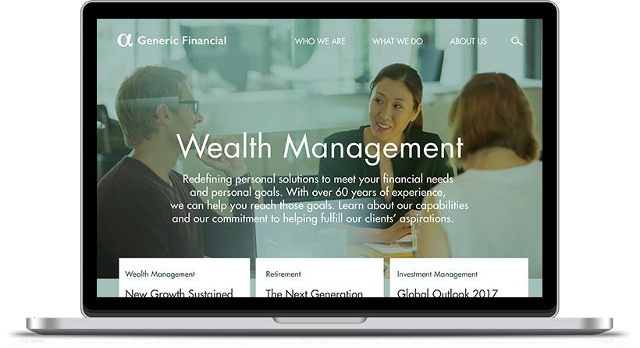
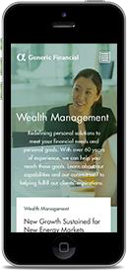
Stay up to date on technology
Source: Stanford University Web Credibility Project, 1999-2002.

Slide 15
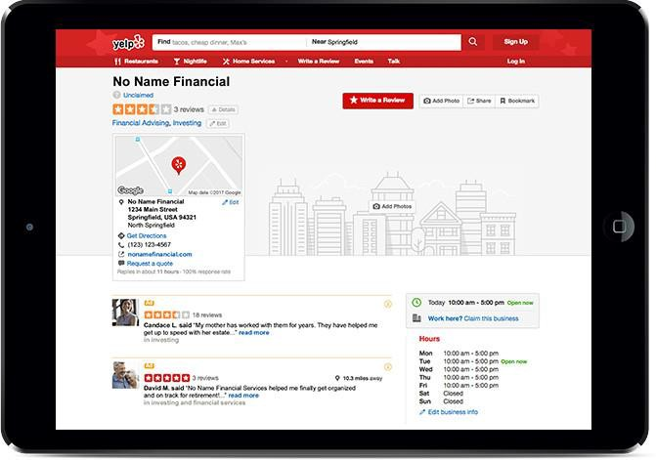
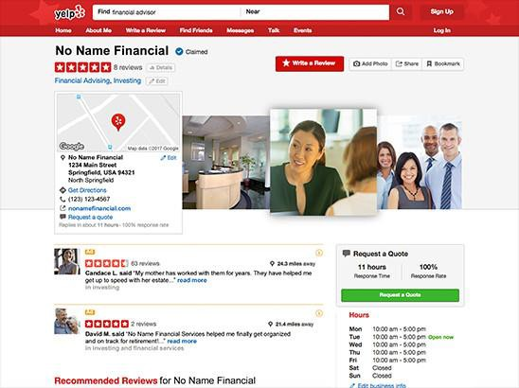
Manage your online listing
Source: BrightLocal, Local Consumer Review Survey, 2019. https://www.brightlocal.com/research/local-consumer-review-survey/
Please refer to your firms' social media policy regarding utilizing social media for business.
For Financial Professional Use Only / Not for Distribution to the Public

Slide 16
Embrace social media
Visible Relevant Insightful Impactful
3
4
financial professionals
Over gained new clients
Half
use social media
1
2
from social media
Source: Market Strategies International. Cogent Reports™, Advisor Media Consumption™, 2015.
Source: LinkedIn® and Financial Planning Association®, Communication Evolution: Financial Professionals and the Future of Thought Leadership and Social Media, 2015.
Please refer to your firms' social media policy regarding utilizing social media for business.
For Financial Professional Use Only / Not for Distribution to the Public

Slide 17
Proliferation of social media
Most Popular Among Financial Professionals
Please refer to your firms' social media policy regarding utilizing social media for business.
For Financial Professional Use Only / Not for Distribution to the Public

Slide 18
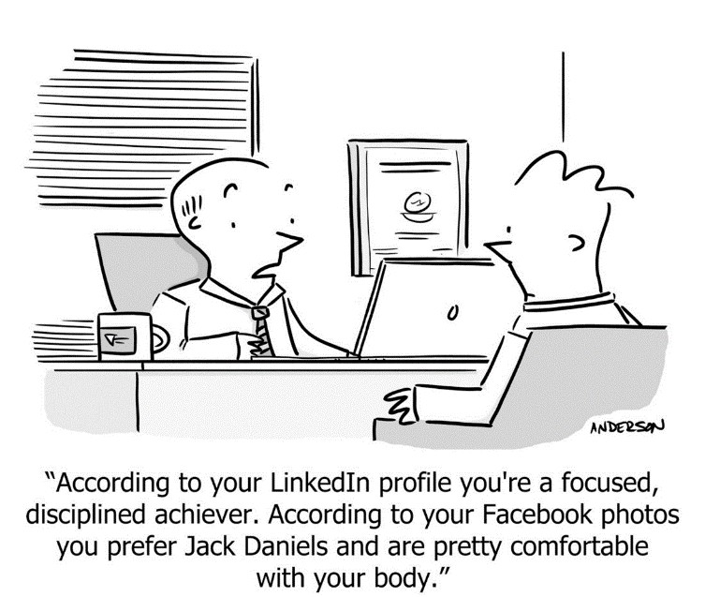

Slide 19
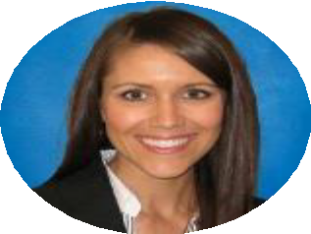
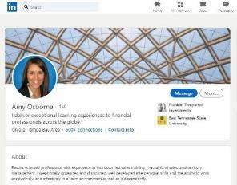
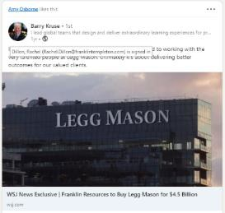
LinkedIn
1
Professional photo
2
Engaging headline
I deliver exceptional learning experiences to financial professionals across the globe.
3
About summary | Value statement
Results oriented professional with experience in instructor-led sales training, mutual fund sales, and territory management.
Exceptionally organized and disciplined, well developed interpersonal skills and the ability to work productively, and effectively in a team environment as well as independently.
4
4
Posts & Activity
Please refer to your firms' social media policy regarding utilizing social media for business.

Slide 20
Make the first contact count
Answer professionally
Speak confidently and clearly
Have a quiet background
Know when to use your cell phone

Slide 21
DO put away personal items and greet clients with a smile
DO stand and greet clients by name
DO dress in professional attire
DO help clients get settled
The firm’s ambassador of first impressions
For Financial Professional U
se Only / Not for Distribution to the Public

Slide 22
Polishing your presence
For Financial Professional Use Only / Not for Distribution to the Public

Slide 23
Dress like a million bucks
For Finan ublicci
al Professional Use Only / Not for Distribution to the P

Slide 24
For Financial Professional Use Only / Not for Distribution to the Public 24

Slide 25
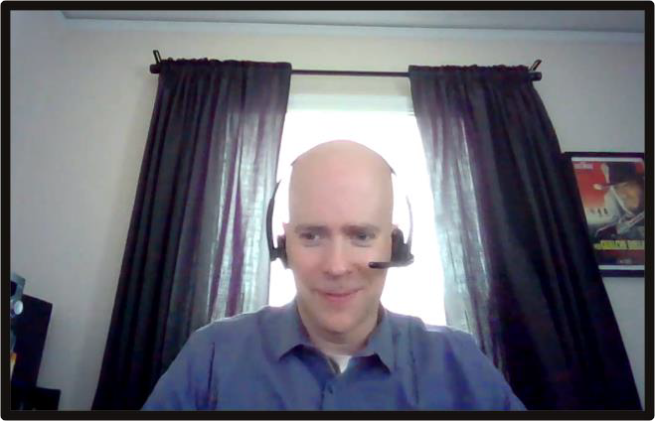
What could be improved in James’ environment?
Setting the scene:
For Financial Professional Use Only / Not for Distribution to the Public

Slide 26
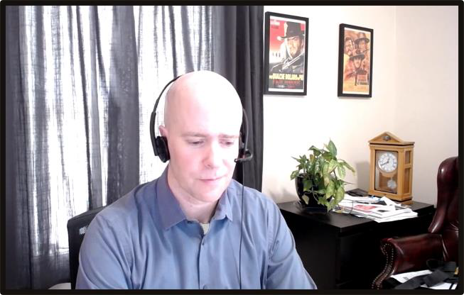
Setting the scene: Lighting
Natural
Front-facing
Sufficient, flattering
Adjust lighting by moving adjacent to window

Slide 27
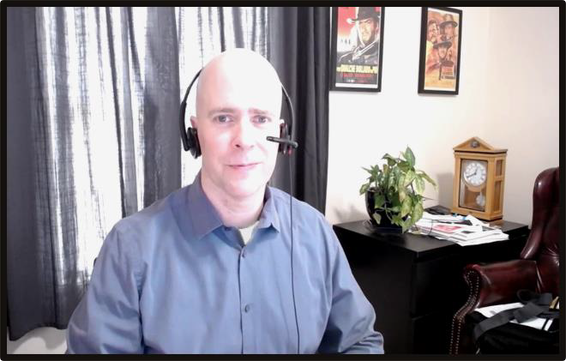
Setting the scene: Camera position
Eye level
Fill the frame
Centered
Change camera angle

Slide 28
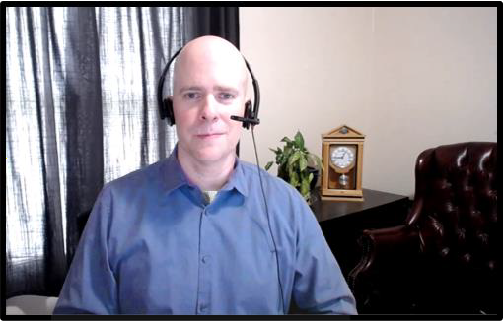
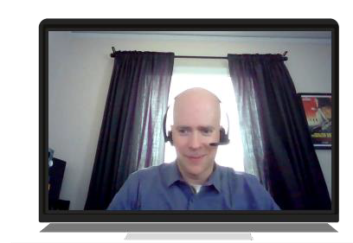
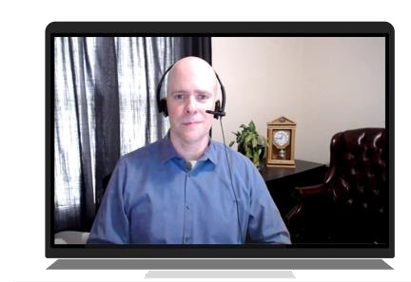
Setting the scene: Background
Neutral
Professional
Blurred
Tidy up and remove clutter

Slide 29
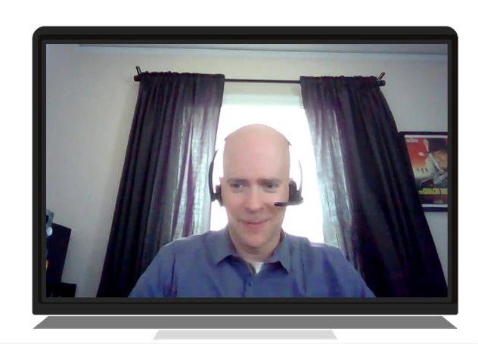
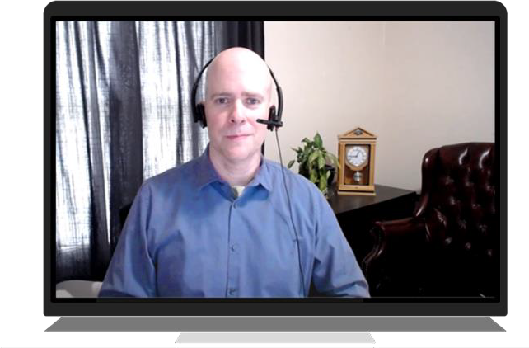
Your environment matters

Slide 30
Setting the scene: Attire
Professional
Camera-friendly colors
Avoid moiré
For Financial Professional Use Only / Not for Distribution to the Public

Slide 31
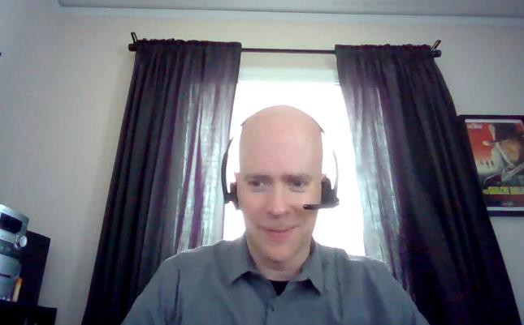
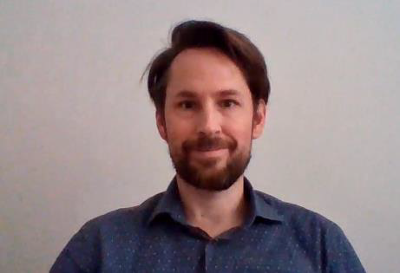
Delivery: Eye contact
Look at the camera
Stay focused
Show you are listening

Slide 32
Delivery: Vocal quality
Energy
Inflection
Microphone
32

Slide 33
Setting the scene: Sound
No ambient noise
Mute button
Headphones
For Financial Professional Use Only / Not for Distribution to the Public

Slide 34
Body language: Handshake
Shows trust and respect
Helps the other person feel welcome
For Financial Professional Use Only / Not for Distribution to the Public

Slide 35
Generate trust with your post-Covid greeting
It’s individual
Gage their body language
Ask their comfort level
Greet with a smile, a slight up-and-down head nod and good eye contact

Slide 36
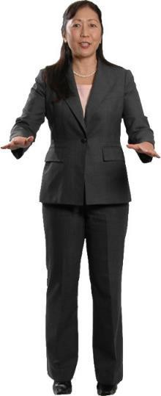
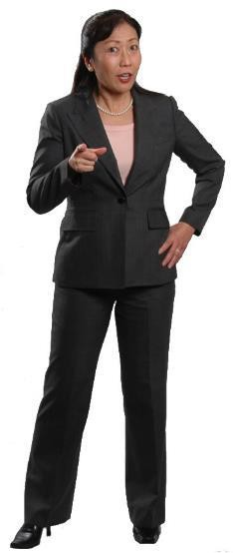
Hand gestures

Slide 37
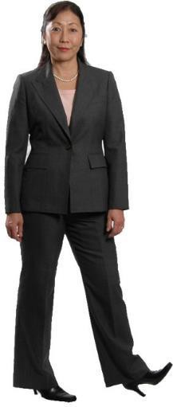
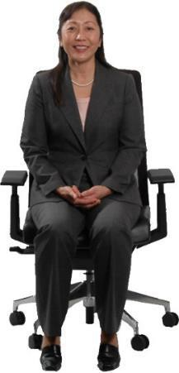
Leg and foot gestures

Slide 38
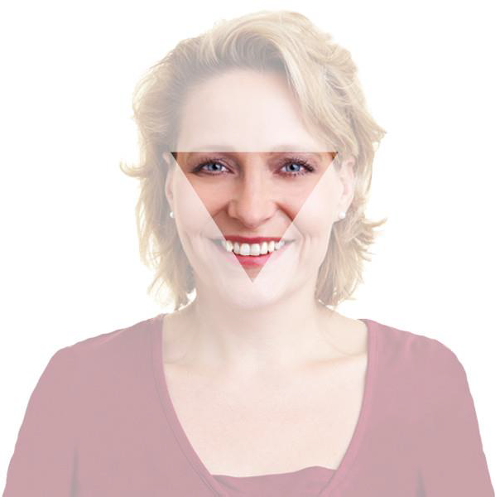
Create lasting impressions through active listening
Active listening means EYE CONTACT
Focus on area between eyes to upper chin

Slide 39
I would like…
Create lasting impressions through active listening
So, I’m hearing that…
I am nervous… So, your concern is…
For Financial Professional Use Only / Not for Distribution to the Public

Slide 40
Can you tell me more about that?
Create lasting impressions through active listening
What might happen if…?
Is there anything else to include?
For Financial Professional Use Only / Not for Distribution to the Public

Slide 41
For review
The science of first impressions
Managing zero-second impressions
Polishing your presence

Slide 42
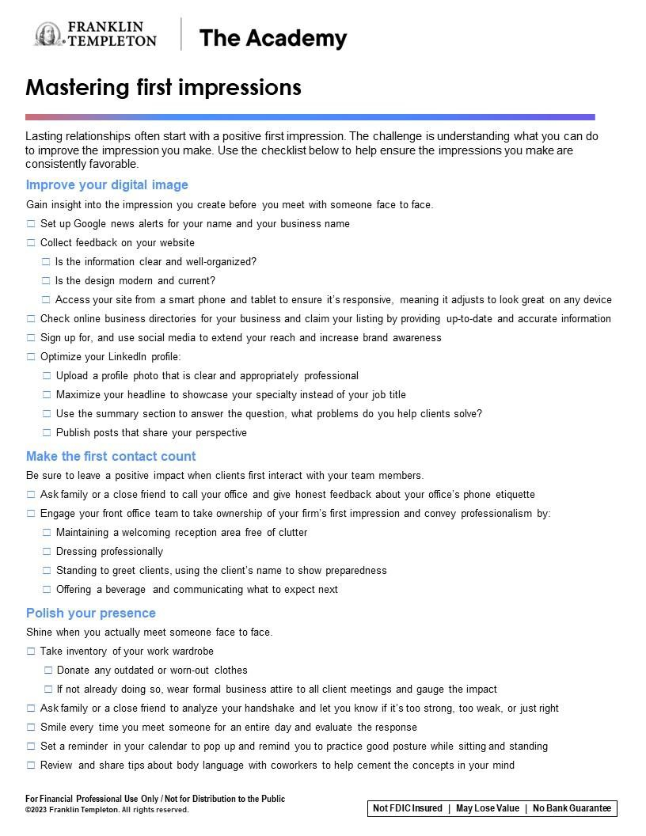
Putting ideas into action
Mastering first impressions checklist
MFIMP LIST

Slide 43
Who would choose you?
you choyooseu
For Financial Professional Use Only / Not for Distribution to the Public

Slide 44
This material is intended to be of general interest only and should not be construed as individual investment advice or a recommendation or solicitation to buy, sell or hold any security or to adopt any investment strategy. It does not constitute legal or tax advice. This material may not be reproduced, distributed or published without prior written permission from Franklin Templeton.
All investments involve risks, including possible loss of principal.
Any research and analysis contained in this material has been procured by Franklin Templeton for its own purposes and may be acted upon in that connection and, as such, is provided to you incidentally. Data from third party sources may have been used in the preparation of this material and Franklin Templeton ("FT") has not independently verified, validated or audited such data. Although information has been obtained from sources that Franklin Templeton believes to be reliable, no guarantee can be given as to its accuracy and such information may be incomplete or condensed and may be subject to change at any time without notice. The mention of any individual securities should neither constitute nor be construed as a recommendation to purchase, hold or sell any securities, and the information provided regarding such individual securities (if any) is not a sufficient basis upon which to make an investment decision. FT accepts no liability whatsoever for any loss arising from use of this information and reliance upon the comments, opinions and analyses in the material is at the sole discretion of the user.
Products, services and information may not be available in all jurisdictions and are offered outside the U.S. by other FT affiliates and/or their distributors as local laws and regulation permits. Please consult your own financial professional or Franklin Templeton institutional contact for further information on availability of products and services in your jurisdiction.
Issued in the U.S. by Franklin Distributors, LLC, One Franklin Parkway, San Mateo, California 94403-1906, (800) DIAL BEN/342-5236, franklintempleton.com - Franklin Distributors, LLC, member FINRA/SIPC, is the principal distributor of Franklin Templeton U.S. registered products, which are not FDIC insured; may lose value; and are not bank guaranteed and are available only in jurisdictions where an offer or solicitation of such products is permitted under applicable laws and regulation.
Franklin Distributors, LLC. Member FINRA/SIPC
One Franklin Parkway San Mateo, CA 94403-1906
franklintempleton.com
© 2023 Franklin Distributors, LLC. Member FINRA/SIPC. All rights reserved.
For Financial Professional Use Only / Not for Distribution to the Public
MFIMP PPT 08/23

