Slide 1
Managing Stress for Success
Strategies to prepare for, respond to, and evolve your experience with stress

Slide 2
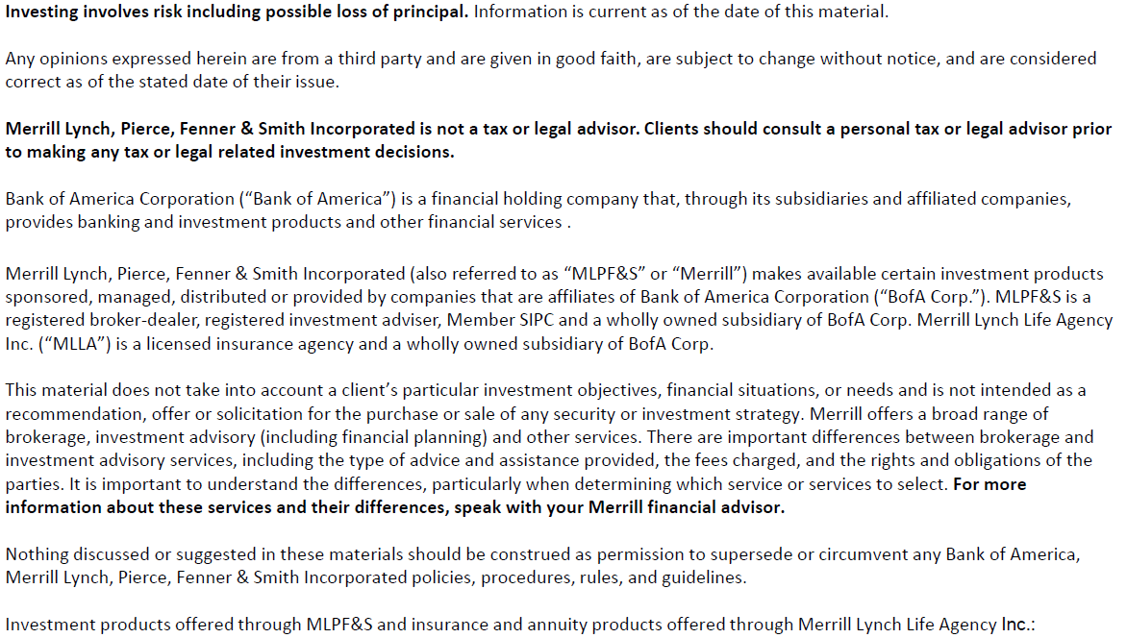

Slide 3
Program overview
Understand stress
Assess your stress
Appreciate your stress
Adjust your stress
Notes:
This program defines stress, provides a short assessment, unpacks the personal formula that drives stress for an individual, and then offers habits, practices and advice for making life changes.
Here's what we're going to do today -
First, we're going to understand what stress is both from a psychological and physiological standpoint.
Next, we're going to take a look at how stressed you are by reviewing your audit results.
Then, we'll explore the power of appreciating how stress shows up for you.
And finally - we'll finish off the session by learning how to better prepare, respond and evolve from the stress we experience

Slide 4
Let's win the war on stress.
Janus Henderson partnered with the Financial Planning Association and Investopedia to understand the drivers and impact of negative stress on financial professionals and investors, both professionally and personally.
We also partnered with Heidi Hanna, New York Times bestselling author and Advisory Board Member for the American Institute of Stress, to provide you actionable tools to identify the sources of stress and our reactions to it, and share ideas to help manage it more productively.
4
Notes:
1. Heidi Hanna
“Chief Energy Officer” of Synergy Brain Fitness
Founding Partner of the Academy for Brain Health and Performance
Fellow and Advisory Board Member for the American Institute of Stress.
NY Times bestselling author who has written several books, including The Sharp Solution, Stressaholic, and Recharge.
Heidi has been featured at many global conferences, including the Fortune Magazine Most Powerful Women in Business Summit, ESPN Leadership Summit and the Million Dollar Round Table.
2. Financial Planning Association & Investopedia partnered with us in doing research on the most common sources of stress for FAs and investors.
Heidi Hanna holds many titles – one of them being Fellow and Advisory Board Member for the American Institute of Stress.
We have also partnered with the Financial Planning Association and Investopedia to gather input from nearly 650 people between December 2018 and January 2019. Our research was designed to quantify the scope and impact of negative stress on investors and financial professionals.
We have Heidi and many others to thank for their expertise on the science behind stress, insights on the brain, and how to change our thought patterns that trigger our stress.

Slide 5
Understand stress
Notes:
Alright! Let's dive in!

Slide 6
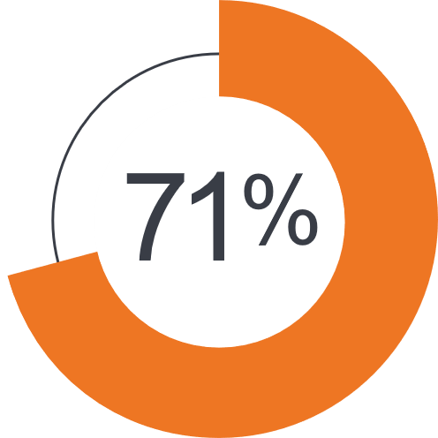
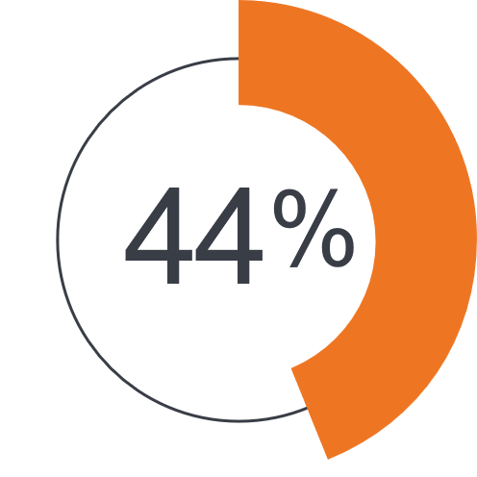
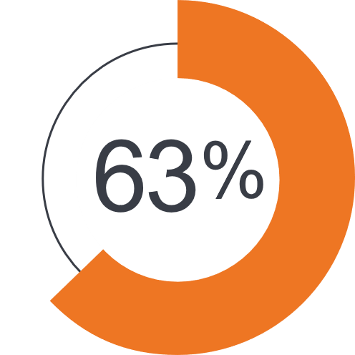
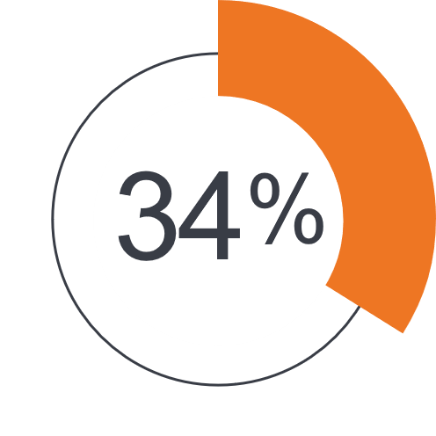
Stress is high and on the rise.
of financial professionals reported moderate or high levels of negative stress
of financial professionals feel higher levels of stress today than 5 years ago
of investors said the same
of investors said the same
Source: Janus Henderson, The Financial Planning Association, and Investopedia, 2019.
Notes:
These statistics were produced as a result of a study Janus Henderson Investors partnered on with the Financial Planning Association and Investopedia to understand the drivers and impacts of negative stress on financial professionals and investors.
While 44% and 34% might not seem significant-consider that this study was done in 2018 AND only shows the percentage that is feeling MORE stressed-its not a measure of absolute stress load.
Based on the research we conducted with the FPA and Investopedia - stress is not only high, but it's on the rise. 63 percent of investors and 71 percent of financial professionals say they experience moderate or high levels of negative stress. And if we were to conduct this research again TODAY - I'm sure that those numbers would be even higher.

Slide 7
Stress is high and on the rise.
Both financial professionals and investors stated negative stress impacts their mood, personal relationships, and health most significantly.
Financial professionals
Financial professionals
Financial professionals
Investors
Investors
Investors
Notes:
These statistics were produced as a result of a study Janus Henderson Investors partnered on with the Financial Planning Association and Investopedia to understand the drivers and impact of negative stress on financial professionals and investors.
- Stress has a financial impact, more than 300B in health costs, and loss of productivity by one study. (American institute of stress and World Health Organization)
- 75-90% of doctor visits are stress related (primarily from side effects due to inflammation and stress)
- Anxiety is the most common mental health disorder.
- Depression is the leading cause of disability at work.
Negative stress takes a toll on most - as you can see here both financial professionals and investors see their stress impacting their mood, personal relationships and their health.
Here are some other crazy statistics…
The American Institute of Stress found that 77% of people regularly experience physical symptoms caused by stress, 75-90% of doctors' visits are for stress related symptoms, and employers are spending about $300 billion dollars annually for stress related health care and missed work.
But what's driving stress?
There were numerous responses to this question but one that was at the top for Financial Professionals and people like you and me was personal health.
However, what these statistics tell me is that it isn’t our personal health issues that is causing our stress, but rather the other way around.

Slide 8
How would you describe stress?
Activity
Notes:
So let’s explore that a bit more….
How would you describe stress?

Slide 9
Common answers
Thoughts
Feelings
Not enough time
Being put on the spot
Too many demands
Obstacles
Challenging people/ personalities
Abundance
Scarcity
Unknown situations
Not knowing what I’m talking about
Anxiety
Vulnerability
Worry
Tension
Pressure
Challenge
Overwhelmed
Embarrassed
Stimulation
Threatened
Loss
Rushed
Nervous
Notes:
When most people are asked that question, they respond with the psychological thoughts like "not having enough time for something that's important" "having too many demands" or "dealing with challenging people.” Maybe for you it’s a feeling - anxiety, scarcity, overwhelm or worry….
But these are thoughts and feelings - these aren't actually stress. These are "nonconscious" reactions that we have to a stressor or circumstance that will ultimately lead to a stress result. Meaning we are deliberately choosing the way we are thinking and feeling by letting our autonomic reactions run wild and because of that we experience stress.
So let’s explore that a bit more….
How would you describe stress?

Slide 10
Stress reactions
Fight or flight
Freeze or faint
Notes:
Science tells us that our bodies experience stress in two main ways - fight or flight / freeze or faint.
One can be described as acute (fight flight) and the other as chronic. (freeze faint)
Example:
Loud noise – body reacts quickly to react to the threat – think about living in a cave and needing to respond to a sound in the dark…
Adrenaline kicks in.
But, let’s say you have a chronically hard commute every day – or you’re on planes 110k miles a year… over time that lifestyle and behavior can lead to these reactions.
This is why we see 90% of doctor’s visits have increased inflammation, etc. These are related to lifestyle stressors.
This is why some people that seem adjusted to stressful situations, when taken out of that state have a hard time coping.
Consider providing examples or actually activating the SAM pathway by making a loud noise (slam hand on desk or table)
Science also tells us that our bodies and minds experience a physiological response to stress. These are our bodies warning signs that we've encountered danger. The problem is that our primitive brain doesn't know the difference between being confronted by a tiger when we step outside the cave and when someone sneezes next to us at the grocery store. The way that Brook Castillio describes it is that our brain is constantly running a program called "somethings wrong" - like virus software on your computer - this program in our brain is looking for things that could kill us, it's looking for things that could harm us - or the people we love. And right now - our brain is going to work on overdrive doing what it does best. Searching for danger - and it's finding it everywhere.
Here's how this works…
When we encounter danger our sensory organs like our eyes and ears send out information to both our prefrontal cortex (our decision-making center) and our amygdala (the area of our brain responsible for emotional processing). The amygdala interprets the images and sounds and triggers our sympathetic nervous system causing our heart rate to increase, our body to sweat so it doesn’t overheat, an increase in our immune function, improved short-term memory and focus along with a release of adrenaline allowing us to fight or flee from the danger. All of this is designed to protect us. And the more sensitive our amygdala is to danger the more likely we are to stay alive. This process happens very quickly. And is a good thing - it protects us.
If our fight or flight response fails your brain shifts into the freeze response. A more chronic and slow process that conserves your resources rather than burning them. Over time this cortisol driven response creates more stress on our cardiovascular system, it stores glucose as fat, decreases your immune function (which we can’t afford right now) and negatively impacts your memory.
Our brains were really only designed to deal with stress in 30 second bursts – the tiger outside our cave.
If the threat continues long term – let’s say you travel 75% of the time for work – our brain isn’t designed to handle that kind of chronic stress or have that constant drip of cortisol – and as a result everything in our body begins to shut down.
This is what happens when we leave our stress unchecked for long periods of time. This is what happens when we let our thoughts about the circumstances that we face run wild.

Slide 11
What stress actually is…
Notes:
But what is stress? Stress can be looked at in these three ways…
The first is that it's based on our personal relationship with the circumstances in our lives. Our response to a particular situation. What is considered stressful for you may not be stressful for me. For example, I don't find public speaking stressful - I deliver many presentations every year and I don't experience stress from them the way someone else might. For some, just the thought of public speaking is more stress-inducing than the thought of death. I don’t have that experience.
The second is when demand exceeds capacity. This is what happens when we are constantly being put into situations that are asking more of us than we can deliver on. Another way to think about this is putting so much stress on something that it snaps.
And finally, it’s the energy potential to be used in negative or positive ways. The easiest way to think about this one is on the positive side. Think about stressing your system either to learn something new that’s super challenging or an intense work out that takes everything you’ve got. That stress to your system generates energy that then can be used in a positive way.
For the sake of today's discussion, we’re going to focus on the first description - the reason for this is - yes, stress can also be a positive - but let's be honest we all want to know how to reduce the negative stress in our lives. And the easiest way to do that is by changing our relationship to it.

Slide 12
Summary
Stress is a multi-billion-dollar problem
There are two main types of stress
To manage our stress more effectively we must manage our responses to it
Notes:
Here are the 3 things I want you to take away from this section.
Stress is a multi-billion-dollar problem - the American Institute on Stress identified that companies are spending $300 billion dollars in annual costs associated with stress related health care and missed work.
There are two main types of physiological stress responses - the acute or more short-term adrenaline driven fight or flight response and the chronic more long-term cortisol driven freeze or faint
And finally, to better manage our negative stress we need to manage our relationship to it

Slide 13
Assess your stress
Notes:
If you've got your workbook in front of you, please flip to pages 6 & 7. Again, if you don't have the workbook, please let us know after the session. I'd recommend jotting down the page numbers that I reference throughout so you can go back after and find what we worked on during the session.

Slide 14
Stress Load Audit
Activity
Notes:
This is the assessment in the workbook-you may or may not have time to have them complete this.
In this section, I’d like you to think about your feelings and thoughts during the last month.
Answer each question quickly with the response that you most associate with for each statement.
So this audit measures your perceived stress load. How much stress are you carrying around due to the non-conscious and automatic thoughts and feelings that you are CHOOSING to think and feel.
Now I'm pretty good at this stress stuff myself - I normally fall right on the line flip flopping between Zen Master and Mildly Stressed. Not a horrible place to be… right now, I’m overwhelmed. I'm noticing that my perceived stress load - over the last month - has changed pretty significantly - I'm sure yours has too.
As we reach overwhelm, we start to see some pretty evident negative actions and results show up - I get snippy, I stress eat, I stress drink a glass or 4 of wine at the end of the day, I stress sleep where I go to bed later (because I’m binging Netflix) and wake up later than normal, I get bloated, I start to feel like I'm coming down with something - I can hide most of these from the world. But when I reach Burn Out - the world knows it. [insert personal story if desired/applicable]
Even now, with tools available - times like these where it's super simple to become distracted by the primitive brain - telling you that danger is everywhere and you believe it.
Notice where you are with this assessment - no judgment - just notice, be curious, and be grateful that you have the ability to change your results.

Slide 15
Appreciate your stress
Notes:
In order change my relationship to stress - I first needed to appreciate my own personal stress formula - how and why stress was showing up for me.

Slide 16
How does stress show up for you?
Activity
Notes:
This is your chance to start to examine your “nonconscious” stress formula-
Heidi Hanna calls this your stress signature - In your workbook, we've asked you to complete page 8 as pre-work. Now again, if you haven't done this already - that's ok, lets walk through what that looks like…

Slide 17
How does stress show up for you?
What are my stress triggers?
What are the warning signs that I have too much stress?
What are the negative behaviors that I have in response to my warning signs?
What happens to me when stress continues for too long?
What has been the most helpful in the past to recharge or reset quickly?
Notes:
If we are able to appreciate what is happening for us we can become more mindful of what is taking place and even condition ourselves to stress and counteract some of its negative effects.
What I'd like you to do, even if you've already done your pre-work is go back to page 8 in the workbook and over the next week or so identify the following.
Identify what kinds of situations trigger your stress. Right now, it shouldn't be hard to find triggers. Maybe it's your kids or your spouse operating in the background during a video conference while you're working from home. Or the empty supermarket shelves. What circumstances - what facts - trigger you to experience stress?
Notice the warning signs - those smoke alarms in your body and mind that are trying to alert you to the stress that's building inside you. For me I become edgy, my back and neck become tense, I stress eat, I get heartburn
I'd like you to observe the negative behavior that you have in response to those warning signs. Maybe you snap at the kids or your spouse, maybe you catastrophize with your friends over video chat and a bottle of wine
Finally, I'd like you to reflect a bit and think about what happens to you when stress continues for too long and goes unmanaged as well as what has been the most helpful for you in the past to recharge or reset quickly…. By looking at what has happened before - we can predict what could happen in the future. Remember for me, in both instances of my reaching burnout I experienced the same warning signs leading up to burnout and experienced the same results - I now know that if I leave my stress levels unchecked, I could find myself right back there again - and I don't want that.
It's easy to believe that we don't have control over our stress levels, but we do.
Let's use a non-coronavirus example first… remember back before the stay-at-home orders took effect… when we were out in the world being busy….

Slide 18
Summary
Trigger
Thoughts
Feelings
Notes:
Imagine you're stuck in this traffic and running late… maybe you're in this taxi down here on the left, as the taxi pulls into frame here all of the cars in front of you have come to a grinding halt - nobody's moving and you need to get all the way down to this exit and then drive all the way back up here where your meeting is - that's starting right now.
What are you experiencing?
What thoughts are you having?
What feelings?
What autonomic reactions do you have?
For me this trigger – this circumstance of being in a taxi, stuck in traffic, running late for a meeting. Those are all facts that are true and neutral.
If I'm not careful and conscious of what's going on those facts can lead to "nonconscious" and automatic thoughts like - They're going to think I don't value their time, They're going to think that I'm a horrible planner and that my life's a mess
My thoughts cause my feelings - frustration, embarrassment, shame, anxiety, stress
The great news is that if I want a different result, if I want to change my relationship with stress - I am in control and able to do it.

Slide 19
What is my current stress formula?
Activity
Notes:
Now we want you to document and memorialize your current and nonconscious stress formula.
Using the workbook prompts, fill in a circumstance, thought feeling action and result you currently experience that you would like to change.

Slide 20
What is my current stress formula?
Trigger: __________________________________
Thought: What do I think when this trigger occurs?
Feeling: How do I feel when I think this thought?
Notes:
Workbook activity
I'd like for everyone to either turn to page 10 in the workbook
So for those of you with the workbook you'll see a spot for you to capture this information.
Just listen to my instructions for now, don't try to complete the work yet.
I want you to identify one trigger that you believe to be causing you stress right now - and write that into the Trigger line.
Then I want you to identify the thoughts you are having about that trigger.
Those thoughts are going to generate some feelings inside you…. What are they?
Ok - let's unpack this further to make this super clear.

Slide 21
The stress formula
Trigger: The circumstance / facts
Thoughts: Our belief about the trigger
Feelings: The emotional response to our thoughts
Notes:
Here's how this goes.
The trigger is the fact - the truth of the situation… this is anything outside of us that we have no control over, other people, our past - things that can't be changed by us. Triggers themselves are not positive or negative until we assign value to them with our thoughts. Death is just as neutral as being stuck in traffic or catching the coronavirus. I know that might sound nuts right now, but it's true.
So a trigger you might put into your workbook could be anything that is a fact. We ran out of hand sanitizer, our child's asthma inhaler is on backorder, I've been laid off, my retirement account is much smaller than it was in January…
Now none of these triggers are what actually cause us stress - it's what we THINK about them that starts the chain reaction. That's why you can talk to two different friends and they can both have very different outlooks or stress levels attached to the same trigger.
Once you've got your trigger I want you to unpack what you are thinking about it. Remember, our brain is wired to search for danger and worst case scenarios to keep us safe. It's really easy in a time like we're experiencing right now to believe that the trigger IS the cause rather than our thinking. Now I don't want you to edit your thoughts yet. Jot down the nasty stuff that is swirling around in your head. If you try to change your thought pattern before recognizing what your brain is doing automatically you won't be able to really make the shift - I promise, we will get there by the end of this session.
Now that you've got your thoughts down I want you to notice how those thoughts make you feel. We might feel anxious, scared, scarcity, fear, overwhelm, grief
When we play this entire formula out in its automatic form we experience stress.

Slide 22
Summary
Triggers may result in different thought patterns for different people
Stress is the result of our thoughts and feelings
Changing how we think about these triggers will result in less stress
Notes:
Hopefully what you are taking away from this section is understanding that circumstances are going to trigger thoughts and feelings in you.
I want to be super clear everything that you are feeling right now is completely normal – and not wrong. If you are feeling confused, or sad, or scared, or stressed, or anxious – those feelings are valid. If you are feeling calm, abundant, grateful, excited – those feelings are valid too. Notice that the same trigger can result in different patterns for different people because of the way they are choosing to think about it.
Once we start to notice what’s going on and be an observer of our thoughts and feelings – without judgement – we can start to be in control of our mind rather than letting it run wild without supervision.

Slide 23
Adjust your stress
Notes:
So what can we do that’s really actionable?

Slide 24
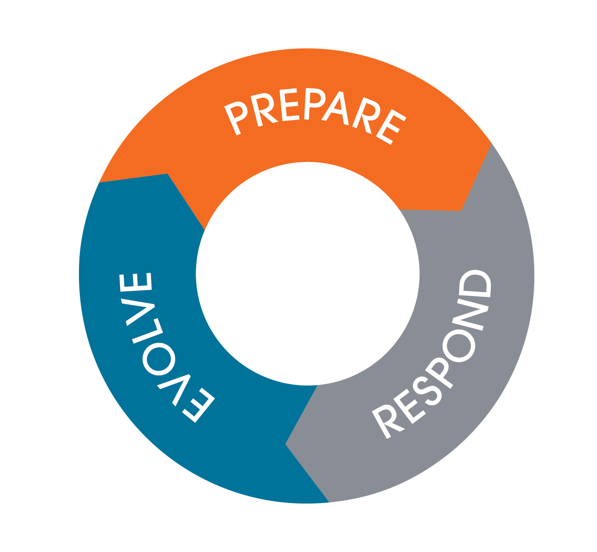
Prepare, respond, evolve
FOR FINANCIAL PROFESSIONAL USE ONLY / NOT FOR PUBLIC VIEWING OR DISTRIBUTION
Notes:
In this final section we are going to focus in on the strategies you can use to prepare for, respond to, and evolve from the stress we experience.

Slide 25
Prepare
Techniques for getting ahead of our stress reactions
Thought downloads
Mental rehearsal / visualization
Mindfulness meditation
Gratitude exercises
Notes:
Workbook: page 13
Thought download https://www.wherethelightplays.com/blog/2017/thought-download-brooke-Castillo
Mental Rehearsal https://lifehacker.com/how-to-calm-your-nerves-with-mental-rehearsal-and-get-1705202829
Mindfulness Meditation https://www.developgoodhabits.com/meditation-vs-mindfulness/
Gratitude https://positivepsychology.com/neuroscience-of-gratitude/
Getting ahead of your stress takes preparation and practice. Close your eyes for a moment and think about being approached in a dark alley by someone holding a gun. Your stress response to that encounter is going to be very different than say that of a Navy Seal - someone who has trained and prepared for that very scenario.
We recommend you to get ahead of your stress by PREPARING for them with the following techniques.
The first is my favorite - Thought downloads - this is a simple 5-minute exercise where you take a trigger or circumstance that you are struggling with, and you write down all of the thoughts that you are having about it. Just write unedited for 5 minutes straight. Like the exercise I just walked you thought, this allows you to see all of the thoughts that you are having that may be sabotaging you without you even knowing it. You can then start to see patterns in your thoughts over time that you can work on changing.
Mental Rehearsal is another technique I use frequently. I think of this one like a video game. This involves reviewing the anticipated circumstance that may be a trigger for your stress and all of the things that could happen surrounding that circumstance. For example - going to the grocery store - right now, that may cause a number of you stress. Instead of rushing out without a plan try using mental rehearsal to construct a plan that will serve you, even when you get thrown curveballs. For me this would look like - what stores am I going to go to try to find toilet paper? What do I need to do to keep myself safe before, during and after being in the store? What am I choosing to think ahead of time when I get there and they still haven't restocked the shelves? Creating a plan gives me a sense of control over what I'm experiencing in the moment.
Mindfulness Meditation is a form of meditation that allows us to focus and become aware of what is happening in the moment. This is as simple as mindfully sipping a cup of tea – feeling the weight of the cup in your hand, feeling the warmth on your hand as you hold the cup, the steam on your nose as you smell the aroma, the taste in your mouth as you sip the tea… By practicing mindfulness meditation as a preparation technique it better equips us to tap into what we are thinking and feeling when things become more chaotic.
And finally practicing gratitude. Not only does practicing gratitude release dopamine and serotonin and reduces the stress hormone cortisol, it also rewires the brain so that we develop resilience to emotional setbacks. So when we're presented with a circumstance like the coronavirus instead of being emotionally blindsided we are able to recognize the good that also comes from the circumstance. For example how the planet is healing itself as we all reduce our carbon footprint by staying at home, or the fact that you've been able to keep your job and work remotely. I'd like you all to take one minute here and just jot down 3 things that you are grateful for right now. Don't over think it. This is a great one to start and end your day with.

Slide 26
Respond
Techniques for managing the acute or immediate phase of our stress reactions
Breathing – longer exhale than inhale
A charm or talisman
Mantras
Move
Watch distracting videos
Engage your five senses
16-second reset ritual
Focus
Feel
Breathe
Notes:
Know: Workbook page 14
Responding is tricky - and challenging because what is happening is rooted in thousands of years of evolution that has kept us ALIVE. We have to slow down the autonomic response first by using the BFF method:
BFF: This process helps to energize the brain from the bottom up, following the hierarchy of sensing, feeling and then thinking so that we can optimize our ability to think and problem solve more effectively.
Breathe – Calm - Sensing – Lizard Brain
Feel – Cue - Feeling – Monkey Brain
Focus – Control - Thinking – Human Brain
Ok, let's talk about responding. The autonomic version of responding is reacting… when something happens and we don't even think about what we are doing - that's a reaction.
What we need to do in order to respond rather than react is slow down our autonomic system. There are 3 phases to this.
The first is breathing - I'd like you to do this for me right now - breathe in for a count of 5 and out for a count of 6. It has been scientifically shown that by having a longer exhale you are able to slow down your sensing or lizard brain here in red on the screen.
Once you've done that we are able to access our limbic system here in blue which is where our feelings come from - and our feelings are the next step in this process. For some they use a physical talisman to make this connection. I've got a worry stone that I ordered off of Amazon that I use that allows me to physically connect with something that creates that cue in my brain to activate and help me feel what is going on for me in the moment.
Finally in order to activate our pre-frontal cortex here in green - our thinking and human brain where we can regain our control - we want to use a mantra - either an image or a saying that we can repeat to ourselves that allows us to settle into our intention of how we want to be in our best state. This could be anything - like "I am calm" "I am love" "I am focused" However you want to show up in the moment of stress.
Again, the point here is to regain control and not just let out lizard and monkey brain run the show - but to activate our human brain and respond rather than react.

Slide 27
Evolve
Techniques for learning from our stress reactions
Journaling
Storytelling
Stress formula recalculation
Recharge tool kit
Notes:
Workbook: page 15
We don’t always rise to the challenge of being our best selves-but we have the capacity to learn-its one of the great things about being human. What happens after – is your opportunity to evolve – learning from the situation to be better prepared in the future to respond rather than react to these circumstances.
Finally what we do with our stress experiences - how we grow and evolve from our experiences is what allows us to become masters at managing our stress in the future. This is what allows us to be better prepared and equipped to respond rather than react to circumstances that may have negatively triggered us in the past.
Journaling is a fantastic way to chronical and reflect on more of the situational elements associated with past experiences and their results. By becoming an observer of your thoughts and behaviors over time you can change patterns that haven't been serving you.
Storytelling is another one that I love. For most of us we have a story that we have been telling ourselves that doesn't serve us. Our past experiences, thoughts, feelings, actions and results create evidence for why the old story should be considered as truth. For me, I had an old story around my stress and burnout and weight that wasn't serving me. I kept telling myself that once I was able to get off the road and not travel as much for work I could manage my weight. It wasn't until I decided that was just a story that I was telling myself, and that I could manage my weight even on the road - that I was finally able to lose the weight. This shift in thinking moves us from a mindset of threat to a mindset of challenge. Think about this for a moment – we don’t like threats our brain tries to fight against threats. That same brain loves to solve challenges. So if we make that shift the same brain that was fighting against us can now go to work FOR us.
The final technique that I want to talk about today is the Stress Formula Recalculation.

Slide 28
Recalculate your stress formula
Activity
Notes:
I'd like those of you that have your workbooks to flip to page 16.

Slide 29
Recalculate your stress formula
STEP 1
Trigger
STEP 3
Thought
STEP 2
Feeling
Notes:
Workbook: page 16
Activity Instructions:
Take your trigger circumstance from page 10 and write it into the Trigger line here on page 16
Work up from the bottom starting with what is the new feeling you want to have
End with the new thought you must have to generate that new feeling
I promised you that we'd come back and talk about how to adjust your stress pattern from earlier in the session.
Here's how this works. Take your trigger from page 10 and enter it into the trigger line on page 16.
Now what I'd like you to do is work from the bottom up starting with what feeling do you want to get.
So let's use an example here.
Let's say my trigger is working from home with the kids and the dogs running around.
My current feeling was high stress, overwhelm, confusion
What do I want my new feeling to be? Same trigger - but what is my desired feeling?
For me, my desired feeling would be - low stress, calm, control, gratitude
What do I need to be thinking in order for me to feel that way? We're all in the same boat - these struggles aren't mine alone right now. People understand that there are working from home challenges of all sorts that we are all facing.
See how that works?
We can flip the script and change our relationship to stress simply by changing how we are thinking.
Now this takes time to master - so practice.
Don't try to recalculate your stress formula until you really understand what your current stress formula looks like.
And be sure that you're really clear on the difference between triggers and thoughts. The trigger is the circumstance – the truth - fact - neutral.
Working from home with kids
No toilet paper on the shelf
My spouse lost their job
It's not the trigger itself that causes us stress - it's what we think about the trigger.
Often people will try to put their thoughts in the trigger line - be careful with that…

Slide 30
Closing and call to action
Techniques for learning from our stress reactions
Commit to change
Keep a stress journal for the next 24 days
Identify the common triggers that provoke negative stress results for you
“If you want something you’ve never had, you must do something you’ve never done.”
– Thomas Jefferson
Notes:
Here's what I want you to do over the next few weeks.
Commit to change – I love this quote from Thomas Jefferson - "if you want something you've never had, you must do something you've never done." You can change your relationship to stress if it is something you desire to do.
Keep a stress journal - I had someone tell me that this sounds stressful - remember that's based on what you're thinking and you can change that if you want.
The stress journal will help you identify what triggers your stress reactions and from there you can make adjustments.
I know that it may feel like we are in uncharted territory right now with what's going on in our world.
But I'd like to offer up the possibility that if we learn to manage our mind we are able to face any circumstance no matter how big it seems.

Slide 31
Connect with us
Janus Henderson provides timely insight and perspective, programs designed to hone your skills, and a team of accessible experts committed to helping you exceed expectations – in business and in life.
To engage with us, contact your Sales Director or call 800.668.0434.
Visit janushenderson.com
This material is for information purposes only. There is no guarantee that the information supplied is accurate, complete or timely, nor is there any warranty with regards to the results obtained from its use. This material may not be reproduced in whole or in part in any form, or referred to in any other publication, without express written permission.
Janus Henderson and Knowledge. Shared are trademarks of Janus Henderson Group plc or one of its subsidiaries. © Janus Henderson Group plc.
C-0523-49821 05-30-24 155-15-433819 05-23
Notes:
Additional resources:
Visit our website for more resources for your managing your stress and your practice, including Portfolio Construction Services
Sign up for the quarterly Practice Management newsletter for more about The Art of WOW and other thought leadership from our team.
https://www.janushenderson.com/en-us/advisor/subscriptions/
Reach out to find out more about the Energize for Purpose and BrainWorks programs to complete the full Life Wellness Trilogy series.
Stress management tools
Headspace
Pacifica
Self-help for Anxiety Management
Calm
Breathe2Relax
Relax Melodies
Muse
emWave2
Stress Thermometer
Stress Squares
Brookstone Shiatsu Neck and Back Massager with Heat
HomMedics Thera-P Shiatsu Kneading Massage Pillow
Acupressure: Heal Yourself

