Slide 1
For Financial Professional Use Only / Not for Distribution to the Public

Slide 2
Decisions can be challenging

Slide 4
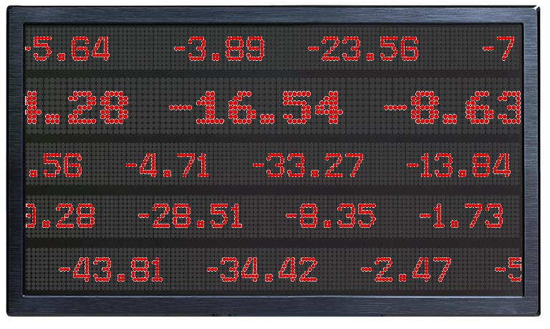
Fight or flight

Slide 5
Six barriers to investment success
Uncovering your behavioral bias
Not FDIC Insured | May Lose Value | No Bank Guarantee

Slide 6
Today’s discussion
Availability Bias
Herding
Loss Aversion
Present Bias
Anchoring
Home Country Bias
6

Slide 7
Availability bias
Our thinking is strongly influenced by what is personally most relevant, recent or traumatic.

Slide 8
Where is the danger?

Slide 9
The lasting impact of a down market
Availability bias
S&P 500 Index annual returns and Franklin Templeton Investor Sentiment Survey results
2/3 of investors thought the market was down or flat²
26.5%
2009¹
-37.0%
2008¹
This chart is for illustrative purposes only and does not reflect the performance of any Franklin Templeton fund.
Past performance does not guarantee future results.
Source: Morningstar.
Source: 2010 Franklin Templeton Investor Sentiment Survey conducted in partnership with ORC International of at least 1,000 US adult respondents.

Slide 10
Investor returns lower than market returns
Availability bias
Average annual total returns
30-year period ended December 31, 2023
10.15%
2.14%
Percentage Point Difference
8.01%
S&P 500 Index
Average Equity Fund Investor's Annualized Return
This chart is for illustrative purposes only and does not reflect the performance of any Franklin Templeton fund.
Past performance does not guarantee future results.
Sources: “Quantitative Analysis of Investor Behavior, 2024,” DALBAR, Inc. Indexes are unmanaged and one cannot invest directly in an index. Index returns do not reflect any fees, expenses or sales
charges.

Slide 11
Herding
We follow the crowd because we fear making mistakes or missing opportunities.

Slide 12
It’s hard to go against the crowd
Used with permission from Candid Camera.
12

Slide 13
Bubbles throughout history
Herding
-82%
-48%
-78%
-35%
+177% +299% +294% +71%
Tulipmania
1636–1637
Roaring 20’s
1929
Dot-Com
2000–2002
Real Estate
2006–2012
Tulipmania
1634–1636
Roaring 20’s
1924–1929
Dot-Com
1997–2000
Real Estate
2002–2006
Sources: Tulipmania Dec. 1634 - May 1637: Thompson, Earl A. “The tulipmania: Fact or Artifact?” Public Choice, 2007; Roaring ‘20s Dec. 1924 - Nov. 1929: Dow Jones Industrial Average; Dot-Com Jan. 1997 - Oct. 2002: NASDAQ Index;
Real Estate Jan. 2002 - Mar. 2012: Case-Shiller Housing Index.
13

Slide 14
The problem of going with the flow
Herding
S&P 500 Index performance vs. equity fund net new flows
1996-2002 2004-2010
$375 375% $400
40%
Equity Fund Net New Flows (in billions)
BUYING HIGH
S&P 500 Index Cumulative Total Return
Equity Fund Net New Flows (in billions)
S&P 500 Index Cumulative Total Return
$300
300%
$200
20%
$225
225%
$150
150%
$0
0%
$75
75%
SELLING LOW
-$200
-20%
$0
0%
-$75
1996
1997
1998
1999
-75%
2000 2001 2002
Equity Fund Flows
-$400
2004 2005 2006 2007 2008 2009 2010
S&P 500 Index
-40%
This chart is for illustrative purposes only and does not reflect the performance of any Franklin Templeton fund.
Past performance does not guarantee future results.
Sources: S&P 500 Index: Morningstar; Equity Fund Flows: ICI. Flows are represented by monthly rolling 12-month net new cash flows. Indexes are unmanaged and one cannot invest directly in an index. Index returns do not reflect any fees,
expenses or sales charges.
14

Slide 15
Loss aversion
The pain we associate with a loss is much more intense than the reward felt from a gain.

Slide 16
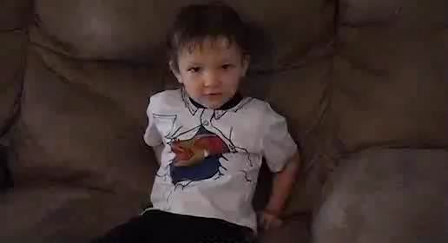
We learn the pain of loss early
Used with permission. Courtesy of VideoSpring.
16

Slide 17
$943B
Fear drives investors into cash
Loss aversion
$491B
Dot-Com Bust
March 2000 – October 2002
Global Financial Crisis
October 2007 – March 2009
Source: Federal Reserve Bank of St. Louis.
17

Slide 18
Perceived safety may come at a cost
Loss aversion
Money market accounts’ average yield before and after inflation
January 1, 2000–December 31, 2023
6%
3%
0.48%
0%
-3%
-2.73%
-6%
-9%
2005
Money Marekt Accounts
2015 2020
Money Marekt Accounts (Inflation-Adjusted)
2000
2010
This chart is for illustrative purposes only and does not reflect the performance of any Franklin Templeton fund. It’s important to note that money market accounts are insured by the Federal Deposit Insurance Corporation (FDIC) for up to $250,000.
Sources: Money Market Accounts’ Average Yield:Bankrate.com US Money Market; Inflation: Bureau of Labor Statistics. Inflation is represented by year-over-year changes of the Consumer Price Index (CPI) plotted on a monthly basis.
18

Slide 19
Present bias
We overvalue immediate rewards at the expense of long-term goals.

Slide 20
Decisions can be challenging

Slide 21
Planning for financial goals takes a backseat
Present bias
Percentage of respondents who prioritized daily expenses, paying down current debts or saving for other goals instead of saving for retirement
61%
62%
55%
Age 40-49
Age 50-59
Age 60-69

Slide 22
Retirement savings are meager
Present bias
Retirement assets
US investors age 60-69
4%
Greater than $1M
5%
$500K to $1M
35%
None
19%
$100K to $500K
37%
$1 to $100K

Slide 23
Anchoring
We often focus too heavily on one piece of information when making decisions.

Slide 24
Expectations frame our feelings about decisions

Slide 25
Anchors influence performance expectations
Anchoring
Franklin Templeton Investor Sentiment Survey results
Hypothetical market return
20%
20%
Adjusted return expectation after introducing the anchor
10%
Original investor return expectations
Source: 2020 Franklin Templeton Investor Sentiment Survey conducted in partnership with Qualtrics of at least 500 US adult investors. Most recent data avilable.

Slide 26
The full picture tells a different story
Anchoring
S&P 500 Index vs. 8% Average Annual Return
Growth of a $10,000 Investment for the 30-Year Period Ended December 31, 2023
$250,000
$200,000
$181,763
10% Average Annual Return
$150,000
$100,000
$100,627
8% Average Annual Return
$50,000
$0
1999 2004 2009
Investment With An 8% Average Annual Return
2014 2019
S&P 500 Index (Index Performance)
1994
2023
This chart is for illustrative purposes only and does not reflect the performance of any Franklin Templeton fund.
Past performance does not guarantee future results.
Source: Morningstar. Indexes are unmanaged and one cannot invest directly in an index.

Slide 27
Home country bias
We tend to favor companies and products from our home country or region.

Slide 28
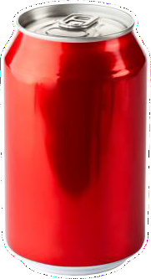
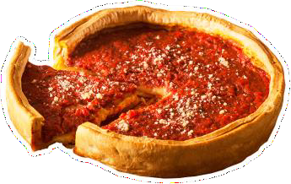
Home sweet home
29

Slide 29
Investors may be out of step
Home country bias
Potential for greater allocation to foreign investments by US investors
as of December 31, 2023
US as part of world market capitalization¹
63%
80%
US retail investors²
Source: MSCI Perspectives.
Source: ICI. Based on total net assets of Equity mutual funds invested in World Equity funds.
29

Slide 30
A global viewpoint tells a different story
Home country bias
Stock market performance by country
Total return for the 20-year period ended December 31, 2023
20%
US ranked 8th out of 43 markets
15%
10%
5%
0%
-5%
-10%
-15%
Source: Morningstar, MSCI. Based on the MSCI All Country World Index. The performance of countries and unmanaged indexes does not reflect expenses and may not correspond to the performance of a mutual fund, which may be actively managed and incur expenses. The All Country MSCI World Index is a free float-adjusted, market capitalization-weighted index that is designed to measure the equity market performance of global developed and emerging markets. MSCI makes no warranties and shall have no liability with respect to any MSCI data reproduced herein. Indexes are unmanaged and one cannot invest directly in an index.
Greece

Slide 31
In summary
Availability Bias
Herding
Loss Aversion
Present Bias
Anchoring
Home Country Bias

Slide 32
Expert coaching makes a difference
Your financial professional will help you:
Build a long-term strategy
Keep emotions in check
Stay on track
Your personal trainer
will help you:

Slide 33
Learn more about investor behavior
www.franklintempleton.com/investorbehavior

Slide 34
All investments involve risks, including possible loss of principal. Stock prices fluctuate, sometimes rapidly and dramatically, due to factors affecting individual companies, particular industries or sectors, or general market conditions. Special risks are associated with foreign investing, including currency fluctuations, economic instability and political developments.
Investors should carefully consider a fund’s investment goals, risks, charges and expenses before investing. To obtain a summary prospectus and/or prospectus, which contains this and other information, talk to your financial professional, call us at (800) 342-5236 or visit franklintempleton.com. Please carefully read a prospectus before you invest or send money.
Important data provider notices and terms available at www.franklintempletondatasources.com.
(800) 342-5236
franklintempleton.com
© 2024 Franklin Distributors, LLC. Member FINRA/SIPC. All rights reserved.
BF-PPT-0324

