Slide 1
The intergenerational divide
Building a bridge to the next generation
For Financial Professional and Institutional Use Only. Not for Public Use.
Not FDIC Insured | No Bank Guarantee | May Lose Value

Slide 2
The challenge
Cerulli Associates’ projects
_{$84T} in wealth could be transferred through 2045.
Transferred to heirs: $72.6T | Donations to Charities: $11.9T
Source: “Cerulli: Press Release: Cerulli Anticipates $84 Trillion in Wealth.” Cerulli Associates, 2022.

Slide 3
For Financial Professional and Institutional Use Only. Not for Public Use.

Slide 4
Agenda
By the end of this session, you will be able to:
TODAY’S JOURNEY:
Baby boomers
Generation X
Millennials
Generation Z
Family meetings
Describe generational wealth complexities
and their impact on client relationships.
Recognize how to better connect with investors across generations.
Determine an ideal format for a family meeting to facilitate effective dialogue and get to know those closest to your clients.

Slide 5
Where is today’s wealth?
Baby Boomers and Gen X
For Financial Professional and Institutional Use Only. Not for Public Use.
For Financial Professional Use Only / Not for Distribution to the Public
For Financial Professional Use Only / Not for Distribution to the Public

Slide 6
Wealth evolution
Changing generational net worth in America
Gen X
$10.03T
Gen X
$35.28T
Baby Boomer
$38.56T
Baby Boomer
$77.48T
Millennials
$784B
Silent Generation 2013
$21.33T
Millennials
$11.90T
Silent Generation
$19.57T
2023
Source: Federal Reserve . “Distribution of Household Wealth in the US since 1989.” Accessed October 2, 2023. Based Q1 2013 and Q1 2023 data. Figures are rounded.

Slide 7
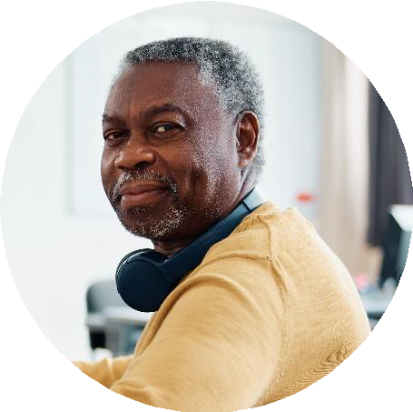
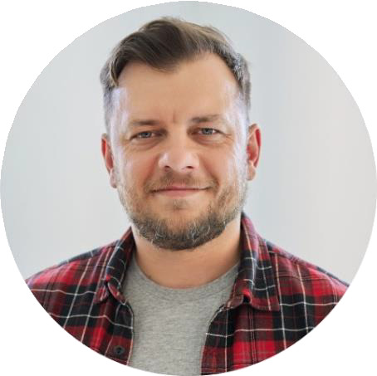
Baby Boomers: Born between 1946* and 1964 Gen X’ers: Born between 1965 and 1980
* Various resources differ in the age range cited for baby boomers. Sources:
Investopedia. “Baby Boomer: Definition, Age Range, Characteristics, and Impact.” Investopedia, 2023. “Age Range by Generation.” Beresford Research, September 27, 2023.
For Financial Professional Use Only / Not for Distribution to the Public

Slide 8
Shifting generations
Wealth transfer in progress
By 2045 the baby boomer generation could transfer over
The larger proportion of the wealth transfer is yet to occur.
72%
of AUM is held by investors
age 58 and above.¹
$53T
Totaling 63% of the great
wealth transfer.²
“U.S. Investor Study: Investor insights you need to know now.” Broadridge Financial Solutions, 2023. Survey methodology: This study draws on de-identified data covering roughly 90% of all U.S. households who invest in mutual funds, equities, and exchange-traded funds (ETFs) sold through financial intermediaries. The study delivers data points on year-end data spanning from 2018 through 2022. Investor survey: semi-annual online survey is given to 1,000 U.S. retail investors, aged 25 or older, responsible for household finances and with income exceeding $25,000 and assets of at least $10,000. Advisor survey: 400 U.S. financial advisors semi-annually, focusing on registered advisors across different channels with at least $10 million in assets under management, and over 20% invested in mutual funds or ETFs.
“Cerulli: Press Release: Cerulli Anticipates $84 Trillion in Wealth.” Cerulli Associates, 2022. | Baby boomer Ages 56–74 as of year-end 2020.

Slide 9
Women in the US generally outlive men by six years.
Population Reference Bureau. World Population Data Sheet 2022, 2022.
*Based on US Life expectancy at birth (years), Males 73, Females 79.
For Financial Professional and Institutional Use Only. Not for Public Use.

Slide 10
Women in the US control
$12 TRILLION IN ASSETS.
Women’s economic power
By women in the US are
2030
expected to CONTROL much of the $ 3 0 T R I L L I O N baby boomers will possess.
Source: “US Wealth Management: A Growth Agenda for the Coming Decade.” McKinsey & Company, February 16, 2022.
For Financial Professional and Institutional Use Only. Not for Public Use.

Slide 11
Financial goals of women over 50
Hear from our mass affluent respondents
Maintaining current lifestyle in retirement
Savings to cover long-term health expenses for self
Financial freedom to enjoy life
Base: Gen Pop (n=502) Women 50+ (n=300) • Q16: How important are each of the following financial goals to you, today? Q17: You mentioned that the following financial goals are important. Please rank order your top 3 most important goals, giving a “1” to the item that is most important to you. Figures are rounded. Franklin Templeton, in partnership with Chadwick Martin Bailey, conducted a survey among a sample of 1,641 U.S. adults ages 18 or older with at least $100K in investable assets. The survey results contain the opinions of the respondents are not necessarily those of Franklin Templeton. Survey results represent a small sample size of voluntary respondents, and therefore may have inherent limitations. The sample includes key populations and audiences including Millennials (survey=298); Women 50+ (survey=300); Latinx & Hispanics (survey=295, interview=4); Asian Americans & Pacific Islanders (survey=299, interview=4); Black & African Americans (survey=595, interview=13); LGBTQ+ (survey=292, interview=4); general population (502). The results from general population are weighted to US Census targets on age, gender and ethnicity and no weighting is done on the demographic groups. Quantitative research was conducted through a structured research survey from July 20th to August 5th, 2022.
For Financial Professional and Institutional Use Only. Not for Public Use.

Slide 12
Financial goals of women over 50
Hear from our mass affluent respondents
Goals prioritized less than the general population?
Providing for family members
Being able to retire early
Paying off non-student loan debt
Base: Gen Pop (n=502) Women 50+ (n=300) • Q16: How important are each of the following financial goals to you, today? Q17: You mentioned that the following financial goals are important. Please rank order your top 3 most important goals, giving a “1” to the item that is most important to you. Figures are rounded. Franklin Templeton, in partnership with Chadwick Martin Bailey, conducted a survey among a sample of 1,641 U.S. adults ages 18 or older with at least $100K in investable assets. The survey results contain the opinions of the respondents are not necessarily those of Franklin Templeton. Survey results represent a small sample size of voluntary respondents, and therefore may have inherent limitations. The sample includes key populations and audiences including Millennials (survey=298); Women 50+ (survey=300); Latinx & Hispanics (survey=295, interview=4); Asian Americans & Pacific Islanders (survey=299, interview=4); Black & African Americans (survey=595, interview=13); LGBTQ+ (survey=292, interview=4); general population (502). The results from general population are weighted to US Census targets on age, gender and ethnicity and no weighting is done on the demographic groups. Quantitative research was conducted through a structured research survey from July 20th to August 5th, 2022.
For Financial Professional and Institutional Use Only. Not for Public Use.

Slide 13
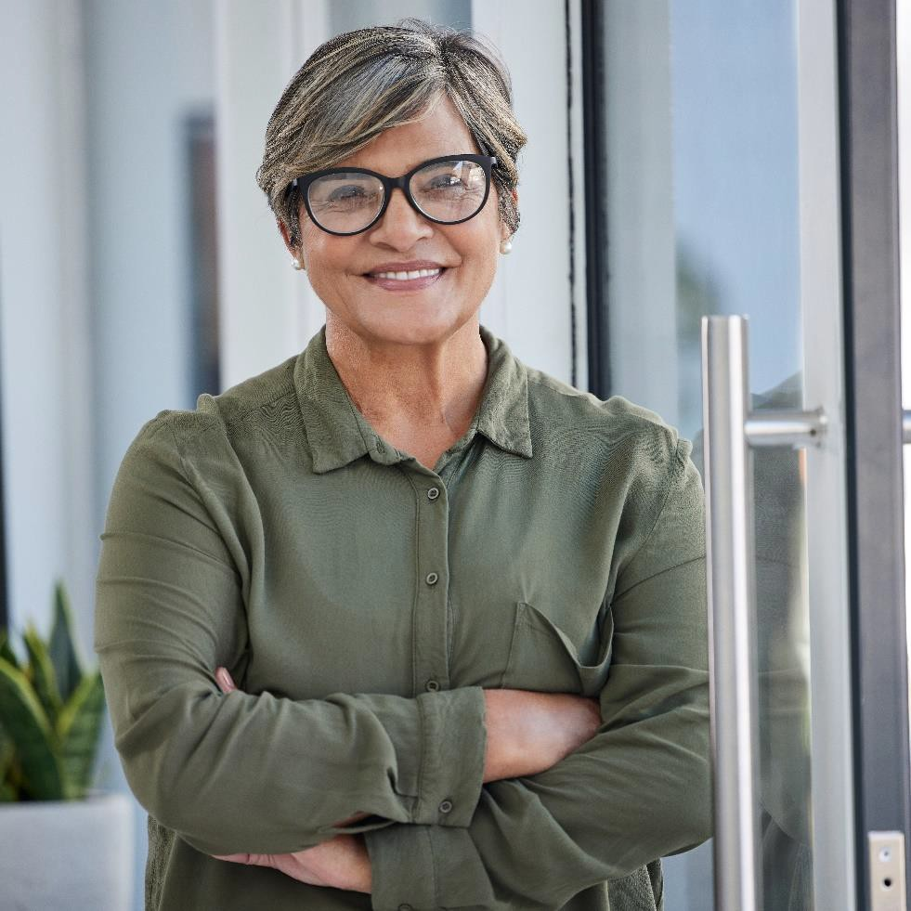
Key advisor attributes for women over 50
Hear from our mass affluent respondents
Sensitivity to my risk tolerance.
Years of industry experience.
Provides suitable recommendations for me.
Base: Has an Advisor | Gen Pop (n=289) Women 50+ (n=200) | Does not have an Advisor | Gen Pop (n=213) Millennial (n=100) • Q26: How important are each of the following in your decision to choose a paid financial advisor? Base: Has an Advisor & Credentials are Important | Gen Pop (n=194) Millennial (n=105) | Does not have an Advisor & Credentials are Important | Gen Pop (n=142) Millennial (n=65) • Q27: Which of the following factors are important to you? Figures are rounded. Franklin Templeton, in partnership with Chadwick Martin Bailey, conducted a survey among a sample of 1,641 U.S. adults ages 18 or older with at least $100K in investable assets. The survey results contain the opinions of the respondents are not necessarily those of Franklin Templeton. Survey results represent a small sample size of voluntary respondents, and therefore may have inherent limitations. The sample includes key populations and audiences including Millennials (survey=298); Women 50+ (survey=300); Latinx & Hispanics (survey=295, interview=4); Asian Americans & Pacific Islanders (survey=299, interview=4); Black & African Americans (survey=595, interview=13); LGBTQ+ (survey=292, interview=4); general population (502). The results from general population are weighted to US Census targets on age, gender and ethnicity and no weighting is done on the demographic groups. Quantitative research was conducted through a structured research survey from July 20th to August 5th, 2022.

Slide 14
Self-reflection
Connecting to younger and more diverse investors
How confident are you in understanding the needs and preferences of the next generations?
› Very confident
› Somewhat confident
› Not very confident
› Not confident at all

Slide 15
The head vs. heart challenge
According to Imprint’s 2023 survey …
❤️ Millennials tend to prioritize heart-driven factors like impact investing, portfolio alignment with values and environmental impact.
🧠 Baby Boomers tend to prioritize head-driven considerations such as asset allocation, investment performance and the impact of inflation.
Source: Imprint, Bridging the Confidence Gap, 2023.

Slide 16
Millennials:
The next big boom
For Financial Professional and Institutional Use Only. Not for Public Use.
For Financial Professional Use Only / Not for Distribution to the Public
For Financial Professional Use Only / Not for Distribution to the Public

Slide 17
Millennials
Born between 1981 and 1996
Source: “Age Range by Generation.” Beresford Research, September 27, 2023.

Slide 18
The future’s wealthiest generation?
Millennials will benefit from the wealth transfer
73 trillion
could be transferred from baby boomers to millennials by 2045.¹
Over 20%
of the US population in 2020 consisted
of millennials.³
More than two-times
the net worth growth from 2020 to 2023.²
1. “Cerulli: Press Release: Cerulli Anticipates $84 Trillion in Wealth.” Cerulli Associates, 2022. Other sources; Federal Reserve . “Distribution of Household Wealth in the US since 1989.” Accessed October 2, 2023. Based on Baby Boomer
wealth for Q2 2022.
2. Federal Reserve . “Distribution of Household Wealth in the US since 1989.” Accessed October 2, 2023. Based on millennial wealth from Q1 2020 ($4.6T) to Q1 2023 ($8.3T).
3. Bureau, US Census. “How Has Our Nation’s Population Changed?” Census.gov, May 25, 2023. Based on millennials ages in 2020 (birth years 1981-1996), using the total 2020 US census data.
For Financial Professional and Institutional Use Only. Not for Public Use.

Slide 19
Millennials value paid advice
Hear from our mass affluent respondents
Key reasons for seeking advice:
Cited by millennial respondents
64%
of millennials
embrace paid
financial guidance.
Exploring savings and investments.
Seeking retirement planning help.
Why do millennials
choose your services?
Want to invest, but not self-manage.
Base: Gen Pop (n=502) Millennial (n=298) • Gen Pop (n=502) Millennial (n=851 Qual + Over-quota) • Q10: Do you currently work with a paid financial advisor to help you manage your money or investments on an ongoing basis? Base: Have an advisor | Gen Pop (n=289) Millennial (n=198) • Q23: For how many years have you had your current paid financial advisor? Figures are rounded. Franklin Templeton, in partnership with Chadwick Martin Bailey, conducted a survey among a sample of 1,641 U.S. adults ages 18 or older with at least $100K in investable assets. The survey results contain the opinions of the respondents are not necessarily those of Franklin Templeton. Survey results represent a small sample size of voluntary respondents, and therefore may have inherent limitations. The sample includes key populations and audiences including Millennials (survey=298); Women 50+ (survey=300); Latinx & Hispanics (survey=295, interview=4); Asian Americans & Pacific Islanders (survey=299, interview=4); Black & African Americans (survey=595, interview=13); LGBTQ+ (survey=292, interview=4); general population (502). The results from general population are weighted to US Census targets on age, gender and
ethnicity and no weighting is done on the demographic groups. Quantitative research was conducted through a structured research survey from July 20th to August 5th, 2022.
For Financial Professional and Institutional Use Only. Not for Public Use.

Slide 20
Financial goals of millennials
Hear from our mass affluent respondents
Maintaining current lifestyle in retirement
Providing for family members
Financial freedom to enjoy life
Base: Gen Pop (n=502) Millennial (n=298) • Q16: How important are each of the following financial goals to you, today? Q17: You mentioned that the following financial goals are important. Please rank order your top 3 most important goals, giving a “1” to the item that is most important to you. Figures are rounded. Franklin Templeton, in partnership with Chadwick Martin Bailey, conducted a survey among a sample of 1,641 U.S. adults ages 18 or older with at least $100K in investable assets. The survey results contain the opinions of the respondents are not necessarily those of Franklin Templeton. Survey results represent a small sample size of voluntary respondents, and therefore may have inherent limitations. The sample includes key populations and audiences including Millennials (survey=298); Women 50+ (survey=300); Latinx & Hispanics (survey=295, interview=4); Asian Americans & Pacific Islanders (survey=299, interview=4); Black & African Americans (survey=595, interview=13); LGBTQ+ (survey=292, interview=4); general population (502). The results from general population are weighted to US Census targets on age, gender and ethnicity and no weighting is done on the demographic groups. Quantitative research was conducted through a structured research survey from July 20th to August 5th, 2022.
For Financial Professional and Institutional Use Only. Not for Public Use.

Slide 21
Financial goals of millennials
Hear from our mass affluent respondents
Which financial goal did millennials prioritize
less than the general population?
Building/maintaining an emergency fund.
Building/maintaining an emergency fund.
A
Saving for future homeownership.
Saving for future homeownership.
B
Funding the higher education of family.
Funding the higher education of family.
C
Base: Gen Pop (n=502) Millennial (n=298) • Q16: How important are each of the following financial goals to you, today? Q17: You mentioned that the following financial goals are important. Please rank order your top 3 most important goals, giving a “1” to the item that is most important to you. Figures are rounded. Franklin Templeton, in partnership with Chadwick Martin Bailey, conducted a survey among a sample of 1,641 U.S. adults ages 18 or older with at least $100K in investable assets. The survey results contain the opinions of the respondents are not necessarily those of Franklin Templeton. Survey results represent a small sample size of voluntary respondents, and therefore may have inherent limitations. The sample includes key populations and audiences including Millennials (survey=298); Women 50+ (survey=300); Latinx & Hispanics (survey=295, interview=4); Asian Americans & Pacific Islanders (survey=299, interview=4); Black & African Americans (survey=595, interview=13); LGBTQ+ (survey=292, interview=4); general population (502). The results from general population are weighted to US Census targets on age, gender and ethnicity and no weighting is done on the demographic groups. Quantitative research was conducted through a structured research survey from July 20th to August 5th, 2022.
For Financial Professional and Institutional Use Only. Not for Public Use.

Slide 22
Key advisor attributes for millennials
Hear from our mass affluent respondents
Understands my unique needs.
Treats me like I’m important.
Experience in crypto and alternatives.
Base: Has an Advisor | Gen Pop (n=289) Millennial (n=198) | Does not have an Advisor | Gen Pop (n=213) Millennial (n=100) • Q26: How important are each of the following in your decision to choose a paid financial advisor? Base: Has an Advisor & Credentials are Important | Gen Pop (n=194) Millennial (n=105) | Does not have an Advisor & Credentials are Important | Gen Pop (n=142) Millennial (n=65) • Q27: Which of the following factors are important to you? Figures are rounded. Franklin Templeton, in partnership with Chadwick Martin Bailey, conducted a survey among a sample of 1,641 U.S. adults ages 18 or older with at least $100K in investable assets. The survey results contain the opinions of the respondents are not necessarily those of Franklin Templeton. Survey results represent a small sample size of voluntary respondents, and therefore may have inherent limitations. The sample includes key populations and audiences including Millennials (survey=298); Women 50+ (survey=300); Latinx & Hispanics (survey=295, interview=4); Asian Americans & Pacific Islanders (survey=299, interview=4); Black & African Americans (survey=595, interview=13); LGBTQ+ (survey=292, interview=4); general population (502). The results from general population are weighted to US Census targets on age, gender and ethnicity and no weighting is done on the demographic groups. Quantitative research was conducted through a structured research survey from July 20th to August 5th, 2022.

Slide 23
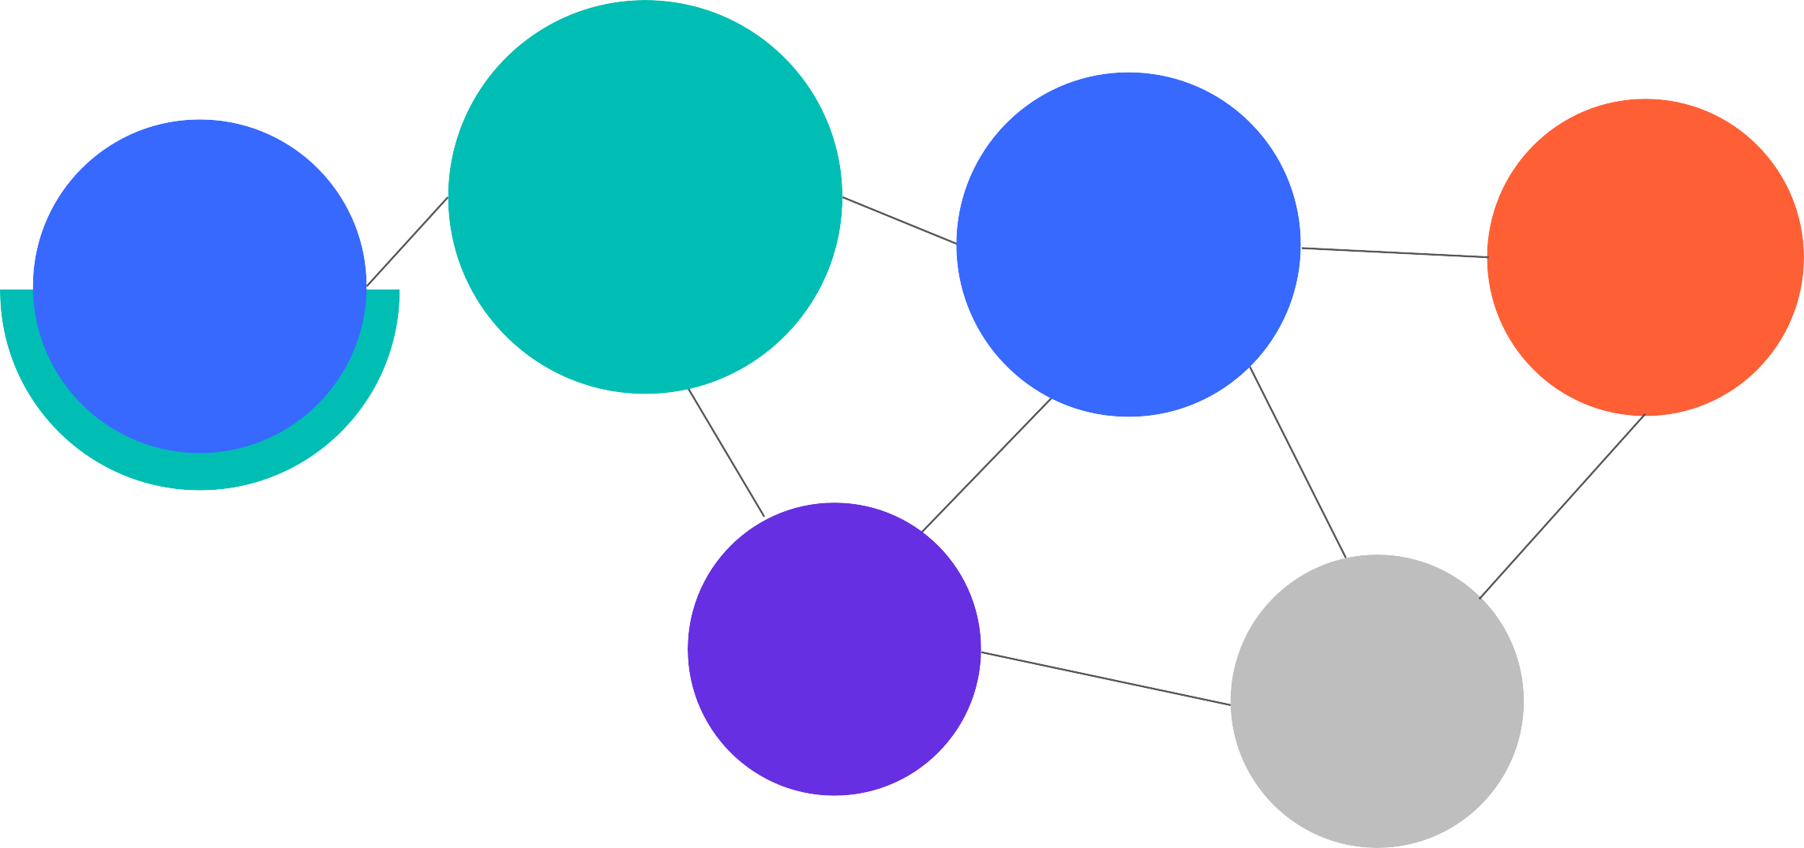
Bridging the generational gap
Engaging with millennials
Adopt technology in both communication and financial planning.
Tailor your advice to their unique life aspirations and goals.
Highlight investment opportunities like alternatives & ESG.
Millennials represent approx. 60% of LinkedIn’s user base in 2023.¹
Demonstrate that you value them by seeking their input.
1. Simon Kemp, “Digital 2023: Global Overview Report - DataReportal – Global Digital Insights,” DataReportal, February 4, 2023. (Page 275, based on ages 25-34)

Slide 24
Generation Z:
Shaping tomorrow's world
For Financial Professional and Institutional Use Only. Not for Public Use.
For Financial Professional Use Only / Not for Distribution to the Public
For Financial Professional Use Only / Not for Distribution to the Public

Slide 25
Generation Z
Born between 1997 and 2012
Source: “Age Range by Generation.” Beresford Research, September 27, 2023.

Slide 26
Gen Z has never experienced a world without the internet, making them the first generation to be born into a digital era.
MYTH vs. FACT
The World Wide Web was introduced in 1993, just four years prior to the birth of Gen Z.¹
Sources: “World Wide Web (WWW) Launches in the Public Domain,” History.com, accessed October 3, 2023.
For Financial Professional and Institutional Use Only. Not for Public Use.

Slide 27
FIRST
generation
Who is Gen Z?
The tech-savvy generation
By 2025
Gen Z may represent over 25% of the global workforce.³
MORE
racially & ethnically diverse than previous generations.¹
to grow up with technology in the palm of their hands.²
“Parker, Kim. “On the Cusp of Adulthood and Facing an Uncertain Future: What We Know about Gen Z so Far.” Pew Research Center, May 14, 2020.
Wolfsen, Natalie. “Gen Z Investors Are Here-Are Financial Advisors Prepared?” Wealth Management, June 22, 2023.
3. “The Gen Z Equation.” McKinsey &amp; Company, June 2023.
For Financial Professional and Institutional Use Only. Not for Public Use.

Slide 28
Gen Z are early investors
According to the CFA Institute
CLOSE TO
six in ten
US Gen Zs report owning
at least some investments.
Source: CFA institute, Gen Z and investing: Social media, Crypto, Fomo, and family , 2023.
Survey methodology: The total sample size for this study is 2,872, comprising Gen Z (ages 18–25) investors and non-investors, in the U.S., Canada, U.K., and China. Data were collected in November and December 2022, and respondents were obtained using a combination of Schlesinger’s proprietary online panel and social media advertising on TikTok and Instagram. Figures may not always sum to 100 percent due to rounding. Within each generation, U.S. participants were sampled to be balanced to the population on age, region, race/ethnicity, and gender (based on the American Community Survey’s five-year rolling average). In addition, the results in the U.S. and the U.K. are balanced on income.

Slide 29
Financial goals of Gen Z
According to the CFA Institute
Having enough money to travel/vacation
Saving for unexpected expenses
Being able to retire when they choose and live comfortably
Source: CFA institute, Gen Z and investing: Social media, Crypto, FOMO, and family, 2023.
Survey methodology: The total sample size for this study is 2,872, comprising Gen Z (ages 18–25) investors and non-investors, in the U.S., Canada, U.K., and China. Data were collected in November and December 2022, and respondents were obtained using a combination of Schlesinger’s proprietary online panel and social media advertising on TikTok and Instagram. Figures may not always sum to 100 percent due to rounding. Within each generation, U.S. participants were sampled to be balanced to the population on age, region, race/ethnicity, and gender (based on the American Community Survey’s five-year rolling average). In addition, the results in the U.S. and the U.K. are balanced on income.

Slide 30
Keys to developing a family-focused practice
For Financial Professional and Institutional Use Only. Not for Public Use.
For Financial Professional Use Only / Not for Distribution to the Public
For Financial Professional Use Only / Not for Distribution to the Public

Slide 31
Position your practice for success
Broaden the scope of your practice to focus on families
Promote intergenerational wealth transfer as part of your value proposition
Develop a network of local professionals to offer comprehensive support to families
Identify the opportunity
Segment and prioritize since it’s likely not possible to meet all heirs of your clients
Capture details on non-liquid asset holdings such as real estate, life insurance, etc.
Construct a “family chart” to document the key family relationships
Meet family members
Offer services and counsel around important life transitions for family members
Facilitate family meetings

Slide 32
Four important family meetings
Helping you create smooth wealth transitions for clients
1 2 3
4
Strategic Meeting
Mapping out plans,
intentions and responsibilities
Navigating the Future
Plans on aging and housing
Investment Philosophy
Exploration of the family's
financial strategies
Crafting Purpose
Developing a family
mission statement

Slide 33
Strategic meeting
Communicating to your client's heirs their plans and intentions around the distribution of their wealth.
For Financial Professional and Institutional Use Only. Not for Public Use.

Slide 34
The strategic meeting
Mapping Out Plans, Intentions, and Responsibilities
FACILITATION TIPS
| Client preparation
Ahead of the meeting encourage clients to begin thinking of important documents and their locations.
| Introduction approach Reassure heirs that their loved ones anticipate living for an extended period, that is why this meeting is important.
SAMPLE MEETING AGENDA
Introduction
Overview of plans and intentions
Specific roles and responsibilities
General instructions: documents, wishes and intentions
Open dialogue and Q&A
Guidelines for ongoing communication

Slide 35
Navigating the Future
Discussing your client’s plans around aging and future housing decisions with their heirs.
For Financial Professional and Institutional Use Only. Not for Public Use.

Slide 36
Navigating the future meeting
Plans on aging and housing
SAMPLE MEETING AGENDA #1 Decisions have been made on aging
Introduction
Overview of the issue of aging and housing choices
Discussion of client’s housing choices and cost
Conversation around family member support
Open dialogue and Q&A
Determine action steps (if needed)
SAMPLE MEETING AGENDA #2 Decisions have not been made on aging
Introduction
Overview of the issue of aging and housing choices
Discussion of the most popular housing options
Conversation around family member support
Open dialogue and Q&A
Determine action steps (if needed)

Slide 37
Facilitation tips
Ideas for effective family meetings
Approach empathetically Navigate discussions about family homes and living arrangements with care, recognizing the emotions involved.
1
Stay organized
Since the agendas involve a significant amount of material, prepare thoughtfully, ensuring organization and conciseness in your materials.
2

Slide 38
Investment Philosophy
Discussing your client's investment philosophy and approach to investing with their heirs.
For Financial Professional and Institutional Use Only. Not for Public Use.

Slide 39
Investment philosophy meeting
Exploration of the family's financial strategies
FACILITATION TIPS
| Investment acumen
In advance of this meeting, discuss with your clients their perception of their heirs’ investment acumen.
| Investment expertise
This meeting is a great opportunity for you to exhibit your professional investment expertise to any heirs.
SAMPLE MEETING AGENDA
Introduction
Overview of your role as a Financial Professional and your value proposition
Investment philosophy
Investment strategy
Existing reporting and communications
Open dialogue and Q&A

Slide 40
Crafting Purpose
Develop a family mission statement that summarizes the factors that define the family’s identity and guide financial decisions.
For Financial Professional and Institutional Use Only. Not for Public Use.

Slide 41
Crafting purpose meeting
Developing a family mission statement
SAMPLE FAMILY MISSION STATEMENTS
Sample 1
“Our family believes that education is imperative and was a key factor leading to our success and happiness. We pledge to support each other in the continued pursuit of learning, as well as support the educational institutions that share our values.”
Sample 2
“Our family is committed to strengthening our financial position and using its assets wisely; to enable our family and others to realize their fullest potential; to value and encourage love, work, self-sufficiency and cooperation within the family and in the larger community.”
SAMPLE MEETING AGENDA
Introduction
Overview of family mission statements
Brainstorming values and beliefs that unify the family
Draft sample family mission statements
Determine action steps (if needed)

Slide 42
Four important family meetings
Helping you create smooth wealth transitions for clients
1 2 3
4
Strategic Meeting
Mapping out plans,
intentions and responsibilities
Navigating the Future
Plans on aging and housing
Investment Philosophy
Exploration of the family's
financial strategies
Crafting Purpose
Developing a family
mission statement

Slide 43
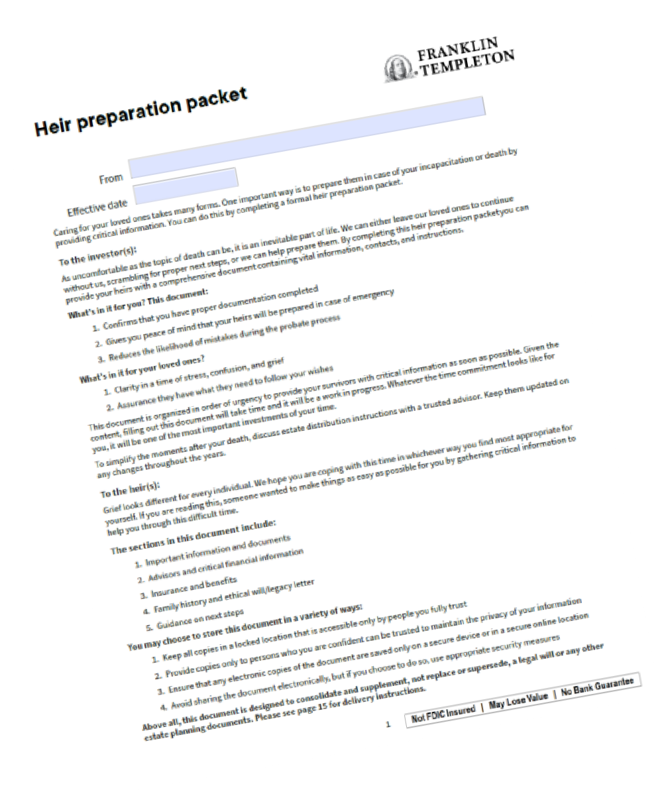
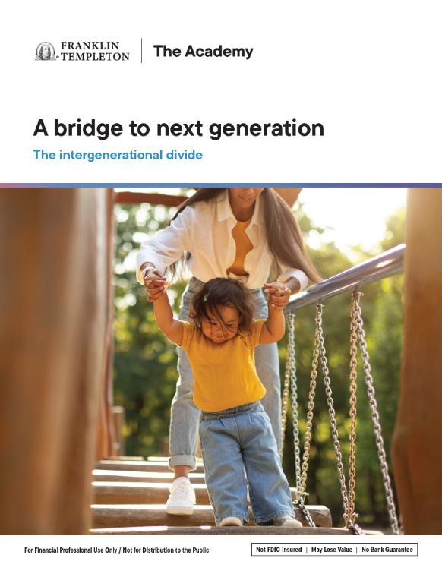
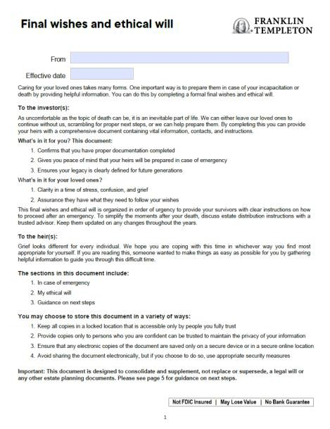
Tools and resources
Supporting you through each step
A bridge to next generation brochure
Client-use tools and resources
Detailed family meeting scripts
Facilitation tips and best practices
Final wishes and ethical will
Heir preparation packet
Note: The information contained in these resources is general in nature and provided for informational and educational purposes only. It should not be considered or relied upon as tax, legal or investment advice, or as an investment
recommendation, or as a substitute for legal or tax counsel. Franklin Templeton does not provide legal or tax advice.

Slide 44
More ways to connect with family members
For Financial Professional and Institutional Use Only. Not for Public Use.
For Financial Professional Use Only / Not for Distribution to the Public
For Financial Professional Use Only / Not for Distribution to the Public

Slide 45
CONSIDER THESE
NEXT STEPS
Assist families in navigating the confusing world of eldercare and assisted living.
Identify current clients whose families you need to develop relationships with.
Prospect older parents of your clients as a potential business opportunity. Connect with account beneficiaries via LinkedIn¹ as a first step to meeting them. Offer services and counsel around important life transitions for family members. Help clients create a roadmap document for other family members to follow.
1. Always check with your firm’s compliance department regarding social media policy.

Slide 46
Important legal information
This material is intended to be of general interest only and should not be construed as individual investment advice or a recommendation or solicitation to buy, sell or hold any security or to adopt any investment strategy. It does not constitute legal or tax advice. This material may not be reproduced, distributed or published without prior written permission from Franklin Templeton. The views expressed are those of the investment manager and the comments, opinions and analyses are rendered as at publication date and may change without notice. The underlying assumptions and these views are subject to change based on market and other conditions and may differ from other portfolio managers or of the firm as a whole. The information provided in this material is not intended as a complete analysis of every material fact regarding any country, region or market. There is no assurance that any prediction, projection or forecast on the economy, stock market, bond market or the economic trends of the markets will be realized. The value of investments and the income from them can go down as well as up and you may not get back the full amount that you invested.
Past performance is not necessarily indicative nor a guarantee of future performance. All investments involve risks, including possible loss of principal.
Franklin Templeton, in partnership with Chadwick Martin Bailey, conducted a survey among a sample of 1,641 U.S. adults ages 18 or older with at least $100K in investable assets. The survey results contain the opinions of the respondents are not necessarily those of Franklin Templeton. Survey results represent a small sample size of voluntary respondents, and therefore may have inherent limitations. The sample includes key populations and audiences including Millennials (survey=298); Women 50+ (survey=300); Latinx & Hispanics (survey=295, interview=4); Asian Americans & Pacific Islanders (survey=299, interview=4); Black & African Americans (survey=595, interview=13); LGBTQ+ (survey=292, interview=4); general population (502). The results from general population are weighted to US Census targets on age, gender and ethnicity and no weighting is done on the demographic groups. Quantitative research was conducted through a structured research survey from July 20th to August 5th, 2022. Qualitative research was conducted through structured interviews from January 10th to January 28th, 2023.
Franklin Templeton Investments or any of its affiliates are not affiliated with Chadwick Martin Bailey.
© 2025 Franklin Distributors, LLC. Member FINRA/SIPC. All rights reserved.
For Financial Professional and Institutional Use Only. Not for Public Use.

Slide 47
Important legal information cont’d
Any research and analysis contained in this material has been procured by Franklin Templeton for its own purposes and may be acted upon in that connection and, as such, is provided to you incidentally. Data from third party sources may have been used in the preparation of this material and Franklin Templeton ("FT") has not independently verified, validated or audited such data. Although information has been obtained from sources that Franklin Templeton believes to be reliable, no guarantee can be given as to its accuracy and such information may be incomplete or condensed and may be subject to change at any time without notice. The mention of any individual securities should neither constitute nor be construed as a recommendation to purchase, hold or sell any securities, and the information provided regarding such individual securities (if any) is not a sufficient basis upon which to make an investment decision. FT accepts no liability whatsoever for any loss arising from use of this information and reliance upon the comments, opinions and analyses in the material is at the sole discretion of the user.
Products, services and information may not be available in all jurisdictions and are offered outside the U.S. by other FT affiliates and/or their distributors as local laws and regulation permits. Please consult your own financial professional or Franklin Templeton institutional contact for further information on availability of products and services in your jurisdiction.
Issued in the US: Franklin Resources, Inc. and its subsidiaries offer investment management services through multiple investment advisers registered with the SEC. Franklin Distributors, LLC and Putnam Retail Management, LP, members FINRA/SIPC, are Franklin Templeton broker/dealers, which provide registered representative services. Franklin Templeton, One Franklin Parkway, San Mateo, California 94403-1906, (800) DIAL BEN/342-5236, franklintempleton.com
© 2025 Franklin Distributors, LLC. Member FINRA/SIPC. All rights reserved.
For Financial Professional and Institutional Use Only. Not for Public Use.
IGD-PPT

