Slide 1
The hidden costs of aging
The important conversations you need to have about care and housing expenses
This material should be regarded as educational information on health care and is not intended to provide specific advice. If you have questions regarding your particular situation, you should contact your healthcare provider and/or legal or tax advisors.
Not FDIC Insured | May Lose Value | No Bank Guarantee

Slide 2
Retirement in theory
Wealth Transfer
Retirement
Chat
What are some unexpected events that might get in the way?

Slide 3
Retirement in reality
In-home Support
In-home Remodeling
Health Crisis
Health Crisis
Skilled Nursing
Unexpected Expenses
Market
Correction
Wealth Transfer
Retirement
Market Correction
In-home Health Care
In-home Remodeling
Assisted Living
Unexpected Expenses

Slide 4
Changing the narrative
No-Go Years (age 86 to 100+)
During this period, it may be more difficult to
maintain the same active lifestyle.
Slow-Go Years (age 76 to 85)
A less active lifestyle with some “Go-Go”
years remaining.
Go-Go Years (age 65 to 75)
Active lifestyle focused on family, friends, travel, hobbies and bucket list.
Time

Slide 5
Agenda
1
2
Profile of Aging
Care and Housing Considerations
3
Formulate a Plan

Slide 6
1 | Profile of aging
For Financial Professional Use Only / Not for Distribution to the Public

Slide 7
True or False
1 22% of population will be 65+ by 2040.
2
A 65-year-old can expect to live an additional 17 - 20 years, on average.
3
80% of older adults are living with one chronic disease.

Slide 8
The over 65 segment is growing
2020
55.7 mil
Each day almost 10,000
baby boomers reach the age of 65 ¹
17% of population
2040
80.8 mil
22% of population
Source: 2021 Profile of Older Americans: ACL, Nov 2022 1. AARP. This number is expected to continue into the 2030s. For illustrative and discussion purposes only.

Slide 9
Women are outliving men
The 85+ group will likely include considerably more women than men
65+
17 years
19.8 years
Additional years a man can expect to live
Additional years a woman can expect to live
Women are more likely than men of the same age to be widowed.
65+
11%
30%
% of Men Widowed
% of Women Widowed
Sources: 2021 Profile of Older Americans: ACL, Nov 2022. For illustrative and discussion purposes only.

Slide 10
80%
More Americans are living with chronic illness
of older adults are living with one chronic disease
77%
have at least two chronic diseases
Source: www.agingstats.gov. For illustrative and discussion purposes only

Slide 11
Residence in full-service facilities increases with age
65+
85+
93% 3% 4%
At 85, the percentage of Medicare beneficiaries who reside in long-term care facilities more than triples to 15%
77% 8% 15%
Traditional Community Community housing with services Long-term care facilities
Source: 2020 Older Americans – Key Indicators of Well – Being For illustrative and discussion purposes only.

Slide 12
CHAT QUESTION
What aging statistic resonates most with you and why?

Slide 13
“If you don’t make a plan, a plan will be made for you”
FOOD FOR THOUGHT

Slide 14
2 | Care and housing considerations
For Financial Professional Use Only / Not for Distribution to the Public

Slide 15
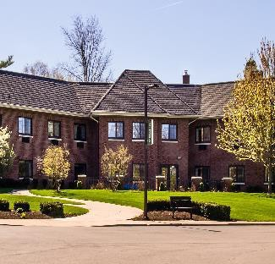
Housing as you age
Aging in place
55+ independent living communities
Continuing care retirement communities
Assisted living
Skilled nursing
For illustrative and discussion purposes only.

Slide 16
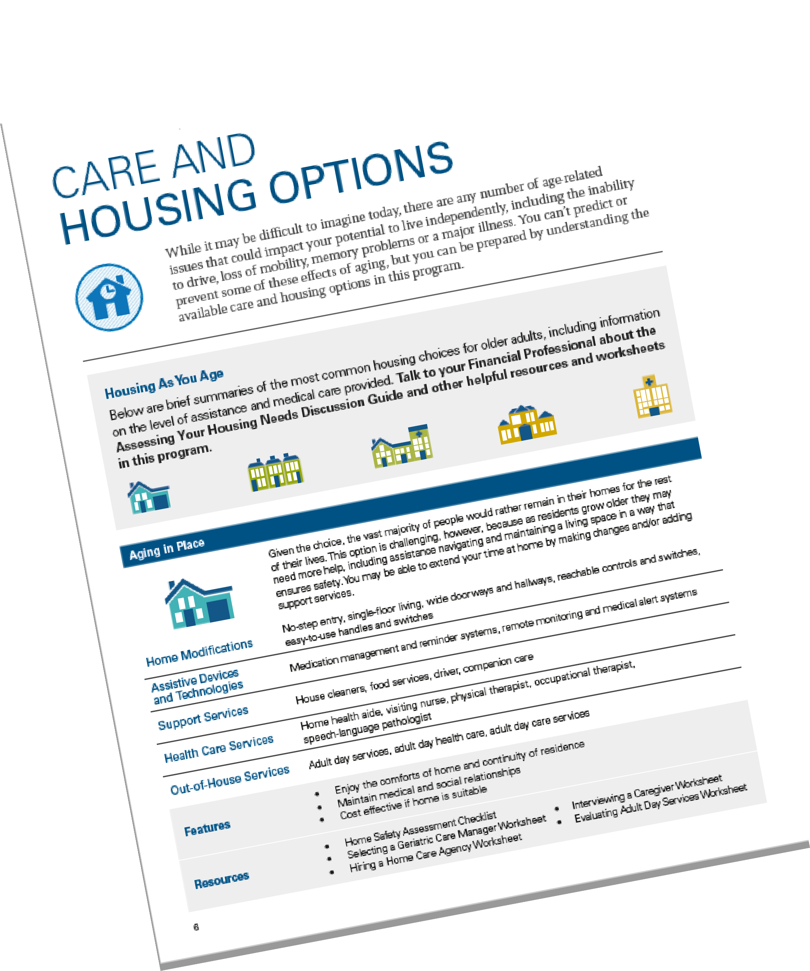
Resources
Care and Housing Brochure
Assessing Your Housing Needs Guide
For illustrative and discussion purposes only.

Slide 17
Aging in place
Staying in one’s home safely, independently and comfortably
For illustrative and discussion purposes only.

Slide 18
Aging in place
Family considerations
Proximity of family
Availability of family
Commitment to aging in place
For illustrative and discussion purposes only.

Slide 19
Aging in place
Lifestyle considerations
Ability to perform activities of daily living
Home modifications
Assistive devices and technology
For illustrative and discussion purposes only.

Slide 20
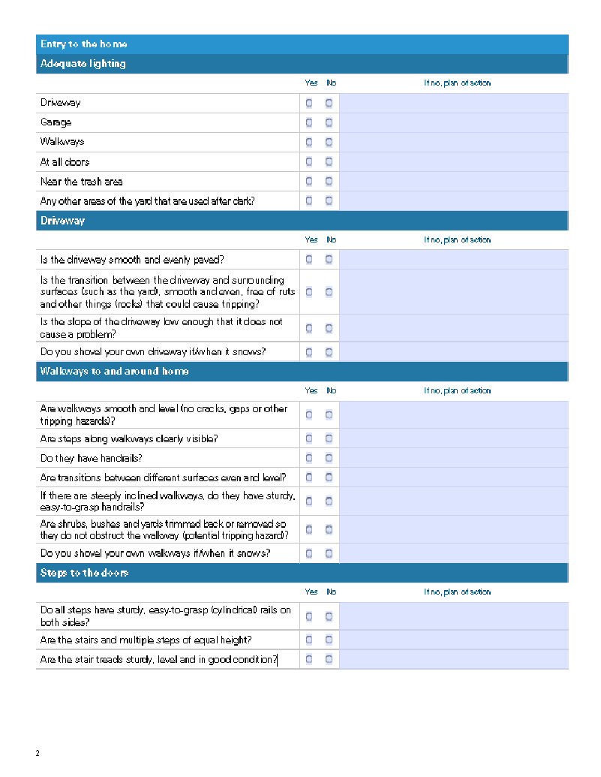
Resources
Home Safety Assessment Worksheet
For illustrative and discussion purposes only.

Slide 21
Aging in place
Health care considerations
Geriatric care managers
Schedules appointments and interacts with health care providers and insurers
Home care services
Private agencies that provide a variety of medical and non- medical services for in-home patient care
Adult
day care services
Social activities with skilled services from social workers, therapists and nurses, etc.
Social services
Help with identifying and finding the appropriate care after a hospital stay
Companion care services
Non-medical staff hired by the hour to provide companionship and comfort to individuals who cannot be left at home alone
For illustrative and discussion purposes only.

Slide 22
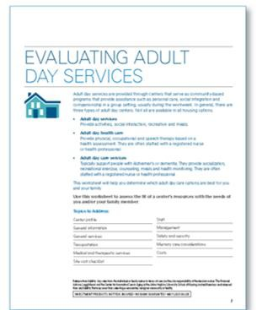
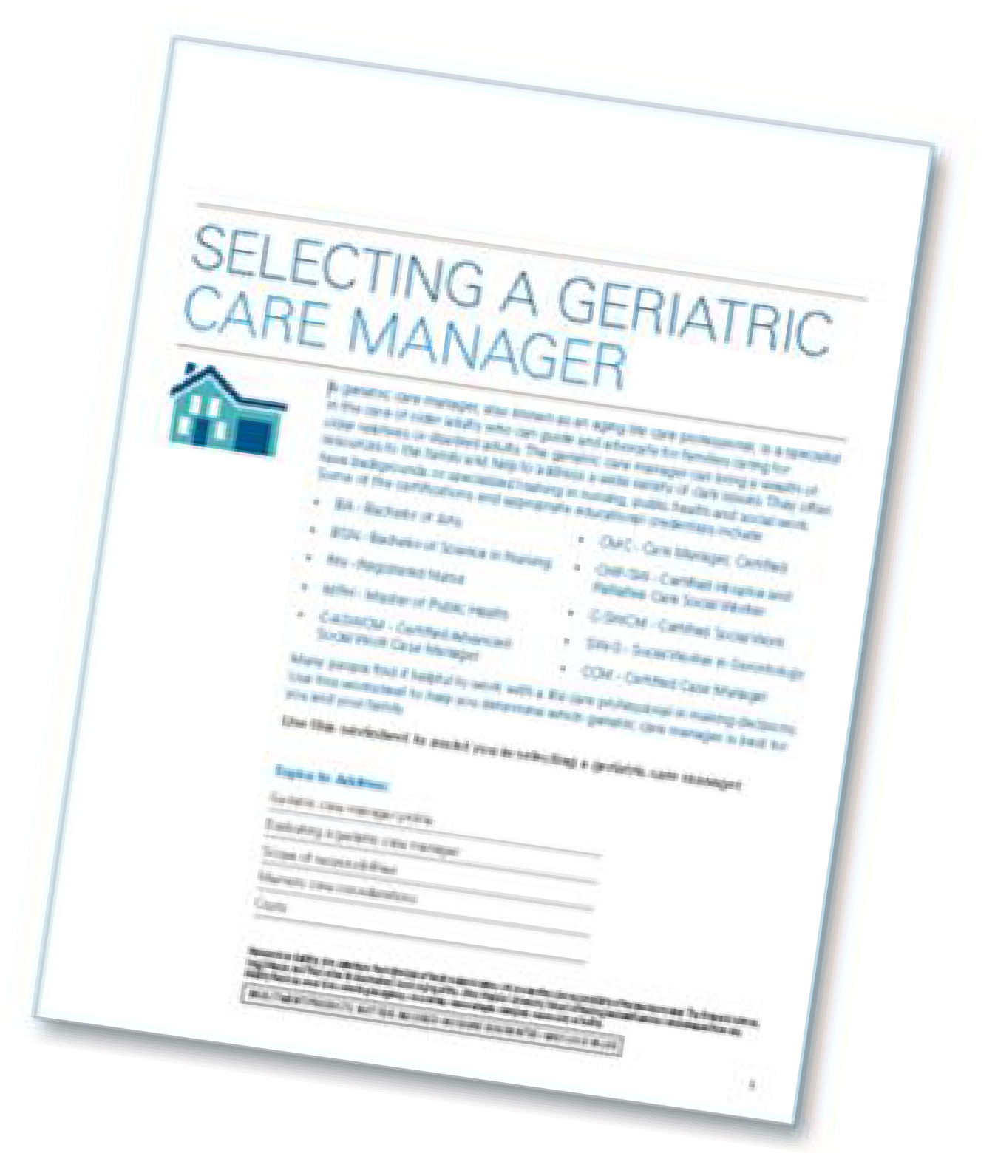
Resources
Home Support Services Worksheets
For illustrative and discussion purposes only.

Slide 23
Aging in place
Financial considerations
 | Hourly | Daily | Monthly | Annual | Year-Over-Year Increase
Homemaker Services | $26 | $156 | $4,680 | $56,160 | 10.64%
Home Health Aide Services | $27 | $162 | $4,860 | $58,320 | 12.50%
Adult Day Health Care | * | $78 | $1,638 | $19,56 | 5.41%
Source: Genworth Cost of Care 2021 Survey. Based on 6 hours per day, 30 days per month. For illustrative and discussion purposes only.

Slide 24
Housing as you age
Aging in place
55+ independent living communities
Continuing care retirement communities
Assisted living
Skilled nursing
For illustrative and discussion purposes only.

Slide 25
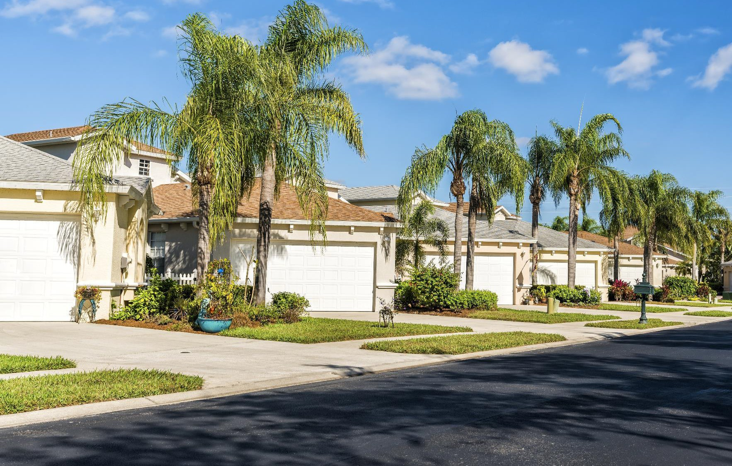
55+ independent living community
Offers relatively maintenance-free homes or
apartments for independent, active singles or couples
Medical services nearby
Access to range of amenities and social activities
Opportunity to engage with others at same stage of life
Estimated Monthly Costs: $1,500- $10,000
For illustrative and discussion purposes only.

Slide 26
Continuing care retirement communities
Ability to stay in place as medical needs increase- from independent living to assisted living to skilled nursing
May include lifestyle amenities such as pools and fitness centers
Estimated Monthly Costs: $900-$10,500
Entry Fee: $100,000 - $500,000
For illustrative and discussion purposes only.

Slide 27
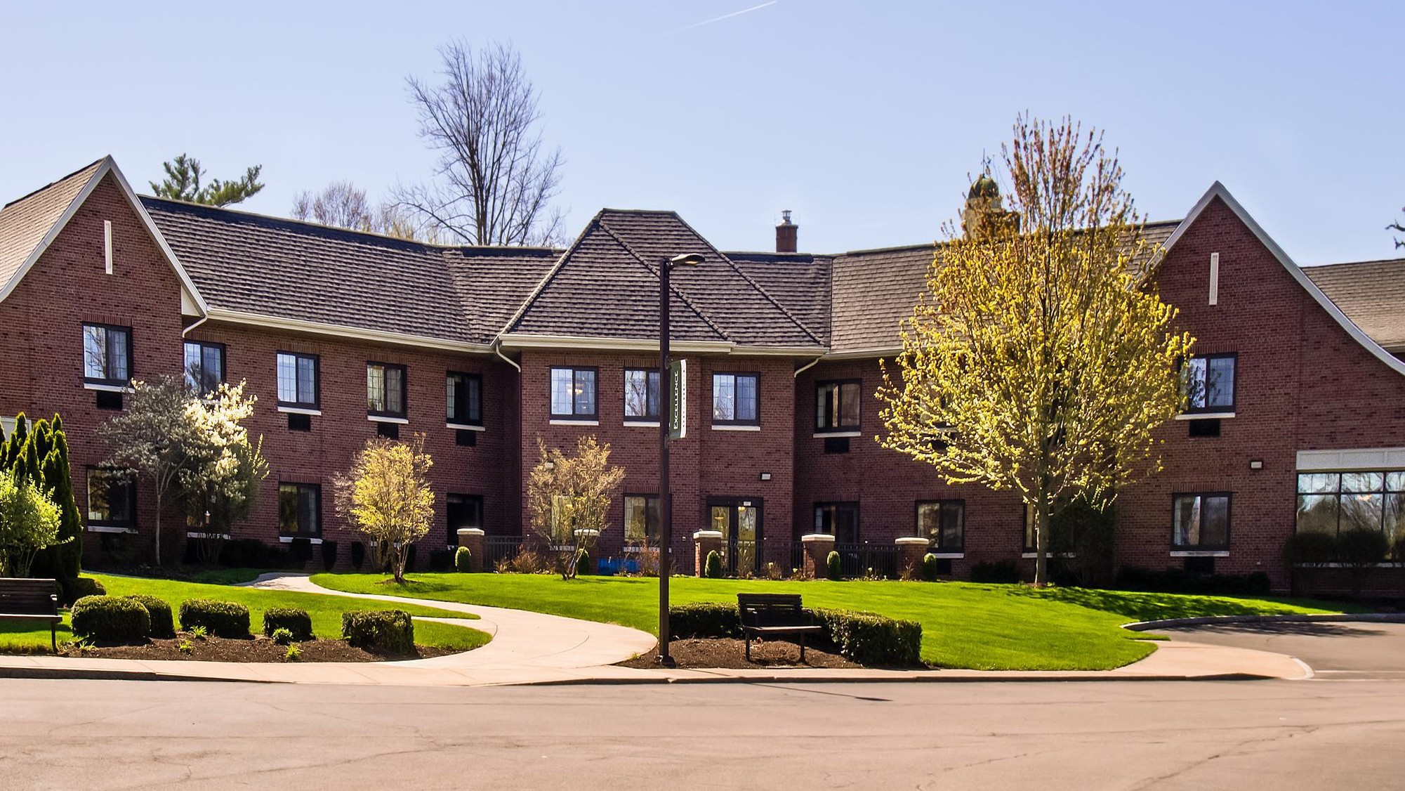
Assisted living facilities
Attractive for people who need some assistance with
daily activities but do not require skilled medical care
Services may include meals, housekeeping, transportation and on-site medical care
Ability to stay in place as medical needs increase
Estimated monthly costs: $4,500
Source: Genworth Cost of Care 2021 Survey. For illustrative and discussion purposes only.

Slide 28
Skilled nursing facilities
For people requiring on-site skilled medical care, including nurses, physical and occupational therapist and doctors
Highest level of medical care on-site
Increased security to protect patient safety
Ability to serve patients with memory care issues
Estimated monthly costs: $7,650 - $8,700
Source: Genworth Cost of Care 2021 Survey. For illustrative and discussion purposes only.

Slide 29
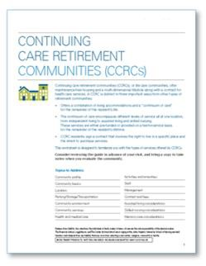
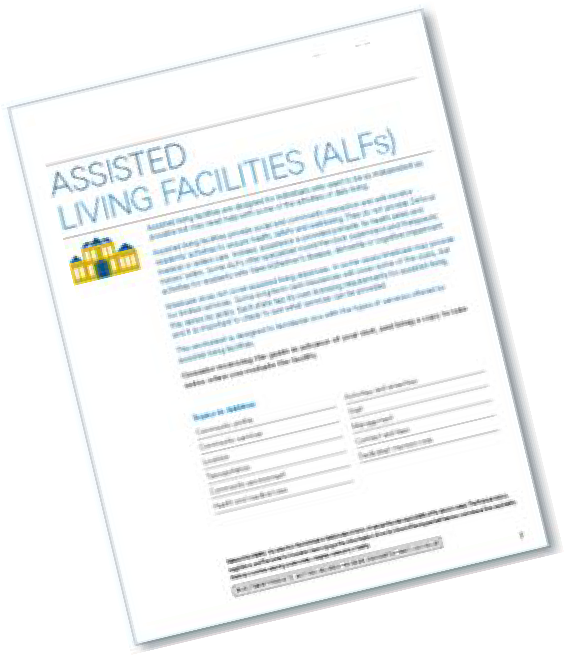
Resources
Housing Options Worksheets
For illustrative and discussion purposes only.

Slide 30
3 | Formulate a plan
For Financial Professional Use Only / Not for Distribution to the Public

Slide 31
Formulate a plan
Speak to a Financial Professional
Determine your wishes
Identify specific resources and facilities
Take action
Document your wishes
For illustrative and discussion purposes only.

Slide 32
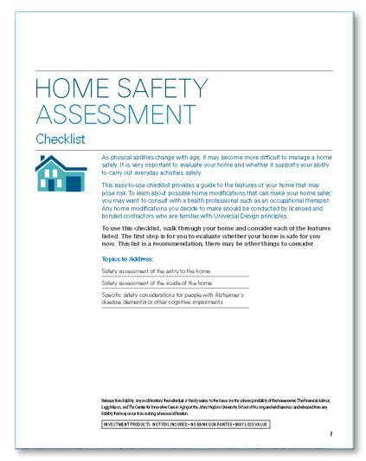
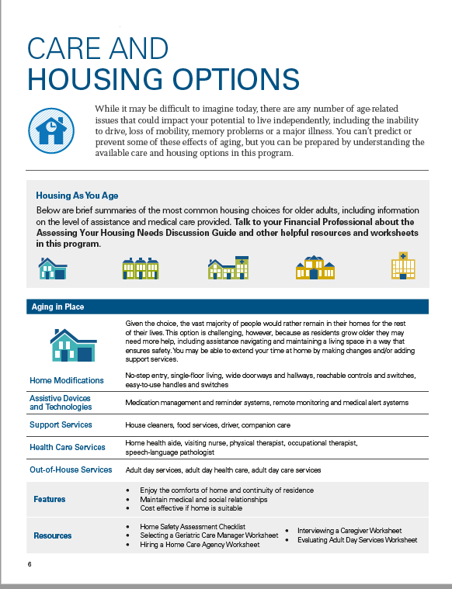
Resources
Care and Housing Brochure
Assessing Your Housing Needs Guide
Home Safety Assessment Worksheet
Home Support Services Worksheets
Housing Options Worksheets
For illustrative and discussion purposes only.

Slide 33
Key takeaways
Population is living longer which increases
the need for careful retirement planning.
Keep in mind the impact that the different housing options might have on family, lifestyle, health care and finances.
Review steps you can take today to formulate a plan.
For illustrative and discussion purposes only.

Slide 34
“The time to repair the roof is when the sun is shining”- John F. Kennedy
FOOD FOR THOUGHT
For illustrative and discussion purposes only.

Slide 35
QUESTIONS?

Slide 36
Important legal information
This material should be regarded as educational information on health care and is not intended to provide specific advice. It does not constitute legal or tax advice. If you have questions regarding your particular situation, you should contact your legal or tax advisors. The information provided in this material is not intended as a complete analysis of every material fact regarding any country, region or market.
All investments involve risks, including possible loss of principal. Stock prices fluctuate, sometimes rapidly and dramatically, due to factors affecting individual companies, particular industries or sectors, or general market conditions. Special risks are associated with foreign investing, including currency fluctuations, economic instability and political developments.
Investors should carefully consider a fund’s investment goals, risks, charges and expenses before investing. To obtain a summary prospectus and/or prospectus, which contains this and other information, talk to your financial professional, call us at (800) DIAL BEN/342-5236 or visit franklintempleton.com. Please carefully read a prospectus before you invest or send money.
Important data provider notices and terms available at www.franklintempletondatasources.com.
© 2023 Franklin Distributors, LLC. Member FINRA/SIPC. All rights reserved.
HCA-CLPPT

