Slide 1
Who would you choose?
For Financial Professional Use Only / Not for Distribution to the Public
Notes:
How long does it take to make a first impression? (Probably a lot less time than you think…many people say 7 seconds. Let’s run through a quick exercise together -
Let’s run a quick experiment to find out.
I’m going to flash two images on the screen. Ready?
Here is the first image [CLICK] and here is the second [CLICK].
Which person makes a more favorable impression?
By show of hands, how many say the first person? How many say the second person?
The first one, right?
You’ve probably heard that it only takes about seven seconds to make a first impression.
The experiment we just did, along with Princeton University research, indicates that first impressions can be formed much quicker.

Slide 2
Source: Willis, Janine and Todorov, Alexander. “First Impressions: Making Up Your Mind After a 100-Ms Exposure to a Face.” Psychological Science, vol. 17, Issue 7. July 1, 2006.
For Financial Professional Use Only / Not for Distribution to the Public
Notes:
You were able to form an impression within 1/10 of a second. (.1 seconds) So is it safe to say first impressions happen much quicker than we thought?
The challenge is, once an impression is made, it can be difficult to change. (Once the mind has made a first impression, it’s hard to break)
If you came in here with a less-than-perfect impression of me, I would have to work really hard to overcome it.
Let’s take a look at another example…
Source: Willis, Janine and Todorov, Alexander. “First Impressions: Making Up Your Mind After a 100-Ms Exposure to a Face.” Psychological Science, vol. 17, Issue 7. July 1, 2006.

Slide 3
Notes:
To illustrate how hard it is to overcome a preconceived impression, let's look at this painting of the Mona Lisa.
It’s easy to see that something is wrong. What is it?
[CLICK] Simple she’s upside down. But is that all she actually is? When we look at this picture we see her eyes are pointing down…she’s frowning …that’s not the face that we’re used to seeing. We’re used to seeing…the Mona Lisa look like this.
[CLICK] How did we overlook those details when she was upside down?
Simply Because we already have a preconceived impression of what the Mona Lisa looks like.
Our brains do a remarkable job of making sense of things, no matter the reality.
When our brains take a shortcut because they have a preconception of what they’re supposed to be seeing, it isn’t overcome easily. This is true whether we’re talking about upside down paintings or the preconceptions you have about people you meet.

Slide 4
For Financial Professional Use Only / Not for Distribution to the Public
Notes:
Think of the impression you had of this meeting…before you walked in today, you probably already had an impression of what this was going to be like. Maybe that came from the invite, the words you saw in the agenda, maybe it was an impression of me OR of the impression you have of Franklin Templeton.
How many of you made an impression of me before I even started this presentation?
What informed your judgments—was it my clothes, gestures or actions before we got started?
It’s more likely that your impression was formed before you stepped foot in this room.
It may have come from the pre-meeting email, the description in the agenda, comments you heard from someone who has seen this presentation, reading my LinkedIn posts, or the image you have of Franklin Templeton as a company.
So you see, your first impression may have been formed before you ever walked in the door.
[CLICK] Which means that I didn’t even have 1/10 of a second to make a first impression—I had zero seconds.
This is no different from the way potential clients create first impressions of you and your business.

Slide 5
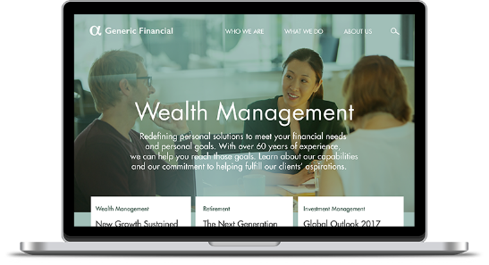
Notes:
The challenge is, there are many ways for prospects to gain insights about you, possibly without you even knowing.
What are some of these sources?
[CLICK] They may be forming an impression of you from your online presence. What do they find when they look you up online? Do you appear credible and professional and up with the times? They may have an impression of you before they even meet you.
[CLICK] Another way they may form an impression - Your existing clients and other professionals in your network. How are these people talking about you and your business to their families, friends, neighbors, colleagues and clients?
[CLICK] And third, you. This includes both you at your job and you going about your everyday life. As someone whose business often comes from the local community, your behavior at your children’s school, sporting event the grocery store or other social settings can have an impact.

Slide 6
Mastering first impressions
Understanding what the client sees in you
Notes:
So, if people form impressions of you quickly, from a number sources, and those impressions have serious sticking power—how do you ensure that the impression you give is one that will encourage prospects to meet and do business with you?
Today’s discussion will focus on mastering first impressions. We’ll do this by seeking to understand what the client sees in you.
That means we have to look at ourselves from the prospect’s point of view and identify the areas in which we can improve ourselves and our business.

Slide 7
Agenda
The science of first impressions
Managing zero-second impressions
Polishing your presence
Notes:
Today, we are going to talk about three things:
The science of first impressions
Managing zero-second impressions
Polishing your presence once we do meet someone face to face
Lasting relationships often start with a positive first impression. The challenge is, there are many ways for people to gain insights about you, possibly without you even knowing. The presentation Mastering First Impressions: Understanding What the Client Sees in You looks at first impressions from the client’s point of view and offers tips for making them favorable.
Let’s get started.

Slide 8
The science of first impressions
Notes:
First, we’re going to pull back the curtain and look at the science of first impressions.
As the great philosopher Yogi Berra said, “You can observe a lot just by watching.”

Slide 9
Judgments are fueled by instinct
Attractiveness
Trustworthiness
Competence
Likability
Aggressiveness
Source: Todorov, A. and Willis, J. First Impressions: Making Up Your Mind After a 100-Ms Exposure to a Face, Psychological Science, 2006.
Source: Cuddy, Amy. Presence: Bringing Your Boldest Self to Your Biggest Challenges, 2015.
Notes:
We just saw that we form impressions quickly, but what characteristics are we making judgments about?
Princeton researchers had people look at facial images and make judgments about specific traits such as attractiveness, trustworthiness, competence, likability and aggressiveness.¹
[CLICK] Now, some financial professionals might argue that competence is the most important trait when it comes to giving financial recommendations. After all, comprehensive solution-based recommendations requires knowledge of complex products and portfolio strategies.
According to researchers at Harvard University, competence is highly valued and a key trait we judge in others when we form a first impression. But, competence is only evaluated once trustworthiness is established.²
[CLICK] The importance of trust is corroborated by the Princeton research. Of the five traits studied, participants made judgments about trustworthiness the fastest.
The ability to judge trustworthiness in others may have evolved as an important survival mechanism. Our caveman ancestors likely used this reflexive response to assess threats and stay safe.
While the other caveman may appear attractive, competent at building fires, all-around likeable and aggressive enough to wrestle a saber-tooth tiger, judging their trustworthiness quickly establishes whether they will steal your food or hit you with a club.
1. Source: Todorov, A. and Willis, J. First Impressions: Making Up Your Mind After a 100-Ms Exposure to a Face, Psychological Science, 2006.
2. Source: Cuddy, Amy. Presence: Bringing Your Boldest Self to Your Biggest Challenges, 2015.

Slide 10
The importance of being trustworthy
You are the product
Relationships = your assets
Your business is making things possible
For Financial Professional Use Only / Not for Distribution to the Public
Notes:
Today, prospective clients may instinctively use the same reflex when determining who they can trust with their business.
But unlike when we buy a pair of shoes or a meal at a restaurant, when a client gives you their money, they don’t get a physical product in return. [CLICK] In a sense, much of what they are buying is you.
And rather than thinking of assets as something found in an account, perhaps the most important thing you must protect is your client relationships. [CLICK] Your business relies on relationships and relationships rely on trust.
And clients aren’t just trusting you with their money. Clients trust you with their ability to retire when they want, or help children with college, or go on that dream vacation or buy that dream home. [CLICK] You could say that you’re in the business of making things possible.

Slide 11
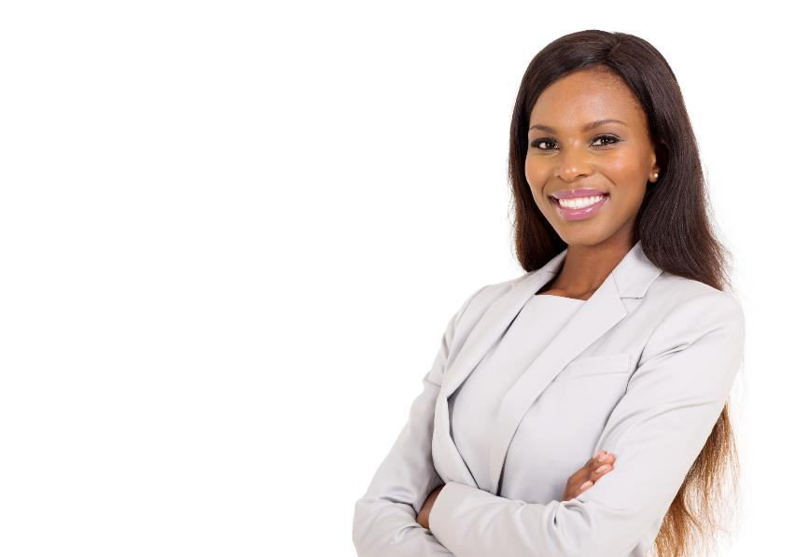
What does the client see?
7% actual words
38% tone of voice
55% body language attire
The following research studies, combined, were utilized to determine the numbers pictured:
Mehrabian & Wiener, 1967 and Mehrabian & Ferris, 1967 & Mehrabian, A. (1972). Nonverbal Communication. New Brunswick: Aldine Transaction. Source: https://www.psychologytoday.com/blog/beyond-words/201109/is-nonverbal-communication-numbers-game
For Financial Professional Use Only / Not for Distribution to the Public
Notes:
So how exactly are traits, such as trustworthiness, communicated?
[CLICK] It’s estimated that things like your body language, attire, and how you walk make up more than half of someone’s first impression.¹
[CLICK] The quality of your voice, the volume, tone, and intonation you use contribute roughly one-third of the impression you make.
[CLICK] Surprisingly, it’s estimated that only 7% comes from the actual words you say!
Consider these statistics when you meet clients face to face. Is it possible that you’ve been emphasizing the elements that have the smallest impact on their first impression?
By asking yourself, “What does the client see?” and incorporating some small changes you can make better impressions that may lead to more business.
In the next two sections, we will examine a number of things related to your first impression and share tips to help you make favorable, lasting impressions with clients.
1. Source: Mehrabian, A., Nonverbal Communication. New Brunswick: Aldine Transaction. 1972.

Slide 12
Managing zero-second impressions
Notes:
The 19th century French novelist Gustave Flaubert said, “There is no truth. There is only perception.”
Two centuries later, this adage still rings true, especially when it comes to the impressions we make. And, as I mentioned previously, many impressions are made even before ever meeting face to face. How?

Slide 13
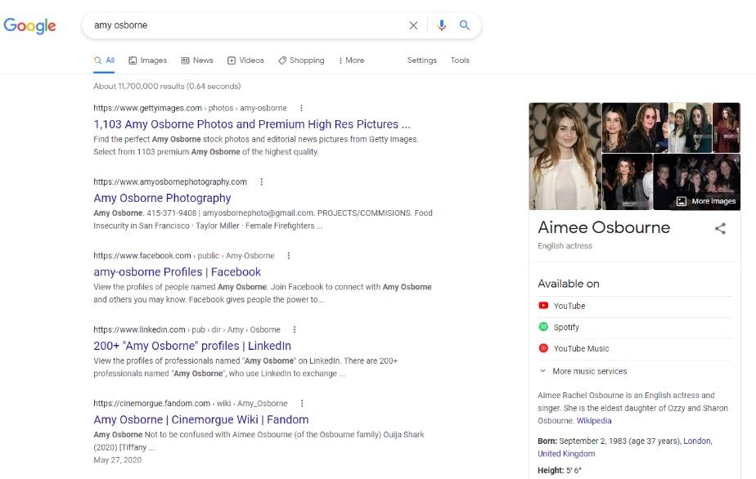
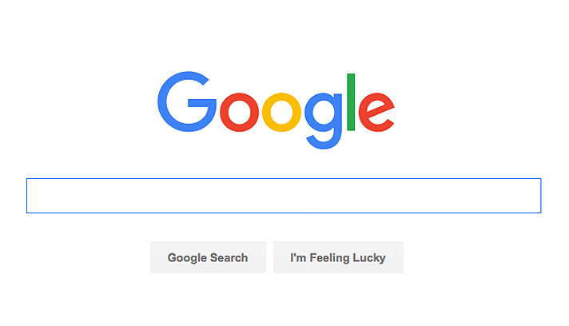
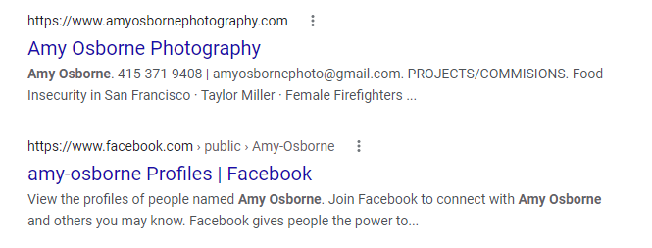
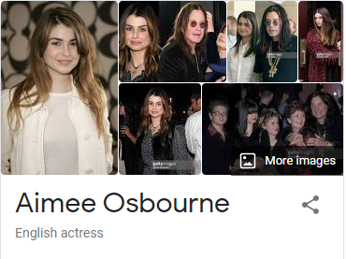
Start with search engines
a
m
y
o
s
b
o
r
n
e
Source: Google AdWords, Average Monthly Volume, July 2019 - July 2020.
Notes:
Before making an appointment with a new mechanic, dentist, doctor or plumber, do you go online to look up information about them?
If not, let me assure you that many people begin with an online search.
According to Google AdWords, the terms financial advisor, financial planner, financial professional and wealth manager are searched on average 235,000 times a month—that’s more than 2.8 million times per year.¹
[CLICK] How many of you have ever searched your name or your business’ name? What did you find in the search results? If you haven’t, I would ask you to.
Here’s what comes up if you search the name of Franklin Templeton North America Spokesperson, Rob Richardson. He’s an active blogger and regular presenter at conferences but he has a fairly common name—one that he shares with tattoo artists, authors, actors and film directors.
Your online presence can be tricky because some aspects are difficult to control.
But being aware of how you appear online can help you develop a communication strategy to combat any ill notions.
1. Source: Google AdWords, Average Monthly Volume, July 2019 - July 2020.

Slide 14
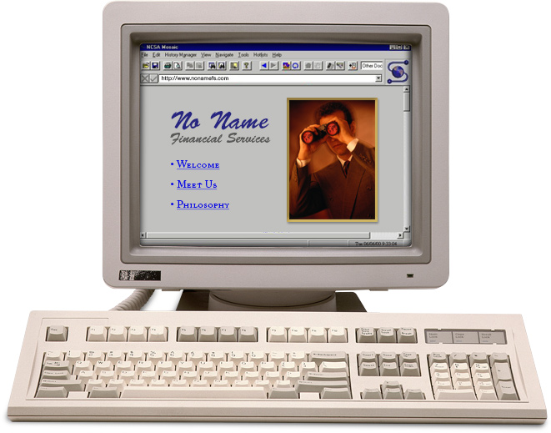
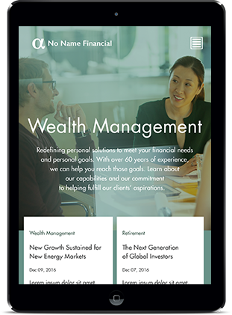
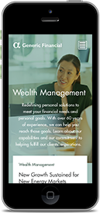
Stay up to date on technology
Source: Stanford University Web Credibility Project, 1999-2002.
Notes:
[NOTE: If presenting at EJ, use second script below]
When they get to your website does it something like this – out of date, out of touch?
Your website may be one aspect of a prospect’s first impression of you and your business that you can manage.
For those of you who have control over your business website, but haven’t updated since the early 2000s, I can assure you that it doesn’t instill confidence you will be proactive managing their money.
[CLICK] It doesn’t require large investments in developing content or functionality to have a well-designed website.
Research has found that 75% of internet users judge a company’s credibility based on their website design.¹
Today, internet users spend more time on mobile devices and may leave quickly if a web page is not mobile friendly.
[CLICK] How does your website look on a smart phone or tablet?
It’s important that your website is responsive—which means it automatically changes the page layout to look great on any device.
Not only does this provide a better user experience, Google ranks responsive websites higher in search results so you are more likely to be found when prospects and clients search for you.
Example of sitting on couch shopping on iPad…
[Edward Jones script]
Your website may be one aspect of a prospect’s first impression of you and your business that you can manage.
For those of you who have control over your business website, but haven’t updated since the early 2000s, I can assure you that it doesn’t instill confidence you will be proactive managing their money.
[CLICK] Research has found that 75% of internet users judge a company’s credibility based on their website design.¹
[CLICK] Today, internet users spend more time on mobile devices and may leave quickly if a web page is not mobile friendly.
1. Source: Stanford University Web Credibility Project, 1999-2002.

Slide 15
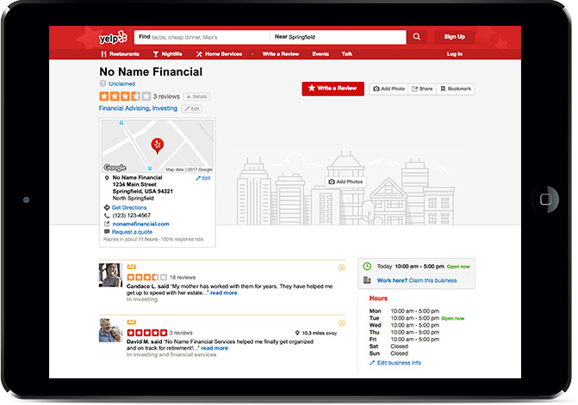
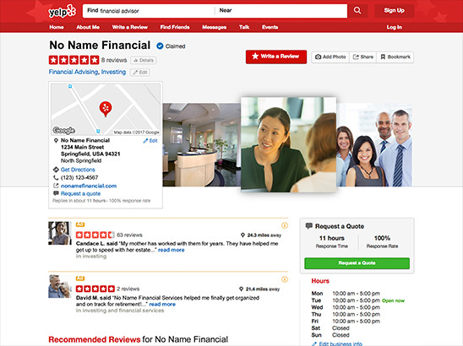
Manage your online listing
Source: BrightLocal, Local Consumer Review Survey, 2019. https://www.brightlocal.com/research/local-consumer-review-survey/
Please refer to your firms' social media policy regarding utilizing social media for business.
Notes:
[NOTE: Delete this slide when presenting to Edward Jones.]
Many business directories are available online, serving as a digital yellow pages but with one notable difference…
[CLICK] Customer ratings and reviews. Websites that combine local search, listings and reviews, like Yelp, may determine if a prospect contacts you or one of your competitors.
That’s because ratings and reviews, though not always reliable or accurate, give insight into the experiences of customers or clients.
It turns out, we value that insight. One study found 82% of consumers read reviews to determine the quality of a local business and they read 10 reviews before feeling able to trust a local business.¹
Do you know what your business listing looks like? It’s possible that it was set up without you knowing and there may already be a few reviews.
[CLICK] While you’ll first need to check if it’s ok with your compliance department, you can claim your business page to make sure it displays accurate and up to date information. Complete your profile by adding photos and filling out any requested fields.
Most importantly, treat clients in a way that will compel them to write positive reviews of your services.
Source: BrightLocal, Local Consumer Review Survey, 2019. https://www.brightlocal.com/research/local-consumer-review-survey/
Example of local FA you found on yelp who has a long career and great reputation – and yelp had two bad review

Slide 16
Embrace social media
Visible
3
Over
financial professionals
4
gained new clients
1
Half
use social media
Relevant
from social media
2
Insightful
Impactful
Source: Market Strategies International. Cogent Reports™, Advisor Media Consumption™, 2015.
Source: LinkedIn® and Financial Planning Association®, Communication Evolution: Financial Professionals and the Future of Thought Leadership and Social Media, 2015.
Please refer to your firms' social media policy regarding utilizing social media for business.
Notes:
Not too long ago, I’d have to make a case for financial professionals using social media. Today, with approximately 3 out of 4 financial professionals using social media for business-related purposes, it’s no longer a nice to have.¹ Social media is becoming a key part of business development.
[CLICK] One survey found more than half of financial professionals reported adding new clients directly as a result of their social media use.²
It’s an opportunity for you to connect with clients and prospects in the crowded financial planning marketplace.
Social media gives you the power to be more [CLICK]:
Visible: By putting your name and your business in the public sphere.
Relevant: Inserting your perspective into current conversations.
Insightful: Uncovering information and providing the feedback you need to have the right conversation at the right time.
Impactful: Extending your reach exponentially with the click of a mouse.
Where do you go to get started with social media – the options are endless
1. Source: Market Strategies International. Cogent Reports™, Advisor Media Consumption™, 2015.
2. Source: LinkedIn® and Financial Planning Association®, Communication Evolution: Financial Professionals and the Future of Thought Leadership and Social Media, 2015.

Slide 17
Proliferation of social media
Most Popular Among Financial Professionals
Please refer to your firms' social media policy regarding utilizing social media for business.
Notes:
[NOTE: If presenting at Edward Jones, use second script below]
But with all of the social media platforms available, how do you decide where to spend your time and effort?
[CLICK] The four social networking platforms that tend to be most popular among financial professionals are YouTube, Facebook, LinkedIn and Twitter.
Each compliance department has different rules around utilizing social media for business, so I encourage you to become familiar with those before setting up accounts.
Today we are going to focus on LinkedIn.
[Edward Jones script]
But with all of the social media platforms available, how do you decide where to spend your time and effort?
[CLICK] The four social networking platforms that tend to be most popular among financial professionals are YouTube, Facebook, LinkedIn and Twitter.
Each compliance department has different rules around utilizing social media for business, so I encourage you to become familiar with those before setting up accounts.
Edward Jones financial advisors can only use Facebook and LinkedIn.
Today we are going to focus on LinkedIn.

Slide 18
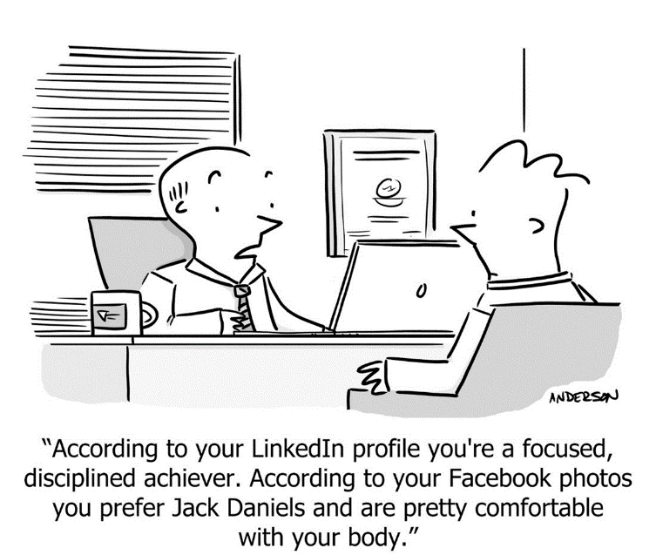
Notes:
One of the main reasons it’s important for you to have a relevant social media presence is to avoid this sort of conversation being had about you. [read caption]
In all aspects of social media, be professional with what you do.
Now let’s move from the digital world to the real world. How are you most likely to interact with a client for the very first time.

Slide 19
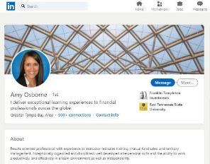
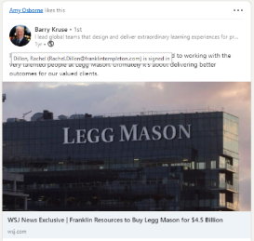
LinkedIn
1
Professional photo
2
Engaging headline
I deliver exceptional learning experiences to financial professionals across the globe.
3
About summary | Value statement
Results oriented professional with experience in instructor-led sales training, mutual fund sales, and territory management. Exceptionally organized and disciplined, well developed interpersonal skills and the ability to work productively, and effectively in a team environment as well as independently.
4
4
Posts & Activity
Please refer to your firms' social media policy regarding utilizing social media for business.
Notes:
There are over ______people on LinkedIn….if you’re not one of them. You are noticeably absent. Your LinkedIn profile is a great place for you to give a positive impression to prospective clients.
However, an empty profile (or no profile) doesn’t make you appear credible or digitally savvy—a trait that is increasingly important with investors.
Take the time to complete your profile, paying special attention to the top sections.
[CLICK] Upload a profile photo that is clear and appropriately professional. Warning here, your favorite facebook photo is not your LinkedIn photo. Fill out every field including your contact information, add links to your website or blog, and create a custom URL.
[CLICK] Your headline is prime real estate. Go beyond just listing your current job title and showcase your value proposition or specialty in an engaging way.
[CLICK] The summary section is your chance to tell your story. Start by answering the question, “What do you do in your role?” “What problems do you help clients solve?” or, perhaps the most important question, “Why do you do what you do?”
[CLICK] The platform is a great place to post content and convey credibility.
A strong LinkedIn profile puts forth a credible impression with prospects and reinforces expertise with current clients. What we want to do with this LinkedIn profile is make sure you aren’t in this cartoon.

Slide 20
Make the first contact count
Answer professionally
Speak confidently and clearly
Have a quiet background
Know when to use your cell phone
Notes:
Most likely, one of the first encounters a prospect will have with you is over the phone.
Are you conscious of the way you answer the phone, or has it simply become routine?
[CLICK] Today, most offices answer the phone much too casually or at a pace that is much too fast. The caller has no idea who answered the phone or if they have even called the right place.
It’s a good idea to consciously listen to your phone conversations to make sure they are clear, professional, energetic, helpful and giving the right impression to the person on the other end.
[CLICK] Is there background noise that could be making it hard for the prospect to hear what you’re saying?
How often do you overhear other conversations, TVs, other phones ringing and loud noises when you call a business? Minimizing distractions will allow you to focus on the conversation at hand.
[CLICK] Be sure you speak clearly, you know what you’re saying but the prospective client may not.
Ask your spouse, children or elderly parent to call your office. Family members can be great judges because they are willing to give you honest feedback to help you succeed.
[CLICK] Know when to use your cell phone.
Use your cell phone only as a last resort and only if you're absolutely certain who is calling, why they're calling, that you have good reception and that you have the time to complete the conversation. Otherwise, let it go to voicemail.
Your goal should be to make this first interaction a good experience for prospects as they begin forming an impression of you and your business.
Example of you calling your office – you call there all the time, you know who’s on the other end of that phone and what they’re saying – suggest a secret shopper and the older the better. Have them call and give you feedback on that experience so that you can share it with your team and the people who answers your phones.
I know it sounds trivial, but this matters.

Slide 21
DO put away personal items and
greet clients with a smile
DO stand and greet clients by name
DO dress in professional attire
DO help clients get settled
The firm’s ambassador of first impressions
For Financial Professional Use Only / Not for Distribution to the Public
Notes:
[When presenting at Edward Jones, change all mentions of “receptionist” to “BOA”]
When a prospective client arrives at your office, your receptionist is often the first person they meet—setting the tone for the rest of the meeting.
Ask them to be the ambassador for your team, taking responsibility for that first impression. You want to make sure your receptionist is properly reflecting your business.
How many times have you come into an office to find a receptionist engrossed in a personal call and completely distracted?
[CLICK] The first step to a better impression is to make sure personal items are put away and that clients are greeted with a smile when they arrive.
[CLICK] If possible, have your receptionist stand up and greet your clients by name to let them know you are prepared for their arrival.
[CLICK] And remember, your staff is a reflection of you and your business. If you want to portray a professional image, make sure all members of your staff are dressed professionally. If they are giving the impression that you run a casual office, clients may question if that reflects the way you do business.
[CLICK] Finally, have your receptionist help your clients get settled by offering a beverage or other refreshments and letting them know what they can expect next, perhaps by saying “Mr. or Ms. Financial Professional is wrapping up a call and will be with you shortly, please have a seat.”
Prospective clients may be feeling a bit nervous or anxious about the meeting, and your receptionist can help create a welcoming environment that puts them at ease.

Slide 22
Polishing your presence
Notes:
Now that we’ve talked about creating favorable zero-second impressions, let’s discuss polishing your presence to make sure you shine when you actually meet in person. As Will Rogers said, “You only get one chance to make a first impression.”

Slide 23
Dress like a million bucks
For Financial Professional Use Only / Not for Distribution to the Public
Notes:
Remember, your physical appearance accounts for more than half of someone’s first impression of you. Right or wrong people will prejudge you based on your appearance and the image they have of how someone in your position should look.
Dressing appropriately can let clients know you are a successful professional and can add to your credibility.
Here is a group of professionals. For most of them, it’s easy to determine what they do by how they’re dressed.
And if we look at these images and I ask you - as financial advisors – which of these images would you suggest are potentially financial advisors?
[CLICK] One of these two
[CLICK] And if you’re a woman, the same rules apply.
Now let me ask the question slightly differently.
Which of these images would you guess your clients would say is the financial advisor?
[CLICK] Most likely, they’ll choose the more professionally dressed. Why?
For most people, the stereotypical financial professional dresses more formally.
Provide the image they expect of you.
(MOST CASUAL DRESS TODAY IS DONE FOR YOUR BENEFIT, NOT THE BENEFIT OF YOUR CLIENT. PROVIDE THE VISUAL THEY EXPECT OF YOU.
That said, you know your clients best and what attire is best for each meeting.
But when in doubt, it’s better to be overdressed than underdressed.

Slide 24
For Financial Professional Use Only / Not for Distribution to the Public
Notes:
Developing trust is critical and today many of us are reliant on developing trust on-screen. In other words, the way you appear on a screen matters and influences client perceptions of you.
So, how can we put our best virtual foot forward?

Slide 25
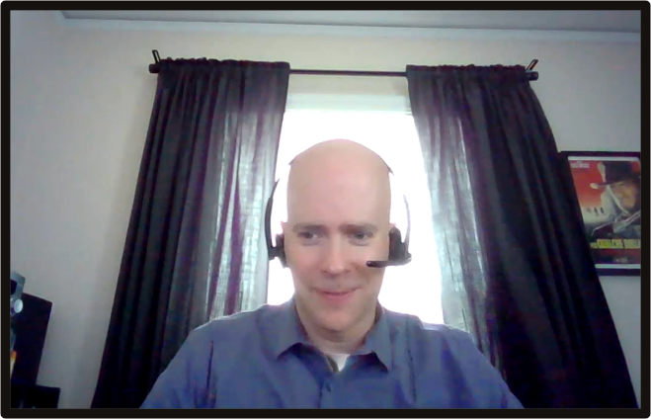
Setting the scene:
What could be improved in James’ environment?
A. Adjust lighting
B. Change camera angle
C. Look at camera
D. Other
For Financial Professional Use Only / Not for Distribution to the Public
Notes:
Slide objective: good lighting and your environment makes a big impact on how a client sees you.
Your environment makes a big impact on how a client sees you.
POLL: what could be improved in James’ environment?
Show results.
Transition: let’s make a few small changes to his environment.

Slide 26
Setting the scene: Lighting
Natural
Front-facing
Sufficient, flattering
Adjust lighting by moving adjacent to window
Notes:
Slide objective: good lighting and your environment makes a big impact on how a client sees you.
First, let’s adjust James’ lighting by moving him adjacent to the window.
Good lighting will present you in the most realistic, flattering way, whereas bad lighting will obscure you or create a distraction for viewers.
[click mouse]:
Natural lighting is more desirable than artificial lighting, but it can be difficult to arrange.
The easiest hack for good lighting is to sit facing window. Overcast days, surprisingly provides you with the kind of lighting Hollywood pays for...for free!
However, If you need to sit adjacent to a window (as was the case in James’ environment), consider adding a light to balance and get rid of shadows.
Most importantly, whether its natural or artificial, never turn your back to the light source.
Front lighting is your new best friend on camera.

Slide 27
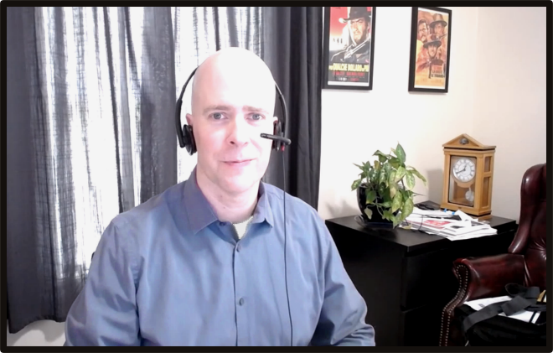
Setting the scene: Camera position
Eye level
Fill the frame
Centered
Change camera angle
Notes:
Slide objective: good lighting and your environment makes a big impact on how a client sees you
Next let’s change the camera angle so it’s at eye level. This allows James to look directly into the camera and it eliminated that large space between the top frame and the top of his head.
In terms of height, you want to be sure that the camera is at your eye level. You want to be seen as on the same plane as your clients, looking them directly in the eye.
To get the right height you may need to raise up your computer, with books for example, or lower the height of the chair you sit in.
You will also need to determine how far to position the camera from your face. If you are too close you will overwhelm the viewers, and if you are too far out you will be lost in the background.
It’s a best practice to fill the frame, meaning you are the most visible thing on the screen to viewers and you are squarely in the middle of the frame.

Slide 28
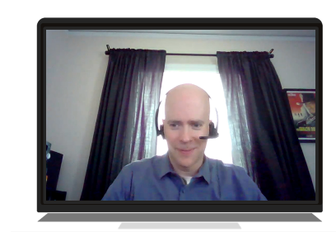
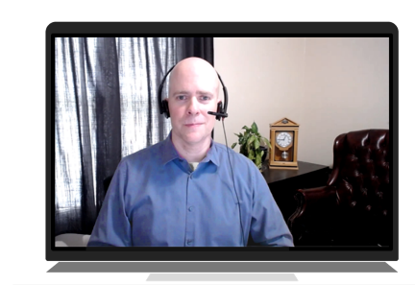
Setting the scene: Background
Neutral
Professional
Blurred
Tidy up and remove clutter
Notes:
Slide objective: good lighting and your environment makes a big impact on how a client sees you.
And lastly, lets tidy up and remove clutter.
Always be aware of any excess items or clutter in your background.
After changing James’ camera angle, excess papers came into view.
Remember the pictures on this wall? Who doesn’t love to relax to a great Clint Eastwood movie, but is this the image James wants to portray to his clients?
When you video conference, you are giving your clients a view of your workspace. It is important that the space gives the right impression of you and your business.
Best practice is to have a clean, neutral background with only work-appropriate decorations. In other words: less is more.

Slide 29
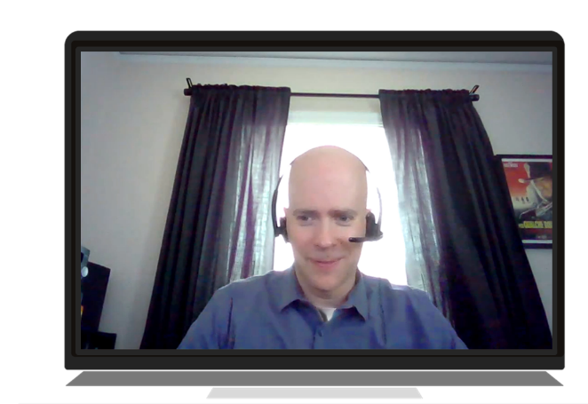
Your environment matters
Notes:
Slide objective: good lighting and your environment makes a big impact on how a client sees you.
Your environment matters. A few small changes can make a big impact on mastering your on-camera presence and a client’s first impression.

Slide 30
Setting the scene: Attire
Professional
Camera-friendly colors
Avoid moiré
For Financial Professional Use Only / Not for Distribution to the Public
Notes:
Now, let’s talk about how you dress for video meetings.
(CLICK) Working at home can lull you into adopting a less professional appearance, even on camera. It is important to remember that you are dressing for the occasion, not for your environment.
Keep your appearance consistent with the style and standard you set in past, in in-person-meetings.
(CLICK)
The next tip is to wear camera-friendly colors. Try choosing solid colors which adds contrast with your background.
If you are comfortable with bold colors, the camera loves rich jewel tones. Men can add color and contrast by adding a bold colored tie.
[click mouse]
Avoid strips, patterns and busy patterns. Be on the lookout for the visual phenomenon called moiré that causes busy patterns to appear to vibrate on screen.
Your best strategy is to choose simple clothing in solid tones for video. You want people to focus on you and your message, not your clothing.

Slide 31
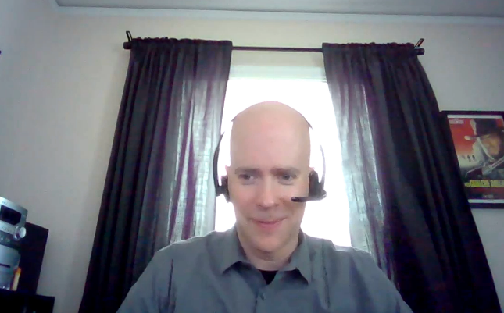
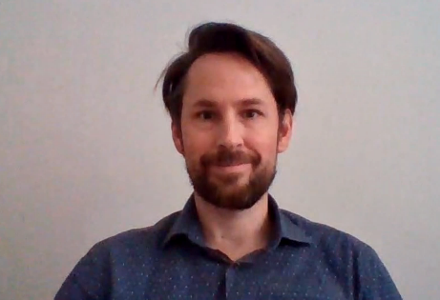
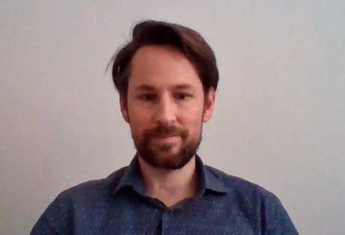
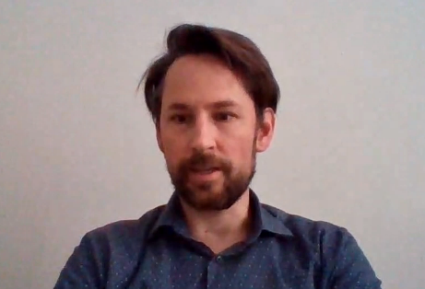
Delivery: Eye contact
Look at the camera
Stay focused
Show you are listening
Notes:
And then there is eye contact.
When you meet with people face-to-face it is second nature to look them in the eye. That can be much harder to do over video, but it is no less important. Looking your clients directly in the eye lets them know that you are fully engaged and actively listening to what they have to say. To look your audience directly in the eye over video you actually need to look at the camera, and not at their images on your screen or on your own image on the screen. This can be a difficult skill to master, but as the pictures here show, it can make a critical difference in how you come across.
It is also important not to get distracted while on camera. Glancing down at your phone or reading off papers will break eye contact with your audience.

Slide 32
Delivery: Vocal quality
Energy
Inflection
Microphone
Notes:
Another delivery consideration is your voice.
Bring some energy into your speaking voice. You can do that by standing or sitting up straight. Good posture conveys confidence and helps add natural inflection and strength to your voice.
You also want to think about how your voice is being transmitted. You can improve your sound quality by using a headset with a microphone or a podcast-style standing microphone.

Slide 33
Setting the scene: Sound
No ambient noise
Mute button
Headphones
For Financial Professional Use Only / Not for Distribution to the Public
Notes:
Finally, consider how ambient noises can distract your meeting. Could your call be interrupted by the doorbell, a lawnmower, a barking dog or family members talking?
It is incumbent on you to select a meeting location where you can control, or better yet, eliminate the risk of unwanted sounds. And, if all else fails, know where the mute button is and be prepared to use it.
Another best practice is to wear headphones so that you get a clear understanding of what your meeting attendees are saying.

Slide 34
Body language: Handshake
Shows trust and respect
Helps the other person feel welcome
For Financial Professional Use Only / Not for Distribution to the Public
Notes:
Let’s take this opportunity to talk about body language—beginning with the importance of the handshake.
In the business world, the handshake has been a staple for a very long time and is a sign of trust and respect. If done correctly, it sets a good first impression and helps the other person feel welcome.
Now with vaccines and the lifting of social restrictions, some people are ready to shake hands again and some people are not.
[click mouse]:
This moves us into a so-called greeting gray area.
What do we do? Do we shake hands, fist bump, elbow bump, handshake or give a brief wave?
The reality is that Covid–19 forced a change, and we all need to navigate the new normal.

Slide 35
Generate trust with your post-Covid greeting
It’s individual
Gage their body language
Ask their comfort level
Greet with a smile, a slight up-and-down head nod and good eye contact
Notes:
So, how do you navigate a post-Covid-19 handshake? How do you generate trust and respect with a fist or elbow bump?
[click mouse]
Remember that it’s individual. There is no one greeting fits all. Everybody understands the psychological trauma that we’ve endured during this time. This has been a big ordeal in our lives so let your conscience be your guide.
[click mouse]:
Gage your client’s body language. As you approach them look for cues to determine the direction they want to go.
An advisor I work with greets clients at the door to get a read on comfort level. She offers them hand sanitizer to get a sense right when they are coming in and use that cue for interaction.
[click mouse]:
If you are unsure, ask them. In one-on-one or small group settings, make a point to ask about individual comfort level and be respectful of that.
[click mouse]:
No matter what greeting you choose – handshake, fist bump, elbow bump, waive – greet your clients with a smile along with a slight up-and-down head nod and good eye contact.
Additional Facilitator Notes:
On the hand, what do you do if your client is coming in for a handshake and you’re not ready for it?
Stop them in a polite manner by simply saying, 'I hope you understand, but I have become a little accustomed now to not shaking hands, not giving hugs, please don't take offense.' And once you’ve set yourself up that way, most people are very kind and very receptive to understanding.

Slide 36
Hand gestures
For Financial Professional Use Only / Not for Distribution to the Public
Notes:
Gestures are small movements that pack a lot of meaning—they can make what you say more memorable and influence how others perceive you. Let’s perform a small experiment.
I’m going to repeat the same instructions three times and only change how I gesture with my hands. Your job is simple—see if you notice a difference in the meaning.
I want everyone on this side [use right hand with upward facing/open palm to gesture toward right side of the room] of the room to get up and move over to this side [use left hand with upward facing/open palm to gesture toward left side of the room]. And everyone on this side of the room [same gesture toward left side of the room], please get up and take new seats over on the other side [same gesture toward right side of the room].
[Repeat phrase with palms facedown]
[Repeat phrase with pointed fingers]
Although my words stayed the same, did you get a different message each time?
Gesturing with an open hand and upward facing palm is welcoming and you’re more likely to win someone’s favor with this type of gesture. Open hands can also increase listener retention, a critical benefit when discussing financial solutions or goals with clients.
[CLICK] What about the second example? When you gesture with palms facing downward, people feel as if they are being told what to do, and that’s not going to instill a sense of partnership.
[CLICK] The last example was the worst, right? Finger pointing is basically an order and makes the listener feel as if you aren’t giving them a choice. That kind of forcefulness will not likely result in a future meeting.
[CLICK] The other gesture we see often is folding your arms or hands across your body. This gesture may come off as defensive, closed-off, negative, unsure or insecure.
[Presenter note—to watch this exercise in action, check out the video: https://www.youtube.com/watch?v=ZZZ7k8cMA-4]

Slide 37
Leg and foot gestures
Notes:
Hands aren’t the only way we gesture. Make sure you are sending the right message from the feet up.
Your feet can be the most expressive parts of your body. But like your hands, there are some gestures to avoid.
Standing on one hip not only looks unprofessional, studies have shown that others may not take what you say as seriously. Having your feet pointed in a specific direction indicates that’s where you want to head. Let your client know you are engaged in what they are saying by keeping your feet pointed toward them rather than out the door.
[CLICK] When seated, crossing your legs creates a barrier and can make you seem closed off. Leaning way back in your chair may look too relaxed.
[CLICK] It’s best to keep your body in the “ready” position while seated—feet on the floor, sitting up tall, shoulders relaxed and hands are lightly folded on your lap.
It’s important to note that gestures are not universal and what’s considered neutral in one culture may be offensive in another culture.

Slide 38
Create lasting impressions through active listening
Active listening means EYE CONTACT
Focus on area between eyes to upper chin
Notes:
One final way we can make a favorable, lasting impression is by being active listeners.
How many of you are guilty of having a conversation with someone and realizing after 10 or 20 seconds you haven’t heard a word they said? Or, how often are you ready to answer someone before they've even finished talking? These are all signs that we're not very good listeners.
Trustworthiness is really about making someone feel understood and being an active listener truly connects us to what our clients are saying.
The first step to being a better active listener is eye contact.
For those that are uncomfortable giving eye contact, you don't have to look directly into your client’s eyes.
[CLICK] Instead, focus somewhere within the triangle that goes from the eyes to the upper chin. This way the other party will perceive that you're making eye contact.

Slide 39
Create lasting impressions through active listening
I would like…
So, I’m hearing that…
I am nervous…
So, your concern is…
For Financial Professional Use Only / Not for Distribution to the Public
Notes:
Next, Harvard University researchers say that we can instill trust by letting the client have the floor to speak first. Ask them an open-ended question that gets them talking.
You can further elevate the active listening process by paraphrasing what your client has just said. You want to use power of the word, "So.”
[CLICK] "I would like…” "So, I'm hearing that...”
"I am nervous..." "So, your concern is..."
This lets the other party know that you're not just hearing their words, but processing to the point you can rephrase what they've just said.

Slide 40
Create lasting impressions through active listening
Can you tell me more about that?
What might happen if…?
Is there anything else to include?
For Financial Professional Use Only / Not for Distribution to the Public
Notes:
In addition to paraphrasing your client, you also want to respond with phrases like [CLICK], "Can you tell me more about that?”
This gives your client the permission to go deeper into what their challenge really is.
The more information you are able to elicit the better you will understand them and be able to solve their challenges.
So let's be better listeners to demonstrate our trustworthiness and set the stage for a long-term partnership.

Slide 41
For review
The science of first impressions
Managing zero-second impressions
Polishing your presence
Notes:
To review, today we talked about three things:
The science of first impressions
Managing zero-second impressions
Polishing your presence
When it comes to first impressions, the way we see ourselves is often not the way others see us.

Slide 42
Putting ideas into action
Mastering first impressions checklist
MFIMP LIST
Notes:
[Delete slide for Edward Jones]
To help you implement the ideas you’ve learned in this presentation, we’ve created a checklist to help you master first impressions.
Set a reminder to review it periodically and choose one or two additional points to implement.
If you apply just one new strategy a month, 12 months later you’ll have 12 new best practices.
Continuing this process year after year can help your business grow.

Slide 43
Who would
you
you
choose
?
choose you
For Financial Professional Use Only / Not for Distribution to the Public
Notes:
We began this presentation with an experiment to show how quickly first impressions are formed.
Imagine [CLICK] I snapped a photo of your face in this moment. How do you look? Do you have a slight scowl? A furrowed brow? Or, are you shuffling to prepare for your next meeting or head to the next presentation?
Now, what if I gave you a heads up that I’d be taking your picture? How would your expressions change? Would you smile? Sit up straight? [CLICK]
The difference between those two facial expressions could be the difference between new business or no business from a prospective client.
[CLICK] At the beginning of this presentation I showed you how quickly you could choose between two faces and asked, “Who would you choose?”
I hope you’ll leave today’s discussion on making first impressions last with more confidence about how you present yourself and your business.
This will allow you to answer the more critical question in relation to your business, [CLICK] who would choose you?

Slide 44
This material is intended to be of general interest only and should not be construed as individual investment advice or a recommendation or solicitation to buy, sell or hold any security or to adopt any investment strategy. It does not constitute legal or tax advice. This material may not be reproduced, distributed or published without prior written permission from Franklin Templeton.
All investments involve risks, including possible loss of principal.
Any research and analysis contained in this material has been procured by Franklin Templeton for its own purposes and may be acted upon in that connection and, as such, is provided to you incidentally. Data from third party sources may have been used in the preparation of this material and Franklin Templeton ("FT") has not independently verified, validated or audited such data. Although information has been obtained from sources that Franklin Templeton believes to be reliable, no guarantee can be given as to its accuracy and such information may be incomplete or condensed and may be subject to change at any time without notice. The mention of any individual securities should neither constitute nor be construed as a recommendation to purchase, hold or sell any securities, and the information provided regarding such individual securities (if any) is not a sufficient basis upon which to make an investment decision. FT accepts no liability whatsoever for any loss arising from use of this information and reliance upon the comments, opinions and analyses in the material is at the sole discretion of the user.
Products, services and information may not be available in all jurisdictions and are offered outside the U.S. by other FT affiliates and/or their distributors as local laws and regulation permits. Please consult your own financial professional or Franklin Templeton institutional contact for further information on availability of products and services in your jurisdiction.
Issued in the U.S. by Franklin Distributors, LLC, One Franklin Parkway, San Mateo, California 94403-1906, (800) DIAL BEN/342-5236, franklintempleton.com - Franklin Distributors, LLC, member FINRA/SIPC, is the principal distributor of Franklin Templeton U.S. registered products, which are not FDIC insured; may lose value; and are not bank guaranteed and are available only in jurisdictions where an offer or solicitation of such products is permitted under applicable laws and regulation.
Franklin Distributors, LLC. Member FINRA/SIPC
One Franklin Parkway
San Mateo, CA 94403-1906
franklintempleton.com
MFIMP PPT 08/23

Slide 45
Source List
Princeton research:
http://einstein-blog-live.s3.amazonaws.com/public/uploads/documents/603/first_impressions.pdf
Amy Cuddy, Harvard research:
http://www.businessinsider.com/harvard-psychologist-amy-cuddy-how-people-judge-you-2016-1
http://www.telegraph.co.uk/news/newstopics/howaboutthat/12107680/The-two-key-things-people-judge-you-on-when-they-first-meet-you.html
Albert Mehrabian 55/38/7 Research:
https://www.psychologytoday.com/blog/beyond-words/201109/is-nonverbal-communication-numbers-game
These two research studies combined to make the determination of 55/38/7
Mehrabian & Wiener, 1967 and Mehrabian & Ferris, 1967
Mehrabian, A. (1972). Nonverbal Communication. New Brunswick: Aldine Transaction.
Stay up-to-date on technology [75% internet users judge a company’s credibility based on website design]:
Stanford Web Credibility Project: http://credibility.stanford.edu/
Link to article with stat: http://www.kinesisinc.com/the-truth-about-web-design/
Manage your online listing [92% of customers have read reviews to determine the quality of a local business and 2/3 say positive reviews make them trust a local business more]:
BrightLocal Local Consumer Review Survey 2015: https://www.brightlocal.com/learn/local-consumer-review-survey/
Embrace social media:
Source: Communication Evolution: Financial Professionals and the Future of Thought Leadership and Social Media; March 2015 FPA® research report
Source: Market Strategies International. Cogent ReportsTM. Media ConsumptionTM Advisor, Web. Q1 2015.
Tenth of a Second:
Source: Willis, Janine and Todorov, Alexander. “First Impressions: Making Up Your Mind After a 100-Ms Exposure to a Face.” Psychological Science, vol. 17, Issue 7. July 1, 2006.

