Slide 1
Modern Prospecting
Building a strategic plan focused on growth
FOR FINANCIAL PROFESSIONAL USE ONLY / NOT FOR PUBLIC VIEWING OR DISTRIBUTION

Slide 2
Specialist Consulting Group
Advisors at the center
With more than 20 dedicated specialists and consultants, we strive to help you tackle challenges and implement solutions across key practice areas.
At Janus Henderson, “world-class service” is more than a buzzword. It is central to our mission as a firm and that of our growing team of experts focused on helping you build and manage your practice.
2

Slide 3
Agenda
01
Key findings from FPA and Janus Henderson study
01
02
Three steps to Modern Prospecting
03
Next steps

Slide 4
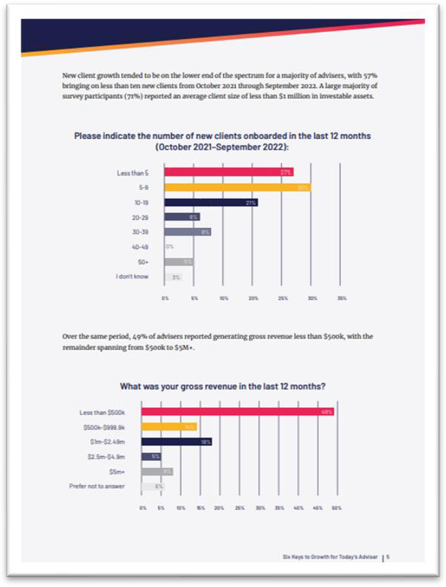
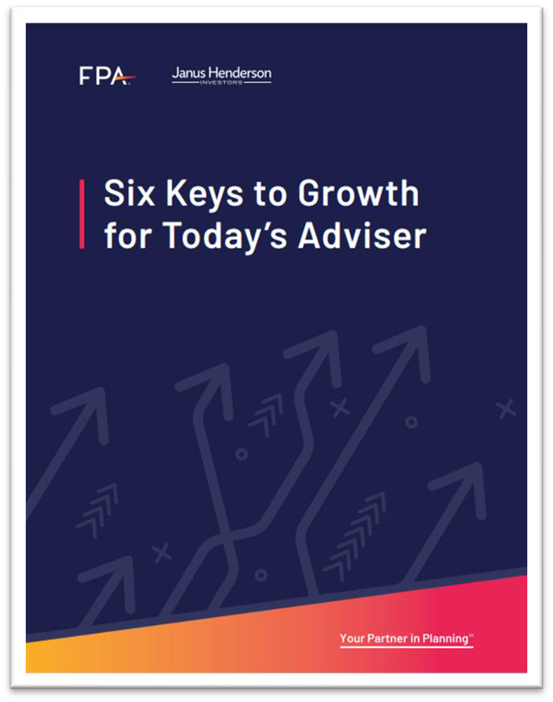
Six keys to organic growth
Understanding the influences on growing your practice
In partnership with Janus Henderson Investors, the Financial Planning Association® set out to understand what aids and inhibits an advisory firm’s ability to grow.
71% are motivated, though to varying degrees of success in achieving a comfortable growth rate.
While 46% of advisers report that they are comfortable with their current growth rate, only 12% would strongly agree with this statement. Growth aspirations are much higher than what advisers can achieve.
Source: “Six Keys to Growth for Today’s Adviser, 2023.” Financial Planning Association and Janus Henderson Investors.

Slide 5
Advisor impediments to growth
Knowing vs. doing
What gets in the way?
Circumstantial issues:
Investing in cryptocurrencies (49%)
Advisor mindset:
I worry about appearing pushy or “salesy” (43%)
Personally need to improve:
Cultivating relationships with COIs (61%)
Team needs to improve:
Encouraging clients to make referrals (52%)
30%
64%
I have a clear plan to grow my business
Having a clear plan in place to drive growth
Source: “Six Keys to Growth for Today’s Adviser, 2023.” Financial Planning Association and Janus Henderson Investors.

Slide 6
The anatomy of a business plan matters
Leading vs. lagging indicators
Top five business goals and tracking progress
Business goal | % of advisors that include goal in business plan | % of advisors tracking goal progress
Number of new clients | 81% | 81%
New revenue | 78% | 76%
New assets | 70% | 68%
Number of prospects in sales funnel | 48% | 40%
Client satisfaction | 44% | 22%
Prospect-to-new-client conversation rate | 37% | 26%
84% of the fastest growing firms have a clear plan for growth.
Source: “Six Keys to Growth for Today’s Adviser, 2023.” Financial Planning Association and Janus Henderson Investors.

Slide 7
Key findings
Systems and processes form a strong foundation for growth
How would you describe your process to nurture relationships with new business leads?
80%
Number of new clients added
Less than 5 5 - 9 10+ I don't know
70%
68%
67%
60%
57%
50%
49%
49%
40%
33%
30%
23%
24%
20%
20%
10%
8%
0%
2%
0%
Formal - our prospect experience is documented and Informal - leads are followed up on but there are no leverages workflow automation where possible formal processes in place
We have no process in place to nuture relationships with leads
Source: “Six Keys to Growth for Today’s Adviser, 2023.” Financial Planning Association and Janus Henderson Investors.

Slide 8
Focusing on growth
Business plan
Anatomy of a business plan matters.
System and process
Systems and processes help establish a
strong foundation for growth.
Acting on knowledge
Advisors know what they need to do to drive growth but don’t always act.
Actively engage
It’s not enough to define your ideal clients; you need to actively engage them.
Team goals
Teams grow faster
Firms with teams grow fast than those without.
Mindset
Mindset can be a powerful influence on growth prospects.
Source: “Six Keys to Growth for Today’s Advisor,” Janus Henderson and The Financial Planning Association, 2023.

Slide 9
3 Steps to Modern Prospecting
Clarity
Focus
Action

Slide 10
Clarity
Identify
Analyze
Define

Slide 11
Top 30 Clients
Who is your ideal client and what attributes make them special to you and your team?
1
2
3
With your team, identify the firm’s top 30 clients
Analyze quantitative and qualitative attributes that impact the relative client value
Define the characteristics of your ideal prospect and commit

Slide 12
Meaningful attributes
What attributes does your team value in your top 30 clients and ideal prospects?
Quantitative
AUM
Production
Revenue
Advisory
Referral source
Qualitative
Trusting relationship
Appreciate your knowledge and
expertise
Introduced to 2nd generation of wealth
Clients act as brand ambassadors
Enjoy working together
For internal use only.

Slide 13
Clarity recap
Affinity Audit
Discuss during your time together:
Identify the “ideal prospect” that fits your practice.
Analyze the attributes both
quantitative and qualitative.
Design as a team who you want to onboard in the future and commit.

Slide 14
Focus
Define
Strategize
Commit

Slide 15
Centers of influence
What is your definition and strategy for acquiring a COI partnership that leads to growth?
01
Define what a COI is for your practice
02
Strategize your meeting structure
03
Commit to consistent engagement

Slide 16
Centers of influence
Build your consistent strategy
Discovery meeting
Planning meeting
Value-add contacts

Slide 17
Centers of influence
Commit to consistent engagement
Reach out proactively with questions they can address to keep you top
of mind.
Establish a consistent cadence in your follow-up meetings, preferably
with an agenda.
Pivot on a monthly or quarterly basis if COI partnerships are not meeting your criteria.

Slide 18
Digital presence
How are you consistently building your digital presence and measuring success?
01
Define your team’s digital presence
02
Strategize how to share your unique voice
03
Commit to measuring the impact

Slide 19
Digital presence
Define your team's digital presence strategy
Nominate an individual and/or committee to build a strategy that fits your practice.
Website
Thought
leadership articles
Research
LinkedIn

Slide 20
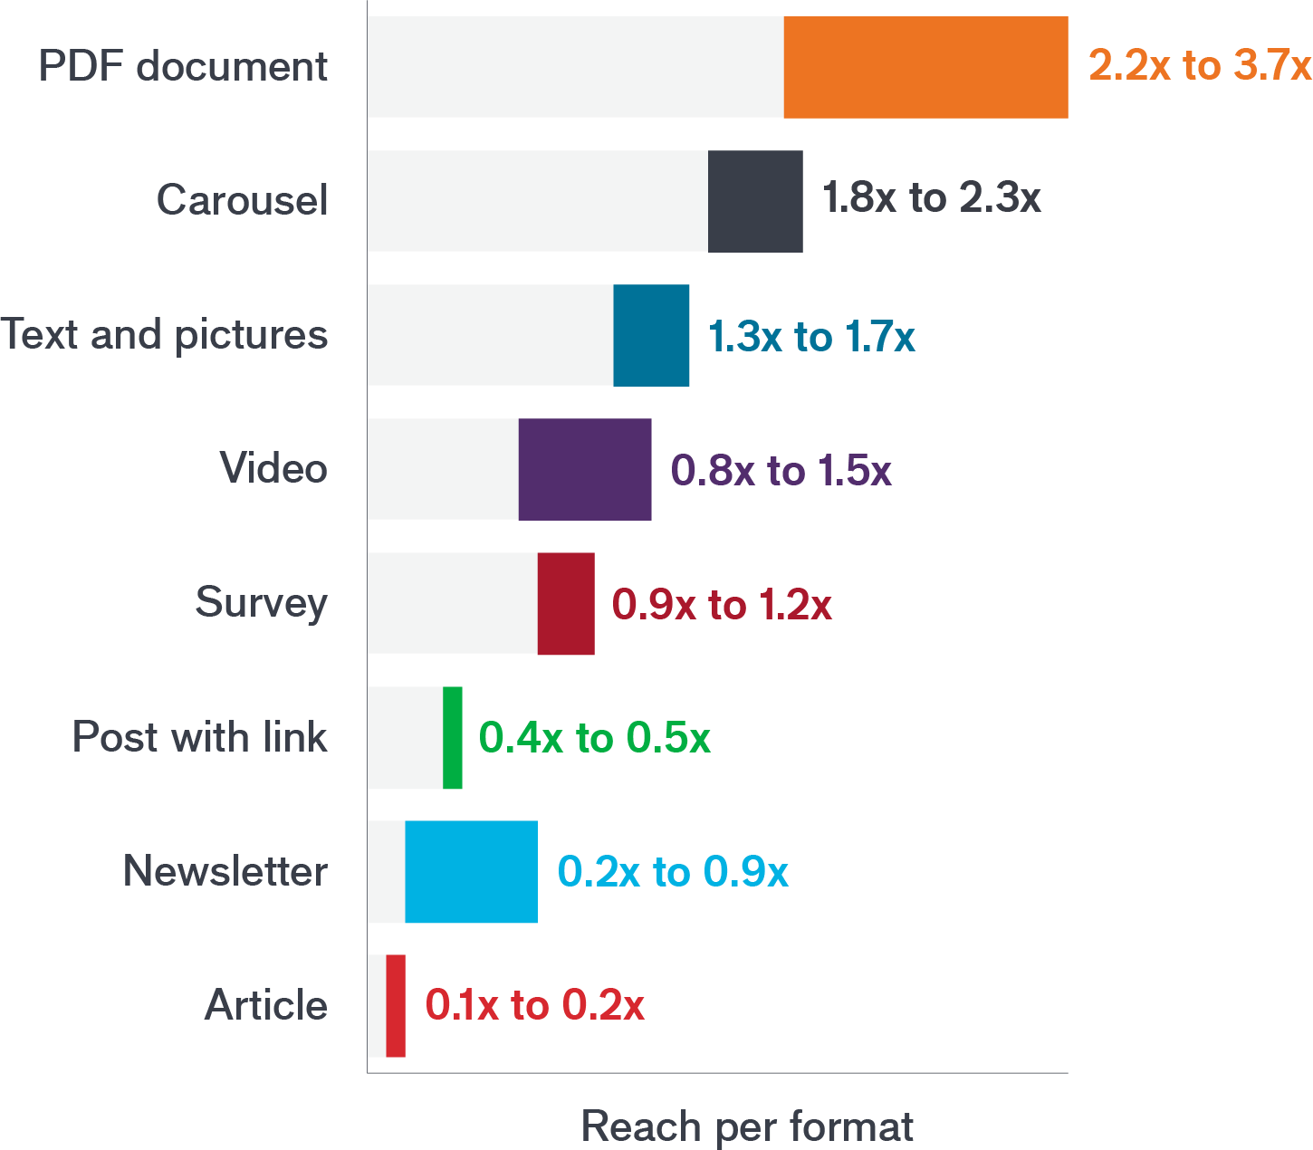
Digital presence
Strategize how to share your unique voice
Best times to publish
Monday | 9:30am – 1:00pm
Tuesday | 8:00am – 11:30am
Wednesday | 8:45am – 11:45am
Thursday | 8:00am – 11:30am
Friday | 1:00pm – 3:30pm
Saturday | 9:00am – 1:30pm
Sunday | 12:00pm – 1:45pm
Source: 4th annual Algorithm Research (2022) by Richard van der Blom and Just Connecting.

Slide 21
Digital Presence
Commit to measuring the impact of your digital presence strategy.
Are you gaining connections and followers organically?
How many prospective clients have reached out?
Do your articles get shared with prospects and clients? How many new clients found your unique posts online?
How are you gaining a following through sharing your experience?
Source: Four keys to goal setting that increase employee performance and reduce attrition. BI Worldwide. Maryam Tajmirriyahi, Ph.D.

Slide 22
Investor education
What educational topics does your audience expect and how will you deliver?
01
Define what your prospects need and want
02
Strategize with partners to provide materials and presenters
03
Commit to an expected ROI

Slide 23
Investor education
Define what would be valuable to prospects
Create an investor education committee.
Determine the cadence and topics ideal prospects are likely to attend.
Schedule placeholder events for the next 12 months.

Slide 24
Investor education
Strategize with partners on materials and presenters so that you can provide education events to your clients and prospects.
An investment in knowledge pays the best interest.”
- Benjamin Franklin
01
Schedule time with business partners that can provide
impactful resources.
02
Have them submit a proposal on the topic, materials, and takeaways the audience can expect.
03
Gain commitment for a specific time and date of the event.

Slide 25
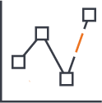
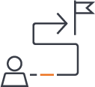
Investor education
Commit to an Expected ROI
Number of introductory meetings
AUM
Production
Proactive outreach with questions
Conversion
to clients
Referrals

Slide 26
Networking events
How will you measure success in attending networking events?
01
Define success in attending networking events
02
Strategize how to
measure progress
03
Commit to accountability toward results

Slide 27
Networking events
Define success in attending networking events
Number of introductions
Qualified prospects for a discovery meeting
New clients onboarded each quarter from the events

Slide 28
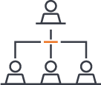
Networking events
Strategize how to measure progress
Monthly reflection
Are you achieving your success metrics at each event?
If not, what needs to shift for you personally?
Confidence
Messaging
Mindset
"Assess the value of the event with your
team"
Is this a good use of our time that will lead to growth?
Where else could we spend this time that would allow us to meet or exceed expectations?

Slide 29
Networking Events
Commit to accountability towards your progress and results.
Prepare your results on a quarterly basis.
Be open and objective.
Commit to next steps.
Present them during a team meeting to share your progress.
Discuss where you are seeing results and solicit feedback on areas to improve.
Declare your specific action steps that you will take over the next quarter.

Slide 30
Referral process
What is your referral process and how does it lead to consistent growth?
01
Define a consistent referral strategy with the team
02
Strategize how to incorporate into daily interactions
03
Commit to reporting progress at team meetings

Slide 31
Referral process
Define and build a consistent strategy with the team
Define what a successful referral looks like for your practice
Discuss how you will ask for a referral that feels right for your team
Form a strategy to focus on referrals that meet the criteria for your ideal client

Slide 32
Referral Process
Strategize on how to incorporate into our interactions
01
Identify the opportunities that we should ask for a referral.
02
Develop messaging that fits the values and culture of our firm.
03
Commit to a follow up process that is consistent using our technology.

Slide 33
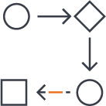
Referral process
Commit to reporting progress
Report results during the monthly Modern Prospecting growth meeting
Identify specific opportunities where the team is finding success
Commit to specific action steps over the next 30 days
FORFFOINRAFNINCAIANLCIPARLOPFREOSFSEIOSNSAIOLNUASLEUOSNELOYN/LNYO/TNFOOTRFPOURBPLUICBLVIICEWVIEWG IONRG DOIRSTDRISIBTURTIBIOUNTION

Slide 34
Action
Implement
Track
Adjust
FOR FINANCIAL PROFESSIONAL USE ONLY / NOT FOR PUBLIC VIEWING OR DISTRIBUTION

Slide 35
Action
Implement a consistent plan of action that your team can review and adjust.
01
Build your strategic plan.
Implement and track your measures of success consistently.
02
03
Adjust, coach, and support success.

Slide 36
Next steps
Building a strategic plan that is focused to measure results and grow consistently.
Strategic plan:
Build a strategic plan focused on growth that includes key measurements.
Instill clarity, ownership, and commitment to the plan.
Strategic plan
2-3 Focus areas
2-3 Focus areas:
Choose areas that the individuals on the team commit
to grow the organization.
Measure results
Growth meetings
Measure results:
Track your progress and review performance indicators together to achieve success.
“Ideas are easy. Execution is everything.”
John Doerr
Growth meetings:
Monthly or quarterly meet as a team to go over results, share feedback, and commit to next steps.

Slide 37
Connect with us
Janus Henderson provides timely insight and perspective, programs designed to hone your skills, and a team of accessible experts committed to helping you exceed expectations – in business and in life.
To engage with us, contact your Sales Director or call 800.668.0434.
Visit janushenderson.com
This material is for information purposes only. There is no guarantee that the information supplied is accurate, complete or timely, nor is there any warranty with regards to the results obtained from its use. This material may not be reproduced in whole or in part in any form, or referred to in any other publication, without express written permission. Janus Henderson and Knowledge. Shared are trademarks of Janus Henderson Group plc or one of its subsidiaries. © Janus Henderson Group plc.
W-24-532940-03-30-2025 400-25-532940 03-24
FOR FINANCIAL PROFESSIONAL USE ONLY / NOT FOR PUBLIC VIEWING OR DISTRIBUTION

Slide 38
Appendix
FOR FINANCIAL PROFESSIONAL USE ONLY / NOT FOR PUBLIC VIEWING OR DISTRIBUTION

Slide 39
Modern Prospecting Blueprint
Define what a COI is for your practice
Strategize your meeting structure
Commit to consistent engagement
Define your team’s digital presence
Strategize how to share your unique voice
Commit to measuring the impact
Define what your ideal prospects need and want
Strategize with partners to provide materials and presenters
Commit to an expected ROI
Define success in attending networking events
Strategize how to measure progress with Monthly Reflections
Commit to pivoting to different events if not meeting results
Define a consistent referral strategy with the team
Strategize on our language and “Moments of Impact”
Commit to growing together as a team to ask consistently
Centers of influence
Digital presence Investor education
Networking events
Referral process

Slide 40
Mindset matters
What determines our outcomes?
Thoughts
Emotions
Actions
Outcomes
Source: “Mindset: The New Psychology of Success,” Dweck, C., 2007.

Slide 41
Mindset matters
Which mindset do you have?
Fixed |  | Growth
 | Beliefs
Avoids | Challenges | Embraces
Gives up | Obstacles | Perseveres
Futile | Effort | Necessary
Ignores | Criticism | Open
Threatened | Success of others | Inspired

Slide 42
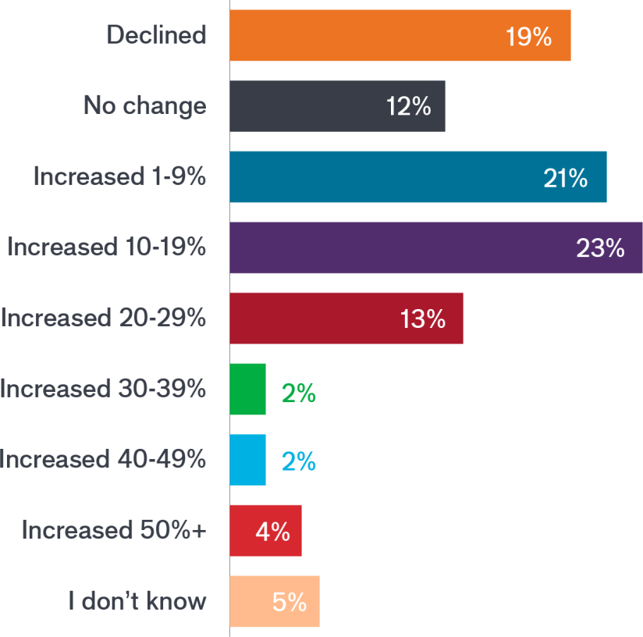
Growth in assets under management
What was your percentage growth in assets under management in the last 12 months?
29% - Either experienced no change or a decline 21% - Increased by less than 10%
13% - Increased by less than 30% 8% - Increased between 30% – 50%
Source: “Six Keys to Growth for Today’s Advisor,” Janus Henderson and The Financial Planning Association, 2023.

Slide 43
Client persona
Example: Dual Income, No Kids (DINK)
Demographic:
Life stage:
Age range: Household revenue: Geographic location: Profession:
Psychographic:
Personality type: Interests: Beliefs: Motivation:
Behavioral:
Needs
Values
Frustrations
Relationship goals
Influenced by
Top of mind

