Slide 1
Investor’s Guide to Market Volatility
Wealth planning in a turbulent environment
Notes:
The market has been volatile, it has gone down, it has gone up but at the end of the day if you look at your 401k or IRA the balance is not where it was at the end of last year. While that is the case, we can’t just stick our heads in the sand. We must move forward so we need to figure out what the future should look like for us.

Slide 2
Agenda
Capital markets review and outlook
Don’t panic!
Strategies and tactics to consider for today and tomorrow
Notes:
Agenda
Review of recent market events.
Reasons why you shouldn’t panic (Stay the course.)
Financial planning ideas and strategies to consider

Slide 3
Capital markets review and outlook
Notes:
Let’s start by taking a look at what’s going on in the markets and around the world.

Slide 4
Why the volatility?
Stock market performance
A bear market occurs when prices fall 20% or more from recent highs
Source: Federal Reserve Economic Data, fred.stlouisfed.org. As of March 31, 2023.
Notes:
We have seen more volatility in the markets since the beginning of the year, and much of that volatility has been negative.
Source: Federal Reserve Economic Data, https://fred.stlouisfed.org

Slide 5
Why the volatility?
Market correction v. bear market
Market Correction
Drop in stock prices of 10% or greater from their most recent peak
31 market corrections since World War II
Average decline: 14.3%
Average time to recover: 4.1 months
Most recent: September 2018 to December 2018
Bear Market
Drop in stock prices by 20% or more
13 bear markets since World War II
Average decline: 32.9%
Average length: approximately 18.6 months
Most recent: January 2022 to October 2022
Source: “Here’s how long stock market corrections last and how bad they can get.” CNBC, February 27, 2020.
Notes:
Its important to understand where all the volatility puts us. And to do that we need to understand the difference between a market correction and a bear market. As you can see a correction is a decrease of 10% off the most recent peak and a bear market is a drop in 20% or more off the peak. So unfortunately based on all this we can say that we are in a bear market.
Even though we all wish that weren’t the case I think its important to help you understand what that may mean for you. As you can see there have been 12 bear markets since WWII with an average decline of 32.5%. Plus and this is most important for you it has taken approximately two years to recover.
By understanding this I believe it allows you to set expectations. Sure we may be stressed, we may be angry that we’ve lost money, we may be somewhere within the five stages of grief but by having these expectations it allows you to think about or discuss with your advisors what type changes you may need to make. Whether it be to your portfolio, your spending or other aspects of your life.
Again what’s interesting is that this is the first bear market created by a global public health crisis. So it will be interesting to see how this plays out.
There have been 26 market corrections (not including Thursday) since World War II with an average decline of 13.7% over an average of four months. Recoveries have taken four months on average. The most recent corrections occurred from September 2018 to December 2018. The S&P 500 bounced into and out of correction throughout the autumn of 2018 before plunging into a bear market (a 20% decline from its all-time high) on Christmas Eve.
There have been 12 bear markets since World War II with an average decline of 32.5% as measured on a close-to-close basis. The most recent was October 2007 to March 2009, when the market dropped 57% and then took more than four years to recover. The S&P 500 closed in a bear market in December 2018 using intraday data.
Bear markets have lasted 14.5 months on average and have taken two years to recover on average.

Slide 6
Why the volatility?
COVID-19 cases
Source: Our World in Data, Johns Hopkins. January 1, 2021 – March 31, 2023.
Notes:
So how did we get here? Well much of this, as with many of the changes we see today stem from the pandemic.
COVID 19 cases have improved significantly recently. At this point all 50 states have gotten rid of mask mandates. Businesses are able to be fully open and people are starting to travel and take advantage of restrictions being eased. While that is the case the economy and supply chain is still getting back up to speed after two years of issues which leads to ongoing uncertainty.

Slide 7
Why the volatility?
Inflation
Source: Bloomberg, as of March 31, 2023..
https://www.rateinflation.com/inflation-rate/usa-inflation-rate/
Notes:
Inflation definition: the increase in prices for goods and services over a period of time.
From a macro level, inflation is generally a sign that the economy is starting to heat up. It’s not necessarily a bad thing for the economy, but because it impacts people on a day-to-day basis, we all notice it more through things like higher gas and food prices.
February 2022 = 7.9%
A shockingly high August Consumer Price Index reading. The report released on Sept. 13 showed inflationary pressures were far from peaking, adding pressure on the Fed to maintain its aggressive tightening stance.

Slide 8
Why the volatility?
Interest rates
Source: US Department of the Treasury; Data reflects January 1, 2022, through March 31, 2023.
Notes:
We have also heard a lot about interest rates increasing.
When the Federal Open Market Committee (FOMC) changes the interest rate, it impacts both the economy and the stock markets because borrowing becomes either more or less expensive for individuals and businesses.
Higher interest rates tend to negatively affect earnings and stock prices (with the exception of the financial sector).
This is because it costs financial institutions more to borrow money, these same financial institutions often increase the rates they charge their customers to borrow money. So individual consumers are impacted through increases to their credit card and mortgage interest rates, especially if these loans carry a variable interest rate.
When the interest rate for credit cards and mortgages increases, the amount of money that consumers can spend decreases. And as we all know we still have to pay our bills. When those bills become more expensive, households are left with less disposable income. When consumers have less discretionary spending money, businesses' revenues and profits decrease.
Investors need to remember that Fed rate hikes usually happen near the middle of the economic cycle, with potentially years left of gains in stocks and the economy,”
Bond yields have soared to their highest levels in years, with the 2-year Treasury at 4.16% and the 10-year note topping 4% briefly Tuesday for the first time in 14 years, before settling at 3.82%. The credit markets are responding to Federal Reserve projections that the appropriate federal-funds rate will be 4.40% at year-end, one percentage point higher than projected in June. Turmoil surrounding budget policies in the U.K. under new Prime Minister Liz Truss, concerns about a looming recession in Europe, and slowing growth in China also attracted overseas investors to the perceived haven of the U.S. bond market.
A more hawkish Federal Reserve Board raised the federal-funds rate by another 0.75% on Sept. 21. It was the third 0.75% hike in a row and the fifth increase this year, bringing rates to 3.00%. Chairman Jerome Powell adopted a sterner tone in describing the central bank’s determination to fight escalating inflation. He vowed the Fed would move rates “purposefully to a level that will be sufficiently restrictive” to bring inflation down to the target 2% level, reiterating past statements that it “will likely require maintaining a restrictive policy stance for some time” and that it is “likely to require a sustained period of below-trend growth.”
A surging U.S. dollar that is gaining strength from rising rates. The stronger dollar is pressuring corporate earnings. It is also driving other currencies lower, which in turn, leads foreign investors to flock to the safe haven of U.S. Treasuries, driving up yields and making bonds are more attractive alternative to equities.

Slide 9
Why the volatility?
Bond market performance
Source: Federal Reserve Economic Data, fred.stlouisfed.org. As of March 31, 2023.
Notes:
We have seen more volatility in the markets since the beginning of the year, and much of that volatility has been negative.
Source: Federal Reserve Economic Data, https://fred.stlouisfed.org

Slide 10
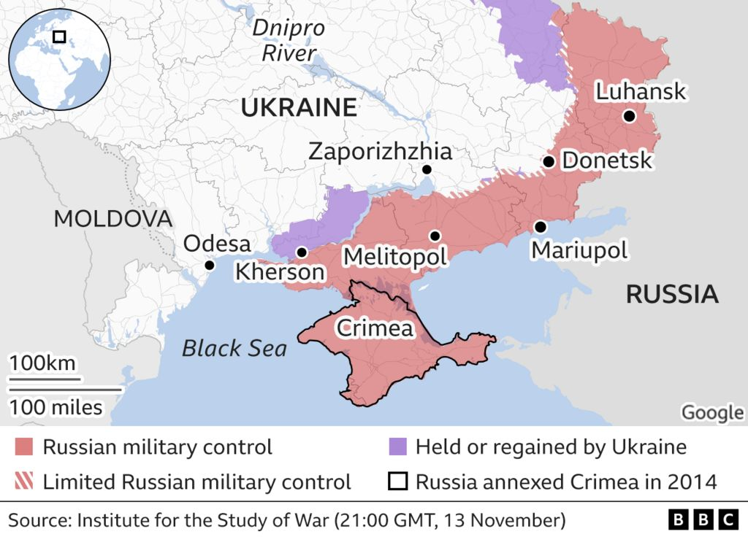
Why the volatility?
Geopolitical tensions
Source: BBC Institute for the Study of War, as of 7 August 2022.
Notes:
A major risk event usually sees investors rushing back to bonds, generally seen as the safest assets, and this time may not be different, even if a Russian invasion of Ukraine risks further fanning oil prices -- and therefore inflation.
Any interruption to the flow of grain out of the Black Sea region is likely to have a major impact on prices and add further fuel to food inflation at a time when affordability is a major concern across the globe following the economic damage caused by the COVID-19 pandemic. Four major exporters - Ukraine, Russia, Kazakhstan and Romania - ship grain from ports in the Black Sea which could face disruptions from any military action or sanctions.
Ukraine is projected to be the world's third largest exporter of corn in the 2021/22 season and fourth largest exporter of wheat, according to International Grains Council data. Russia is the world's top wheat exporter.
Natural Gas and Oil: Energy markets are likely to be hit if tensions turn into conflict. Europe relies on Russia for around 35% of its natural gas, mostly coming through pipelines which cross Belarus and Poland to Germany, Nord Stream 1 which goes directly to Germany, and others through Ukraine.
Western company exposure: Britain's BP owns a 19.75% stake in Rosneft, which makes up a third of its production, and also has a number of joint ventures with Russia's largest oil producer.

Slide 11
Don’t panic!
Notes:
Even though there is a lot of negative news and volatility in the market lets zoom out a bit and see why its best not to panic.

Slide 12
Time in the market, not timing the market
Value of a hypothetical $10,000 investment in the S&P 500® index from 1999 – 2022
Note: Past performance is no guarantee of future results.
Investing involves risk, including the possible loss of principal and fluctuation of value.
S&P 500® Index reflects U.S. large-cap equity performance and represents broad U.S. equity market performance. Index performance does not reflect the expenses of managing a portfolio as an index is unmanaged and not available for direct investment.
Source: FactSet Research Systems, Inc. from 1/1/99 - 12/31/22. The example provided is hypothetical and used for illustration purposes only. It does not represent the returns of any particular investment.
Notes:
Many times, when markets are volatile or we see large decreases, people get emotional, and they lose sight of their long-term goals and plans. This leads them to change their allocation to be more conservative or consider sell out of everything and go completely to cash.
Here you can see how letting your emotions drive your asset allocation might have affected you between 1999 and 2022. Remember that during this period you have the tech bubble bursting, the global financial crisis and the COVID 19 Pandemic. If you would have invested just $10,000 at the beginning of that period and stayed invested you would have more than double what you would have if you were able to just miss the 10 best days.
I say “JUST” miss because that’s the other part of this equation. Sure you may sell out of your positions on the way down or at the quote unquote right time, but then you have to be able to get back in at the right time. You know what they say about lighting striking in the same place twice.

Slide 13
S&P 500’s best days often come near the worst
A majority of the best and worst days happened during the same time period
Global Financial Crisis
2008
Daily Return %
Covid-19 Crisis
2020
+11%
September 2008 |  |  |  |  |  | October 2008
Mo | Tu | We | Th | Fr |  | Mo | Tu | We | Th | Fr
1 | 2 | 3 | 4 | 5 |  |  |  | 1 | 2 | 3
8 | 9 | 10 | 11 | 12 |  | 6 | 7 | 8 | 9 | 10
15 | 16 | 17 | 18 | 19 |  | 13 | 14 | 15 | 16 | 17
22 | 23 | 24 | 25 | 26 |  | 20 | 21 | 22 | 23 | 24
29 | 30 |  |  |  |  | 27 | 28 | 29 | 30 | 31
November 2008 |  |  |  |  |  | December 2008
Mo | Tu | We | Th | Fr |  | Mo | Tu | We | Th | Fr
 |  |  |  |  |  | 1 | 2 | 3 | 4 | 5
3 | 4 | 5 | 6 | 7 |  | 8 | 9 | 10 | 11 | 12
10 | 11 | 12 | 13 | 14 |  | 15 | 16 | 17 | 18 | 19
17 | 18 | 19 | 20 | 21 |  | 22 | 23 | 24 | 25 | 26
24 | 25 | 26 | 27 | 28 |  | 29 | 30 | 31
February 2020 |  |  |  |  |  | March 2020
Mo | Tu | We | Th | Fr |  | Mo | Tu | We | Th | Fr
 |  |  |  |  |  | 2 | 3 | 4 | 5 | 6
3 | 4 | 5 | 6 | 7 |  | 9 | 10 | 11 | 12 | 13
10 | 11 | 12 | 13 | 14 |  | 16 | 17 | 18 | 19 | 20
17 | 18 | 19 | 20 | 21 |  | 23 | 24 | 25 | 26 | 27
24 | 25 | 26 | 27 | 28 |  | 30 | 31
April 2020
Mo | Tu | We | Th | Fr
 |  | 1 | 2 | 3
6 | 7 | 8 | 9 | 10
13 | 14 | 15 | 16 | 17
20 | 21 | 22 | 23 | 24
27 | 28 | 29 | 30
+2%
-2%
-12%
Source: Bloomberg, as of 7 January 2022.
Notes: S&P 500 Total Return Index, daily returns.
Past performance is no guarantee of future results.

Slide 14
Staying invested during volatile times
What has the impact of each of the following been on the likelihood that your clients will remain invested in a portfolio allocation that aligns with their financial goals?
Source: 2023 Financial Advisor Survey – Retirement and Annuities: Product, Perceptions and Practices. Insured Retirement Institute.
Notes:
Q. What has the impact of each of the following been on the likelihood that your clients will remain invested in a portfolio allocation that aligns with their financial goals?
Dovetailing with the previous slides on maintaining investment allocations and client behavior, financial advisors are most likely to point to insured guaranteed income as an important tool to keep clients invested during periods of extraordinary market volatility. However, they also point to education, and in fact view education as equivalent to both guaranteed income and downside protection for the purpose of helping investors stay the course. And only slightly below these are other strategies such as options, bucketing to segregate assets by utilization time horizon, and simply reassuring or encouraging their clients to remain invested.
The ability to empirically, and simply, show how lifetime income or downside protection strategies using annuities enable the portfolio to be more resilient during market downturns could impact these perceptions.

Slide 15
The snowball effect
$1 invested in S&P 500 Index since 1940
$7,006 in 2022
$53 in 1980
1% of Total Gain
$1 in 1940
Note: Past performance is no guarantee of future results. Data reflects S&P 500 Total Return Index which assumes dividend reinvestment. Index performance does not reflect the expenses of managing a portfolio as an index is unmanaged and not available for direct investment.
Data as of 1/1/1940 – 12/31/2022.
Notes:
So based on all the charts we’ve seen on the past couple slides I think we can all agree that taking the long view and staying invested is probably in your best interest.
I always remind people that your long-term goals are not built on short term emotions.
Warren Buffet once said, "Someone's sitting in the shade today because someone planted a tree a long time ago.” That tree and the shade it provides takes time to develop. You can’t continually transplant a tree and expect it to grow to its potential. Your assets are the same.

Slide 16
Strategies and tactics to consider for today and tomorrow
Notes:
So now I want to leave with some concrete ideas that all of you can put into practice to help you stay on the right track.

Slide 17
Discussing and owning annuities
Are your clients generally more open to discussing annuities now as compared to when you first became a financial advisor?
Do you believe your clients who have owned annuities for five years or longer are financially better off for having invested in annuities?
Source: 2023 Financial Advisor Survey – Retirement and Annuities: Product, Perceptions and Practices. Insured Retirement Institute.
”Trends in Retirement Income Practices, Products and Perceptions – 2015 Financial Advisor Survey,” (IRI, 2015)
Notes:
FIGURE 1 (LEFT) One of the most interesting, and important, findings in the study is the extent to which financial advisors perceive their clients to be open to discussing annuities. An IRI report published in 20151 found that 71 percent of advisors believed their clients were very or somewhat receptive to annuities, with only 23 percent saying they thought clients were very receptive. One in five advisors thought their clients were somewhat or very reluctant to discuss annuities, with the remaining 10 percent neutral. While the questions were posed somewhat differently in each survey, having over nine in 10 advisors indicate their clients are open to discussing annuities is a significant improvement over the 2015 results.
Key inference: This merits further exploration into why most advisors perceive their clients are more receptive to annuities and whether this shift is rooted in product design, education and perception, or both.
Figure 2 (RIGHT): By a large margin, financial advisors believe that their clients who have owned annuities for five or more years are financially better off due to the impact of annuities on their portfolios. Of course, “better off” can be the result of different annuity driven outcomes, such as guaranteed income contributing to financial security, downside protection preventing or limiting loss of principal, or both these aspects of annuities supporting decisions to remain allocated to risk assets during periods of high market volatility. Regardless, a finding that nearly nine in 10 advisors believe their clients who own annuities would not be as well situated financially if they did not own the product is significant.
Key inference: Exploring the specific aspects of annuities that advisors feel contribute most to their clients overall financial well being, or segmenting clients to further understand which annuity aspects impact which segments, would enhance this finding.

Slide 18
Themes and select findings
Advisors and Annuities
Clients and Annuities
Growth Opportunities
Advisor attitudes toward/use of annuities
Impact of annuities on clients
Factors that can drive growth in annuities
91%
Believe their clients are more open to annuities than when they began working as advisors.
92%
Believe guaranteed lifetime income has helped their clients maintain their investment allocations through volatile periods.
84%
Say more generous free withdrawals (e.g., 10% versus interest only) would increase their use of fixed and fixed indexed annuities.
70%+
View variable, fixed, and fixed indexed annuities favorably.
89%
Believe downside protection has helped their clients maintain their investment allocations through volatile periods.
82%
Say more generous living benefits and simpler products would increase variable annuity sales.
64%
Are more likely to use annuities for lifetime income than when they began working as advisors.
88%
Believe their clients who own annuities for five or more years are financially better off.
82%
Say an easier purchasing experience would increase their use of fee-based annuities.
63%
Are more likely to use annuities for downside protection than when they began working as advisors.
51%
Believe their clients who own annuities are more comfortable spending money in retirement.
81%
Say the addition of lifetime income benefits would increase their use of RILAs.
Source: 2023 Financial Advisor Survey – Retirement and Annuities: Product, Perceptions and Practices. Insured Retirement Institute.

Slide 19
Important aspects of variable annuities
How important are each of the following characteristics of variable annuities for your clients?
Source: 2023 Financial Advisor Survey – Retirement and Annuities: Product, Perceptions and Practices. Insured Retirement Institute.
Notes:
Living benefits are perceived by financial advisors as the most important aspect of variable annuities, followed closely by tax deferral. A majority also find low cost, investment ratings, and death benefits to be of equal importance. The meaningful difference between the percentage selecting living benefits versus historic returns as important aspects of VAs suggest that what the product guarantees the client is more important to advisors than the past performance of the investment options offered in the product. In IRI research published in 2015, living benefits were selected as most important by 52 percent of advisors.
Despite sales of VA products having fallen in recent years, living benefits are still valued by advisors. This suggests that sales could rebound strongly with even modest increases in these income guarantees.

Slide 20
Important aspects of FIA and fixed annuities
How important are each of the following characteristics of fixed and fixed indexed annuities (FIA) for your clients?
Source: 2023 Financial Advisor Survey – Retirement and Annuities: Product, Perceptions and Practices. Insured Retirement Institute.
Notes:
As with VAs, living benefits are highly valued when offered in FIAs. However, close behind living benefits, advisors are equally interested in other aspects of FIAs for their clients, such as a strong insurer brand, the highest rates and caps they can find, the issuer’s track record of offering competitive renewal rates, and a generous free withdrawal provision. Annuities are often criticized as being illiquid, and a liberal free withdrawal policy can help deflect that criticism.
Except for living benefits by a modest margin, advisors are equally likely to view many other aspects of fixed and FIAs as very important aspects of the product, highlighting the importance of strength in all aspects listed.

Slide 21
Important aspects of RILAs
How important are each of the following characteristics of registered index-linked annuities (RILAs) for your clients?
Source: 2023 Financial Advisor Survey – Retirement and Annuities: Product, Perceptions and Practices. Insured Retirement Institute.
Notes:
Living benefits were selected most often as being “very important” aspects of RILAs, despite relatively few RILAs yet offering such benefits. The fact that RILAs do not have an explicit cost was least likely to be noted as very important, indicating that for more advisors the value proposition of the product itself is more important than whether the annuity is a directly charged or spread product. Advisors also slightly favored a range of different strategies to choose from within the products and the availability of death benefits.
Living/death benefits and a range of strategies differentiate RILAs from buffered exchange-traded funds (ETFs). As most advisors assess these features as very important, they should be used to promote RILAs as a value-added alternative.

Slide 22
Financial planning strategies
Review and update your goals
To be better off than my peers
To pay for personal self-improvement (e.g., go back to school)
To experience the excitement of investing
To start a new business
To buy a house
To help pay my kids’ college education
To stop working and do something I love
To go on a dream vacation
To relocate in retirement
To care for my aging parents
To give to charity or other causes I care about
To feel secure about my finances in retirement
To feel secure about my finances now
To leave an inheritance to my loved ones
To retire early
To pay for future medical expenses
To not be a financial burden to my family as I grow older
Source: Morningstar, Inc.
Notes:
Part of that plan is going to include your goals. And when it comes to this aspect of planning the data is clear. People who set goals relative to their finances tend to do better. They tend to be better savers, they tend to achieve better returns over time. They tend to meet their goals and objectives, whatever those may be.
So at this point review the goals you’ve created. Maybe they have changed, or maybe they need to be altered. But overall if you decide on those goals and write them out in your financial plan you’re more likely to achieve them.
Here we can see a list of goals that may be helpful to you. Not all of these will apply but I feel its important to go through these and figure out what makes sense for your situation and your family.

Slide 23
Financial planning strategies
Cash and liquidity
Increase emergency savings
Setting aside an extra 3-6 months of living expenses can help to buffer against the loss of income
Refinance debt
The low interest rate environment offers clients an opportunity to refinance credit card and student loan debt in addition to existing home mortgages
Home equity line of credit (HELOC)
Provides a liquidity source in the event of a future emergency
Source: Morningstar, Inc.
Notes:
Let’s now talk about some more concrete ideas specifically when it comes to cash and liquidity. Many people have been financially impacted by this pandemic, so something that may be a good idea is to simply increase the amount you have in your emergency savings. You might have three months of expenses saved up now but having an extra month or even a few months may help you feel more comfortable during periods like this in the future.
Also, even if they may be increasing, we know that interest rates are quite low these days so it’s a great time to reach out to lenders and request a lower rate or refinance any outstanding debt. Doing this for credit cards, student loans, your mortgage or your car may be a great way to decrease your payments and give yourself some extra liquidity.
Finally, if you’ve lived in your house for a while, it might be a good time to look into a home equity line of credit. This way you have an extra liquidity source for the future whether you want to improve your house or if you have emergency expenses that need to be covered.

Slide 24
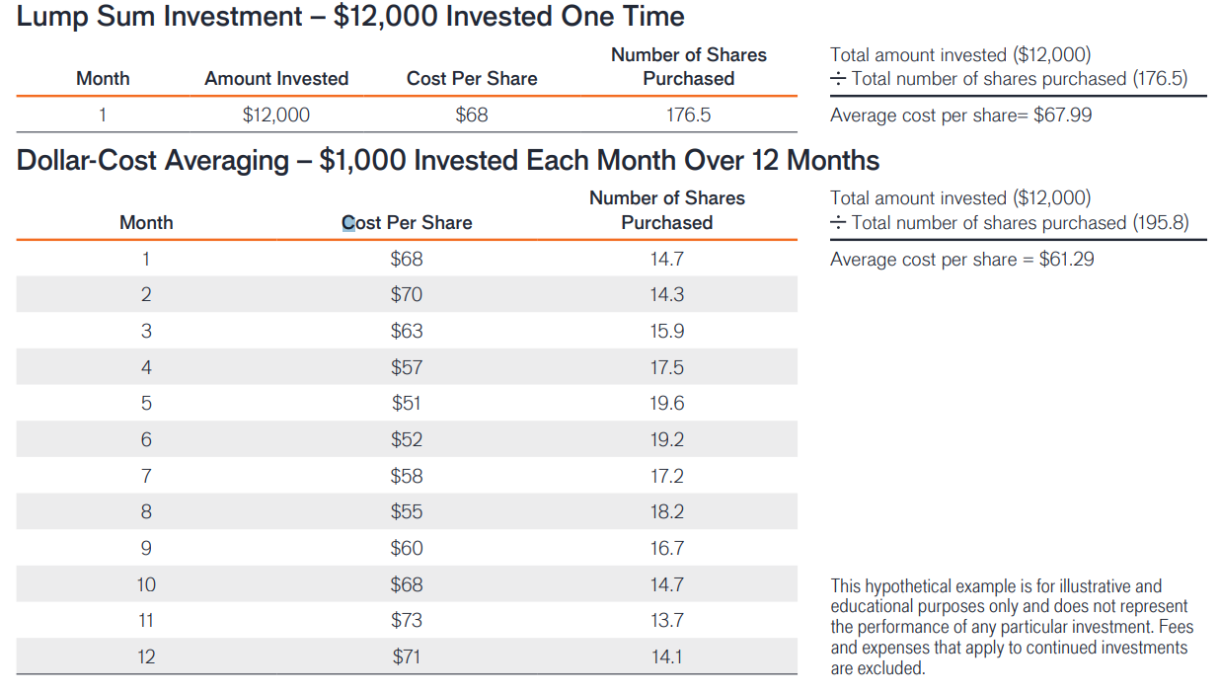
Financial planning strategies
Dollar cost averaging
A program of regular investing does not assure a profit or protect against depreciation in a declining market. Since a consistent investing program involves continuous investment in securities regardless of fluctuating prices, you should consider your financial ability to continue purchases through periods of various price levels.
Notes:
Weather its your Roth account, a traditional qualified account or an after-tax nonqualified account, dollar cost averaging is a wonderful way to create a disciplined investing strategy with small incremental investments.
This strategy will then help you build assets that can be used for future expenses associated with health care, education, and/or retirement. Along with that a dollar cost averaging helps you avoid having to decide the precise moment you should invest in the market. This helps us avoid the many behavioral and emotions problems that can get in the way us developing successful savings and investing plans.
As you can see, through this type of approach, at the end of the 12-month period where there was significant volatility, you end up with more shares and you will have paid a lower average share price for those shares. Furthermore, you’ve created a larger investment with lower tax ramifications just by systematically investing.

Slide 25
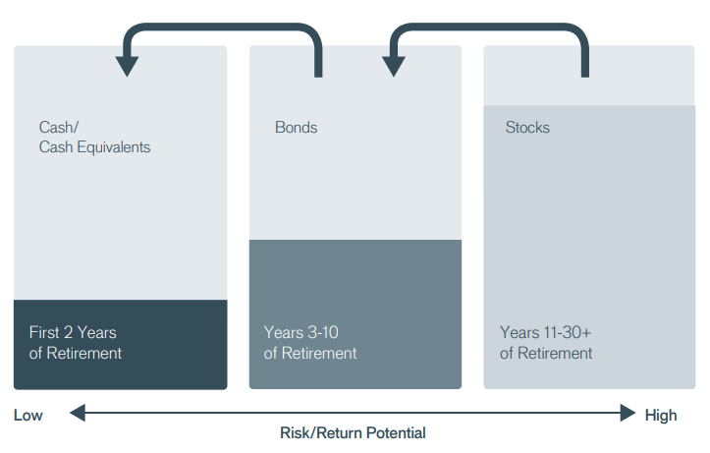
Financial planning strategies
If close to retirement, investors might use a bucket approach to help prepare for market shocks
The example provided is hypothetical and used for illustrative purposes only.
Notes:
One final idea that I want to leave you with is a way to put this into practice by using a bucketing approach.
This stems from the idea that many people in retirement, their time horizon may be 20 or 30 years, and creating a long-term investment strategy for such a long time horizon can be quite daunting. One of the challenges, of course, is on one hand keeping ample monies available or liquid, if you will, to meet today’s expenses while at the same time keeping a portion of one’s portfolio invested in growth orientated investments to make sure that your portfolio keeps pace with inflation.
So how do you do that? Well you take that 20 or 30 year time period and break it up into smaller periods. So, for the most near term period, that is for the next two years, we would suggest having cash available to help meet expenses for the next 24 months. Then for expenses that you are likely to incur in Years 3 through 10, we would suggest earmarking some of your more conservative investments to meet those needs. These investments are likely to include bonds. And then for Years 10 and after, we would suggest using your more aggressive investments, namely stocks, to meet these needs.
So the benefit, of course, is that over the next 24 months regardless of what happens in the markets, you have peace of mind that there is adequate liquidity available for your needs. At the same time, your stocks and other aggressive assets are working for you…earmarked for those expenses that are not going to occur for at least ten years or longer.
Overall what this allows you to do is in Years following positive market returns you are able to rebalance in order to refill your cash bucket. Alternatively, in years following negative market returns, you simply stay the course knowing that you have liquidity available as well as and if needed sufficient bonds to carry your cash flow from Years 3 through 10. In essence, it helps to avoid selling low and buying high or making bad decisions.

Slide 26
Thank You
“We don’t have to be smarter than the rest, we have to be more disciplined than the rest.”
– Warren Buffett
Notes:
Discipline is key in times like these. If you able to stay the course, you’ll be able to meet your goals.
Remember your long-term goals are not reached based on short term emotions.
So I hope that this has helped you view this period of time, while unprecedented, with a long-term lens; and that we’ve been able to give you some ideas on how to meet your goals.

Slide 27
Important Information
The opinions and views expressed are as of the date published and are subject to change. They are for information purposes only and should not be used or construed as an offer to sell, a solicitation of an offer to buy, or a recommendation to buy, sell or hold any security, investment strategy or market sector. No forecasts can be guaranteed. Opinions and examples are meant as an illustration of broader themes, are not an indication of trading intent and may not reflect the views of others in the organization. It is not intended to indicate or imply that any illustration/example mentioned is now or was ever held in any portfolio. Janus Henderson Group plc through its subsidiaries may manage investment products with a financial interest in securities mentioned herein and any comments should not be construed as a reflection on the past or future profitability. There is no guarantee that the information supplied is accurate, complete, or timely, nor are there any warranties with regards to the results obtained from its use. Past performance is no guarantee of future results. Investing involves risk, including the possible loss of principal and fluctuation of value.
The information contained herein is for educational purposes only and should not be construed as financial, legal or tax advice. Circumstances may change over time so it may be appropriate to evaluate strategy with the assistance of a financial professional. Federal and state laws and regulations are complex and subject to change. Laws of a particular state or laws that may be applicable to a particular situation may have an impact on the applicability, accuracy, or completeness of the information provided. Janus Henderson does not have information related to and does not review or verify particular financial or tax situations, and is not liable for use of, or any position taken in reliance on, such information.
Annuities are long-term investment vehicles designed to accumulate money on a tax-deferred basis for retirement purposes. They limit access to the investment as a result of a surrender charges and are subject to a 10% tax penalty on certain withdrawals. Riders are generally available for an additional charge. Variable annuities are subject to investment risk, and investment return and principal value will fluctuate.
Actively managed portfolios may fail to produce the intended results. No investment strategy can ensure a profit or eliminate the risk of loss.
10-Year Treasury Yield is the interest rate on U.S. Treasury bonds that will mature 10 years from the date of purchase.
Basis point (bp) equals 1/100 of a percentage point. 1 bp = 0.01%, 100 bps = 1%.
Volatility measures risk using the dispersion of returns for a given investment.
S&P 500® Index reflects U.S. large-cap equity performance and represents broad U.S. equity market performance.
Index performance does not reflect the expenses of managing a portfolio as an index is unmanaged and not available for direct investment.
A retirement account should be considered a long-term investment. Retirement accounts generally have expenses and account fees, which may impact the value of the account. Non-qualified withdrawals may be subject to taxes and penalties. For more detailed information about taxes, consult a tax attorney or accountant for advice.
Tax information contained herein is not intended or written to be used, and it cannot be used by taxpayers for the purposes of avoiding penalties that may be imposed on taxpayers. Such tax information and any estate planning information is general in nature, is provided for informational purposes only, and should not be construed as legal or tax advice.
In preparing this document, Janus Henderson has relied upon and assumed, without independent verification, the accuracy and completeness of all information available from public sources.
This material is for information purposes only. There is no guarantee that the information supplied is accurate, complete or timely, nor is there any warranty with regards to the results obtained from its use. This material may not be reproduced in whole or in part in any form, or referred to in any other publication, without express written permission.
Janus Henderson is a trademark of Janus Henderson Group plc or one of its subsidiaries. © Janus Henderson Group plc.
FOR MORE INFORMATION CONTACT JANUS HENDERSON INVESTORS 151 Detroit Street, Denver, CO 80206 | www.janushenderson.com
C-0323-48835 12-30-23 166-25-448835 04-23
Notes:
Since WWII, the S&P 500 finished the year down more than 20% only three times. 1972, 2002, and 2008. This year could be number 4. (But I'd still say we have time for a nice year-end bounce) The following year stocks gained 31.5%, 26.4%, and 23.5%.

