Slide 1
Social Security
Preparing for Retirement
mfs.com
NOT FDIC INSURED • MAY LOSE VALUE • NO BANK GUARANTEE
34853.15

Slide 2
This presentation is for informational use only. MFS does not provide tax, legal, accounting or Social Security advice. Contact the Social Security Administration at 1-800-772-1213 or www.ssa.gov to determine the benefits that may be available to participants and spouses. Participants should obtain and speak with an investment professional regarding tax and legal advice based on their particular circumstances.
MFS Fund Distributors, Inc. may have sponsored this seminar by paying for all or a portion of the associated costs. Such sponsorship may create a conflict of interest to the extent that the broker dealer's financial advisor considers the sponsorship when rendering advice to customers.
The views expressed in this presentation are those of MFS and are subject to change at any time. These views should not be relied upon as investment advice, as securities recommendations, or as an indication of trading intent on behalf of any other MFS investment product.
MFS Fund Distributors, Inc., Member SIPC, Boston, MA

Slide 3
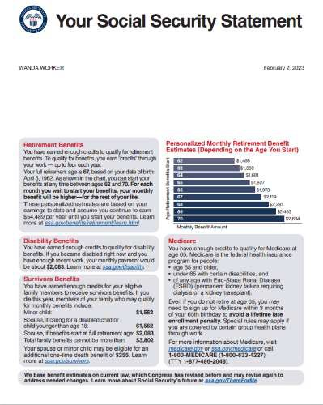
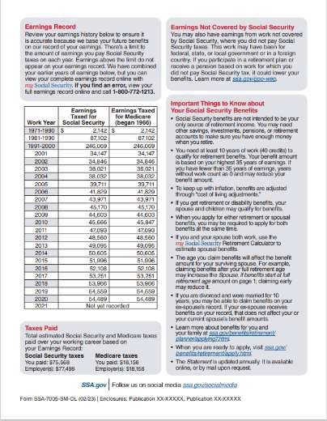
“Social Security benefits are not intended to be your only source of income when you retire.”
Source: ssa.gov, Sample Statement, 2023.
3

Slide 4
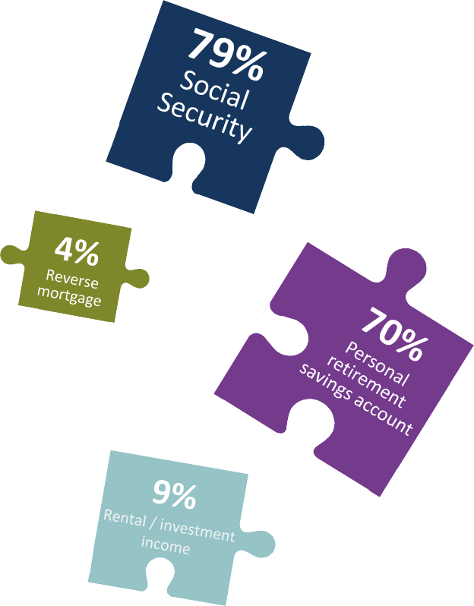
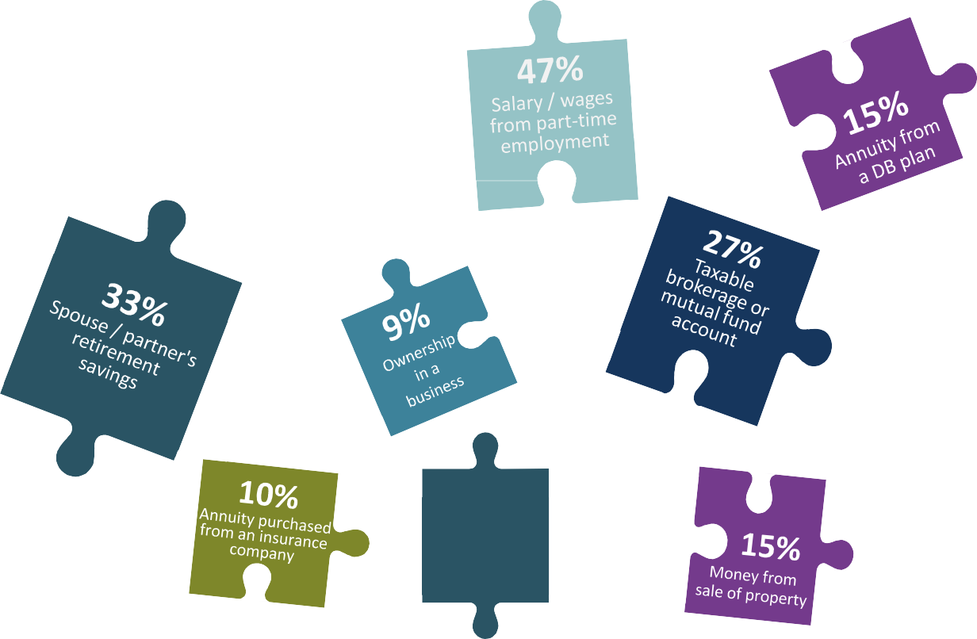
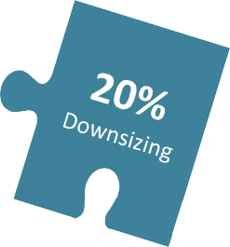
No “One-Size-Fits-All” Solution to the Retirement Income Puzzle
Potential Sources of Retirement Income
14%
Inheritance
Source: MFS 2024 Global Retirement Survey, US participants. Q: Select all potential sources of retirement income in retirement. This question was only posed to respondents age 45+. Respondents could choose more than one response so responses will not total to 100%. See slide 49 for survey methodology.

Slide 5
Agenda
How retirement benefits are calculated
Options for married couples and divorcees
Taxes and your retirement plan

Slide 6
How Retirement Benefits Are Calculated

Slide 7
Full Retirement Age
Year of Birth
Full Retirement Age (FRA)
1943-1954
66 years
1955
66 years and two months
Social Security benefits are based on your Full Retirement Age.
1956
66 years and four months
1957
66 years and six months
1958
66 years and eight months
1959
66 years and ten months
1960+
67 years
Source: Social Security Administration.

Slide 8
Retirement Benefits
40 quarters to qualify for Social Security retirement benefits, averaged over 35 highest years of earnings
Full Retirement Age 66 Full Retirement Age 67
+32.0%
+24.0%
+24.0%
+16.0%
+16.0%
+8.0%
+8.0%
100%
100%
-6.7%
-6.7%
-13.3%
-13.3%
-20.0%
-25.0%
-20.0%
-30.0%
-25.0%
62 63 64 65 66 67 68 69 70
62 63 64 65 66 67 68 69 70
Source: Social Security Administration.

Slide 9
Social Security Options While Working
Earnings limit affects your Social Security benefits (retirement, spousal, survivor, divorce) received before FRA
 | Through year before you reach Full Retirement Age | In the year you reach Full Retirement Age | Month you reach Full Retirement Age and older
Earnings Limit (2025) | $23,400 ($1,950 per month) | $62,160 ($5,180 per month) | No restrictions
Amount of Withholding | $1 of benefits withheld for every $2 of earnings above limit | $1 of benefits withheld for every $3 of earnings above limit | No restrictions
Earnings limit looks at gross wages only. Unearned income (pensions, IRAs, rental income, etc.) does not cause Social Security benefits to be withheld.
Earnings limit only affects gross wages received after you start Social Security.
If married, Social Security only considers the wages of the spouse receiving Social Security.
Source: Social Security Administration.

Slide 10
Retirement Benefits: Potential Options to Stop Social Security benefits
Before FRA
At/After FRA
Any age
GO BACK TO WORK
SUSPEND BENEFITS
WITHDRAW APPLICATION
Benefits will be temporarily withheld.*
Eight percent annual growth continues off current amount.
Cannot receive spousal
benefits nor can your spouse receive a spousal benefit off you.
Medicare premiums are paid out of pocket.
Must be done within first twelve months
Must repay everything (Social Security, taxes withheld, Medicare)
*If some of your retirement benefits are withheld because of your earnings, your monthly benefit will increase starting at your Full Retirement Age to take into account those months in which benefits were withheld.
Source: Social Security Administration.
10

Slide 11
Options for Married Couples and Divorcees

Slide 12
Spousal Benefits
Based on spouse’s FRA benefit, earnings test applies to spousal benefits until Full Retirement Age
Age When You Claim the Spousal Benefit
FRA 66 FRA 67
45.8%
50.0% _{45.8%}
50.0% 50.0%
35.0%
37.5% _{35.0%}
41.7% _{37.5%} 41.7%
32.5%
Age 62 Age 63
Age 64 Age 65
Age 66 Age 67
Calculation
Requirements
If both spouses worked
Amount is based on your spouse’s FRA benefit
Percent is based on your age when you receive the spousal benefit
Available even if you did not work
Your spouse must be receiving his or her retirement benefit
Receive greater of your retirement or spousal benefit.
Cannot start with spousal and switch to your own benefit*
*The option to start with the spousal benefit and then switch to your own retirement benefit was only available if you were born on or before 1/1/1954.
Source: Social Security Administration.
12

Slide 13
Calculating Spousal Benefits
Spousal benefits are based on higher earner’s benefit at Full Retirement Age
Diane and Jack
Diane is the higher earner
Jack’s retirement benefit is less than spousal benefit
Diane’s annual Social Security retirement benefit at
Age 62: $7,000
Age 67: $10,000
Age 70: $12,400
What is Jack's maximum and minimum spousal benefit?
For Illustrative purposes only. Based on Full Retirement Age (FRA) of 66. Calculations will vary if your FRA is different. Divorced spousal benefits are calculated in the same manner.
13

Slide 14
Calculating Spousal Benefit
Diane claims retirement benefit at Full Retirement Age of 67
$10,000
?
Diane's retirement benefit at age 67
Jack claims at age 67
For Illustrative purposes only. Based on Full Retirement Age (FRA) of 67. Calculations will vary if your FRA is different. Divorced spousal benefits are calculated in the same manner.
14

Slide 15
Calculating Spousal Benefit
Maximum spousal benefit at Full Retirement Age
$10,000
$5,000
?
Diane's retirement benefit at age 67
Jack claims at age 62
Jack claims at age 67
For Illustrative purposes only. Based on Full Retirement Age (FRA) of 67. Calculations will vary if your FRA is different. Divorced spousal benefits are calculated in the same manner.
15

Slide 16
Calculating Spousal Benefit
Minimum spousal benefit at age 62
$10,000
$5,000
$3,250
Diane's retirement benefit at age 67
Jack claims spousal at age 62
Jack claims spousal at age 67
For Illustrative purposes only. Based on Full Retirement Age (FRA) of 67. Calculations will vary if your FRA is different. Divorced spousal benefits are calculated in the same manner.
16

Slide 17
Calculating Spousal Benefit
If Diane claims at age 70
$12,400
$10,000
AGE 70
AGE 67
$5,000
$3,250
?
?
Diane's retirement benefit
Jack claims at age 62
Jack claims at age 67
For Illustrative purposes only. Based on Full Retirement Age (FRA) of 67. Calculations will vary if your FRA is different. Divorced spousal benefits are calculated in the same manner.
17

Slide 18
Calculating Spousal Benefit
Spousal benefit based on Diane’s benefit at Full Retirement Age
$12,400
$10,000
AGE 70
AGE 67
$5,000
$3,250
Diane's retirement benefit
Jack claims at age 62
Jack claims at age 67
For Illustrative purposes only. Based on Full Retirement Age (FRA) of 67. Calculations will vary if your FRA is different. Divorced spousal benefits are calculated in the same manner.
18

Slide 19
Calculating Spousal Benefit
If Diane claims at age 62
$12,400
$10,000
AGE 70
AGE 67
$7,000
AGE 62
$5,000
$3,250
?
?
Diane's retirement benefit
Jack claims at age 62
Jack claims at age 67
For Illustrative purposes only. Based on Full Retirement Age (FRA) of 67. Calculations will vary if your FRA is different. Divorced spousal benefits are calculated in the same manner.
19

Slide 20
Calculating Spousal Benefit
Spousal benefit based on Diane’s benefit at Full Retirement Age regardless of when Diane claims
Diane claims at 62
Diane claims at FRA
Diane claims at 70
$12,400
$10,000
AGE 70
AGE 67
$7,000
AGE 62
$5,000
$3,250
Diane's retirement benefit
Jack claims at age 62
Jack claims at age 67
For Illustrative purposes only. Based on Full Retirement Age (FRA) of 67. Calculations may vary if client's FRA is different. Divorced spousal benefits are calculated in the same manner.
20

Slide 21
What if Jack Applies First
Low earner starts with their retirement benefit, receives “top off” after spouse applies
WHEN YOU APPLY
Start with your own retirement benefit
WHEN SPOUSE APPLIES
Top off current amount with excess spousal benefit
TOTAL AMOUNT AFTER YOUR SPOUSE APPLIES
Current benefit + excess spousal benefit = total amount after spouse applies
Excess spousal benefit (spousal top off)*
Maximum spousal benefit at your FRA
Your retirement benefit at FRA
*If you are under FRA when your spouse applies, the excess spousal benefit will also be reduced.
21

Slide 22
Case Study: What if Jack Applies for His Benefit at 62
Diane and Jack
Jack retires at 62.
Jack’s retirement benefit 62: $1,400 Jack’s retirement benefit 67: $2,000
Diane is also 62 and plans to work until 67
Diane’s retirement benefit at 67: $10,000
What will Jack receive at age 62? When Diane applies?
For Illustrative purposes only. Based on Full Retirement Age (FRA) of 67. Calculations will vary if your FRA is different. Divorced spousal benefits are calculated in the same manner.
13

Slide 23
Case Study: What if Jack Applies for His Benefit at 62
Start with (reduced) retirement benefit; top off with excess spousal benefit when Diane applies
Jack applies at 62
Diane applies when
Jack is 67
After Diane applies
Jack’s retirement benefit at age 62 is …
Jack’s total amount is now …
Excess Spousal _{= $3,000*} Benefit (top-off)
 | Max Spousal _{$5,000} Benefit
 | Minus Jack’s retirement - $2,000 benefit at 67
$1,400
$4,400
$4,400z
*If Jack was under FRA when Diane applies, the excess spousal benefit (top off) would be reduced
This hypothetical example is for illustrative purposes only.
23

Slide 24
Survivor Benefits
Available at 60 (50 if you are disabled), earnings test applies to survivor benefits until Full Retirement Age
Age when you claim the survivor benefit
FRA 66 FRA 67
85.8% 83.7%
90.5% _{87.8%}
95.3% _{91.9%}
100.0% _{95.9%}
100.0%100.0%
71.5% 71.5%
76.3% 75.6%
81.0% 79.6%
Age 60
Age 61
Age 62
Age 63
Age 64
Age 65
Age 66
Age 67
Amount based on
Percentage based on
Age at which deceased claimed retirement benefit*
The greater the deceased’s benefit, the greater the survivor benefit
Age survivor claims the survivor benefit
If survivor claimed retirement or spousal before FRA: No impact. Survivor percentage based on when survivor claims the survivor benefit
*If deceased was receiving disability benefits, the survivor benefit is based on the deceased’s disability benefit. If deceased passed away without claiming, the survivor’s benefit is based
on the greater of the deceased’s FRA benefit or what the deceased would have been entitled to at death.
24

Slide 25
Case Study: Lower Earner Claims Their Benefit Before FRA
Lower earner still eligible for max survivor
Higher earner passes away
$3,125
Lower earner steps up to deceased’s benefit at death
$3,125
Higher earner receives
$3,125
$1,042
Lower earner receives
$1,042
65 66 67 68 69 70 71 72 73 74 75 76 77 78 79 80 81 82 83 84 85 86 87 88 89 90
Assumptions: Both spouses worked and paid into Social Security. Full Retirement Age for both spouses is 67. Lower earner is five years younger than higher earner. Higher earner claims at 70, lower earner claims at 65. Lower earner is 75 when the higher earner passes away. Higher earner’s retirement benefit at 67 is $2,500, retirement benefit at 70 is $3,125. Lower earner’s retirement benefit at 67 is $1,000. Lower earner’s calculation at 65: Lower earner applied after the high earner applied, therefore the lower earner receives an amount that
equals the higher of their reduced retirement benefit ($867) or the reduced spousal benefit ($1,042 = 41.7% x $2,500). Assumes no inflation or Cost-of-Living Adjustments (COLA).
25

Slide 26
Deceased’s Claiming Decision Affects the Surviving Spouse
Change the conversation from “me” to “we”
$70,000
Survivor benefits based on when deceased claimed their Social Security benefit
Average Earner Maximum Earner
$60,000
$60,000
$50,000
$48,000
$40,000
$40,000
$34,000
$30,000
$27,500
$23,000
$20,000
$10,000
$0
Deceased Claims at 62
Deceased Claims at FRA
Deceased Claims at 70
Source: Social Security Administration and MFS Calculations, 2024.
26

Slide 27
Options for Widow(er)s
May start with one benefit and switch; earnings limit applies to benefits received before Full Retirement Age.
Option 1
Start with reduced survivor benefit
Option 2
Start with reduced retirement benefit
Switch to retirement
Start with reduced survivor
Switch to survivor
Start with reduced retirement
Source: Social Security Administration.

Slide 28
Divorcee Benefits Available if Marriage Lasted 10+ Consecutive Years
Max spousal is 50%, max survivor is 100%
R E Q U I R E M E N T S
C U R R E N T M A R I TA L S TAT U S
I F YO U W O R K E D
Ex is age 62, dead or disabled
Ex does not need to be receiving their benefits (unless divorce was
< two years ago*)
Receiving a benefit off your ex will not reduce your ex’s benefit
Spousal off ex: unmarried
Survivor off ex: unmarried or remarried at or after age 60**
Receive the greater of your retirement or spousal/survivor benefit off ex***
Subject to earnings test until FRA
*If divorce was less than two years ago, former spouse needs to apply in order for you to receive a spousal benefit.
**50 if you are disabled.
***Spousal benefit: Only eligible to start with spousal benefit and switch to retirement benefit if you were born on/before 1/1/1954; Survivor benefits: May be eligible to start with one benefit and switch to the other.
Source: Social Security Administration.

Slide 29
Remarriage and Social Security (for Divorcees and Surviving Spouses)
If your former spouse remarries, it does not affect your benefits
Former Spouse Remarries
You Remarry Before Age 60*
You Remarry After Age 60*
Does not dilute your benefits off former spouse
Forfeit spousal benefit off ex Forfeit survivor benefit off ex
Forfeit spousal benefit off ex Keep survivor benefit off ex**
If your second marriage ends (either through divorce, annulment or death),
you may become re-entitled to benefits off of the first marriage regardless of your age when you remarry.
*50 if you are disabled.
**If you remarry at or after age 60 (50 if you are disabled), you may receive greater of (1) spousal/survivor benefit of current spouse, (2) your retirement benefit or (3) survivor benefit of former spouse.
Source: Social Security Administration.
29

Slide 30
Case Study: Divorce and Remarriage
If both marriages ended after 10+ years, you receive highest available benefit
Married Tom at 25
Married 15 years
Divorced
Tom is deceased
Jane
Tom
Jane is single, receives greater of
Her retirement benefit
Survivor from Tom
Spousal/survivor from Theo
Married Theo at 45
Married 10 years
Divorced
Theo is alive and is age 62
Jane
Theo
This hypothetical example is for illustrative purposes only.
30

Slide 31
Case Study: Divorce and Remarriage
If both marriages ended after 10+ years, you receive highest available benefit
Married Spouse A at 25
Married 15 years
Divorced
Kris
Spouse A
Kris is single, receives greater of
Kris’ retirement benefit
Survivor from Spouse A
Spousal/survivor from Spouse B
Spouse A is deceased
Married Spouse B at 45
Married 10 years
Divorced
Spouse B is alive and is age 62
Kris Spouse B
This hypothetical example is for illustrative purposes only.
31

Slide 32
Taxes and Your Retirement Plan

Slide 33
Taxes and Social Security
 | Social Security benefits are not taxable | Up to 50% of Social Security Benefits May Be Taxable | Up to 85% of Social Security Benefits May Be Taxable
Individuals | < $25,000 | $25,000 ̶ $34,000 | $34,001+
Married Couples Filing Jointly | < $32,000 | $32,000 ̶ $44,000 | $44,001+
Source: IRS INFO 2001-0131.
33

Slide 34
Combined Income Determines if Social Security Benefits Are Taxable
AGI
Tax- Exempt Income
Half of Social Security
Combined Income
This is not all-encompassing. May include income from savings bonds to pay for higher education and deductions for qualified educational loans. Contact a qualified tax advisor for more information. MFS does not provide tax advice. For informational purposes only.
Source: Social Security Administration.
34

Slide 35
Taking Social Security at 70 versus 62 may Reduce Taxes
Federal taxes for married couple, age 71, after-tax income goal of $75,000
 | Begin Social Security at age 62 | Begin Social Security at age 70
Annual Social Security benefit | $30,545 | $51,160
Withdrawal from tax-deferred account | $48,722 | $24,103
Combined income¹ | $63,995 | $49,683
Taxable Social Security | $22,995 | $10,831
AGI² | $71,717 | $34,931
Taxable income after standard deduction³ | $41,017 | $2,634
Federal income taxes | $4,482 | $263
¹Modified AGI + Tax-exempt income + half of Social Security.
²Withdrawal from tax-deferred account plus taxable portion of Social Security.
³Standard deduction in 2024 is $29,200 per couple; additional deduction for joint filer 65 and over is $1,550 per person, for a total of $3,100 if both joint filers are age 65+. Sources: Social Security Administration, IRS and MFS Calculations.
Social Security benefits based on worker with average lifetime earnings of $66,000
This situation is hypothetical in nature and for informational use only. Every situation is different. MFS does not provide tax advice.
35

Slide 36
Combined Income Exclusions
Nontaxable portion of pensions
and annuities*
Roth IRA and Roth 401(k)/403(b)*
Qualified charitable distributions*
HSA withdrawals for qualified medical expenses**
Life insurance proceeds**
Inheritance and gifts**
Sources: *IRS Publication 590-B. ** IRS Publication 525. This may not be a comprehensive list.
MFS does not provide tax, legal, retirement, Social Security, or accounting advice. Please consult with a qualified tax advisor for more information.
36

Slide 37
Questions to Consider
Discuss claiming options and the impact it will have on your retirement income goals with your investment professional
Guidelines to Claim Social Security and Minimize Longevity Risk
How long will you work?
What are your income needs in retirement?
If single: What is your life expectancy?
If married: Who has the higher benefit?
Single
Average life expectancy: take when needed
Long life expectancy: let Social Security grow as long as possible
Married
Spouse with lower Social Security benefit begins as soon as possible
Spouse with higher Social Security benefits maximizes benefits as much as possible
MFS does not provide tax, legal, retirement, Social Security or accounting advice.
37

Slide 38
Get More From Social Security
If single
In peak earnings year, consider working for longer, as your higher earning years will replace your lower earning ones
If married
Encourage the spouse with the highest benefit to let it grow in order to maximize the survivor benefit
If divorced
If you were married for 10 years or longer, you may qualify for benefits off your ex-spouse(s)
If widowed
Check to see if you can start with one benefit ̶ yours or the survivor ̶ then switch to the other
For more information and answers to many questions about Social Security benefits, go to ssa.gov. For help determining what role Social Security benefits will play in your financial future,
work closely with your investment or other relevant professional.
38

Slide 39
Social Security Fairness Act

Slide 40
Social Security Fairness Act (SSFA)
Increases Social Security benefits for people with a non-covered pension
Non-covered pension: pension paid by employer that does not withhold Social Security taxes.
What it does
Some state and local government employees
Teachers, firefighters, police officers, first responders
Social Security coverage varies
Who does it help
Federal employees covered by Civil Service Retirement System
People whose work had been covered by a foreign social security system
Source: Congressional Research Service, “Social Coverage of State and Local Government Employees”, March 19, 2024.
The right to alter, amend or repeal any provision of the Social Security Act is reserved to Congress. 42 U.S. Code Section 1304.
40

Slide 41
SSFA Eliminated Two Provisions That Reduced Social Security Benefits
Windfall Elimination Provision (WEP)
Government Pension Offset (GPO)
You had
one job that did not pay into Social Security
another job that did pay into Social Security
You worked in a federal, state or local government position that didn’t pay into Social Security
Your spouse worked in the private sector
Example: Public school teacher, spouse works in private sector
Social Security spousal/survivor benefits off your spouse
May have eliminated spousal and survivor benefits
Who it affected
Example: Firefighter who worked in the private sector on their days off
Your Social Security retirement or disability benefit
What was reduced
Max reduction in 2024: $587.00/month
Source: Social Security Administration.

Slide 42
Social Security Fairness Act
Higher benefits, retroactive to January of 2024
Repealed WEP
Repealed GPO
Retroactive benefits
Higher monthly retirement benefits
Higher spousal and survivor benefits
Retroactive benefits payable for January 2024 and later
Source: Social Security Administration.

Slide 43
WEP and GPO
WEP Adjustment: Maximum reduction based on year you turned 62
Year you turned 62 | Max reduction to retirement and disability benefits
2024 | $587.00
2023 | $557.50
2022 | $512.00
2021 | $498.00
2019 | $463.00
GPO: Sample Offset Amounts
Non-covered government pension | Offset to Social Security spousal and survivor benefits
$1,500 | $1,000
$3,000 | $2,000
$4,500 | $3,000
$6,000 | $4,500
WEP reduced your retirement and disability benefits
GPO reduced spousal and survivor benefits by two-thirds of the non-covered government pension
Source: Social Security Administration.

Slide 44
Case Studies
Teacher with non-covered pension,
tutored in the summers
Before: WEP reduced Social Security retirement benefit
Now: Social Security retirement is not reduced
Teacher with non-covered pension, spouse worked in the
private sector
Before: GPO reduced spousal and survivor benefits by 2/3 of the government pension
Now: May be eligible for spousal or survivor benefit for the first time
Teacher with non-covered pension, tutored in the summers; spouse worked in the private sector
Before: received higher of retirement benefit (reduced by WEP) or spousal/ survivor (reduced by GPO)*
Now: receives higher of retirement or spousal/survivor benefit
Teacher with non-covered pension,
Never married
No change. Not eligible for Social Security
*Technically the teacher received the retirement benefit reduced by WEP. That was topped off with an excess spousal or survivor benefit that was reduced by GPO.
44

Slide 45
Thank You!

Slide 46
Appendix

Slide 47
Calculating Survivor benefits
Deceased’s claiming decision impacts the survivor benefit
Deceased's claiming decision
Survivor benefit based on
Claimed at or after Full Retirement Age
Amount deceased was receiving at death
Passed away before Full Retirement Age, did not claim Social Security
Deceased's benefit at Full Retirement Age
Passed away at or after Full Retirement Age, did not claim
Amount deceased was entitled to receive at death (includes credits)
Social Security
Claimed before Full Retirement Age
Widow(er) limit may apply*
Under the widow(er) limit, the surviving spouse receives the lesser of 1) the widow(er) percentage based off the deceased’s FRA benefit or 2) the greater of the benefit the deceased was receiving at death or 82.5% of the deceased’s FRA benefit.
41

Slide 48
Medicare Part B and D premiums
Monthly Premiums
Medicare Part B and D premiums for 2025
Individual tax return in 2023 < $106,000 | Joint tax return in 2023 < $212,000 | PART B Premium per person | PART D Premium per person
 |  | $185.00 | Plan premium
$106,001–$133,000 | $212,001–$266,000 | $259.00 | $13.70 + plan premium
$133,001–$167,000 | $266,001–$334,000 | $370.00 | $35.30 + plan premium
$167,001–$200,000 | $334,001–$400,000 | $480.90 | $57.00 + plan premium
$200,001–$499,999 | $400,001–$749,999 | $591.90 | $78.60 + plan premium
$500,000+ | $750,000+ | $628.90 | $85.80 + plan premium
PREMIUMS BASED ON MAGI FROM TWO YEARS AGO
Source: Medicare.gov, “Costs” www.medicare.gov/basics/costs/medicare-costs.
48

Slide 49
Taking Social Security at 70 versus 62 may Reduce Taxes
Federal taxes for married couple, age 71, after-tax income goal of $75,000
 | Begin Social Security at age 62 | Begin Social Security at age 70
Annual Social Security benefit | $40,344 | $67,572
Withdrawal from tax-deferred account | $36,809 | $7,428
Combined income¹ | $56,981 | $41,214
Taxable Social Security | $17,034 | $4,607
AGI² | $53,843 | $12,035
Taxable income after standard deduction³ | $21,543 | $0
Federal income taxes | $2,154 | $0
¹Modified AGI + Tax-exempt income + half of Social Security.
²Withdrawal from tax-deferred account plus taxable portion of Social Security.
³Standard deduction in 2024 is $29,200 per couple; additional deduction for joint filer 65 and over is $1,550 per person, for a total of $3,100 if both joint filers are age 65+. Sources: Social Security Administration, IRS and MFS Calculations.
Social Security benefits based on worker with average lifetime earnings of $105,000.
This situation is hypothetical in nature and for informational use only. Every situation is different. MFS does not provide tax advice.
49

Slide 50
Disability Benefits
 | SSDI Social Security Disability Trust Fund | SSI Supplement Social Insurance
Initial Qualifications | Based on your work history (If 31 or older when disability occurred: Generally must have worked 5 out of the last 10 years) | Must have limited income and resources.
Full Retirement Age | At Full Retirement Age: Amount does not change Funding switches from Disability to Retirement | Assuming assets, income and life circumstances do not change, then dollar amount will not change
Dependent Eligibility | Entitles children and spouse to Social Security benefits | Does not entitle children and spouse to Social Security benefits
Health insurance | Medicare after two years | Medicaid
Sources: www.ssa.gov/redbook/eng/overview-disability.htm#&a0=2.
Social Security Handbook 723.2, Social Security Publication No. 05-10029, "Disability Benefits".
50

Slide 51
Eligibility for Family Benefits
QUALIFYING EVENT
CHILDREN QUALIFICATION
CHILD-IN-CARE SPOUSE/ WIDOW(ER) QUALIFICATIONS*
Disablement
Retirement
Death
Unmarried
Younger than age 18
Or 18 to 19 years old and a full- time student (no higher than grade 12)
Caring for child who is under age 16 or disabled
Benefits end if child-in-care spouse/widow(er) remarries
Or 18 or older and disabled (disability must have started before age 22)

Slide 52
Maximum Family Benefits*
Children’s Benefit Up to 50% of disability benefit | Child-in-Care Spousal / Widow(er) Benefit | Family Maximum
 | Up to 50% of disability benefit | 100% – 150% of worker’s PIA
Up to 50% of full retirement benefit | Up to 50% of full retirement benefit | 150% – 180% of worker’s PIA
Up to 75% of deceased parent’s basic Social Security benefit | Up to 75% of deceased parent’s basic Social Security benefit | 150% – 180% of worker’s PIA
If parent is disabled
If parent is retired
If parent is deceased
If total amount payable to all family members exceeds family maximum limit, each person’s benefit is reduced proportionately (except retired/disabled parent’s benefit) until total equals family maximum.

Slide 53
Survey Methodology
A U D I E N C E
M E T H O D O L O G Y
Participants/Members
Retirees
Mode: 15 min. online survey
MFS not revealed as the sponsor
Field period: March 28 – April 13, 2024
Ages 18+, employed at least part-time
Active workplace retirement plan participants / members in the US, Canada, UK, and Australia.*
Data weighted to mirror the age / gender distribution of the workforce in each country.
Fully or partially retired (if 73+ must have retired within last 6 years)
Must have had a workplace DC or DB retirement plan
GLOBAL INSIGHTS FROM OVER 4,000 GLOBAL RESPONDENTS
Including 2,800+ Workplace Defined Contribution Retirement Plan / Scheme Members & 1,200+ Retirees
C A N A D A
U K
703 Members
303 Retirees
701 Members
303 Retirees
U S A
A U S T R A L I A
725 Participants
310 Retirees
703 Members
306 Retirees
*To qualify in each region:
US Participants: actively contributing to a 401(k), 403(b), 457, or 401(a) | US Retirees: had a 401(k), 403(b), 457, or 401(a), DB plan, or SEP/Simple IRA.
Canada Participants: actively contributing to DC Pension Plan, Group Registered Retirement Savings Plan, Deferred Profit Sharing Plan, Non-Registered Group Savings Plan, or Simplified Employee Pension Plan | Canada Retirees: had a DC Pension Plan, Group Registered Retirement Savings Plan, Deferred Profit Sharing Plan, Non-Registered Group Savings Plan, or Simplified Employee Pension Plan, or DB plan.
UK Members: actively contributing to a Defined Contribution Scheme or Master Trust | UK Retirees: had a Defined Contribution Scheme, Master Trust, or DB plan
Australia Members: actively contributing to an industry, retail, corporate or public sector super fund or a self-managed super fund | Australia Retirees: had an industry, retail, corporate or public sector super fund, a self-managed super fund, or a DB plan.
53

Slide 54
WEP Adjustment: Maximum reduction based on year you turned 62
WEP reduced your retirement and disability benefits
Year you turned 62 Max reduction to retirement and disability benefits
2024 | $587.00
2023 | $557.50
2022 | $512.00
2021 | $498.00
2019 | $463.00
GPO: Sample Offset Amounts
GPO reduced spousal and survivor benefits by two-thirds of the non-covered government pension
Offset to Social Security spousal and survivor benefits
$1000
$2000
$3000
$4500
Non-covered government pension
$1500
$3000
$4500
$6000
54

