Slide 1
Emotions, expectations and economics®
Not FDIC Insured | May Lose Value | No Bank Guarantee

Slide 2
Are emotions affecting your investment decisions?
Average Annual Total Returns
10-Year Period Ended 12/31/23
12.03%
8.47%
S&P 500 Index
Average Equity Investor Return
This chart is for illustrative purposes only and does not reflect the performance of any Franklin Templeton fund.
Source: “2024 QAIB Report,” DALBAR, Inc. www.dalbar.com. An index is unmanaged. It does not reflect any fees, expenses or sales charges. One cannot invest directly in an index. Past performance does not guarantee future results.
2

Slide 3
Agenda
Emotions
Expectations
Economics
Investors should carefully consider a fund’s investment goals, risks, charges and expenses before investing. To obtain a summary prospectus and/or prospectus, which contains this and other information, talk to your financial professional, call us at (800) 342-5236, or visit franklintempleton.com. Please read a prospectus carefully before you invest or send money.
3

Slide 4
Emotions

Slide 5
Fear
Investors tend to be influenced more by the prospect of loss than by the opportunity for gain¹
Good investors may be exceptionally skilled at suppressing emotional reactions²
Source: Journal of Marketing Research. “The Boundaries of Loss Aversion.” May 1, 2005.
Source: The Wall Street Journal. wsj.com. “Lessons From The Brain-Damaged Investor.” July 21, 2005.

Slide 6
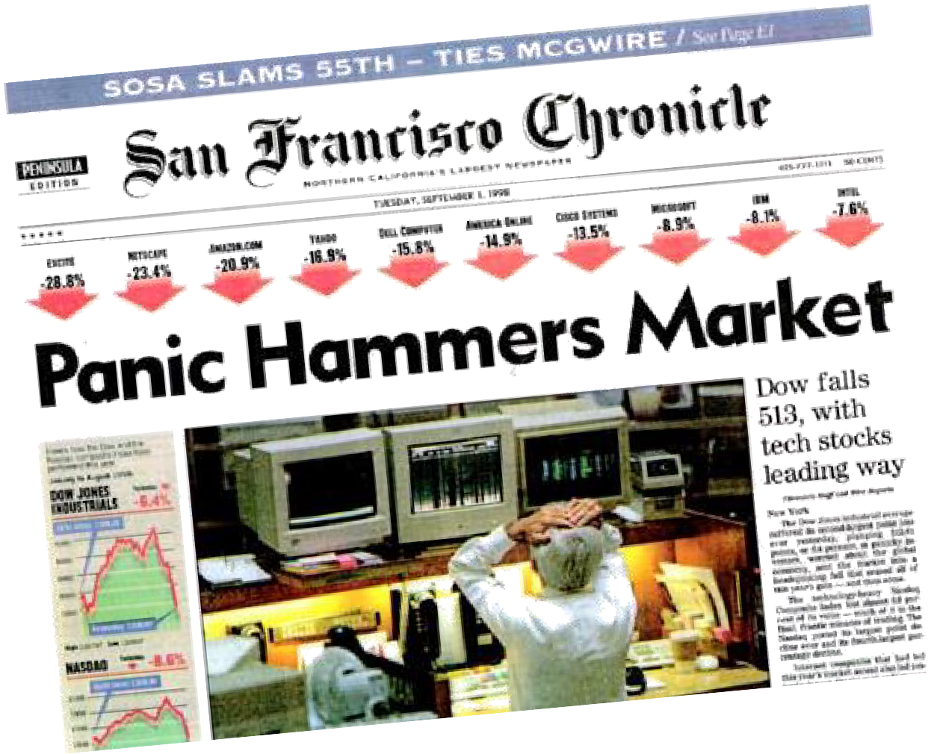
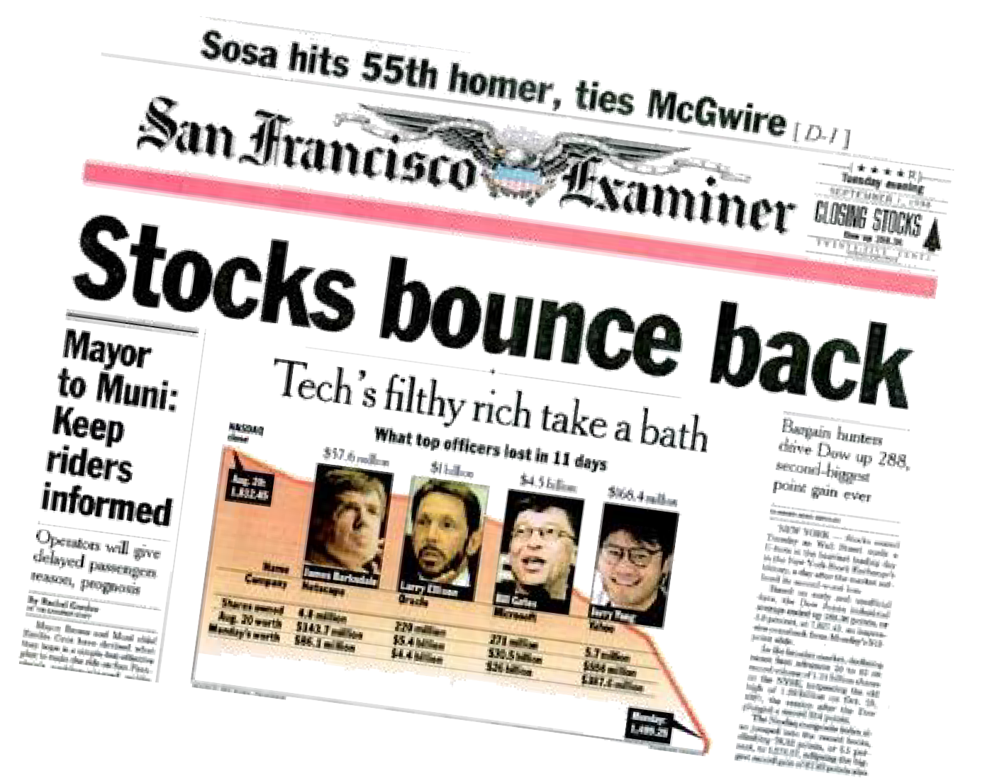
The old media
September 1, 1998
Tuesday morning
September 1, 1998
Tuesday evening

Slide 7
Newer media
US stocks plummet on coronavirus fears CNN Business – March 9, 2020
Stocks swing wildly and close higher CNN Business – March 10, 2020
Stocks Plunge, with Dow in Bear Market New York Times – March 11, 2020
Dow Plunges 2,300 Points: Stocks in Meltdown As Panic Selling Continues NPR – March 12, 2020
Major indices jump 9% in monster rally – but traders expect more ‘uneasiness’ next week Fortune – March 13, 2020

Slide 8
Market timing
20-year period ended 12/31/23
Period of Investment | S&P 500 Average Annual Total Return
If you stayed fully invested | 9.69%
If you missed the 10 best days | 5.50%
If you missed the 20 best days | 2.84%
If you missed the 30 best days | 0.70%
If you missed the 40 best days | -1.18%
This chart is for illustrative purposes only and does not reflect the performance of any Franklin Templeton fund.
Source: ©2024 Morningstar. All rights reserved. Based on returns of the S&P 500 Index over the 20-year period ended 12/31/23. The index is unmanaged and includes reinvested dividends. It does not reflect any fees, expenses or sales charges. One cannot invest directly in an index.
8

Slide 9
Expectations

Slide 10
Bull markets
Investors tend to forget stocks’ historical risks and rewards
Investor optimism often distorts expectations
“This time it’s different”

Slide 11
Bear markets in the last 50 years
Based on the Dow Jones Industrial Average
Bear Market | Decline | Months
January 1973–December 1974 | -45.1% | 23
September 1976–February 1978 | -26.9% | 17
September 1978–April 1980 | -16.4% | 19
April 1981–August 1982 | -24.1% | 16
November 1983–July 1984 | -15.6% | 8
August 1987–October 1987 | -36.1% | 2
July 1990–October 1990 | -21.2% | 3
July 1998–August 1998 | -19.3% | 2
January 2000–September 2001 | -29.7% | 21
March 2002–October 2002 | -31.5% | 7
October 2007–March 2009 | -53.8% | 17
April 2011–October 2011 | -16.8% | 5
May 2015–February 2016 | -14.5% | 9
February 2020–March 2020 | -37.1% | 1
This chart is for illustrative purposes only and does not reflect the performance of any Franklin Templeton fund.
Source: Ned Davis Research, as of 12/31/22. Figures based on the Dow Jones Industrial Average, which comprises 30 large capitalization stocks. Indexes are unmanaged and include reinvested dividends; one cannot invest directly in an index. Past performance does not guarantee future results.

Slide 12
“Bull markets are born on
pessimism, grow on skepticism, mature on optimism and die
on euphoria.”
SIR JOHN TEMPLETON

Slide 13
The optimist
Assumes the market can only go up
Thinks stocks are the only way to go
Expects double-digit annual returns from stocks

Slide 14
Optimist’s view of the market
Dow Jones Industrial Average (3/6/2009–12/31/19)
28,645
6,627
Mar 2009
Mar 2010
Mar 2011
Mar 2012
Mar 2013
Mar 2014
Mar 2015
Mar 2016
Mar 2017
Mar 2018
Mar 2019
This chart is for illustrative purposes only and does not reflect the performance of any Franklin Templeton fund.
Source: Dow Jones & Company. The Dow Jones Industrial Average comprises 30 large capitalization stocks. Indexes are unmanaged, and one cannot directly invest in an index. Past performance does not guarantee future results.

Slide 15
Optimist’s potential fall
Dow Jones Industrial Average¹
Average annual total returns
19.35%
11.18%
35-year period ended 12/31/23
‘90s Bull Market² (10/11/90–7/17/98)
This chart is for illustrative purposes only and does not reflect the performance of any Franklin Templeton fund.
Source: © 2024 Bloomberg. The Dow Jones Industrial Average (DJIA) comprises 30 large capitalization stocks. Total returns include reinvested dividends. Indexes are unmanaged and one cannot invest directly in an index.
A bull market requires a 30% rise in the DJIA after 50 calendar days or a 13% rise after 155 calendar days. Reversals of 30% in the Value Line Geometric Index, an equally weighted price index of the approximately 1,700 stocks covered in the Value Line Investment Survey, also qualify.
Past performance does not guarantee future results.

Slide 16
The skeptic
Assumes the market will stay flat
Thinks bonds are the only way to go
Often handcuffed by indecision

Slide 17
Skeptic’s view of the market
Dow Jones Industrial Average (9/1/67–8/31/82)
901
901
Sep | Sep | Sep | Sep | Sep | Sep | Sep | Sep | Sep | Sep | Sep | Sep | Sep | Sep | Sep
1967 | 1968 | 1969 | 1970 | 1971 | 1972 | 1973 | 1974 | 1975 | 1976 | 1977 | 1978 | 1979 | 1980 | 1981
This chart is for illustrative purposes only and does not reflect the performance of any Franklin Templeton fund.
Source: Dow Jones & Company. The Dow Jones Industrial Average comprises 30 large capitalization stocks. Indexes are unmanaged, and one cannot invest directly in an index. Past performance does not guarantee future results.

Slide 18
Missed opportunity
Stocks and bonds—relative performance in rolling 5- and 10-year periods since 1975
 | 5-Year Rolling Periods | 10-Year Rolling Periods
Dow Jones Industrial Average (DJIA) Outperformed Bloomberg Barclays US Aggregate Index | 34 | 35
Bloomberg Barclays US Aggregate Index Outperformed DJIA | 10 | 4
% of Periods DJIA Outperformed Bloomberg Barclays US Aggregate Index | 77% | 90%
Average Annual Returns | Stocks | Bonds
12/31/1975–12/31/2023 | 11.64% | 6.61%
All investments involve risks, including possible loss of principal. Stock prices fluctuate, sometimes rapidly and dramatically, due to factors affecting individual companies, particular industries or sectors, or general market conditions. Bond prices generally move in the opposite direction of interest rates. As interest rates rise, bond prices often decline.
This chart is for illustrative purposes only and does not reflect the performance of any Franklin Templeton fund.
Source: © 2024 Morningstar. Stocks are represented by the Dow Jones Industrial Average. Bonds are represented by the Bloomberg Barclays US Aggregate Index. All rights reserved. See www.franklintempletondatasources.com for additional data provider information. Indexes are unmanaged and total returns include reinvestment of dividends or interest. One cannot invest directly in an index. Past
performance does not guarantee future results.

Slide 19
The pessimist
Thinks the stock market is too much of a gamble
Thinks bonds may be better, but even they fluctuate in value
Believes CDs are the only sure way to go

Slide 20
Insurance and a fixed interest rate
Certificates of Deposit (CDs) and savings accounts are currently FDIC-insured for up to $250,000. They offer a fixed interest rate for a fixed period of time.
The principal amount invested is fixed
Interest and principal invested are unaffected by daily market or interest-rate movements
Since markets fluctuate, a mutual fund’s investment return and principal value will change with market conditions so that your shares, when sold, may be worth more or less than their original cost.

Slide 21
NEW Pessimist’s view of the market
Dow Jones Industrial Average (12/31/99–9/30/02)
11,497
7,592
Dec 1999 Mar 2000 Jun 2000 Sep 2000 Dec 2000 Mar 2001 Jun 2001 Sep 2001 Dec 2001 Mar 2002 Jun 2002 Sep 2002
Source: Dow Jones & Company. The Dow Jones Industrial Average comprises 30 large capitalization stocks. Indexes are unmanaged, and one cannot directly invest in an index. Past performance does not guarantee future results.
21

Slide 22
Missed opportunity
A different type of risk
1-Year CD returns and inflation-adjusted returns
2014-2023
3%
2%
1%
0%
-1%
-2%
-3%
-4%
-5%
-6%
-7%
-8%
2014
2015
2016 2017
1-Year CD Return
2018
2019 2020
Inflation-Adjusted Return
2021
2022
2023
Source: Federal Reserve Economic Data. CD returns are based on a 1-year CD purchased at the national average rate in the week including January 1 and held to maturity. Inflation-adjusted returns reflect the impact of inflation as reported by the Bureau of Labor Statistics for each calendar year.

Slide 23
The bottom line
Optimist
Skeptic
Pessimist

Slide 24
Economics

Slide 25
Hypothetical asset allocation portfolios
Stocks
100%
Stocks
Bonds
Stocks
Bonds
20%
Aggressive Growth
Moderate Growth
40%
Growth
60%
80%
Stocks
Cash equivalent
Stocks _{20%}
Cash equivalent
20%
20%
40%
Conservative Growth
Income
40%
Bonds Bonds
60%
Diversification does not guarantee a profit or protect against a loss.
Stocks represented by Standard & Poor’s 500 Index (S&P 500); bonds by long-term US government bonds and cash equivalents by US Treasury bills. Indexes are unmanaged and include reinvested dividends or interest. They do not include fees, expenses or sales charges. One cannot invest directly in an index.
These five asset allocation portfolios are for Illustrative purposes only, and do not represent any Franklin Templeton fund. A financial professional can help in selecting an asset allocation plan designed for you, They offer market knowledge and planning expertise, and will take into account your specific investment needs to create an investment strategy tailored to your specific investment goals and risk tolerance.
Past performance does not guarantee future results.
25

Slide 26
1930s: The great depression
Growth of a $1,000 investment (1/1/30–12/31/39)
$1,500
$1,464
$1,387
$1,366
$1,192
Income
Conservative Growth
Moderate Growth
Growth
Growth of a $1,000 Investment¹ (1/1/30–12/31/39)
$1,000
$995
Aggressive Growth
$500
$0
1930 1931 1932 1933 1934 1935 1936 1937 1938 1939
This chart is for illustrative purposes only and does not reflect the performance of any Franklin Templeton fund.
Source: © 2022 Morningstar. Stocks represented by Standard & Poor’s 500 Index (S&P 500); bonds by long-term US government bonds and cash equivalents by US Treasury bills. Indexes are unmanaged and include reinvested dividends or interest. They do not include fees, expenses or sales charges. One cannot invest directly in an index. Indexes are unmanaged and include reinvested dividends or interest. They do not include fees, expenses or sales charges. One cannot invest
directly in an index. Portfolios are rebalanced annually. See www.franklintempletondatasources.com for additional data provider information. Past performance does not guarantee future results.
26

Slide 27
1940s: An economy spurred by war
Growth of a $1,000 investment (1/1/40–12/31/49)
$2,500
$2,405
Aggressive Growth
$2,185
Growth
$2,000
$1,970
Moderate Growth
$1,673
$1,483
Conservative Growth
$1,500
Income
$1,000
$500
1940 1941 1942 1943 1944 1945 1946 1947 1948 1949
This chart is for illustrative purposes only and does not reflect the performance of any Franklin Templeton fund.
Source: © 2022 Morningstar. Stocks represented by Standard & Poor’s 500 Index (S&P 500); bonds by long-term US government bonds and cash equivalents by US Treasury bills. Indexes are unmanaged and include reinvested dividends or interest. They do not include fees, expenses or sales charges. One cannot invest directly in an index. Indexes are unmanaged and include reinvested dividends or interest. They do not include fees, expenses or sales charges. One cannot invest directly in an index. Portfolios are rebalanced annually. See www.franklintempletondatasources.com for additional data provider information. Past performance
does not guarantee future results.
27

Slide 28
1950s: The Eisenhower years
Growth of a $1,000 investment (1/1/50–12/31/59)
$6,000
$5,865
Aggressive Growth
$4,309
Growth
$4,000
$3,100
Moderate Growth
$2,258
Conservative Growth
$2,000
$1,550
Income
$0
1950
1951
1952
1953
1954
1955
1956
1957
1958
1959
This chart is for illustrative purposes only and does not reflect the performance of any Franklin Templeton fund.
Source: © 2022 Morningstar. Stocks represented by Standard & Poor’s 500 Index (S&P 500); bonds by long-term US government bonds and cash equivalents by US Treasury bills. Indexes are unmanaged and include reinvested dividends or interest. They do not include fees, expenses or sales charges. One cannot invest directly in an index. Indexes are unmanaged and include reinvested dividends or interest. They do not include fees, expenses or sales charges. One cannot invest directly in an index. Portfolios are rebalanced annually. See www.franklintempletondatasources.com for additional data provider information. Past performance does not guarantee future results.

Slide 29
1960s: Conformity gives way to social revolution
Growth of a $1,000 investment (1/1/60–12/31/69)
$3,000
$2,121
$1,920
$1,720
$1,595
$1,401
Aggressive Growth
Growth
Moderate Growth
Conservative Growth
Income
$2,000
$1,000
$0
1960
1961
1962
1963
1964
1965
1966
1967
1968
1969
This chart is for illustrative purposes only and does not reflect the performance of any Franklin Templeton fund.
Source: © 2022 Morningstar. Stocks represented by Standard & Poor’s 500 Index (S&P 500); bonds by long-term US government bonds and cash equivalents by US Treasury bills. Indexes are unmanaged and include reinvested dividends or interest. They do not include fees, expenses or sales charges. One cannot invest directly in an index. Indexes are unmanaged and include reinvested dividends or interest. They do not include fees, expenses or sales charges. One cannot invest directly in an index. Portfolios are rebalanced annually. See www.franklintempletondatasources.com for additional data provider information. Past performance does not guarantee future results.

Slide 30
1970s: Energy crisis sparks economic crisis
Growth of a $1,000 investment (1/1/70–12/31/79)
$2,000
$1,825
$1,802
$1,795
$1,793
$1,769
Conservative Growth
Moderate Growth
Growth
Income
Aggressive Growth
$1,500
$1,000
$500
$0
1970
1971
1972
1973
1974
1975
1976
1977
1978
1979
This chart is for illustrative purposes only and does not reflect the performance of any Franklin Templeton fund.
Source: © 2022 Morningstar. Stocks represented by Standard & Poor’s 500 Index (S&P 500); bonds by long-term US government bonds and cash equivalents by US Treasury bills. Indexes are unmanaged and include reinvested dividends or interest. They do not include fees, expenses or sales charges. One cannot invest directly in an index. Indexes are unmanaged and include reinvested dividends or interest. They do not include fees, expenses or sales charges. One cannot invest directly in an index. Portfolios are rebalanced annually. See www.franklintempletondatasources.com for additional data provider information. Past performance does not guarantee future results.

Slide 31
1980s: Reaganomics
Growth of a $1,000 investment (1/1/80–12/31/89)
$6,000
$5,038
$4,695
$4,345
$3,754
$3,432
Aggressive Growth
Growth
Moderate Growth
Conservative Growth
Income
$4,000
$2,000
$0
1980
1981
1982
1983
1984
1985
1986
1987
1988
1989
This chart is for illustrative purposes only and does not reflect the performance of any Franklin Templeton fund.
Source: © 2022 Morningstar. Stocks represented by Standard & Poor’s 500 Index (S&P 500); bonds by long-term US government bonds and cash equivalents by US Treasury bills. Indexes are unmanaged and include reinvested dividends or interest. They do not include fees, expenses or sales charges. One cannot invest directly in an index. Indexes are unmanaged and include reinvested dividends or interest. They do not include fees, expenses or sales charges. One cannot invest directly in an index. Portfolios are rebalanced annually. See www.franklintempletondatasources.com for additional data provider information. Past performance does not guarantee future results.

Slide 32
1990s: Longest bull market in history
Growth of a $1,000 investment (1/1/90–12/31/99)
$6,000
$5,328
Aggressive Growth
$4,581
Growth
$4,000
$3,912
Moderate Growth
$3,109
$2,616
Conservative Growth
Income
$2,000
$0
1990
1991
1992
1993
1994
1995
1996
1997
1998
1999
This chart is for illustrative purposes only and does not reflect the performance of any Franklin Templeton fund.
Source: © 2022 Morningstar. Stocks represented by Standard & Poor’s 500 Index (S&P 500); bonds by long-term US government bonds and cash equivalents by US Treasury bills. Indexes are unmanaged and include reinvested dividends or interest. They do not include fees, expenses or sales charges. One cannot invest directly in an index. Indexes are unmanaged and include reinvested dividends or interest. They do not include fees, expenses or sales charges. One cannot invest directly in an index. Portfolios are rebalanced annually. See www.franklintempletondatasources.com for additional data provider information. Past performance does not guarantee future results.

Slide 33
2000s: The new millennium
Growth of a $1,000 investment (1/1/00–12/31/09)
$2,000
$1,738
$1,513
$1,433
Income
Conservative Growth
Moderate Growth
$1,170
Growth
$1,000
$909
Aggressive Growth
$0
2000
2001
2002
2003
2004
2005
2006
2007
2008
2009
This chart is for illustrative purposes only and does not reflect the performance of any Franklin Templeton fund.
Source: © 2022 Morningstar. Stocks represented by Standard & Poor’s 500 Index (S&P 500); bonds by long-term US government bonds and cash equivalents by US Treasury bills. Indexes are unmanaged and include reinvested dividends or interest. They do not include fees, expenses or sales charges. One cannot invest directly in an index. Indexes are unmanaged and include reinvested dividends or interest. They do not include fees, expenses or sales charges. One cannot invest directly in an index. Portfolios are rebalanced annually. See www.franklintempletondatasources.com for additional data provider information. Past performance does not guarantee future results.

Slide 34
2010s: The iGeneration
Growth of a $1,000 investment (1/1/10–12/31/19)
$4,000
 | $3,567 | Aggressive Growth
 | $3,217 | Growth
 | $2,871 | Moderate Growth
$3,000
$2,261
$1,979
Conservative Growth
$2,000
Income
$1,000
$0
2010
2011
2012
2013
2014
2015
2016
2017
2018
2019
This chart is for illustrative purposes only and does not reflect the performance of any Franklin Templeton fund.
Source: © 2022 Morningstar. Stocks represented by Standard & Poor’s 500 Index (S&P 500); bonds by long-term US government bonds and cash equivalents by US Treasury bills. Indexes are unmanaged and include reinvested dividends or interest. They do not include fees, expenses or sales charges. One cannot invest directly in an index. Indexes are unmanaged and include reinvested dividends or interest. They do not include fees, expenses or sales charges. One cannot invest directly in an index. Portfolios are rebalanced annually. See www.franklintempletondatasources.com for additional data provider information. Past performance does not guarantee future results.

Slide 35
2020s: A new normal
Growth of a $1,000 investment (1/1/20–12/31/23)
$1,600
$1,500
$1,400
$1,300
$1,331
Aggressive Growth
$1,200
$1,192
$1,063
$1,021
$902
Growth
$1,100
Moderate Growth
$1,000
Conservative Growth
Income
$900
$800
2020 2021 2022 2023
This chart is for illustrative purposes only and does not reflect the performance of any Franklin Templeton fund.
Source: © 2024 Morningstar. Stocks represented by Standard & Poor’s 500 Index (S&P 500); bonds by long-term US government bonds and cash equivalents by US Treasury bills. Indexes are unmanaged and include reinvested dividends or interest. They do not include fees, expenses or sales charges. One cannot invest directly in an index. Indexes are unmanaged and include reinvested dividends or interest. They do not include fees, expenses or sales charges. One cannot invest directly in an index. Portfolios are rebalanced annually. See www.franklintempletondatasources.com for additional data provider information. Past performance does not guarantee future results.
35

Slide 36
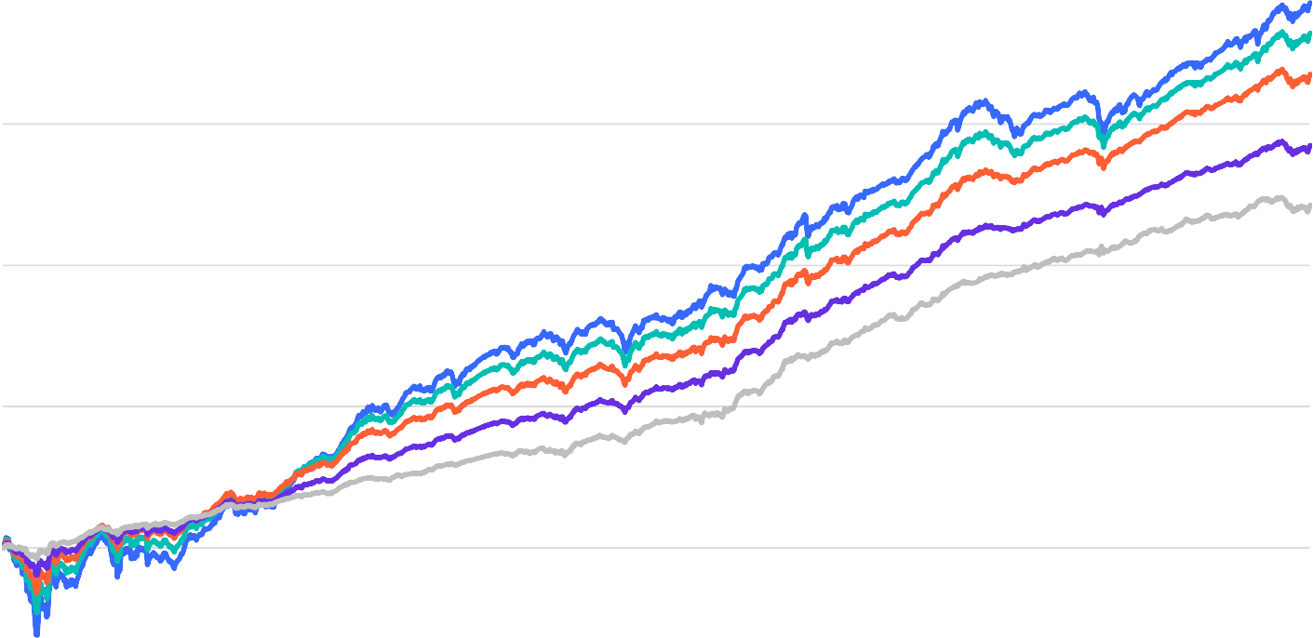
Key to long-term planning
Growth of a $1,000 investment (1/1/30–12/31/23)
$10,000,000
$7,217,051
$4,403,794
$2,256,770
$708,327
$266,857
Aggressive Growth
Growth
Moderate Growth
Conservative Growth
Income
$1,000,000
$100,000
$10,000
$1,000
$100
1930 1940 1950 1960 1970 1980 1990 2000 2010 2023
This chart is for illustrative purposes only and does not reflect the performance of any Franklin Templeton fund.
Source: © 2024 Morningstar. Stocks represented by Standard & Poor’s 500 Index (S&P 500); bonds by long-term US government bonds and cash equivalents by US Treasury bills. Indexes are unmanaged and include reinvested dividends or interest. They do not include fees, expenses or sales charges. One cannot invest directly in an index. Indexes are unmanaged and include reinvested dividends or interest. They do not include fees, expenses or sales charges. One cannot invest directly in an index. Portfolios are rebalanced annually. See www.franklintempletondatasources.com for additional data provider information. Past performance does not guarantee future results.
2020

Slide 37
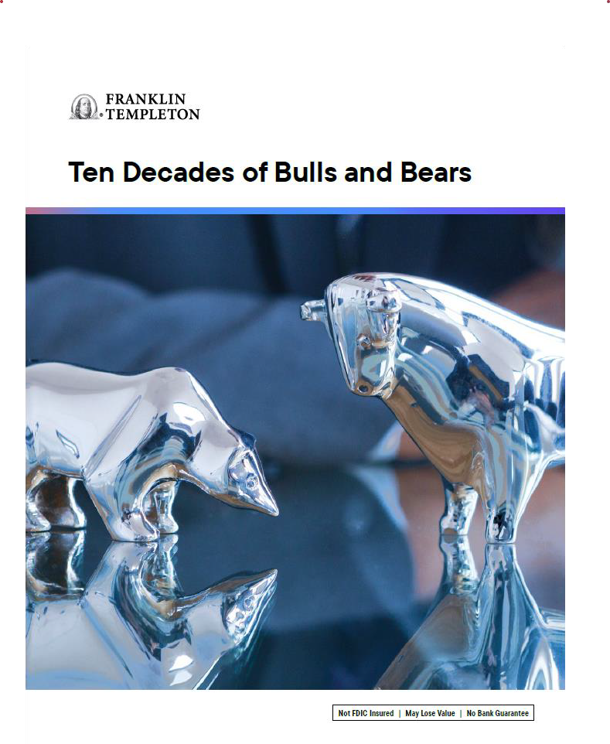
Investment tools
Talk to your financial professional to learn more about these tools
Ten Decades of Bulls and Bears
Why diversify? Because winners rotate.
Brochure
Flyer

Slide 38
Review
Emotions
Impact investors’ decisions
Expectations
Unrealistic expectations may lead to disappointment
Economics
Is it different this time?

Slide 39
5 steps you should take now
1
Make an appointment to see your financial professional.
2
Review your financial plan to determine if your portfolio matches your risk tolerance.
3
Understand the rationale for your investment strategy, plan and choices.
4
Set realistic performance expectations.
5
Discuss how to prepare yourself financially and mentally during
times of market decline.

Slide 40
Determining your financial goals—a comfortable retirement, a college education for the kids, a new home—may not be too complicated, but developing an appropriate asset allocation plan designed to help you meet those goals can be. Working with a financial professional can help. They offer market knowledge and planning expertise, and will take into account your individual investment needs to create a strategy tailored to your specific goals and risk tolerance.
The content in this presentation is general in nature and intended for educational purposes only; it should not be considered tax, legal or investment advice or an investment recommendation. Consult your financial professional for personalized advice that is tailored to your specific goals, individual situation, and risk tolerance.
Investors should carefully consider a fund’s investment goals, risks, charges and expenses before investing. To obtain a summary prospectus and/or prospectus, which contains this and other information, talk to your financial professional, call us at (800) 342-5236, or visit franklintempleton.com. Please read a prospectus carefully before you invest or send money.
(800) 342-5236
© 2024 Franklin Distributors, LLC. Member FINRA/SIPC. All rights reserved.
EEE-SEM-12-23

