Slide 1
An Investor’s Guide to Navigating the Markets

Slide 2
Agenda
Markets and volatility
Time, not timing
Strategies and tactics to consider for today and tomorrow
2

Slide 3
Markets and volatility

Slide 4
A new decade of investing
Stock market performance
S&P 500 Index Daily Closing
January 2019 – December 2023
6000
5000
4000
3000
2000
1000
0
Source: Federal Reserve Economic Data, fred.stlouisfed.org. Data reflects January 2, 2019 – December 29, 2023. Shaded areas reflect market corrections and bear markets.

Slide 5
Volatility
Market correction v. bear market
Market Correction
Drop in stock prices of 10% or greater from their most recent peak
Bear Market
Drop in stock prices by 20% or more
13 bear markets since World War II
Average decline: 32.9%
Average length: approximately 18.6 months
Most recent: January 2022 to October 2022
31 market corrections since World War II
Average decline: 14.3%
Average time to recover: 4.1 months
Most recent: September 2018 to December 2018
Source: Giles, Margaret. What’s the Difference Between a Bear Market and a Correction? Morningstar, Inc. May 2022.

Slide 6
Volatility: Inflation
U.S. Inflation Rate
January 1, 2019 – December 31, 2023
10%
9%
8%
7%
6%
5%
4%
3%
2%
1%
0%
Inflation Rate
Source: Bloomberg, as of December 31, 2023. and Rateinflation.com

Slide 7
Volatility: Interest rates
10-Year Treasury Yield
% January 2019 – December 2023
6.00
5.00
4.00
3.00
2.00
1.00
0.00
Source: US Department of the Treasury; Data reflects January 2, 2019 – December 29, 2023.

Slide 8
Volatility: Bond market performance
7-10 Year Corporate Index
January 2019 – December 2023
700
650
600
550
3/6/20 – 3/20/20
-15.6% change
8/2/21 – 10/20/22
-22.9% change
500
450
400
Source: Federal Reserve Economic Data, fred.stlouisfed.org. Data reflects time period: January 1, 2019 – December 31, 2023

Slide 9
Time, not timing

Slide 10
Time in the market, not timing the market
Value of a hypothetical $10,000 investment in the S&P 500® index from 1999 – 2022
$35,000
$33,099
$30,000
$25,000
$20,000
$15,164
$15,000
$10,000
$8,900
$5,625
$5,000
$3,721
$0
Continually Invested
Missed 10 Best Days
Missed 20 Best Days
Missed 30 Best Days
Missed 40 Best Days
Note: Past performance is no guarantee of future results.
Investing involves risk, including the possible loss of principal and fluctuation of value.
S&P 500® Index reflects U.S. large-cap equity performance and represents broad U.S. equity market performance. Index performance does not reflect the expenses of managing a portfolio as an index is unmanaged and not available for direct investment.
Source: FactSet Research Systems, Inc. from 1/1/99 - 12/31/22. The example provided is hypothetical and used for illustration purposes only. It does not represent the returns of any particular investment.

Slide 11
S&P 500’s best days often come near the worst
A majority of the best and worst days happened during the same time period
Global Financial Crisis 2008
Daily Return %
Covid-19 Crisis 2020
+11%
September 2008 |  |  |  |  |  | October 2008
Mo | Tu | We | Th | Fr |  | Mo | Tu | We | Th | Fr
1 | 2 | 3 | 4 | 5 |  |  |  | 1 | 2 | 3
8 | 9 | 10 | 11 | 12 |  | 6 | 7 | 8 | 9 | 10
15 | 16 | 17 | 18 | 19 |  | 13 | 14 | 15 | 16 | 17
22 | 23 | 24 | 25 | 26 |  | 20 | 21 | 22 | 23 | 24
29 | 30 |  |  |  |  | 27 | 28 | 29 | 30 | 31
November 2008 |  |  |  |  |  | December 2008
Mo | Tu | We | Th | Fr |  | Mo | Tu | We | Th | Fr
 |  |  |  |  |  | 1 | 2 | 3 | 4 | 5
3 | 4 | 5 | 6 | 7 |  | 8 | 9 | 10 | 11 | 12
10 | 11 | 12 | 13 | 14 |  | 15 | 16 | 17 | 18 | 19
17 | 18 | 19 | 20 | 21 |  | 22 | 23 | 24 | 25 | 26
24 | 25 | 26 | 27 | 28 |  | 29 | 30 | 31
February 2020 |  |  |  |  |  | March 2020
Mo | Tu | We | Th | Fr |  | Mo | Tu | We | Th | Fr
 |  |  |  |  |  | 2 | 3 | 4 | 5 | 6
3 | 4 | 5 | 6 | 7 |  | 9 | 10 | 11 | 12 | 13
10 | 11 | 12 | 13 | 14 |  | 16 | 17 | 18 | 19 | 20
17 | 18 | 19 | 20 | 21 |  | 23 | 24 | 25 | 26 | 27
24 | 25 | 26 | 27 | 28 |  | 30 | 31
April 2020
Mo | Tu | We | Th | Fr
 |  | 1 | 2 | 3
6 | 7 | 8 | 9 | 10
13 | 14 | 15 | 16 | 17
20 | 21 | 22 | 23 | 24
27 | 28 | 29 | 30
+2%
-2%
-12%
Source: Bloomberg, as of 7 January 2022.
Notes:
S&P 500 Total Return Index, daily returns.
Past performance is no guarantee of future results.

Slide 12
Staying invested during volatile times
What has the impact of each of the following been on the likelihood that your clients will remain invested in a portfolio allocation that aligns with their financial goals?
Insured guaranteed income
51%
41%
8% 0%
9% 1%
Education
49%
41%
Insured downside protection
48%
41%
10% 1%
10% 2%
Reassurance, encouragement
45%
43%
Options strategies
45%
41%
11%
3%
Bucketing (risk assets for longer term goals)
44%
44%
11% 1%
Other
9%
9%
7%
75%
Significant impact
Moderate impact
No impact
Do not use
Source: 2023 Financial Advisor Survey – Retirement and Annuities: Product, Perceptions and Practices. Insured Retirement Institute.

Slide 13
Strategies and tactics to consider for today and tomorrow

Slide 14
Discussing and owning annuities
Are your clients generally more open to discussing annuities now as compared to when you first became a financial advisor?
Do you believe your clients who have owned annuities for five years or longer are financially better off for having invested in annuities?
8%
1%
3%
9%
91%
Yes No Don't know
88%
Yes No Don't know
Source: 2023 Financial Advisor Survey – Retirement and Annuities: Product, Perceptions and Practices. Insured Retirement Institute. ”Trends in Retirement Income Practices, Products and Perceptions – 2015 Financial Advisor Survey,” (IRI, 2015)

Slide 15
Discussing and owning annuities
Are you more likely or less likely to use downside protection with annuities now versus when you started in this business?
Are you more likely or less likely to use guarantee income from annuities now versus when you started in this business?
1%
1%
24%
23%
12%
63%
12%
64%
More likely
No change, have always used
Less likely
No change, do not use
More likely
No change, have always used
Less likely
No change, do not use
Source: 2023 Financial Advisor Survey – Retirement and Annuities: Product, Perceptions and Practices. Insured Retirement Institute. ”Trends in Retirement Income Practices, Products and Perceptions – 2015 Financial Advisor Survey,” (IRI, 2015)

Slide 16
Themes and select findings
Advisors and Annuities Advisor attitudes toward/use of annuities
Believe their clients are more open to
Clients and Annuities
Impact of annuities on clients
Growth Opportunities Factors that can drive growth in annuities
Say more generous free withdrawals
91% annuities than when they began working as advisors.
92% h^{B}as^{eliev}elph ^{e g}ed^{uar}ht ^{an}eir^{teed}enicl ^{lif}ts^{eti}main^{me in}aint^{come} their investment allocations through volatile periods.
84% (e.g., 10% versus interest only) would increase their use of fixed and fixed indexed annuities.
_{82% a}Sa_{nd}y _{s}m_{mplei}ore ge_{producr} nerous_{ts}liv_{w}ing_{ould}benefits increase variable annuity sales.
70%+
View variable, fixed, and fixed indexed annuities favorably.
89% h^{B}elp^{eliev}ed^{e}th^{do}eir^{wn}clien^{side}ts^{pr}main^{otect}aint^{ion} th^{has}rei investment allocations through volatile periods.
64% lifetime^{Are mor}in^{e} co^{likel}me^{y t}thº an^{use}w^{an}enh ^{nu}th^{iti}ey^{es}b^{fo}eg^{r} an working as advisors.
88% an^{Bel}n^{i}u^{ev}tiesi ^{e th}fo^{eir}r ^{cl}veif ^{ien}o^{ts}r mo^{wh}re^{o o}years^{wn} are financially better off.
82%
Say an easier purchasing experience would increase their use of fee-based annuities.
63% dow^{Are m}sn ºide^{re l}prote^{ikely} c^{to}iont ^{use}hant ^{ann}w^{ui}hen^{ties} they^{for} began working as advisors.
51%
Believe their clients who own annuities are more comfortable spending money in retirement.
81% in^{Sa}co^{y t}me^{he} b^{ad}en^{d}efits^{ition} w^{of}ou^{life}dl ^{ti}inmecrease their use of RILAs.
Source: 2023 Financial Advisor Survey – Retirement and Annuities: Product, Perceptions and Practices. Insured Retirement Institute.

Slide 17
Important aspects of variable annuities
How important are each of the following characteristics of variable annuities for your clients?
Living benefits 5%1%
60%
34%
Tax deferral
56%
38%
6%
Low cost
53%
36%
10% 1%
Investment ratings
53%
40%
5% 2%
Death benefits
53%
39%
7% 1%
Historic returns
51%
39%
9% 1%
Very Important
Somewhat Important
Not Important
DK/Do Not Use
Source: 2023 Financial Advisor Survey – Retirement and Annuities: Product, Perceptions and Practices. Insured Retirement Institute.

Slide 18
Important aspects of FIA and fixed annuities
How important are each of the following characteristics of fixed and fixed indexed annuities (FIA) for your clients?
Living benefits 5%1%
60%
34%
Death benefits
54%
38%
8%
Brand Recognition
53%
39%
7% 1%
Highest Rates/Caps
52%
40%
7% 1%
Renewal rate history
52%
39%
7% 2%
Generous free w/d (e.g., 10% v. interest only)
52%
39%
7% 2%
Very Important
Somewhat Important
Not Important
DK/Do Not Use
Source: 2023 Financial Advisor Survey – Retirement and Annuities: Product, Perceptions and Practices. Insured Retirement Institute.

Slide 19
Important aspects of RILAs
How important are each of the following characteristics of registered index-linked annuities (RILAs) for your clients?
Living benefits
57%
37%
6%
Range of strategies
54%
40%
6%
Death benefits
54%
37%
8% 1%
9% 1%
9% 1%
8% 2%
Brand Recognition
50%
40%
Highest cap/par rates
49%
41%
Renewal Rate history
48%
42%
No explicit cost
45%
41%
11%
3%
Very Important Somewhat Important Not Important DK/Do Not Use
Source: 2023 Financial Advisor Survey – Retirement and Annuities: Product, Perceptions and Practices. Insured Retirement Institute.

Slide 20
Re-evaluation of the 4% spending rule
Historical context
A 4% starting withdrawal rate, with annual adjustments for inflation, has long been considered a good “rule of thumb” to help set expectations about generating retirement income
In 2021, researchers from Morningstar conducted an analysis to determine forward-looking sustainable withdrawal rates
Using a Monte Carlo success rate of 90%, the researchers concluded that the rule of thumb should be adjusted downward to 3.3%
In 2022, Morningstar revised their analysis to account for lower market valuations and concluded that a safe withdrawal rate is 3.8%
Source: Benz, C., Ptak, J., & Rekenthaler, J. “The state of retirement income.” Morningstar, December 12, 2022.

Slide 21
Safe withdrawal rate research from Morningstar
Projected starting safe withdrawal rates, by asset allocation and time horizon
Equity weighting % | 10 years | 15 years | 20 years | 25 years | 30 years |  |  | 35 years | 40 years
100 | 8.5 | 5.9 | 4.7 | 3.9 | 3.5 |  |  | 3.3 | 3.1
90 | 8.7 | 6.1 | 4.9 | 4.0 | 3.6 |  |  | 3.3 | 3.1
80 70 60 | 8.9 9.1 9.3 | 6.2 6.3 6.5 | 4.9 5.1 5.2 | 4.1 4.2 4.3 | 3.7 3.7 |  |  | 3.3 3.4 3.4 | 3.1 3.2 3.2
 |  |  |  |  |  | 3.8
50 | 9.5 | 6.6 | 5.2 | 4.3 |  | 3.8 |  | 3.4 | 3.2
40 | 9.6 | 6.7 | 5.3 | 4.4 |  | 3.8 |  | 3.4 | 3.2
30 | 9.7 | 6.7 | 5.3 | 4.3 |  | 3.8 |  | 3.4 | 3.1
20 | 9.7 | 6.7 | 5.2 | 4.3 | 3.7 |  |  | 3.3 | 3.0
10 | 9.7 | 6.6 | 5.1 | 4.1 | 3.5 |  |  | 3.1 | 2.8
0 | 9.4 | 6.4 | 4.8 | 3.9 | 3.3 |  |  | 2.9 | 2.6
Source: Benz, C., Ptak, J., & Rekenthaler, J. “The state of retirement income.” Morningstar, December 12, 2022.

Slide 22
Re-evaluation of the 4% spending rule
Higher withdrawal rates may be possible using a flexible approach
01
Forgo inflation adjustments: no inflation adjustments following years in which the portfolio declined in value
In addition
to a base-case scenario, five other methods were analyzed
02
Required minimum distribution (RMD): annual distributions using life expectancy tables
03
Guardrails method: using the rules suggested by Jonathon Guyton and William Klinger, withdrawals are adjusted upwards following good years and downwards following bad years
04
Spending reduction following losing years: withdrawals are reduced by 10% following down years, and return to previous levels once the portfolio generates a positive return
05
Inflation haircut: Inflation adjustments are 1% less than the actual inflation rate
Source: Benz, C., Ptak, J., & Rekenthaler, J. “The state of retirement income.” Morningstar, December 12, 2022.

Slide 23
Safe withdrawal rate research from Morningstar
Flexible withdrawal rate summary using a 50% stock/50% bond portfolio
Method | Starting safe withdrawal rate | Lifetime withdrawal rate | Year 30 cash flow standard deviation % | Median year 30 ending value ($M)
Best case – no flexibility | 3.8 | 3.8 | 0.0 | 1.9
Forgoing inflation adjustment | 4.4 | 4.0 | 6.4 | 1.6
RMD | 4.4 | 5.4 | 50.0 | 0.2
Guardrails method | 5.3 | 4.8 | 35.2 | 0.8
Spending reduction following losing years | 4.0 | 3.9 | 6.9 | 1.8
Inflation haircut | 4.3 | 3.7 | 0.0 | 1.9
Source: Benz, C., Ptak, J., & Rekenthaler, J. “The state of retirement income.” Morningstar, December 12, 2022.

Slide 24
Capital market assumptions
Consider using two sets of capital market assumptions:
One for shorter-term periods that addresses the current market environment (i.e., years one through 10)
One for longer-term periods (i.e., years 10 and beyond)
Ensure the capital market assumptions reflect arithmetic returns and not geometric returns
To ensure the analysis is net of fees, reduce the capital market return assumptions as appropriate
Source: Blanchett, D. Into the unknown: Rethinking retirement return assumption. ThinkAdvisor, December 21, 2021.

Slide 25
Life expectancy assumptions
While the gender life expectancy gap can be as high as five years at birth, men who survive to age 65 have a life expectancy that is only about 2.5 years shorter than 65-year-old women
The life expectancy gender gap also shrinks as income rises; men in the top 5th percentile of lifetime income have a life expectancy that is about 1.5 years shorter compared to high-income women at age 65
Source: Blanchett, D., & Finke, M. About that 5-year gender longevity gap. ThinkAdvisor, September 30, 2022.

Slide 26
Financial planning strategies
Review and update your goals
To be better off than my peers
To pay for personal self-improvement (e.g., go back to school)
To experience the excitement of investing
To start a new business
To buy a house
To help pay my kids’ college education
To stop working and do something I love
To go on a dream vacation
To relocate in retirement
To care for my aging parents
To give to charity or other causes I care about
To feel secure about my finances in retirement
To feel secure about my finances now
To leave an inheritance to my loved ones
To retire early
To pay for future medical expenses
To not be a financial burden to my family as I grow older
Source: Morningstar, Inc.

Slide 27
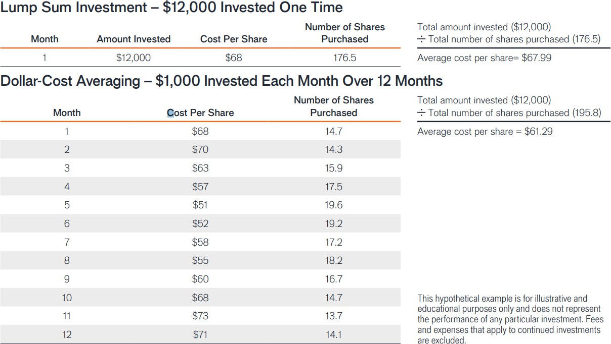
Financial planning strategies
Dollar cost averaging
A program of regular investing does not assure a profit or protect against depreciation in a declining market. Since a consistent investing program involves continuous investment in securities regardless of fluctuating prices, you should consider your financial ability to continue purchases through periods of various price levels.

Slide 28
Financial regrets
Top financial regrets and what we can learn from them
57%
of respondents regretted not having saved more
40%
regretted not buying long term care insurance
33%
regretted not having purchased lifetime income payments
75%
of respondents who do not have a plan report high negative stress
2X
Regret increased by 2x when given information about longevity
Source: Financial Regret at Older Ages and Longevity Awareness, Hurwitz, A., Mitchell, O. December 2022

Slide 29
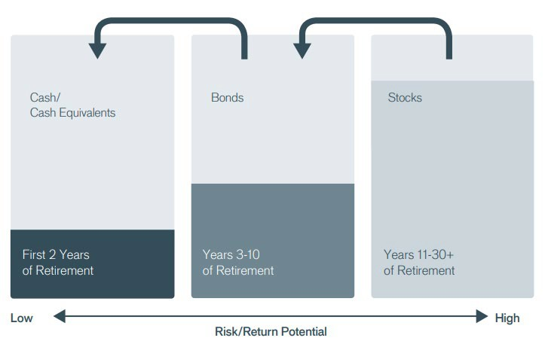
Financial planning strategies
If close to retirement, investors might use a bucket approach to help prepare for market shocks
The example provided is hypothetical and used for illustrative purposes only.

Slide 30
Thank You
“We don’t have to be smarter than the rest, we have to be more disciplined than the rest.”
– Warren Buffett

Slide 31
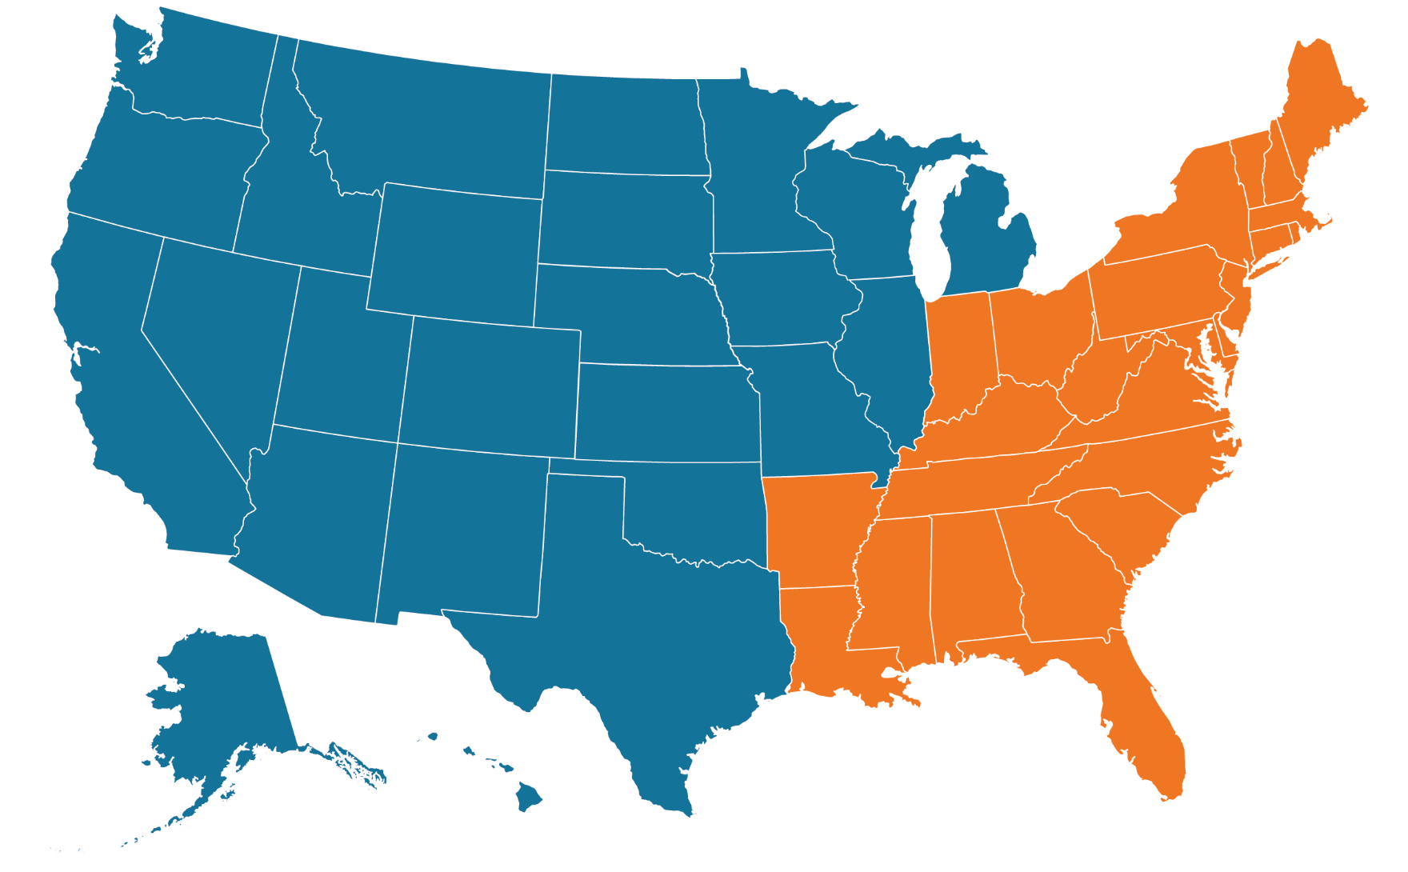
Your Annuity Specialists
West
CJ Nizich
Director, Annuity Specialist cj.nizich@janushenderson.com 516.314.1532
East
Sheila Jelinek
Director, Annuity Specialist sheila.jelinek@janushenderson.com 561.941.1173

Slide 32
Important Information
The opinions and views expressed are as of the date published and are subject to change. They are for information purposes only and should not be used or construed as an offer to sell, a solicitation of an offer to buy, or a recommendation to buy, sell or hold any security, investment strategy or market sector. No forecasts can be guaranteed. Opinions and examples are meant as an illustration of broader themes, are not an indication of trading intent and may not reflect the views of others in the organization. It is not intended to indicate or imply that any illustration/example mentioned is now or was ever held in any portfolio. Janus Henderson Group plc through its subsidiaries may manage investment products with a financial interest in securities mentioned herein and any comments should not be construed as a reflection on the past or future profitability. There is no guarantee that the information supplied is accurate, complete, or timely, nor are there any warranties with regards to the results obtained from its use. Past performance is no guarantee of future results. Investing involves risk, including the possible loss of principal and fluctuation of value.
The information contained herein is for educational purposes only and should not be construed as financial, legal or tax advice. Circumstances may change over time so it may be appropriate to evaluate strategy with the assistance of a financial professional. Federal and state laws and regulations are complex and subject to change. Laws of a particular state or laws that may be applicable to a particular situation may have an impact on the applicability, accuracy, or completeness of the information provided. Janus Henderson does not have information related to and does not review or verify particular financial or tax situations, and is not liable for use of, or any position taken in reliance on, such information.
Annuities are long-term investment vehicles designed to accumulate money on a tax-deferred basis for retirement purposes. They limit access to the investment as a result of a surrender charges and are subject to a 10% tax penalty on certain withdrawals. Riders are generally available for an additional charge. Variable annuities are subject to investment risk, and investment return and principal value will fluctuate.
Actively managed portfolios may fail to produce the intended results. No investment strategy can ensure a profit or eliminate the risk of loss.
10-Year Treasury Yield is the interest rate on U.S. Treasury bonds that will mature 10 years from the date of purchase.
Basis point (bp) equals 1/100 of a percentage point. 1 bp = 0.01%, 100 bps = 1%.
Volatility measures risk using the dispersion of returns for a given investment.
S&P 500® Index reflects U.S. large-cap equity performance and represents broad U.S. equity market performance.
Standard Deviation measures historical volatility. Higher standard deviation implies greater volatility.
Index performance does not reflect the expenses of managing a portfolio as an index is unmanaged and not available for direct investment.
A retirement account should be considered a long-term investment. Retirement accounts generally have expenses and account fees, which may impact the value of the account. Non-qualified withdrawals may be subject to taxes and penalties. For more detailed information about taxes, consult a tax attorney or accountant for advice. Tax information contained herein is not intended or written to be used, and it cannot be used by taxpayers for the purposes of avoiding penalties that may be imposed on taxpayers. Such tax information and any estate planning information is general in nature, is provided for informational purposes only, and should not be construed as legal or tax advice.
In preparing this document, Janus Henderson has relied upon and assumed, without independent verification, the accuracy and completeness of all information available from public sources.
This material is for information purposes only. There is no guarantee that the information supplied is accurate, complete or timely, nor is there any warranty with regards to the results obtained from its use. This material may not be reproduced in whole or in part in any form, or referred to in any other publication, without express written permission.
Janus Henderson is a trademark of Janus Henderson Group plc or one of its subsidiaries. © Janus Henderson Group plc.
FOR MORE INFORMATION CONTACT JANUS HENDERSON INVESTORS
151 Detroit Street, Denver, CO 80206 |www.janushenderson.com
W-0124-488416-09-30-2024 166-25-448835 01-24

