Slide 1
The Psychology of Referrals
What the client sees when asked for a referral
Not FDIC Insured | May Lose Value | No Bank Guarantee
Notes:
That’s why today I want to talk about the psychology of referrals. ​
At Franklin Templeton, we believe you should always look at your business from the perspective of the client—and today is no different.​
We’re going to be talking about how you can build your business with behavioral science. How you can make clients feel safe and give you more referrals.​

Slide 2
Agenda
How psychology can complicate the referral process
Making it safe to give you a referral
Creating an experience worthy of a remark
Reframing referrals with confidence
For Financial Professional Use Only / Not for Distribution to the Public
For Financial Professional Use Only / Not for Distribution to the Public
Notes:
Today we’ll discuss four things:​​
How psychology can complicate the referral process ​​
Making it safe to give you a referral
Creating an experience worthy of a remark​​
Reframing referrals with confidence​
Let’s get started​​

Slide 3
How psychology complicates the referral process
Notes:
The first step is understanding how psychology can complicate the referral process. ​

Slide 4
In theory, a referral should be simple
Who do you know that could use my services?
Here is a list of everyone I know, their liquid assets and phone numbers.
For Financial Professional Use Only / Not for Distribution to the Public
Notes:
In theory, a referral request should be simple. You ask your client, “Who do you know that could use my services?”​
[CLICK] Your client thinks for a moment and then offers the name and contact information of someone they know.​
How often would you say it’s this easy? Probably not very often.​

Slide 5
In reality, it’s complicated
Do I appear desperate for business?
Will I get credit if it works out, blame if it doesn’t?
Is this awkward?
Does this elevate the client experience?
Do I want to be responsible if my friend has a bad experience?
Will she get too busy for me or raise her rates if I refer someone?
Would it look like I am getting special treatment if I refer someone?
How does a referral make me look?
For Financial Professional Use Only / Not for Distribution to the Public
Notes:
In reality, a referral is a lot more complicated. ​
You ask, “Who do you know that could use my services?”​
[CLICK] At the same time, you might be thinking about how awkward you feel. Maybe you wonder if it seems like you’re desperate or sound pushy? You may even be asking yourself if you’re elevating the client experience. ​
Similarly, even if the client is happy with your service, there are a lot of questions that may pop up for them [CLICK].​
These are the questions you need to answer to make them feel safe.
Because, left unanswered, those thoughts and questions are hurdles to receiving referrals.​

Slide 6
Humans are social creatures
Social Benefits
Social Costs
Notes:
Why is that?​
Humans are inherently social creatures. Social exchange theory states that we judge interactions and determine behavior based on the costs and benefits.​
We always want to maximize social and personal benefits while minimizing the costs. ​
[CLICK] It’s your job to ensure the social benefits of a referral outweigh the social costs.

Slide 7
The flaw in traditional referral requests
Who do you know that could use my services?
YOU benefit the most
Clients do all the work
Clients take on the social risk
They do it for free
For Financial Professional Use Only / Not for Distribution to the Public
Notes:
A traditional referral request like, “Who do you know that could use my services?” clearly benefits you.​
You’re asking clients to work for you, for free, and take on the social risk that accompanies it. ​
What’s in it for them? Traditional referral requests often lack motivation for the person being asked, which could be why we find the conversation awkward in the first place.​

Slide 8
What motivates a referral?
1
2
3
For Financial Professional Use Only / Not for Distribution to the Public
Notes:
If we look at the benefits of making a referral, what is it that motivates people?​
[CLICK] First, people make referrals to help themselves. They want to feel influential, receive acknowledgement or earn a tangible rewards.​
[CLICK] Second, people make referrals to help others. They want the people they care about to know about the things that might benefit them as well.​
[CLICK] Last, people will make a referral to help you and your business. That bears repeating—helping you grow your business is low on the list of what motivates a referral. ​
But, what if we change how we think about referrals?
Instead of a “you centered” request, we look deeper at what clients want and need, and translate it into actionable ideas for you to incorporate into your client experience.

Slide 9
Maslow’s hierarchy of needs
Self
Actualization
Self-fulfillment needs
Esteem
Psychological needs
Love and Belonging
Safety
Basic needs
Physiological
Source: Maslow’s Hierarchy of Needs by Saul McLeod, PhD., April 2022. www.simplypsychology.org
Notes:
How do we know this? From Maslow’s hierarchy of needs.
Many of you may already use this to guide your planning conversations with clients and prospects. ​
But, as a refresher, a psychologist named Abraham Maslow came up with this theory that organizes human needs into five levels. ​
The lower levels represent our most basic needs and the upper levels are the more cerebral ones. ​
This theory is often used to understand how drive and motivation are intertwined when discussing human behavior.​
For today’s discussion, we’ll focus on the first four levels of the hierarchy which include basic and psychological needs.
If we use these needs to inform the way we approach referrals, satisfying our clients’ central and core needs could possibly result in more enthusiastic introductions. ​

Slide 10
Making it safe to give you a referral
Notes:
Let’s start by looking at how you can address your clients’ most basic needs, making it safe to give you a referral.

Slide 11
Poll
What is more important to YOUR clients?
Structure
Repetition
Notes:
Poll purpose: Discussion
What is more important to YOUR clients? Structure or repetition?

Slide 12
Understanding basic needs
Notes:
What are basic human needs?​
There are physiological needs such as food, water, warmth, rest and shelter.​
You may already support physiological needs of clients by creating a welcoming environment, offering a beverage or snack and taking strides to ensure they are comfortable while in your office. ​
[CLICK] The next need is of critical importance—safety. Determining who we can trust and what situations or places are safe colors our worldview. When we feel safe, we’re more open to engage in experiences and interactions. ​
When clients meet with a financial professional, they bare their financial baggage while placing their future in some else’s hands. That can be uncomfortable, and they may need to reclaim a feeling of security.​
While you can’t promise the markets won’t go through periods of volatility, you can make them feel safe through your actions.​
The bottom line is, if you haven’t made your clients feel safe, you’re unlikely to receive many referrals.​

Slide 13
What helps clients feel secure?
Structure
Repetition
Notes:
How can a financial professional help clients feel a sense of safety? ​
It boils down to two elements that you can weave throughout your client experience.​
[CLICK] First, it should be well-structured. From birth, we crave structure because it helps us feel secure in our environment and its boundaries. ​
Not only can a structured client experience help your business run smoothly, it demonstrates competence and conveys respect to your clients. ​
[CLICK] Next is repetition. We take comfort in consistency and, when we’re able to anticipate what’s coming next, it makes us feel safe. ​
When your words and actions are consistent, it lets clients know exactly what their friends or family might experience—making them feel “safe” to give you an introduction. ​
[For Edward Jones financial advisors:] You have a great tool to set up a consistent structure for client meetings—your meeting agenda. Use the agenda to set client expectations about the structure of each meeting. Also, using the agenda with every meeting will help reinforce consistency, or that repetition that humans crave.
Chat: What do you do to make your clients feel more secure?

Slide 14
Chat
?
What do YOU do to make your clients feel more secure?
Notes:
Chat purpose: to discuss ways financial professionals make their clients feel more secure

Slide 15
Setting expectations
Benefits
Process​
Communication
Value vs. cost
For Financial Professional Use Only / Not for Distribution to the Public
Notes:
One of the most important points in the planning process is how you set expectations at the first meeting and then revisit them at future meetings. ​
In-person meetings are a great opportunity for you to remind clients of what you’re doing for them, thereby illustrating what a friend or family member would experience by working with you. ​
You want to make sure you continually answer questions such as:​
[CLICK] What benefit will they gain by working with you? [For EDJ financial advisors] For instance, remind clients how you are here to help them meet their needs, including preparing for and living in retirement, paying for education, preparing for the unexpected and planning their estate.
[CLICK] What process will you use?​ [For EDJ financial advisors] Use this opportunity to discuss your Solutions Based Approach and walk clients through the five-step process.
[CLICK] How will you communicate with them?​
[CLICK] How does the value you provide exceed the cost?​ [For EDJ financial advisors] Walk clients through “Making Good Choices” to determine how you’ll work together and provide transparency about fees.
The problems and solutions may vary, but your process should be consistent. This lets clients know that, even as you solve each client’s problems with different solutions, you treat everyone in a similar manner.

Slide 16
Helping clients tell their financial story
17th meeting
19th meeting
13th meeting
Funded college tuition
Retired
10th meeting
8th meeting
Purchased first house
1st meeting
3rd meeting
5th meeting
Notes:
Many financial professionals try to communicate their value to clients to, honestly, justify their fees. The problem is, too many financial professionals talk about value in terms of the services and solutions they offer.​
Remember, people care most about themselves. Shift the focus from you and help clients tap into their personal financial journey. ​
Illustrate how their lives have improved since you first met by highlighting specific milestones they’ve achieved. Ask about the emotional benefits they’ve experienced. Are they less stressed than when you first met? Is the excitement of retirement beginning to build? ​
Ultimately, you want to paint a picture of how they are benefitting from working with you. ​
Focusing on what you have accomplished together and how they feel about it is a much better way to explain your fees. It also illustrates the benefit someone else could garner from your services.
It is not about price. You want to be able to say, “This costs a lot but it’s worth even more.”​

Slide 17
Poll
Which financial milestones have you helped clients achieve?
First home purchase
Tuition for children
Second home purchase
First million
Retirement
Notes:
Poll purpose: Discuss financial milestones

Slide 18
Chat
?
Which financial milestones have you helped clients achieve?
Notes:
Poll purpose: Discuss financial milestones

Slide 19
Delivering consistent communications
Quarterly Calls
Review Meeting
Client Event
Seminar
Survey
Q1
Q2
Q3
Q4
Quarterly Statements
Monthly Newsletters
Daily interactions on social media
Notes:
You can use repetition in your client communications to make clients feel safe and keep you top of mind.​
Let’s look at an example of a year’s worth of client communications. ​
[CLICK] There are items like quarterly statements that are expected to be delivered regularly.
[CLICK] You may use a 90-day call rotation to personally connect with clients every few months.
[CLICK] These communications can be augmented with monthly newsletters. If you’re consistent with a newsletter, you’ll teach clients it is something they can expect.
[CLICK] Not to mention if you post regularly on social media.​
[CLICK] Then there are items that provide an opportunity for you to connect with the client in-person, or for you to learn more about what they’re enjoying or how you could improve. ​
You want to set the expectation for consistent communication so that, just about the time clients feel they should be hearing from you, they do. ​
A plan like this gives clients the impression you’re always thinking about them and what they might be interested in. ​
Seeing your name regularly pop-up in their inbox or mailbox will help keep you top of mind and reinforce that you’re proactively working on keeping a strong relationship.

Slide 20
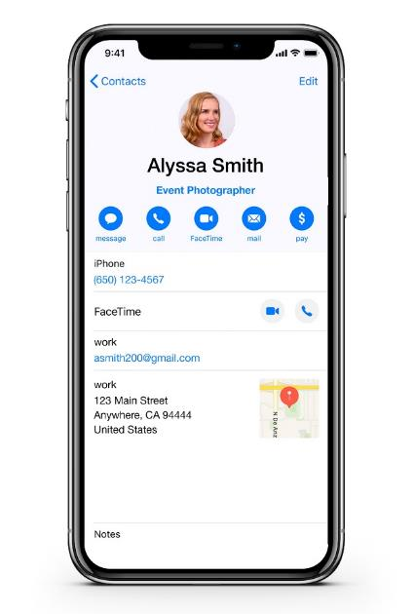
Use professional referrals to solve clients’ other needs
Attorneys
Event planners
In-home healthcare
Real estate agents
Photographers
Notes:
Another way to convey reliability is to help clients solve their other needs by providing referrals of your own. ​
You probably count entrepreneurs and business owners among your clients. Do you have their business cards in your desk or have their contact cards saved on your phone? ​
Make sure you have them readily available to share when asked for a recommendation. ​
Better yet, use your active listening skills to deduce when someone could use help. ​
You can say, “I heard you say you were having trouble with [x]. I know a few people who could help in that area.”​
You’ll make the clients receiving the referral feel great. ​
When you provide a referral, contact the clients you’ve referred to let them know they may receive a call. ​
The bottom line is, when we receive a high-quality recommendation, it raises our opinion of the person who provided it. And, by helping clients solve problems, you become an indispensable source for more than just financial recommendations. ​
For Edward Jones Financial Advisors: Due to privacy concerns, you may not disclose to either party that they are clients of yours without explicit permission.

Slide 21
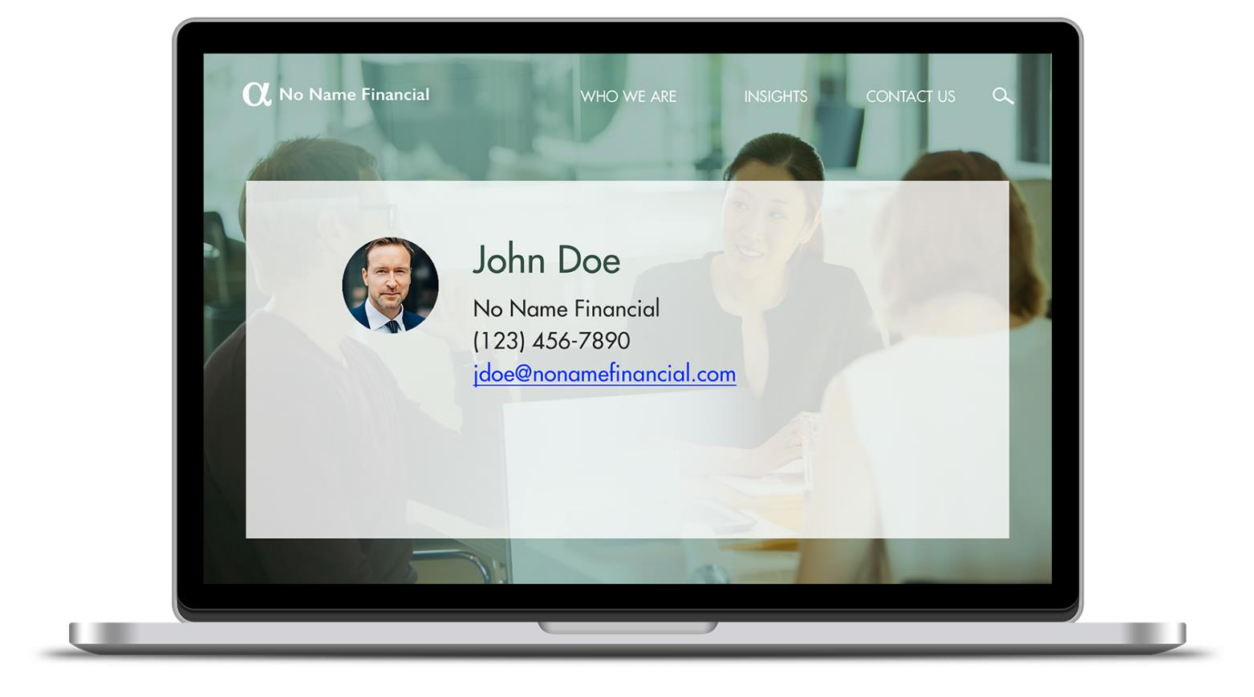
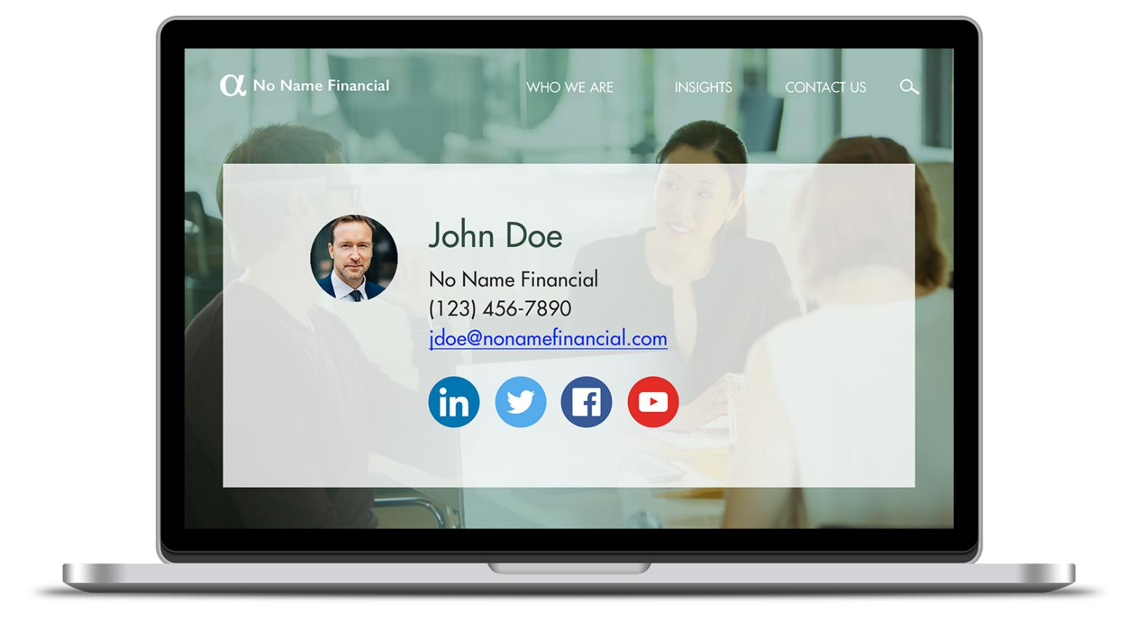
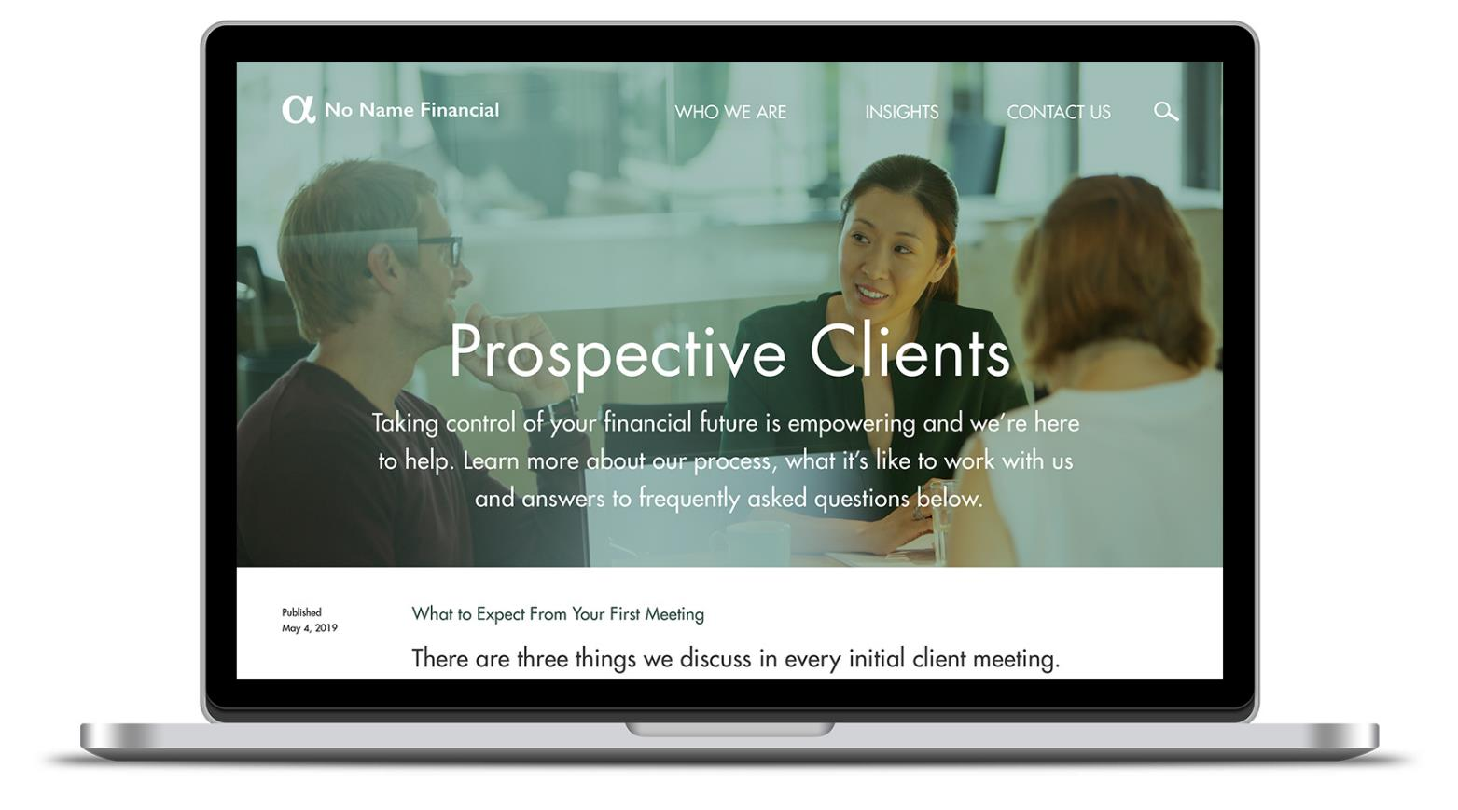
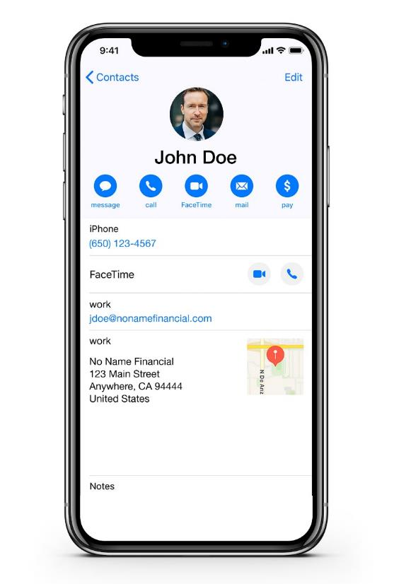
Remove obstacles to sharing your information
Notes:
Last, there are a few things you can do to allow clients to easily share your information in a low-risk way. They may not be ready to share their sister’s contact information with you right away, but they may be open to some of these ideas. ​
As always, be sure to check with your compliance department before implementing any new ideas. ​
Are you in your clients’ phone? Create an electronic contact card for yourself. It should include your name, business name, address, website, email address and phone number. Then, while your client is in your office, send them your contact card so they can easily save and find it later.​
[CLICK] If you have control over your website, consider adding a section for prospective clients. Be clear you’re still accepting new clients and describe what someone should expect the first time they meet with you.​ [For Edward Jones financial advisors]: Reference WEB5046338.
Make it easy to share blogs, contacts, FAQs and other relevant information on your website by adding a share button. ​
[CLICK] Ensure your email signature is up to date. [CLICK] If you’re active on social media, add the icons at the bottom that link directly to your profiles. You’d be surprised how many times I’ve clicked on an icon under someone’s signature and they’ve forgotten to link it.​
You should also connect with current clients and prospects on LinkedIn and other social platforms you use for business. ​

Slide 22
Creating an experience worthy of a remark
Notes:
Now that we’ve discussed the basics, let’s look at how you can create an experience worthy of a remark.​

Slide 23
Psychological needs
Belonging and Community
Recognition
Notes:
The next levels of needs we’re going to talk about are psychological. ​
[CLICK] First up, belonging and community. Although most humans no longer live in a tribal society, we still have a primitive desire to be part of a group. Our need for connection with others is strong and difficult to break. For example, think about how many of us send out holiday cards to people we haven’t seen in years, yet we are hesitant to cut that last tie to them.​
[CLICK] Next, recognition needs. We have a deep need to be acknowledged and earn the respect of others. Most people strive to satisfy this need through their careers or personal hobbies. ​

Slide 24
Elevating the client experience
Personal
Remarkable
Notes:
How can you invoke feelings of belonging and recognition with your clients?​
[CLICK] Your client experience should be a personal one. Everyone wants to feel special and understood. The more you personalize your client experience, the more your clients will feel connected and loyal to you. ​
[CLICK] And, the experience needs to be remarkable. What does “remarkable” mean? Worthy of a remark. The best experiences are worth talking about. ​
Whether it’s unconventional and surprising, or unexpected and delightful, it compels clients to tell others.​

Slide 25
Poll
Which do you find more effective with your clients?
Personal
Remarkable
Notes:
Poll purpose: Discuss financial milestones

Slide 26
Client expectations are high
LOW COST
≠ Referrals
GOOD SERVICE
= the expectation
For Financial Professional Use Only / Not for Distribution to the Public
Notes:
What can you give your clients that your competitors cannot?​
The answer is not merely customer service. ​
Many financial professionals think if they provide good service, the referrals will roll in. ​
Good customer service is the minimum expectation. ​
[CLICK] It does not automatically result in referrals.
[CLICK] What else doesn’t provide more referrals? Being the lowest cost.
Your clients are paying you. The very least you can do is meet their expectation of good customer service.​

Slide 27
Welcome to the experience economy
They’ll be comparing YOU to elevated experiences
80% would pay more for a better client experience
Source: Capgemini Digital Transformation Institute, 2017.
For Financial Professional Use Only / Not for Distribution to the Public
Notes:
It also doesn’t have to be about lowering your fees either.
[CLICK] Research has found 80% of people would pay more for a better client experience. ​
That’s great news in an industry where you’re under pressure to justify what you charge. ​
So, make the experience better. Make it personal. Make it truly remarkable.​
To start, don’t just benchmark your customer experience to other financial professionals. ​
[CLICK] The clients you really want are having great experiences elsewhere, especially the wealthier they are, such as luxury hotels, ​private aircraft, yachts and luxury cruises, fine restaurants, or concierge services.
[CLICK] They’ll be comparing you against those elevated experiences.​

Slide 28
Redefining significant moments
Notes:
By now, it should be obvious that we need to be relentlessly focused on elevating the client experience. Let’s discuss more strategies to create remarkable moments.​
Most of us send a gift after someone becomes a client. Maybe we send a card for a client’s birthday, too. Those are thoughtful actions, but are they noteworthy? ​
Consider celebrating unconventional anniversaries and dates such as:​
[CLICK] Six months BEFORE they plan to retire—when they might need a little extra motivation to show up at work. Send a gift to remind them what you’ve been working together to accomplish.​
[CLICK] Or, one year AFTER they’ve retired—when they may need a reminder of what they wanted to be doing. ​
[CLICK] Send a care package to clients during their first month as empty nesters, or when they use that 529 to send a child off to college.​
[CLICK] Congratulate them when they finally pay off their mortgages, tuition bills and student loans. ​
These are incredibly personal, emotional moments in your clients’ lives, and they typically go unacknowledged. When you highlight them with a small gift or encouraging note, it reinforces that you truly know what’s on their mind. ​
[Specific for Edward Jones financial advisors]: Please ensure gifts are in compliance with your Gifts and Entertainment policy. Additional information can be found in your compliance manual.

Slide 29
The art of gift giving
Notes:
When you change the moments you celebrate, you’ll find that branded tchotchkes or generic gift cards no longer fit the bill.​
Client gifts don’t have to be expensive or extravagant—just relevant. There should be no question that the gift was selected for them. ​
[CLICK] Instead of sending one book, send two so they can share the extra copy with a friend or family member. Books related to challenging life events like births, marriage, widowhood or retirement may also be appreciated. Unless you’ve personally read the book, make sure it’s recommended by someone you trust. You wouldn’t want to accidentally recommend a book about navigating widowhood that gives a suggestion about finding a new financial professional.
[CLICK] Send a gift that’s specific to a client’s hobby or passion. Instead of a generic travel guide, find one that suits a deeper interest. An avid hiker might appreciate a guide to the best trails, whereas a pocket translator or engraved passport holder could be helpful for those traveling abroad. ​
[CLICK] Gloves for gardeners or kitchen tools for cooks are also cost-effective but show you listen and care to know what they enjoy doing. ​

Slide 30
Hosting unique events
Hosting unique events
Caveat: Nothing discussed or suggested should be construed as permission to supersede or circumvent your firm’s policies, procedures, rules, and guidelines. Advisors must consider their firm’s compliance guidelines around business entertainment.
For Financial Professional Use Only / Not for Distribution to the Public
Notes:
We make things better, by making better things. Those better things might be in the list of gifts mentioned, or they might be hosting different events.​​
Holiday parties are common but, for many, it’s a busy time of year which could impact your attendance. ​​
What if instead you hosted a unique event such as:​​
[CLICK] A night at the symphony
[CLICK] Or, learn a new skill in a painting class.​​
An event can also be a great opportunity with a strategic business partner. Ask yourself, “Who does business with my ideal clients?”​
[CLICK] Take your client events to the next level by teaming up with other experts in their field, such as a health experts, yoga teachers, or professional organizers.​
[CLICK] You might also center an event around a useful skill like helping older clients use technology to stay connected and feel independent.
[For Edward Jones advisors]: These topics are ideas that can be used for client-appreciation events and business building events; however, should not be topics considered for client-education seminars.
Beyond the events you organize, it’s important to accept speaking opportunities in your community and at other people’s events. Small business groups and professional associations are always looking for speakers that can add value.​
Use your imagination to design an event, just be sure there’s time to connect with each person attending.​​

Slide 31
Champion the causes that matter to your clients
Habitat for Humanity
Beach cleanup
Local soup kitchen
5K charitable run
Notes:
Many of us enjoy giving back to the community and we should support our clients who do the same.​
Champion their causes by contributing your time. ​
[CLICK] Drop by their Habitat for Humanity build or [CLICK] show up at their beach cleanup with garbage bags in hand. ​
[CLICK] For clients that want to get involved, but don’t know where to start, take the initiative and organize volunteering shifts at a local soup kitchen. ​
Involve clients in causes you care about. [CLICK] If your favorite charitable organization is hosting a 5K, build a team with clients.​

Slide 32
Involve clients in your improvement
Survey
Client Advisory Council
Review
Notes:
Finally, exceptional client experiences need to be able to grow and improve based on your clients’ needs. ​
To know what your clients need, want and think—you need to ask for their advice. It should be noted to always ask for advice rather than feedback. Feedback tends to be granular and often critical, while advice is generally more helpful.​
There are three good ways financial professionals can create opportunities for client advice. ​
[CLICK] First, you should be developing and deploying client surveys annually. ​
A survey tells your clients that you care about their experience and are genuinely interested in what they think. ​
[For Edward Jones financial advisors] Edward Jones has the Client Experience Index, or CEI—a survey designed to measure client satisfaction and loyalty from your clients’ point of view.
[CLICK] The second route is through your client advisory council. This is a small group of your top clients who agree to be open to providing you with advice and insight. With this group, you can get deeper, richer intel on what you are getting right and where you can improve. Empower your advisory council to be honest and free to make suggestions.​
[CLICK] Last, you can collect input directly from your in-person meetings. You will be amazed what you will learn from your clients if you just ask.
Be sure to take all the insights you receive from surveys, the advisory council and in-person meetings and review it with your team. ​
When you make changes, communicate it broadly and credit the survey, council or individual client who brought it to your attention. Clients will see that you’re willing to improve and, more importantly, listen to what they have to say. ​
When clients view themselves as “advisors to their financial professional” they feel psychologically invested in your success, which may result in more referrals. ​

Slide 33
Poll
How have you involved clients in your improvement in the last 12 months?
Survey
Client Advisory Council
Review
Notes:
Poll purpose: Discuss how financial professionals have involved clients in their improvement over the last 12 months

Slide 34
Reframing referrals with confidence
Notes:
Our entire presentation to this point has been about doing things necessary to make you referable without having to ask.
However, there are times we want to speak directly about referrals. ​

Slide 35
Does this look familiar?
Stumbling over your words
Awkward
Passive
Notes:
Many of us were taught to say, “Do you happen to know two or three friends who are similar to you, that you could introduce me to?” For some financial professionals, this approach works. But, if you are in this seminar, chances are it doesn’t work for you—at least not very well.​
How does it feel when you ask for referrals in this way?
[CLICK] Do you stumble over the words? Or, do you start to ask, see your client’s demeanor change, and then get tongue tied?​
[CLICK] Does fear of rejection or looking desperate in the eyes of the client can make you avoid the topic entirely?​
[CLICK] Maybe you employ a passive technique in which you display a sign or note in your email signature that reads, “A referral is the highest compliment I can receive.” ​
There is a better way to position referrals—as a genuine offer for clients to help those they care about.​

Slide 36
FRAMING
MATTERS
For Financial Professional Use Only / Not for Distribution to the Public
Notes:
The key is the framing. In psychology, framing is the concept that people make decisions based on how the options are presented. ​
[CLICK] The classic example is the half-full or half-empty glass. ​
Generally speaking, we’re more likely to prefer options framed positively. ​
Changing the way you frame a discussion on referrals with your clients can go a long way in motivating them to take action.​

Slide 37
Flipping the referral script
Old way: You benefit. Client does the work, for free. Unclear how client benefits.
New way: Benefit for clients to enjoy and share with others.
Old way: You benefit. Client does the work, for free. Unclear how client benefits.
Notes:
The old way of asking for a referral was a request for the client to do work for you. ​
[CLICK] The new way is to position referrals as something you offer to do for them. ​
By framing referrals as a service, they get to share with the people they care about, it’s no longer a burdensome task they’re doing because you want to build your business. ​
Remember, they do want to help—if the social costs aren’t too high.​

Slide 38
One of the privileges I’ve enjoyed over the years, is when one of my clients’ friends calls me seeking a second opinion. I want you to know if one of your friends called me seeking a second opinion, I would immediately pause what I was doing and see if I could help. Most likely, all I’d do is confirm the path they’re on can help to get them to their destination. But, I’ve always been amazed how some minor corrections can lead to very major improvements down the road.”
For Financial Professional Use Only / Not for Distribution to the Public
Notes:
Here’s an example of how to frame referrals as a service. There is nothing magic about the words. It simply shows how your words and tone change the request from something about you to a benefit for your client.​
“One of the privileges I’ve enjoyed over the years, is when one of my clients’ friends calls me seeking a second opinion. I want you to know, if one of your friends called me seeking a second opinion, I would immediately pause what I was doing and see how I could help. Most likely, all I’d do is confirm that the path they’re on can help get them to their destination. But, I’ve always been amazed how some minor corrections can lead to major improvements down the road.” ​
A statement like this shifts the focus from how you’d benefit, to emphasizing the benefit for the client. It is for them, not for you. You’re offering to take time out of your day to see how you can help their friend, with zero expectation they become a client. ​
And, if they were to become a client, you wouldn’t sell everything they own and start over, you would most likely make subtle adjustments and improvements that could have a significant impact in the future.​
But remember, your statement should be said in a matter-of-fact manner so that it comes across as part of a normal conversation. ​

Slide 39
Perfecting your delivery
Write
Script, edit and refine each word
Record
Practice it and record yourself
Repeat
Repeat and practice until polished
Notes:
Finally, you’ve got to nail the delivery. ​
Unfortunately, too often we ask for a referral from a negative position because we are uncomfortable with the “old” style of asking and have not practiced and polished our referral statement. You must get so comfortable with the statement that it comes across as matter-of-fact.​
[CLICK] To do that, you need to script it, edit it and refine the words you want to say. Every word should be deliberately chosen. ​
[CLICK] Then, practice it and record yourself—you can even use your phone. First record it with audio only and then record it with video. ​
[CLICK] Repeat it and practice it over and over until you’ve got it down pat. Practice with your spouse, a colleague or a trusted friend and ask for feedback.​
Imagine watching a play. The actors interact and speak in a way that appears natural—as if the action is happening for the first time. In reality, every word, movement and gesture is there on purpose—they’ve simply rehearsed and practiced enough to make it look spontaneous. ​
It’s the same with your referral statement. The more you are comfortable and confident with it, the less awkward you’ll feel when you say it. ​

Slide 40
What’s next?
Next meeting
Specific ideal prospect
Notes:
Once you have a referral statement you feel confident about, it’s time to get tactical. ​
Start by making a list of your top 10-20 clients. They aren’t necessarily your biggest, but those you believe are most likely to be advocates for you. You’re confident they understand the value you provide and they’re highly engaged—reading your emails, liking your social posts and attending your client events.​
[CLICK] Next, get the timing right. The best time to tackle the topic is at the end of a productive meeting or after you’ve done something that benefited them. ​
[CLICK] Last, give the client a clear picture of who you want as a referral. Again, ask for their advice on how to approach them. ​

Slide 41
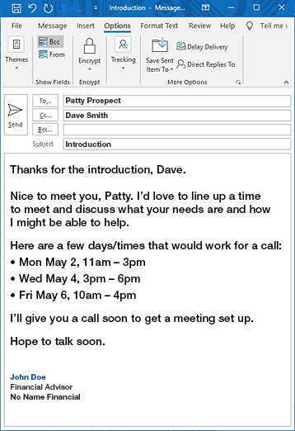
Responding to email introductions
Step one: Respond to the email.
Step two: Contact the client making the referral.
Step three: Call the prospective client to set the meeting.
Step four: Make sure to call your client and send a handwritten note to thank him for the introduction.
Notes:
Today, many introductions happen via email. ​
There’s specific etiquette that you should use when responding in email.​
[CLICK] First, respond as soon as you’re able. The longer an email sits without a reply, the more the client may question if they should have made the referral in the first place. ​
Your response should read something like this: “Thank you for the intro, Dave. Nice to meet you, Patty. I’d love to line up a time to meet and discuss what your needs are and how I might be able to help. Here are a few days and times that would work for me. I’ll give you a call soon to get a meeting set up.”
[CLICK] Once you respond to the email, give Dave, the client who made the referral, a call. Ask Dave what he and Patty have already discussed and how they know each other. Find out what led him to think Patty would be a good fit and why he thinks you'd be able to help her. Ask if there's any other background information that might be helpful to know before you meet Patty in person.
[CLICK] Then call the prospect, Patty. Mention the person who referred you, that you have had a productive relationship and you appreciate his introduction. Find out what Dave has already told her about your business. Ask Patty about her relationship with her current financial advisor, if she has one. This may give insights into any pain points.
[CLICK] Regardless of whether the referral works out, make sure you call Dave and send a handwritten note to thank him for making the introduction.

Slide 42
Expressing appreciation
Notes:
Your actions after a client sends you a referral can determine if they ever do it again.​
Show your appreciation that they trusted and had the confidence in you to refer someone.​
Regardless of the outcome of the referral, send them a handwritten thank you note. Acknowledge the referral and thank them so they will want to do it again.​
The thank you note is especially critical if the referral does not work out. ​
You don’t want your client thinking, “I sent them a referral once and it didn’t work out. So, I’m never going to refer someone again.”​
By thanking them, telling them how much you enjoyed meeting their friend and how appreciative you are that they referred someone to you, you increase the chance they will do it again. ​

Slide 43
Review
How psychology can complicate the referral process
Making it safe to give you a referral
Creating an experience worthy of a remark
Reframing referrals with confidence
Notes:
Today we discussed discuss four main areas that can help improve the quality and number of referrals you receive:​
How psychology can complicate the referral process ​
Making it safe to give you a referral
Creating an experience worthy of a remark​
Reframing referrals to ask with confidence​

Slide 44
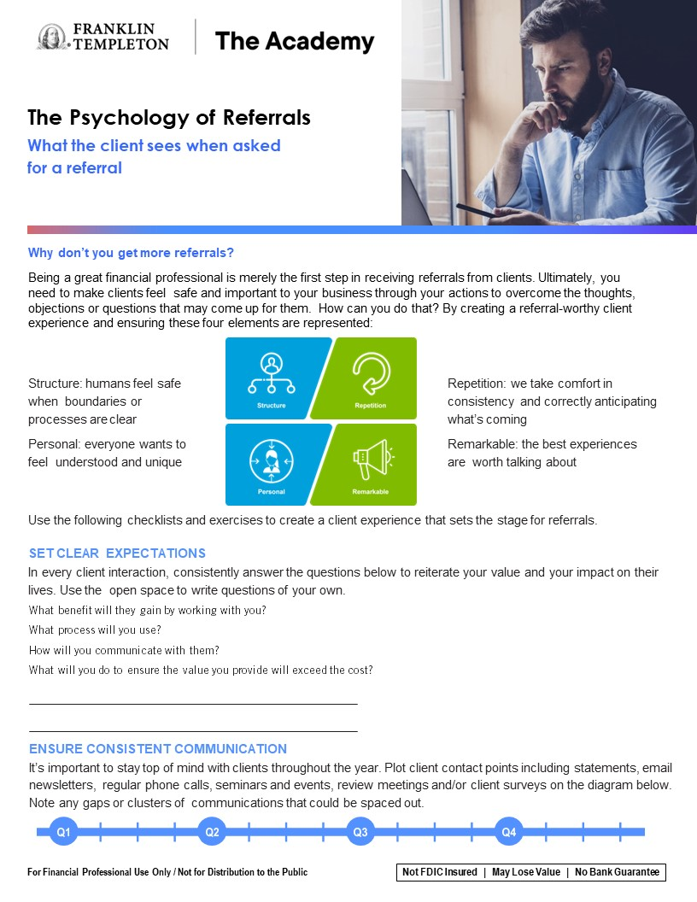
Putting ideas into action
The psychology of referrals checklist
POR LIST
Notes:
Any presentation that goes unused is merely entertainment. There is no intentional entertainment in this presentation. ​
Instead, there is a call to action. For you to grow your business through referrals. ​
To help with that we have created a checklist to remind you of the things we discussed today. ​
I saw many of you taking notes, which I truly appreciate, but don’t stop there. When you get back to your office pull out this sheet and review it. ​
Next, create a recurring appointment on your calendar to revisit this list every 30 days. Think about how your business will have grown 12 months from now by adding 10-12 best new practices to help you gain new referrals.​

Slide 45
Important Legal Information
This material is intended to be of general interest only and should not be construed as individual investment advice or a recommendation or solicitation to buy, sell or hold any security or to adopt any investment strategy. It does not constitute legal or tax advice. This material may not be reproduced, distributed or published without prior written permission from Franklin Templeton.
All investments involve risks, including possible loss of principal.
Any research and analysis contained in this material has been procured by Franklin Templeton for its own purposes and may be acted upon in that connection and, as such, is provided to you incidentally. Data from third party sources may have been used in the preparation of this material and Franklin Templeton ("FT") has not independently verified, validated or audited such data. Although information has been obtained from sources that Franklin Templeton believes to be reliable, no guarantee can be given as to its accuracy and such information may be incomplete or condensed and may be subject to change at any time without notice. The mention of any individual securities should neither constitute nor be construed as a recommendation to purchase, hold or sell any securities, and the information provided regarding such individual securities (if any) is not a sufficient basis upon which to make an investment decision. FT accepts no liability whatsoever for any loss arising from use of this information and reliance upon the comments, opinions and analyses in the material is at the sole discretion of the user.
Products, services and information may not be available in all jurisdictions and are offered outside the U.S. by other FT affiliates and/or their distributors as local laws and regulation permits. Please consult your own financial professional or Franklin Templeton institutional contact for further information on availability of products and services in your jurisdiction.
Issued in the U.S. by Franklin Distributors, LLC, One Franklin Parkway, San Mateo, California 94403-1906, (800) DIAL BEN/342-5236, franklintempleton.com - Franklin Distributors, LLC, member FINRA/SIPC, is the principal distributor of Franklin Templeton U.S. registered products, which are not FDIC insured; may lose value; and are not bank guaranteed and are available only in jurisdictions where an offer or solicitation of such products is permitted under applicable laws and regulation.
POR PPT 07/23

