Slide 1
The Psychology of Referrals
What the client sees when asked for a referral
For Financial Professional Use Only / Not for Distribution to the Public
Not FDIC Insured | May Lose Value | No Bank Guarantee

Slide 2
Agenda
How psychology can complicate the referral process
Making it safe to give you a referral
Creating an experience worthy
of a remark
Reframing referrals with confidence
For Financial Professional Use Only / Not for Distribution to the Public
For Financial Professional Use Only / Not for Distribution to the Public

Slide 3
How psychology complicates the referral process
For Financial Professional Use Only / Not for Distribution to the Public

Slide 4
In theory, a referral should be simple
Who do you know that could use my services?
Here is a list of everyone I know, their liquid assets and phone numbers.
For Financial Professional Use Only / Not for Distribution to the Public

Slide 5
In reality, it’s complicated
Do I appear desperate for business?
Will I get credit if it works out, blame if it doesn’t?
Is this awkward?
Does this elevate the client experience?
Do I want to be responsible if my friend has a bad experience?
Will she get too busy for me or raise her rates if I refer someone?
Would it look like I am getting special treatment if I refer someone?
How does a referral make me look?
For Financial Professional Use Only / Not for Distribution to the Public

Slide 6
Humans are social creatures
Social Benefits
Social Costs

Slide 7
The flaw in traditional referral requests
Who do you know that could use my services?
YOU benefit the most
Clients do all the work
Clients take on the social risk
They do it for free
For Financial Professional Use Only / Not for Distribution to the Public

Slide 8
What motivates a referral?
1
2
3
For Financial Professional Use Only / Not for Distribution to the Public

Slide 9
Maslow’s hierarchy of needs
Self Actualization
Self-fulfillment needs
Esteem
Psychological needs
Love and Belonging
Safety
Basic needs
Physiological
Source: Maslow’s Hierarchy of Needs by Saul McLeod, PhD., April 2022. www.simplypsychology.org

Slide 10
Making it safe to give you a referral
For Financial Professional Use Only / Not for Distribution to the Public

Slide 11
Poll
In your experience, what is more important to clients?
Structure
Repetition

Slide 12
Understanding basic needs

Slide 13
What helps clients feel secure?
Structure
Repetition

Slide 14
Chat
?
What do YOU do to make clients feel more secure?

Slide 15
Setting expectations
Benefits
Process
Communication
Value vs. cost
For Financial Professional Use Only / Not for Distribution to the Public

Slide 16
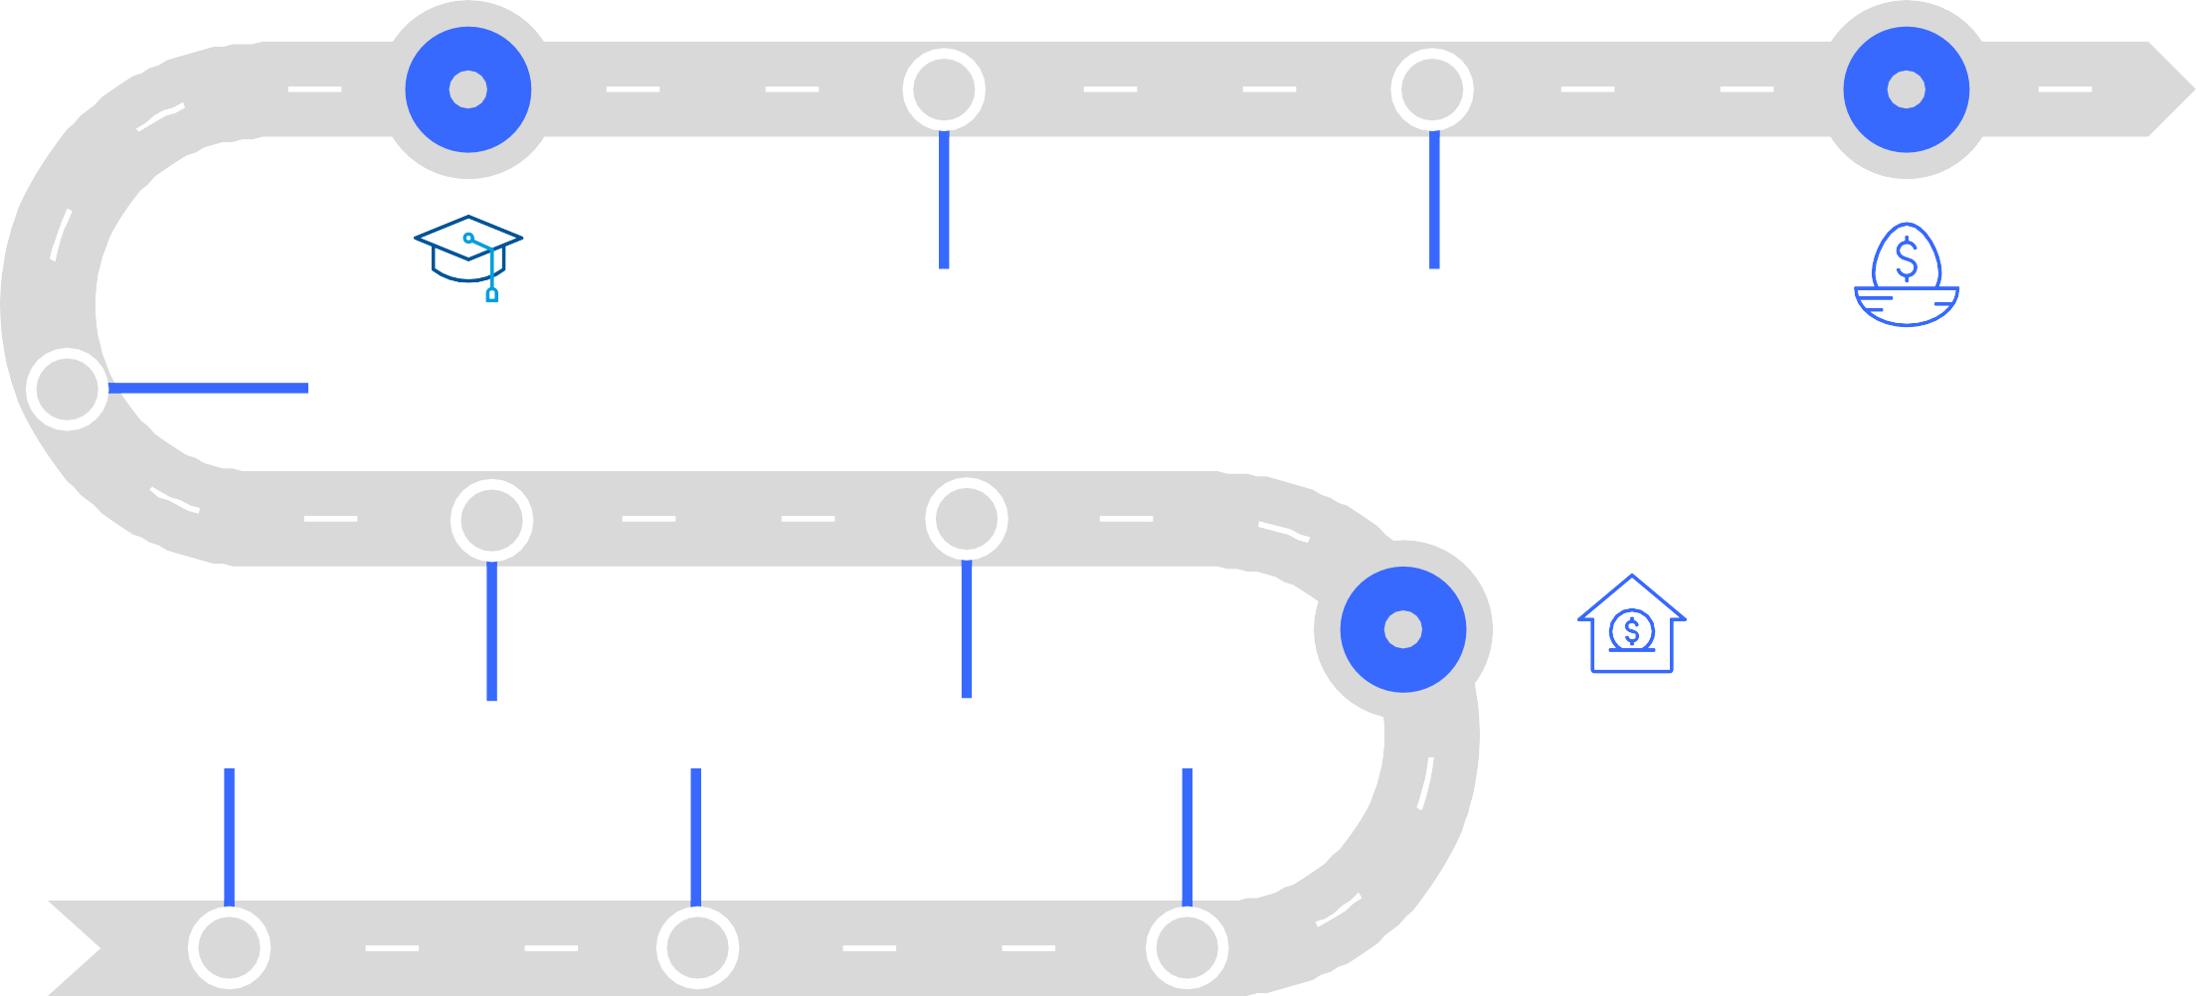
Helping clients tell their financial story
17th meeting
19th meeting
13th meeting
Funded college tuition
Retired
10th meeting
8th meeting
Purchased first house
1st meeting
3rd meeting
5th meeting

Slide 17
Poll
Which financial milestones have you helped clients achieve?
First home purchase
Tuition for children
Second home purchase
First million
Retirement

Slide 18
Chat
?
Which financial milestones have you helped clients achieve?

Slide 19
Delivering consistent communications
Quarterly
Calls
Review Meeting
Client Event
Seminar
Survey
Q1
Q2
Q3
Q4
Quarterly Statements
Monthly Newsletters
Daily interactions on social media

Slide 20
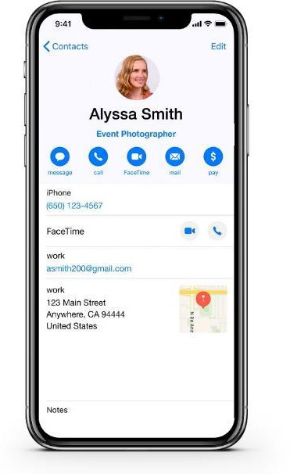
Use professional referrals to solve clients’ other needs
Attorneys
Event planners
In-home healthcare
Real estate agents
Photographers

Slide 21
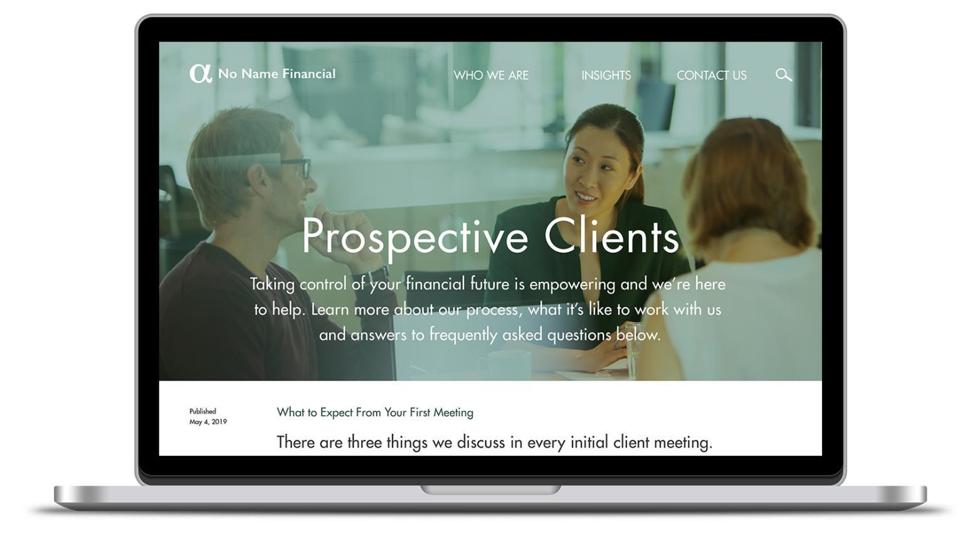
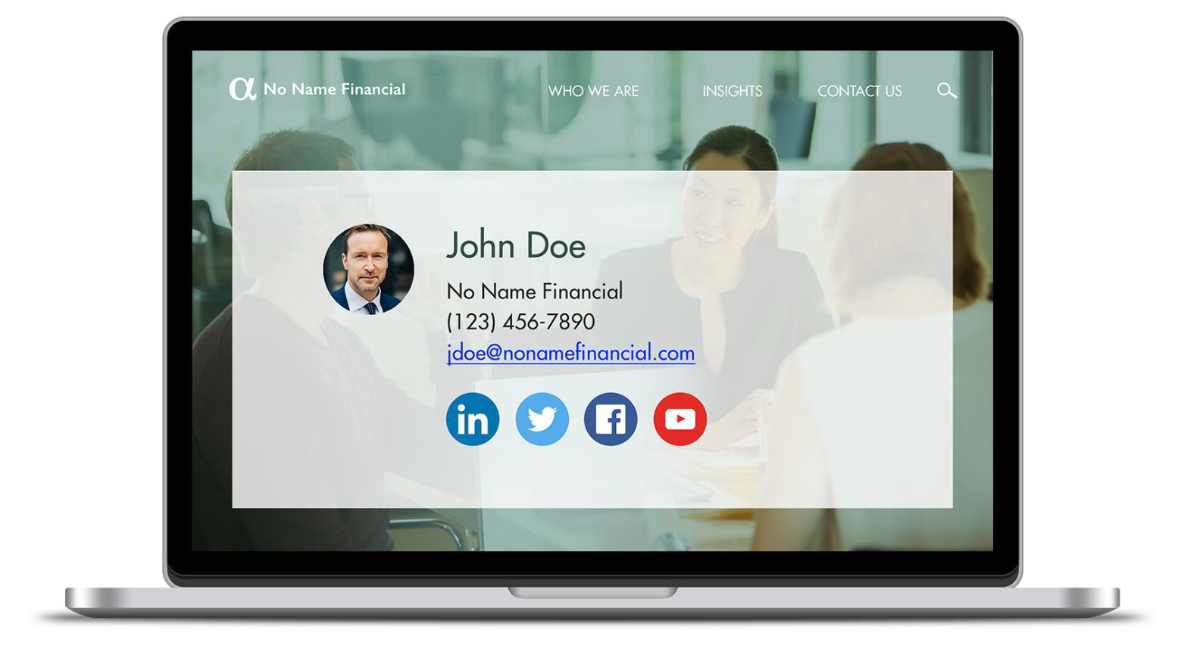
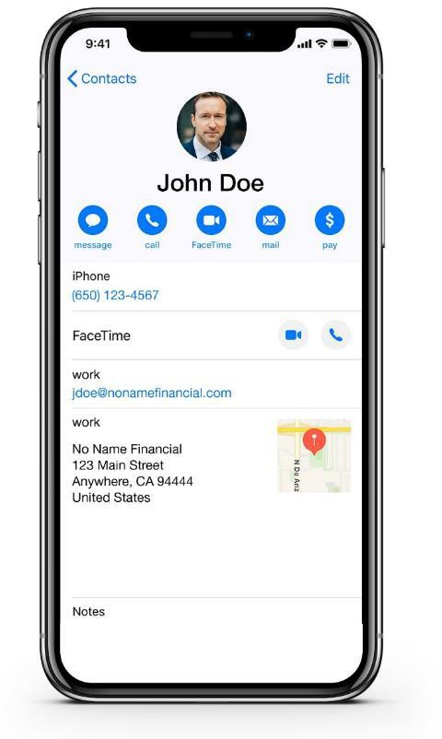
Remove obstacles to sharing your information

Slide 22
Creating an experience worthy of a remark
For Financial Professional Use Only / Not for Distribution to the Public

Slide 23
Psychological needs
Belonging and Community
Recognition

Slide 24
Elevating the client experience
Personal
Remarkable

Slide 25
Poll
Which do you find more effective with clients?
Personal
Remarkable

Slide 26
Client expectations are high
LOW COST ≠ REFERRALS
GOOD SERVICE
= THE EXPECTATION

Slide 27
They’ll be comparing YOU to elevated experiences
Welcome to the experience economy
n
Source: Capgemini Digital Transformation Institute, 2017.
For Financial Professional Use Only / Not for Distribution to the Public
80% would pay more for a better clie
t experience

Slide 28
Redefining significant moments

Slide 29
The art of gift giving

Slide 30
Hosting unique events
Hosting unique events
Caveat: Nothing discussed or suggested should be construed as permission to supersede or circumvent your firm’s policies, procedures, rules, and guidelines. Financial professionals must consider their firm’s compliance guidelines around business entertainment.
For Financial Professional Use Only / Not for Distribution to the Public

Slide 31
Champion the causes that matter to clients
Habitat for Humanity
Beach cleanup
Local soup kitchen
5K
charitable run

Slide 32
Involve clients in your improvement
Survey
Client Advisory Council
Review

Slide 33
Poll
How have you involved clients in your improvement in the last 12 months?
Survey
Client Advisory Council
Review

Slide 34
Reframing referrals with confidence
For Financial Professional Use Only / Not for Distribution to the Public

Slide 35
Does this look familiar?
Stumbling over your words
Awkward
Passive

Slide 36
FRAMING MATTERS
For Financial Professional Use Only / Not for Distribution to the Public

Slide 37
Flipping the referral script
New way: Benefit for clients to enjoy and share with others.
Old way: You benefit. Client does the work, for free.
Unclear how client benefits.
Unclear how client benefits.
_{Old way: Yo}u benefit. Client does the work, for free.

Slide 38
One of the privileges I’ve enjoyed over the years,
is when one of my clients’ friends calls me seeking a second opinion. I want you to know if one of your friends called me seeking a second opinion, I would immediately pause what I was doing and see if I could help. Most likely, all I’d do is confirm the path they’re on can help to get them to their destination.
But, I’ve always been amazed how some minor corrections can lead to very major improvements down the road.”
For Financial Professional Use Only / Not for Distribution to the Public
Forr Fiinanciall Prroffessional Use Onlly // Nott fforr Distrriibuttiion tto tthe Publliic

Slide 39
Perfecting your delivery
Write
Script, edit and refine each word
Record
Practice it and record yourself
Repeat
Repeat and practice until polished

Slide 40
Expressing appreciation

Slide 41
Review
How psychology can complicate the referral process
Making it safe to give you a referral
Creating an experience worthy of a remark
Reframing referrals with confidence

Slide 42
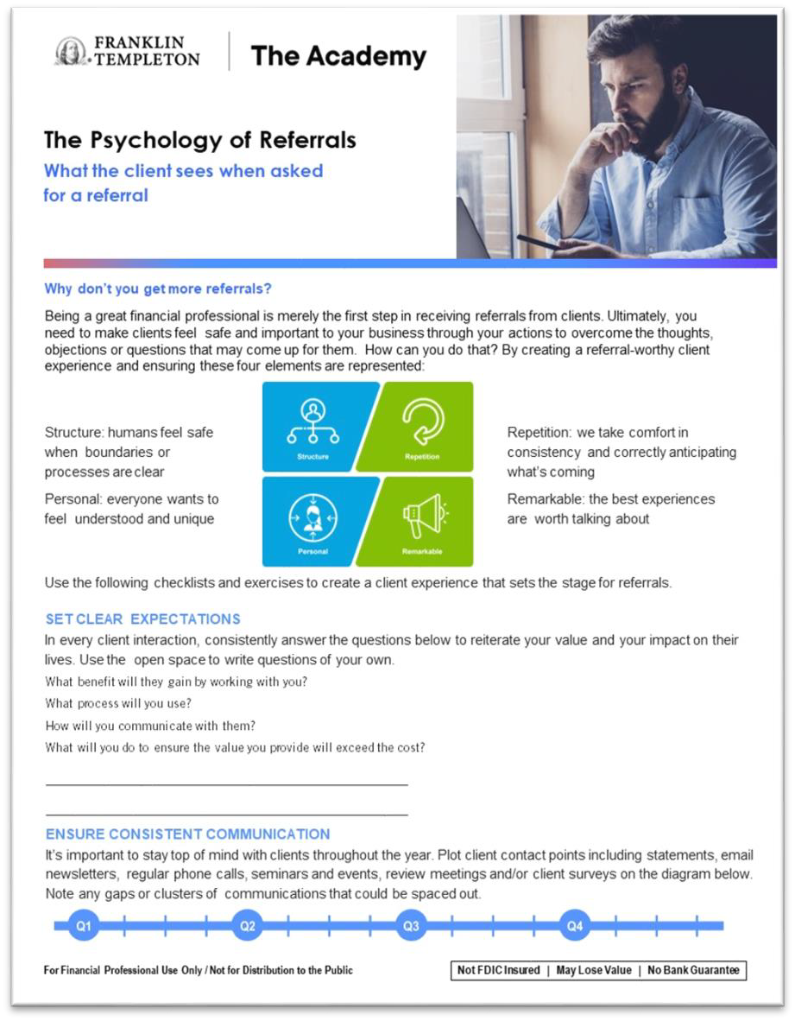
Putting ideas into action
The psychology of referrals checklist
POR LIST

Slide 43
Important Legal Information
This material is intended to be of general interest only and should not be construed as individual investment advice or a recommendation or solicitation to buy, sell or hold any security or to adopt any investment strategy. It does not constitute legal or tax advice. This material may not be reproduced, distributed or published without prior written permission from Franklin Templeton.
All investments involve risks, including possible loss of principal.
Any research and analysis contained in this material has been procured by Franklin Templeton for its own purposes and may be acted upon in that connection and, as such, is provided to you incidentally. Data from third party sources may have been used in the preparation of this material and Franklin Templeton ("FT") has not independently verified, validated or audited such data. Although information has been obtained from sources that Franklin Templeton believes to be reliable, no guarantee can be given as to its accuracy and such information may be incomplete or condensed and may be subject to change at any time without notice. The mention of any individual securities should neither constitute nor be construed as a recommendation to purchase, hold or sell any securities, and the information provided regarding such individual securities (if any) is not a sufficient basis upon which to make an investment decision. FT accepts no liability whatsoever for any loss arising from use of this information and reliance upon the comments, opinions and analyses in the material is at the sole discretion of the user.
Products, services and information may not be available in all jurisdictions and are offered outside the U.S. by other FT affiliates and/or their distributors as local laws and regulation permits. Please consult your own financial professional or Franklin Templeton institutional contact for further information on availability of products and services in your jurisdiction.
Issued in the U.S. by Franklin Distributors, LLC, One Franklin Parkway, San Mateo, California 94403-1906, (800) DIAL BEN/342-5236, franklintempleton.com - Franklin Distributors, LLC, member FINRA/SIPC, is the principal distributor of Franklin Templeton U.S. registered products, which are not FDIC insured; may lose value; and are not bank guaranteed and are available only in jurisdictions where an offer or solicitation of such products is permitted under applicable laws and regulation.
© 2024 Franklin Distributors, LLC. Member FINRA/SIPC. All rights reserved.
For Financial Professional Use Only / Not for Distribution to the Public
POR-PPT

