Slide 1
Managing Stress for Success
Strategies to prepare for, respond to, and evolve your experience with stress
FOR FINANCIAL PROFESSIONAL USE ONLY / NOT FOR PUBLIC VIEWING OR DISTRIBUTION

Slide 2
Specialist Consulting Group
Advisors at the center
With more than 20 dedicated specialists and consultants, we strive to help you tackle challenges and implement solutions across key practice areas.
At Janus Henderson, “world-class service” is more than a buzzword. It is central to our mission as a firm and that of our growing team of experts focused on helping you build and manage your practice.

Slide 3
Program overview
Understand stress
Assess your stress Appreciate your stress
Adjust your stress

Slide 4
Let's win the war on stress.
Janus Henderson partnered with the Financial Planning Association and Investopedia to understand the drivers and impact of negative stress on financial professionals and investors, both professionally and personally.
Based on our findings, we have created actionable tools to identify the sources of stress and our reactions to it, and share ideas to help manage it more productively.

Slide 5
Understand stress

Slide 6
Stress is high and on the rise.
of financial professionals reported moderate or high levels of negative stress
of financial professionals feel higher levels of stress today than 5 years ago
of investors
said the same
said^{of investors}samethe
FOR FINANCIAL PROFESSIONAL USE ONLY / NOT FOR PUBLIC VIEWING OR DISTRIBUTION
Source: Janus Henderson, The Financial Planning Association, and Investopedia, 2019.

Slide 7
Stress is high and on the rise.
Both financial professionals and investors stated negative stress impacts their
mood, personal relationships, and health most significantly.
61%
56%
54%
50%
Financial
professionals
Financial
professionals
38%
38%
Financial
professionals
Investors
Investors
Investors
Mood
Personal Relationships
Health

Slide 8
How would you describe stress?
Activity

Slide 9
Common answers
Thoughts
Feelings
Not enough time
Being put on
the spot
Too many demands
Obstacles
Challenging people/ personalities
Abundance
Scarcity
Unknown situations
Not knowing what I’m talking about
Anxiety
Vulnerability
Worry
Tension
Pressure
Challenge
Overwhelmed
Embarrassed
Stimulation
Threatened
Loss
Rushed
Nervous

Slide 10
Stress reactions
Fight or flight
Freeze or faint

Slide 11
What stress actually is…

Slide 12
Summary
Stress is a multi-billion-dollar problem
There are two main types of stress
To manage our stress more effectively we must manage our responses to it

Slide 13
Assess your stress

Slide 14
Stress Load Audit
Activity

Slide 15
Appreciate your stress

Slide 16
How does stress show up for you?
Activity

Slide 17
How does stress show up for you?
What are my stress triggers?
What are the warning signs that I have too much stress?
What are the negative behaviors that I have in response to my warning signs?
What happens to me when stress continues for too long?
What has been the most helpful in the past to recharge or reset quickly?

Slide 18
Summary
Trigger
Thoughts Feelings

Slide 19
What is my current stress formula?
Activity

Slide 20
What is my current stress formula?
Trigger:
Thought: What do I think when this trigger occurs?
Feeling: How do I feel when I think this thought?

Slide 21
The stress formula
Trigger: The circumstance / facts
Thoughts: Our belief about the trigger
Feelings: The emotional response to our thoughts

Slide 22
Summary
Triggers may result in different thought patterns for different people
Stress is the result of our thoughts and feelings
Changing how we think about these triggers will result in less stress

Slide 23
Adjust your stress

Slide 24
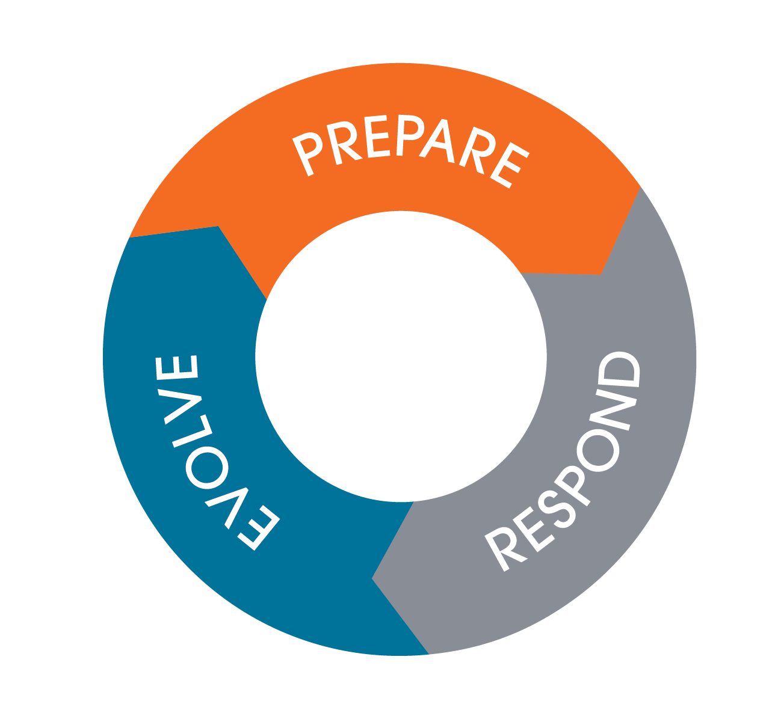
Prepare, respond, evolve

Slide 25
Prepare
Techniques for getting ahead of our stress reactions
Thought downloads
Mental rehearsal / visualization
Mindfulness meditation
Gratitude exercises

Slide 26
Respond
Techniques for managing the acute or immediate phase of our stress reactions
Breathing – longer exhale than inhale
A charm or talisman
Mantras
Move
Watch distracting videos
Engage your five senses
16-second reset ritual
Focus
Feel
Breathe

Slide 27
Evolve
Techniques for learning from our stress reactions
Journaling
Storytelling
Stress formula recalculation
Recharge tool kit

Slide 28
Recalculate your stress formula
Activity

Slide 29
Recalculate your stress formula
STEP 1
Trigger
STEP 3
Thought
Feeling
STEP 2

Slide 30
Closing and call to action
Techniques for learning from our stress reactions
Commit to change
Keep a stress journal for the next 24 days
Identify the common triggers that provoke negative stress results for you
“If you want something you’ve never had, you must do something you’ve never done.”
– Thomas Jefferson

Slide 31
Connect with us
Janus Henderson provides timely insight and perspective, programs designed to hone your skills, and a team of accessible experts committed to helping you exceed expectations – in business and in life.
To engage with us, contact your Sales Director or call 800.668.0434.
Visit janushenderson.com
This material is for information purposes only. There is no guarantee that the information supplied is accurate, complete or timely, nor is there any warranty with regards to the results obtained from its use. This material may not be reproduced in whole or in part in any form, or referred to in any other publication, without express written permission. Janus Henderson and Knowledge. Shared are trademarks of Janus Henderson Group plc or one of its subsidiaries. © Janus Henderson Group plc.
W-0724-577818 04-30-2026 155-15-428078 07-24
FOR FINANCIAL PROFESSIONAL USE ONLY / NOT FOR PUBLIC VIEWING OR DISTRIBUTION

