Slide 1
Not FDIC Insured | No Bank Guarantee | May Lose Value

Slide 2
The Home Stretch
Seven Things You Need to Do in the Decade Before You Retire
Not FDIC Insured | No Bank Guarantee | May Lose Value

Slide 3
Seven Things You Need to Do in the Decade Before You Retire
Determine When the Time is Right
Take Aim at Your Retirement Target
Maximize Your Nest Egg
Get a Portfolio Checkup
Create a Social Security Strategy
Build a Retirement Income Stream
Look Beyond the Money

Slide 4
1. Determine When the Time is Right

Slide 5
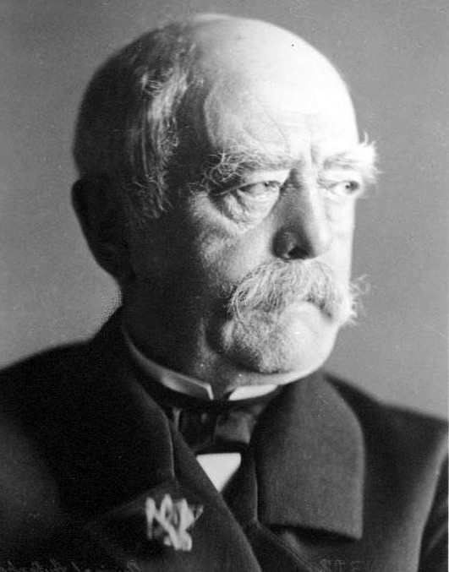
The Godfather of Retirement
1890
2024
AGE
90
80
70
60
50
40
30
20
10
0
LIFE EXPECTANCY
RETIREMENT AGE
LIFE EXPECTANCY
RETIREMENT AGE
LIFE EXPECTANCY
LIFE EXPECTANCY
OTTO VON BISMARCK
Sources: US Census Bureau: US Life Tables 1890,1901, 1910, and 1901-1910. Life expectancy for 1890 based on state of Massachusetts life tables. United Nations, Department of Economic and Social Affairs, Population Division. World Population Prospects 2024: Summary of Results.

Slide 6
At What Age Do You Think You’ll Retire?
Cost of healthcare (Medicare doesn’t start until 65) Nest egg not big enough
Expenses higher than anticipated
60 61 ₆62₂ 63 64 65 66 67 68 69 70
Source: Employee Benefit Research Institute. 2024 Retirement Confidence Survey. January 2024.

Slide 7
Nearly Half of People Retire in Their Early 60s
Percentage of Americans Retiring by Age Group
44%
61–65
22%
55–60
11%
8%
6%
6%
66–69
2%
<50
1%
50–54
70–74
75–79
>80
Source: Franklin Templeton Retirement Income Strategies and Expectations (RISE) Survey, 2022. The RISE survey was conducted online among a sample of 2,029 adults 40 years of age and older and weighted by age, gender, geographic region, race, and education. The custom-designed program assigns a weighting factor to the data based on current population statistics from the US Census Bureau and was administered February 17-28, 2022 by ENGINE INSIGHT’s Online CARAVAN®, which is not affiliated with Franklin Templeton. The percentage refers to the percent of survey respondents who retired between certain ages.

Slide 8
Couples Should Plan for Age Differences
Women may live 5 years or more on their own
25 23
65 63
83 81
Sources: US Census Bureau, Current Population Survey, Annual Social and Economic Supplements. Social Security Administration, 2023 OASDI Trustees Report, Period Life Expectancy

Slide 9
Important Ages for Retirement
65 ±3 months²
Sign up for Medicare
50
IRA/401(k) Catch-Up Contributions Begin
55
Eligible for Early Distributions from Current Qualified Employer Plan
60
Widow(er) Social Security Eligibility
66-67
Social Security
Full Retirement Age
70
Maximum Social Security Benefits
59½
Full retirement age for qualified plans¹
62
Early Social Security Benefits Eligibility
73-75³
Required Minimum
Distributions (RMDs)
Begin
At this age, individuals may begin taking withdrawals from their 401(k) without penalty.
Initial Medicare enrollment eligibility is a 7-month period that includes the month you turn 65 and the 3 full months before and after.
Starting in 2023, the age to begin taking Required Minimum Distributions (RMDs) from qualified, tax-deferred retirement accounts and avoid IRS penalties increased from 72 to 73. Starting in 2033, the age to begin taking RMDs from qualified, tax-deferred retirement accounts and avoid IRS penalties will increase from 73 to 75.

Slide 10
2. Take Aim at Your Retirement Target

Slide 11
Rule of Thumb #1
Save enough to generate 70–90% of your pre-retirement income.
Income Needs Are Different in Retirement
CoCostssts ThThatat MayMay GoGo UpDow
Costs That Go Away n
70%–90%
SociMortgaHealthcareal Securige ty payroll taxes
pre-retirement income
ReTTransportravtirementel atcontributionsion
CUtlothiilitiesng
FoodHome maintenance

Slide 12
How Much You Should Have Saved at Various Ages
Multiples of Your Current Salary To Save by Age
SALARY
$100,000
SAVINGS
$600,000– _{10–12X}
$800,000
8–10X
6–8X
_{3–4X 4–5X} 5–6X
_{1X} 2–3X
30 35 40 45 50 55 60 65 Years
AGE
Rule of Thumb #2
Save a multiple of your salary based on your age.

Slide 13
Rule of Thumb #3
Save enough to generate a 4% withdrawal rate.
What You Need in Order to Withdraw 4% Over 20 Years
RETIREMENT SAVINGS REQUIRED
DESIRED ANNUAL INCOME with a 1.5% return with a 5% return
$25,000 $545,000 $391,000
$50,000 $1,091,000 $782,000
$100,000 $2,181,000 $1,564,000
This is for illustrative purposes only and does not reflect the performance of any Franklin Templeton fund.
Desired annual income is increased by 2.5% each year to account for inflation and is distributed in monthly installments. Assumes constant rates of return and depletion of savings by the end of the 20th year. Actual amounts and time in retirement may differ from the example shown here.

Slide 14
3. Maximize Your Nest Egg

Slide 15
Take Advantage of Work-Sponsored Plans
AGE
50
Historical Society Volunteer
AGE
50
INCOME
$150,000
Maximum annual contribution (2024)
Plan type
401(k) 403(b) 457 | $23,000
SIMPLE 401(k) SIMPLE IRA | $16,000
SEP IRA | $69,000
Employer match
$4,500
$23,000
Employer Plan
Source: US Internal Revenue Service. Must have earned income at least equal to the contribution amount. 401(k)/403(b) and SEP IRA matching contributions are allowable on employee compensation up to a maximum of $345,000 in 2024.

Slide 16
Participate in Catch-up Contributions at Age 50
AGE
50
Historical Society Volunteer
AGE
50
INCOME
$150,000
Maximum annual contribution (2024)
Plan type
401(k) 403(b) 457 | $7,500
SIMPLE 401(k) SIMPLE IRA | $3,500
SEP IRA | —
Catch-up (50+) | $7,500
Employer match | $4,500
Employer Plan | $23,000
Source: US Internal Revenue Service. An individual must be 50 by the end of the calendar year to be eligible for the age 50 and over catch-up provision.

Slide 17
You May be Eligible to Add Personal Retirement Savings
AGE
50
Historical Society Volunteer
AGE
50
INCOME
$150,000
Single income
limit (2024)
Married income limit (2024)
Plan type
Traditional IRA¹ | $87,000 | $143,000
Roth IRA | $161,000 | $240,000
Maximum contribution $7,000
Catch-up contribution $1,000 for age 50+
Catch-up (50+) | $1,000
Roth IRA | $7,000
Catch-up (50+) | $7,500
Employer match | $4,500
Employer Plan | $23,000
1. Anyone, regardless of income, can contribute to a Traditional IRA. However, they lose the tax deduction if their income exceeds the Traditional IRA limits in the table.
Source: US Internal Revenue Service. Must have earned income at least equal to the contribution amount. If you are married and only your spouse is covered by a retirement plan at work, then the Traditional IRA income limit increases to
$240,000. If neither you nor your spouse is covered by a retirement plan at work, then there is no Traditional IRA income limit. An individual must be 50 by the end of the calendar year to be eligible for the age 50 and over catch-up provision.

Slide 18
Add a Spousal IRA for a Spouse Without Income
AGE
50
Historical Society Volunteer
AGE
50
INCOME
$150,000
Married income limit (2024)
Plan type
Traditional Spousal IRA | $143,000
Roth Spousal IRA | $240,000
Catch-up (50+) Spousal IRA | $1,000 $7,000
Catch-up (50+) | $1,000
Roth IRA | $7,000
Catch-up (50+) | $7,500
Employer match | $4,500
Employer Plan | $23,000
Maximum contribution $7,000
Catch-up contribution $1,000 for age 50+
Source: US Internal Revenue Service. Must have earned income at least equal to the contribution amount. If you are covered by a retirement plan at work but your spouse isn’t, then the Traditional Spousal IRA income limit increases to $240,000.
If neither you nor your spouse is covered by a retirement plan at work, then there is no Traditional Spousal IRA income limit. Your spouse must be 50 by the end of the calendar year to be eligible for the age 50 and over catch-up provision.

Slide 19
How Tax-Advantaged Retirement Savings Can Add Up
Hypothetical Growth of Retirement Savings With a 6% Return
AGE AGE
50 50
INCOME
Stay-at- _{$150,000}
home Mom
Catch-up (50+)
Catch-up (50+) 5 @ 6%
Spousal IRA
_{Roth IRA} EA RETURN
Catch-up (50+)
Employer match
Employer Plan
$1,219,376
$1,000
$7,000
$1,000
$7,000
1
Y
$7,500
$4,500
$23,000
1
2
3
4
5
6
7
8
YEARS
9
10
11
12
13
14
15
Shows a compounded annual hypothetical 6% growth over 15 years, without taxes, on an investment of $51,000 made in 12 equal end-of-month installments. This is a hypothetical example only and does not represent any specific investment product. Actual investments may include fees, charges and other expenses that would affect an investment’s return. It assumes no distributions are made during these periods. However, lower maximum tax rates on capital gains and dividends would make the investment return for the taxable investment more favorable. Actual returns will vary, perhaps significantly from the return shown here.

Slide 20
4. Get a Portfolio Checkup

Slide 21
How Today’s Jobs Complicate Retirement Planning
Average worker switches jobs 12 times
63% of American workers have access to defined contribution retirement plans
69% of plans have automatic enrollment
Sources: U.S. Bureau of Labor Statistics, 2023: Number of Jobs, Labor Market Experience, Marital Status and Health for those Born 1957-1964. Congressional Research Service, 2024: Contributions to Defined Contribution Retirement Plans.
DCIIA Retirement Research Center, 2020: Plan Sponsor Survey; Implementation of Auto Features Continues to Rise as Plans Recognize Benefits.

Slide 22
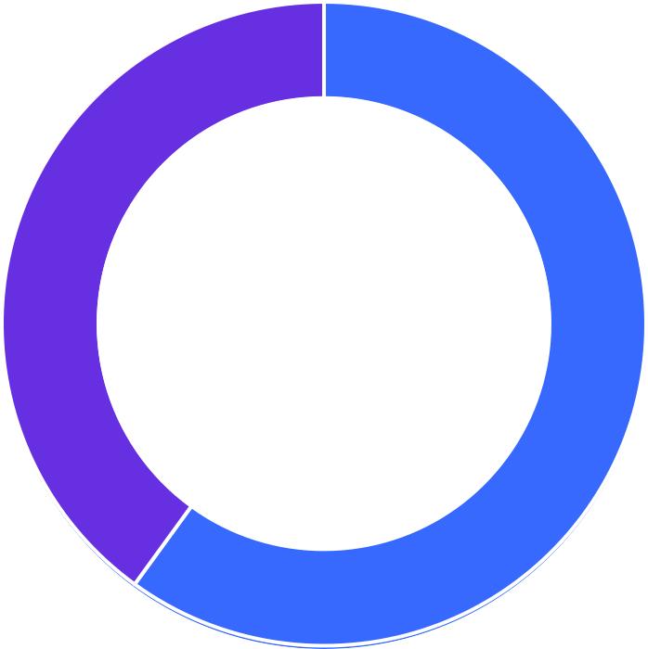
Perception vs. Reality of Your Asset Allocation
Bonds
40%
Stocks
60%
Bonds
10%
Stocks 90%
Current reti^{P}re^{r}m^{ev}e^{io}n^{u}t ^{s}plan allo^{jo}c^{b}at²ion
Overall retirement plan allocation
Previous job 1

Slide 23
What if You Have Too Much Invested in Stocks?
Hypothetical example
$1,200,000
$1,167,595
12 Months
$1,200,000
$1,167,595
$1,100,000 ^{3 Years}
^{Your assumption} 12 Months 10 Months
8% return
$1,000,000 Your goal
$900,000 _{$871,103}
_{$800,000} 50/50 stocks
You are here and bonds
$700,000
$600,000 _{$584,342}
_{$500,000} 100% stocks
12/993 122/00 112/01 Reti12reme/02 nt 12/03 12/04 12/05 12/06 Years to Retirement
3 Years
10 Months
$1,100,000
Your assumption 8% return
$1,000,000
$900,000
$871,103
50/50 stocks
and bonds
$800,000
$700,000
$600,000
$584,342
100% stocks
$500,000
12/99
12/00
12/01
12/02
Retirement
12/03
12/04
12/05
12/06
12/99
12/00
12/01
12/02
This is a hypothetical example only and does not represent any specific investment product. Actual investments may include fees, charges and other expenses that would affect an investment’s return. It assumes no distributions are made
during these periods. Actual returns will vary. Investment return and principal value will fluctuate, and when redeemed, securities may be worth more or less than the original cost.
Source: © 2023 Morningstar, Inc. Assumes $900,000 investment on 12/31/99 and monthly contributions of $833. 100% stocks portfolio represented by the S&P 500 Index. Blended 50/50 stocks and bonds portfolio represented by equal allocations to the S&P 500 Index and the Bloomberg US Aggregate Bond Index, rebalanced annually. Indexes are unmanaged and one cannot invest directly in an index. They do not reflect any fees, expenses or sales charges.

Slide 24
The Problem With Jumping Out of the Market
Hypothetical example
$1,200,000
$1,100,000
$1,200,000
$1,100,000
$1,000,000 ^{Your goal}
50/50 stocks
and bonds
$900,000
^{$800,000}You are here
_{$700,000} $713,368
100% T-Bills
$600,000
$500,000
3 2 1 Retirement
$1,000,000
50/50 stocks and bonds
$900,000
$800,000
$700,000
100% T-Bills
$600,000
$500,000
12/07 12/08 12/09 12/10 12/11 12/12 12/13 12/14 12/15 12/16 12/17 12/18 12/19 12/20 12/21 12/22 12/23
Years to Retirement
12/07 12/08 12/09 12/10
12/11 12/12 12/13 12/14 12/15 12/16 12/17 12/18 12/19 12/20 12/21 12/22 12/23
This is a hypothetical example only and does not represent any specific investment product. Actual investments may include fees, charges and other expenses that would affect an investment’s return. It assumes no distributions are made
during these periods. Actual returns will vary. Investment return and principal value will fluctuate, and when redeemed, securities may be worth more or less than the original cost.
Treasuries if held to maturity, offer a fixed rate of return and fixed principal value; their interest payments and principal are guaranteed.
Source: © 2023 Morningstar, Inc. Assumes $900,000 investment on 12/31/07 and monthly contributions of $833. Blended 50/50 stocks and bonds portfolio represented by equal allocations to the S&P 500 Index and the Bloomberg US Aggregate
Bond Index, rebalanced annually. Treasury Bills represented by the FTSE 3M Treasury Bill Index. Indexes are unmanaged and one cannot invest directly in an index. They do not reflect any fees, expenses or sales charges.

Slide 25
Update Your Beneficiaries
New spouse
Young children
LIVING TRUST
Trust

Slide 26
5. Create a
Social Security Strategy

Slide 27
The Outlook for Social Security
Benefits promised exceeded revenues 2021
Benefits promised
Surplus runs out 2035
Potential
Solution
3.67%
Payroll tax increase
Surplus
79%
of benefits
Revenues
1980 1990 2000 2010 2020 2030 2040 2050 2060
This chart is a conceptual illustration of Social Security revenues, benefits promised and surplus.
Source: Social Security Administration, 2024, The 2024 Annual Report of the Board of Trustees of the Federal Old-Age and Survivors Insurance and Federal Disability Insurance Trust Funds. The figures shown are for the combined Old-Age and Survivors Insurance and Federal Disability Insurance trust funds. There is no assurance any estimate, forecast or projection will be realized.

Slide 28
What’s Your Full Retirement Age (FRA)?
YEAR OF BIRTH
FULL RETIREMENT AGE
<1956 | Completed
1957 | 66 and 6 months
1958 | 66 and 8 months
1959 | 66 and 10 months
1960> | 67
Source: Social Security Administration, Full Retirement and Age 62 Benefit by Year of Birth chart. 2024.

Slide 29
Getting Paid to Wait With Social Security
Social Security Retirement Benefit Amounts By Age
Average monthly benefit
Maximum monthly benefit
$4,873
$4,648
$4,251
$3,911
$3,652
$3,426
$3,027
$2,882
$3,026
$2,710
$2,832
$2,635
$2,261
$2,422
$2,120
$1,752
$1,872
$1,677
62
63
64
65
66
AGE
67
68
69
70
Source: Social Security Administration. Estimated Social Security benefits at different ages for claims filed in 2024. Maximum monthly benefit assumes 35 years of income exceeding the Social Security payroll tax cap, which in 2024 is $168,600. Average monthly benefit assumes 35 years of income matching the national average wage index series, which in 2022, the most recent year available, was $63,795.13.

Slide 30
Income Replaced by Social Security
Pre-retirement Income Replaced by Social Security
100%
75%
48%
50%
38%
30%
23%
25%
0%
$10,000
$50,000
$100,000
$150,000
$200,000
Source: Social Security Administration. Benefits calculated for different income levels using the Social Security Administration’s Primary Insurance Amount formula for an individual retiring at age 62 in 2024 and waiting until FRA to claim benefits.

Slide 31
6. Build a Retirement Income Stream

Slide 32
Living Off Income-Generating Investments
Hypothetical example
10-Year Average Monthly Income From a $500,000 Investment
For the 10-year period ended June 30, 2024
$2,739
6.57%
$214
$1,641
$1,474
$1,162
3.94%
3.54%
$93
2.79%
0.22%
0.51%
Money Market
Savings Accounts
One-Year CDs
Core Bonds
Investment Grade
Corporate Bonds
Municipal Bonds
High Yield Bonds
Past performance does not guarantee future results. This is a hypothetical example only and does not represent any specific investment product. Actual investments may include fees, charges and other expenses that would affect an investment’s return. Actual returns will vary, perhaps significantly from the values shown here. Depending upon the investment, returns and principal can fluctuate, and when redeemed, securities may be worth more or less than the original cost.
Money market savings accounts and CDs are insured by the Federal Deposit Insurance Corporation for up to the current maximum limit of $250,000.
CDs offer a fixed rate of return.
Sources: FDIC for Money Market Savings Accounts and One-Year CDs, Bloomberg. Calculated based on a hypothetical $500,000 investment and the average 10-year yields based on month-end yield-to-worst values of the Bloomberg US Aggregate Bond , Municipal Bond, US Corporate, and the US Corporate High Yield indexes. Municipal Bonds income is based on the tax-equivalent yield, adjusted for the maximum 40.8% top marginal rate for net investment income (includes 3.8% Net Investment Income surtax from the Affordable Care Act). Indexes are unmanaged and one cannot invest directly in an index. They do not reflect any fees, expenses or sales charges.

Slide 33
What are Systematic Withdrawals?
Month
Withdrawal
Share price
Shares sold
Share balance
 |  |  | $5 |  | 100,000
Retirement | January | $1,500 | $6 | -250 | 99,750
 | February | $1,500 | $4 | -375 | 99,375
savings $500,000 | March | $1,500 | $5 | -300 | 99,075
 | April | $1,500 | $5 | -300 | 98,775
 | May | $1,500 | $4 | -375 | 98,400
 | June | $1,500 | $6 | -250 | 98,150
This table is for illustrative purposes only and does not reflect the performance of any Franklin Templeton fund.
An investor participating in a systematic withdrawal plan should review, every year, the results being obtained and the value of remaining shares. Based on this annual review, the individual can increase or decrease the amount of the monthly withdrawals if that seems appropriate. The results of such a program vary substantially depending on the investment performance during the period the program is in effect. The rate or amount chosen for withdrawal determines the value remaining at the end of the period. In a period of declining market values, continued withdrawals could eventually exhaust the principal.
32

Slide 34
Turning Retirement Savings into Retirement Income
Income-
Producing Products
No distribution of
original savings
Income may fluctuate
Systematic Withdrawal Plan
May distribute
original savings
Consistent income

Slide 35
7. Look Beyond the Money

Slide 36
The Human Happiness Curve
Level of Happiness
15
25
35
45
55
Age
65
75
85
95
Sources: The Economist, 2010: The U-Bend of Life: Why, Beyond Middle Age, People Get Happier as They Get Older. Proceedings of the National Academy of Sciences (PNAS), 2010: A Snapshot of the Age Distribution of Psychological Well-Being in the United States. Journal of Consumer Research, 2014: Happiness from Ordinary and Extraordinary Experiences.

Slide 37
Happiness Factors in Retirement
HEALTH
FRIENDSHIPS
FAMILY
Sources: 2018 Academic Research Colloquium for Financial Planning and Related Disciplines: Spending, Relationship Quality, and Life Satisfaction in Retirement. Psychology Today, 2017: To Age Well You Need Friends. University of California, San Francisco, 2012: Loneliness Linked to Serious Health Problems and Death Among Elderly. Cigna, 2018: US Loneliness Index Report, 2018: Most Americans are Considered Lonely.

Slide 38
What is Your Ikigai?

Slide 39
What is Your Ikigai?
What you LOVE
What you are GOOD AT
What the world NEEDS
ikigai
What you can be PAID FOR

Slide 40
Create Your Retirement Living Plan
Contributing to a cause
Visiting family and friends
Pursuing hobbies
Traveling
Starting a business
Going to school

Slide 41
Things Accomplished by People Age 65+
73
65
82
76
80
Peter Roget Invented the thesaurus
Colonel Sanders
Started KFC
Madonna Buder
Triathlete
Grandma Moses
Started painting
Yuichiro Miura Climbed Mount Everest

Slide 42
“
Retirement is wonderful if you have two essentials – much to live on and much to live for.”
- Unknown

Slide 43
Seven Things You Need to Do in the Decade Before You Retire
Determine When the Time is Right
Take Aim at Your Retirement Target
Maximize Your Nest Egg
Get a Portfolio Checkup
Create a Social Security Strategy
Build a Retirement Income Stream
Look Beyond the Money

Slide 44
Work with a financial professional

Slide 45
Important Legal Information
All investments involve risks, including possible loss of principal.
This material is intended to be of general interest only and should not be construed as individual investment advice or a recommendation or solicitation to buy, sell or hold any security or to adopt any investment strategy. It does not constitute legal or tax advice. This material may not be reproduced, distributed or published without prior written permission from Franklin Templeton.
The views expressed are those of the investment manager and the comments, opinions and analyses are rendered as at publication date and may change without notice. The underlying assumptions and these views are subject to change based on market and other conditions and may differ from other portfolio managers or of the firm as a whole. The information provided in this material is not intended as a complete analysis of every material fact regarding any country, region or market. There is no assurance that any prediction, projection or forecast on the economy, stock market, bond market or the economic trends of the markets will be realized.
The value of investments and the income from them can go down as well as up and you may not get back the full amount that you invested. Past performance is not necessarily indicative nor a guarantee of future performance.
Any research and analysis contained in this material has been procured by Franklin Templeton for its own purposes and may be acted upon in that connection and, as such, is provided to you incidentally. Data from third party sources may have been used in the preparation of this material and Franklin Templeton ("FT") has not independently verified, validated or audited such data. Although information has been obtained from sources that Franklin Templeton believes to be reliable, no guarantee can be given as to its accuracy and such information may be incomplete or condensed and may be subject to change at any time without notice. The mention of any individual securities should neither constitute nor be construed as a recommendation to purchase, hold or sell any securities, and the information provided regarding such individual securities (if any) is not a sufficient basis upon which to make an investment decision. FT accepts no liability whatsoever for any loss arising from use of this information and reliance upon the comments, opinions and analyses in the material is at the sole discretion of the user.
Products, services and information may not be available in all jurisdictions and are offered outside the U.S. by other FT affiliates and/or their distributors as local laws and regulation permits. Please consult your own financial professional or Franklin Templeton institutional contact for further information on availability of products and services in your jurisdiction.
U.S. by Franklin Templeton, One Franklin Parkway, San Mateo, California 94403-1906, (800) DIAL BEN/342-5236, franklintempleton.com. Investments are not FDIC insured; may lose value; and are not bank guaranteed.
© 2024 Franklin Distributors, LLC. Member FINRA/SIPC. All rights reserved.
HS-PPT 08/24

