Slide 1
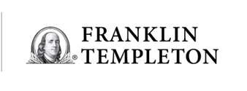
Second Quarter 2025
Not a Deposit │ Not FDIC Insured │May Lose Value │ Not Bank Guaranteed Not insured by any Federal Government Agency

Slide 2
Economic Outlook Market Outlook Fixed Income Fundamentals Market Leadership International Investor Pitfalls
3
13
28
37
44
52
61

Slide 4
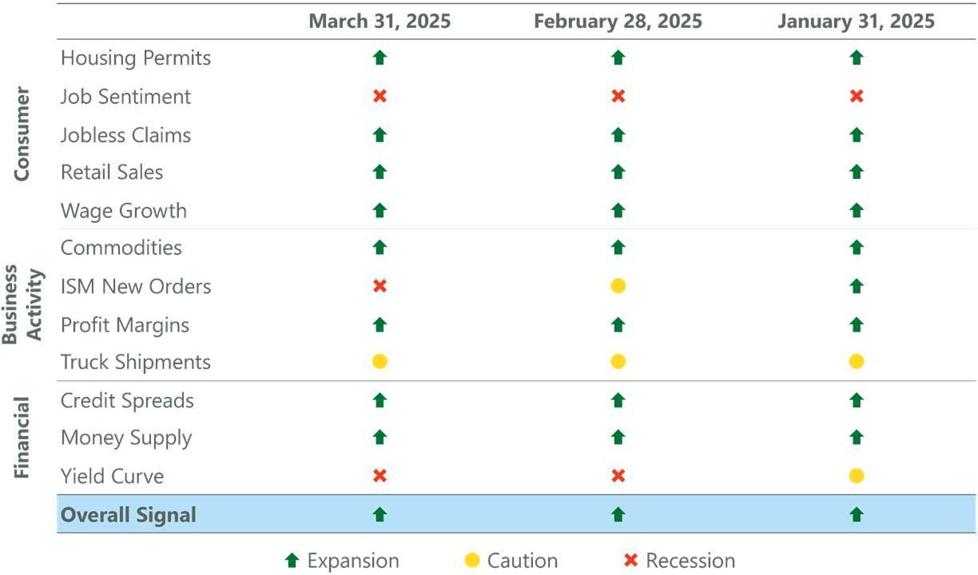
12 variables have historically foreshadowed a looming recession
The overall dashboard is currently signaling expansion
12 variables have historically foreshadowed a looming recession
The overall dashboard is currently signaling expansion

Slide 5
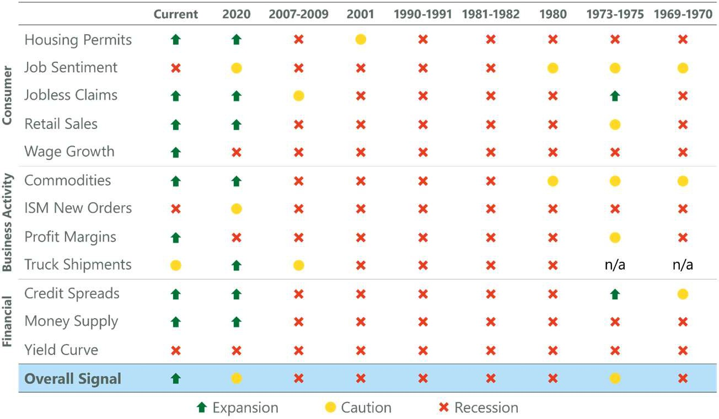
12 variables have historically foreshadowed a looming recession
The overall dashboard is currently signaling expansion
12 variables have historically foreshadowed a looming recession
The overall dashboard is currently signaling expansion

Slide 6
Although the U.S. economy appears to have hit a soft patch amid elevated policy uncertainty, high yield credit spreads remain relatively benign.
So far, we view this as a positive given credit spreads are one of the highest weighted indicators on the ClearBridge Recession Risk dashboard.
Although the U.S. economy appears to have hit a soft patch amid elevated policy uncertainty, high yield credit spreads remain relatively benign.
So far, we view this as a positive given credit spreads are one of the highest weighted indicators on the ClearBridge Recession Risk dashboard.

Slide 7
3.5%
3.0%
2.8
2.8
3.0
GDP Growth (% QoQ SAAR)
2.5%
2.0%
2.1
1.5%
1.0%
Q1
Q2
Q3
Q4
Since the Global Financial Crisis (GFC), the first quarter has tended to be the weakest economically before giving way to more robust growth during the rest of the year.
- Since the Global Financial Crisis, the first quarter has tended to be the weakest economically before giving way to more robust growth during the rest of the year.

Slide 8
160
9
158
150
8
7
6.46
6
5.39
Million
5
4
3
2.99
2
1.86
1
0.35
0.22
0
Est. DOGE-
Related Layoffs
Weekly Initial Total Continuing # of Federal Jobless Claims Jobless Claims Employees
Monthly Gross # of Unemployed Total U.S. Hiring (JOLTS) Workers Employment
Although DOGE-related layoffs have dominated the headlines, the actual impact appears manageable in context of the broader U.S. labor market.
- Although DOGE-related layoffs have dominated the headlines, the actual impact appears manageable in context of the broader U.S. labor market.

Slide 9
While consumer sentiment has remained in the doldrums since the COVID-19 pandemic, this has not led to changes in overall spending patterns.
The recent drop in sentiment has been largely fueled by tariff-related uncertainty, but a healthy labor market and strong household balance sheets provide solid footing for 2025 spending.
-While consumer sentiment has remained in the doldrums since the pandemic, this has not led to changes in overall spending patterns.
-The recent drop in sentiment has largely been fueled by tariff-related uncertainty, but a healthy labor market and strong balance sheets provide a strong baseline for continued consumption.

Slide 10
Consumer deleveraging efforts were a key component of slower GDP growth following the GFC.
With household net worth up by $49.9T since 2020, the U.S. consumer appears to be in a position to sustain their spending even as the economy normalizes.
Consumer deleveraging efforts were a key component of slower GDP growth following the GFC.
With household net worth up by $49.4T since 2020, the U.S. consumer is in position to sustain their spending even as the economy normalizes.

Slide 11
6,000
5,426
5,000
4,000
3,000
2,000
Number of Data Centers by Country
Next 10 Countries: 3,418
1,000
529 523
449
³³⁷ 322 314 298 ₂₅₁
222
0
173
United Germany States
United China Kingdom
Canada France Australia Netherlands Russia Japan Mexico
The U.S. is the leading global destination for AI investment, outpacing the next 10 countries combined by ~2,000 data centers.
-The U.S. is the leading global destination for AI investment, outpacing the next 10 countries combined by over 2,000 data centers.

Slide 12
6%
First Cut
5.1%
5%
4%
4.4%
Real GDP Growth
3.5%
3.4%
3%
2%
1.8%
1.3%
1%
0.5%
0%
18M Prior 12M Prior 6M Prior First Cut 6M Post 12M Post 18M Post
Sustained Fed cut cycles have historically led to inflections in economic growth two quarters later.
With the Fed’s first cut having occurred over six months ago, the economy should start to see the benefits from 2024 rate cuts.
Sustained Fed cut cycles have historically led to inflections in economic growth two quarters later.
With the long-awaited cutting cycle now underway, the economy should re-accelerate in 2025.

Slide 14
90%
80%
70%
60%
S&P 500 Rallies Following Major Market Lows (20% Declines)
S&P 500 Price Return
???
50%
40%
30%
20%
10%
Year One Year Two Year Three Year Four
0%
Number of Weeks
Current (Rally from October 2022 Low) Average Rallies from 1966, 1970, 1974, 1987, 2002, 2009 and 2020 Lows
Historically, the third year of a new bull market has experienced a period of digestion before giving way to further upside in year four.
0
5
10
15
20
25
30
35
40
45
50
55
60
65
70
75
80
85
90
95
100
105
110
115
120
125
130
135
140
145
150
155
160
165
170
175
180
185
190
195
200
205
- Historically, the third year of new bull market has experienced a period of digestion before giving way to further upside in year four.

Slide 15
The S&P 500 index traded largely sideways during the period of tariff escalation during the first Trump administration.
With tariffs front and center, policy sequencing has impacted equity market behavior so far in 2025. The more market-friendly policies of tax cuts and deregulation should arrive in the second half of the year.
The S&P 500 index traded largely sideways during the period of tariff escalation during the first Trump administration.
With tariffs likely to be an early priority, policy sequencing could impact how equity markets behave in early 2025.

Slide 16
20%
Average S&P 500 Returns Based on Starting U.S. Policy Uncertainty Index Level
18%
16%
14%
12%
18.1%
S&P 500 Price Return
11.7%
10% 9.3%
7.9%
8%
6.0%
6%
4.9%
3.7%
4%
1.8%
2.7%
2%
0%
+3 Months +6 Months +12 Months
Below Average Uncertainty (<116) Above Average Uncertainty (116-155) High Uncertainty (>155)
Over the past 40 years, periods of elevated U.S. policy uncertainty (such as today) have historically given way to superior forward equity market returns as clarity is restored.
- Over the past 40 years, periods of elevated U.S. policy uncertainty (such as today) have historically given way to superior forward equity market returns.

Slide 17
Performance Following Corrections of at Least -10% Since 1950
16%
13.9%
14%
12%
Average S&P 500 Price Return
10%
9.2%
8%
6%
4.0%
4%
2%
2.5%
2.8%
1.2%
0%
Three Months
Six Months
No Recession Recession
12 Months
Investors have historically been rewarded for buying U.S. equities following corrections of at least -10% that did not lead to recessions.
History suggests the current pullback could be an opportunity for long-term investors should the expansion continue.
Investors have historically been rewarded for buying U.S. equities following corrections of 10% or worse that did not lead to recessions.
With the U.S. economy remaining on firm footing, history suggests the current pullback could be an opportunity for long-term investors.

Slide 18
45%
40%
35%
Sum of Top 10 Largest Weights in the S&P 500
Current: 35.0%
30%
25%
20%
15%
10%
1990 1992 1994 1996 1998 2000 2002 2004 2006 2008 2010 2012 2014 2016 2018 2020 2022 2024
The weight of the largest stocks in the benchmark has moved down but remains elevated compared to history.
This move has coincided with outperformance for the average stock so far this year, a trend we believe will continue.
The weight of the largest stocks in the benchmark is at the highest levels in recent history.
While this dynamic can persist, historically the market has been less concentrated with a wider group of stocks contributing to the bulk of returns.

Slide 19
Index Concentration vs. Subsequent Five-Year Performance of Equal vs. Cap-Weighted S&P 500
8%
6.3%
S&P 500 Equal vs. Cap Weight 5-Year Annualized Performance
6%
4%
Current
2%
1.0%
2.0%
0%
% Positive: 89%
-2%
-4%
-3.9%
-6%
Less Than 18% 18 - 21% 21 - 24% 24% +
Weight of 10 Largest S&P 500 Constituents
When the top 10 weights in the S&P 500 have historically accounted for over 24% of the benchmark, the equal-weight S&P 500 has outperformed its cap-weighted counterpart by an average of 6.3% (annualized) over the next five years.
The top 10 weights in the S&P 500 currently make up 35% of the benchmark.
When the top 10 weights in the S&P 500 have historically accounted for over 24% of the benchmark, the equal-weight S&P 500 has outperformed its cap-weighted counterpart by an average of 6.3% (annualized) over the next five years.
The top 10 weights in the S&P 500 currently make up 35% of the benchmark.

Slide 20
700%
600% 572%
500%
400% ^{375%}
300% 267%
Cumulative Price Return
200%
221%
208%
100%
0%
114%
-100%
-21% -22%
-67%
-83%
-95%
-200%
Microsoft Walmart S&P 500 Oracle
Exxon Mobil
IBM
GE
Cisco Intel Citigroup Lucent
Technologies*
Following the peak of the dot-com mania, the prospects of the 10 largest S&P 500 constituents have varied widely.
We believe that a similar dynamic may play out in the coming years, presenting a potential opportunity for active managers.
Following the peak of the dot-com mania, the prospects of the 10 largest S&P 500 constituents have varied widely.
We believe that a similar dynamic may play out in the coming years, presenting an opportunity for active managers.

Slide 21
60%
50%
53%
Less Exposed to Tariffs
47%
% of Non-U.S. Revenue
40%
40%
31%
35%
30%
20%
22%
23%
10%
Russell 2000 Russell Mid Cap Russell 1000 Value S&P 493
S&P 500
Russell 1000 Magnificent 7 Growth
The Magnificent 7 stocks derive a substantially larger portion of their revenues from outside of the United States, making them more exposed to the risks from a trade war.
-The Magnificent 7 stocks derive a substantially larger portion of their revenues from outside of the United States, making them more exposed to the risks from a potential trade war.

Slide 22
50%
40%
39.3%
34.0%
Mag7 EPS Converging to S&P 493
37.6%
30%
EPS Growth
20%
Superior EPS Growth Helps Drive Outperformance
17.0%
10%
5.2%
9.3%
0%
-4.4%
-10%
-11.6%
-20%
-17.4%
-30%
2023 (Actual)
Magnificent 7 - Weighted Average
2024 (Actual)
S&P 493 - Weighted Average
2025E
Russell 2000
A key driver of the Magnificent 7 outperformance has been superior earnings growth.
Bottom-up consensus expects this advantage to narrow in the coming year which could help drive broader equity market leadership.
A key driver of the Mag 7 outperformance has been superior earnings growth.
Bottom-up consensus expects this advantage to narrow in the coming year which could help drive broader equity market leadership.

Slide 23
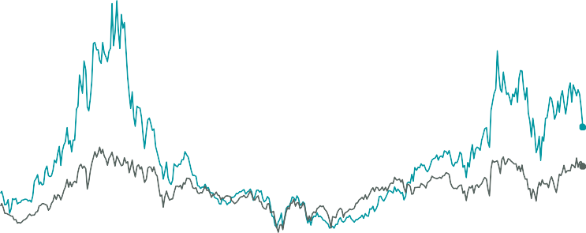
45
40
35
30
25
NTM P/E Ratio (x)
10 Largest: 24.1x
20 Other 490:
18.7x
15
10
5
1994 1996 1998 2000 2002 2004 2006 2008 2010 2012 2014 2016 2018 2020 2022 2024
10 Largest S&P 500 Stocks Other 490 S&P 500 Stocks
The largest stocks in the S&P 500 trade at a significant premium even after de-rating 5x turns in 1Q25.
The typical stock (other 490) still trades at a more reasonable valuation, closer to historical averages.
The largest stocks in the S&P 500 trade at a significant premium which is distorting the broader benchmark's valuation.
The typical stock (other 490) trades at a more reasonable valuation, closer to historical averages.

Slide 24
Consumer sentiment has historically been a contra-indicator for equity investors when hitting extreme levels.
If this historical relationship holds, plummeting sentiment may prove an attractive entry point for long-term equity investors.
Consumer sentiment has historically been a contra-indicator for equity investors when hitting extreme levels.
If this historical relationship holds, plummeting sentiment may prove an attractive entry point for long-term equity investors.

Slide 25
16384
4096
S&P 500 Price Returns
1980-2000
All-Time Highs: 500 Cumulative Return: 1,261.2%
S&P 500 Index (Log-Scale)
1024
1950-1970
All-Time Highs: 365
Cumulative Return: 451.9%
2010-Present All-Time Highs: 406
Cumulative Return:
403.3%
256
64
16
4
1970-1980
All-Time Highs: 35 Cumulative Return: 17.2%
2000-2010
All-Time Highs: 13 Cumulative Return:
-24.1%
1930-1950
All-Time Highs: 0
Cumulative Return: -22.2%
1
1930 1935 1940 1945 1950 1955 1960 1965 1970 1975 1980 1985 1990 1995 2000 2005 2010 2015 2020 2025
Secular Bear: Average Drawdown -46.1%
Secular Bull: Average Drawdown -26.1%
In the 12 months following an all-time high, stocks have historically been up 8.4% on average with positive returns 71% of the time.
-In the 12 months following an all-time high, stocks have historically been up 8.3% on average with positive returns 70% of the time.

Slide 26
U.S. Economic Outlook
The U.S. economy has continued to hold up despite the emergence of a soft patch in Q1. The overall signal from the ClearBridge Recession Risk Dashboard remains in green “expansion” territory.
Elevated policy uncertainty has weighed on consumer, business, and investor sentiment. Whether or not weaker outlooks translate into softer activity will be a key determinate of the economic path forward.
U.S. Market Outlook
The S&P 500 has experienced a correction (-10%) and a leadership rotation in Q1. A period of digestion was anticipated coming into the year due to policy sequencing with tariffs coming before tax cuts.
Elevated policy uncertainty has weighed on U.S. equities; however, history shows these periods have led to strong forward market returns as conditions normalize.
International, value, and equal-weight have handily outperformed this year, which we believe emphasizes the importance of equity portfolio diversification.
Recession Dashboard Overall Signal
Expansion
US economic and market outlooks for the second quarter of 2025

Slide 27
Fixed Income
Fundamentals
Market Leadership
International
Investor Pitfalls

Slide 28
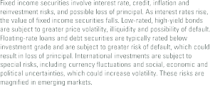

Slide 29
Historical 12-Month Annualized Returns By Starting MOVE Index Level
 | Short- Term Bonds | U.S. Treasury Bonds | MBS | Global Bonds | Multi- Sector | TIPS | Leveraged Loans | Corporate Bonds | High Yield Bonds | Emerging Market Bonds
MOVE <76 | 1.85% | 2.15% | 2.09% | 1.27% | 1.41% | 2.74% | 4.10% | 3.05% | 5.25% | 3.34%
MOVE 76-100 | 2.92% | 4.25% | 4.18% | 3.18% | 3.31% | 6.03% | 4.49% | 4.92% | 4.95% | 8.36%
MOVE >100 | 4.09% | 4.91% | 5.41% | 5.77% | 5.98% | 6.74% | 6.88% | 7.41% | 10.55% | 12.61%
Average | 2.90% | 3.64% | 3.77% | 3.33% | 3.49% | 4.96% | 5.18% | 5.05% | 7.05% | 7.84%
Current MOVE Index (as of March 31, 2025): 101.35
Historically, when bond market volatility has been elevated at these levels (MOVE >100), subsequent 12-month returns were strong.
- Historically, when bond market volatility has been elevated at these levels (MOVE
>100), subsequent 12-month returns were strong.

Slide 30
Impact of a 1% Rise or Fall in Interest Rates*
15-Year Correlation 15-Year
to 10-Year Correlation to
Treasuries S&P 500
U.S. Treasuries
2-Year
5.86%
1.98%
8.65%
0.77
0.94
0.74
1.00
0.93
0.01
-0.01
0.34
-0.06
-0.10
5-Year
TIPS
10-Year
30-Year _{-9.94%}
-0.50%
-2.31%
-3.44%
11.21%
12.62%
22.92%
U.S. Aggregate
IG Corps Convertibles
U.S. HY
Municipals
MBS ABS
-1.28%
10.99%
12.63%
0.90
0.69
-0.04
0.10
0.73
0.82
0.74
0.26
0.47
0.84
0.79
0.27
0.27
0.16
-1.42%
4.92%
Sector
-1.74%
4.17%
11.15%
10.15%
10.61%
-2.65%
-1.07%
7.32%
2.02%
-15% -10% -5% 0% 5% 10% 15% 20% 25%
1% Fall - Total Return 1% Rise - Total Return
Interest rates impact different fixed income asset classes differently

Slide 31
10%
9%
Historical Five-Year Annualized Average Returns at Recent Yield Levels*
Five-Year Annualized Average Return
8%
7%
6%
7.99%
5%
5.22%
5.36%
5.44%
5.62%
5.68%
5.82%
6.10%
6.46%
4%
3.91%
3%
2%
1%
0%
Short-Term U.S. Treasury Leverage
MBS
Corporate Global Bonds Multi-Sector TIPS
High Yield Emerging
Bonds | Bonds | Loans |  | Bonds |  |  |  | Bonds | Market Bonds
Current _{4.09%} | 4.11% | 8.57% | 4.92% | 5.15% | 3.62% | 3.84% | 4.22% | 7.73% | 6.53%
Yield
Following the strongest tightening cycle in 40 years, bond yields have risen to levels that have historically offered attractive five-year returns.
- Following the strongest tightening cycle in 40 years, bond yields have risen to levels that have historically offered attractive five-year returns.

Slide 32
30%
25%
Percent of Total Market Value
20%
Fewer Bonds Maturing
More Bonds Maturing
15%
10%
5%
0%
2025 2026 2027
2028
Current
2029
2030
2023 Year-End
2031 2032 2033 2034+
Companies with sub-investment-grade ratings have taken advantage of ample liquidity in recent years and termed out their debt, meaningfully reducing rollover risk.
- Companies with sub-investment grade ratings have taken advantage of the recent liquidity and termed out their debt, meaningfully reducing rollover risk in the next few years.

Slide 33
8.0%
7.0%
6.69%
7.21%
6.0%
5.0%
Yield
5.41%
4.59% 5.07% ^{4.58%}
4.34% 4.33% ^{4.85%}
4.64% 4.65%
4.0% ^{4.30%}
4.49%
4.27%
4.22% 4.23%
4.10% 4.09%
3.89%
3.88%
3.97%
3.96%
3.0%
2.72%
2.74%
2.87%
3.00%
3.20%
2.57%
2.56%
2.66%
2.0%
3M 6M 1Y 2Y 3Y 5Y 7Y 10Y 20Y 30Y
AAA Muni Tax-Free U.S. Treasury AAA Muni Taxable Equivalent
With the recent rise in interest rates, high-quality municipal bonds now offer attractive yields on an after-tax basis compared with U.S. Treasuries.
- With the recent rise in interest rates, high-quality municipal bonds now offer attractive yields on an after-tax basis compared with U.S. Treasuries.

Slide 34
7%
6%
5%
 |  |  |  | Emerging Economie | s
U. | K. Aust | U.S. alia |  |  | Attractive Yields and GDP Growth
 | Canada | Global
Euro A | ea
 | Japan |  |  |  | China
Yield Comparison (Yield to Worst)
4%
r
3%
r
2%
1%
0%
-1%
0%
1%
2% 3%
Expected Real GDP Growth (Bloomberg 2025 Estimate)
4%
5%
Consensus estimates call for emerging markets to see strong GDP growth in 2025.
Emerging markets also currently boast the highest yields globally, a potentially attractive combination for long-term investors.
Consensus estimates call for Emerging Markets to see strong GDP growth in 2025.
Emerging Markets also boast the highest yields globally, a potentially attractive combination for long-term investors.

Slide 35
Despite a dramatic increase in government debt outstanding since the GFC, total debt servicing costs as a percent of GDP declined due to falling rates.
Current CBO projections show the interest burden returning to early 1990s levels over the next couple of years.
-Despite a dramatic increase in government debt outstanding, total debt servicing costs as a percent of GDP have declined due to falling rates.
-Current CBO projections show the interest burden returning to early 1990's levels over the next decade.

Slide 36
More Government ^{300%}
Debt
General Government Gross Debt as Percent of GDP
250%
Japan
200%
150%
^{Italy} United States
France
100%
Canada Spain
United Kingdom
50%
Germany
Australia
New Zealand
0%
0.5% 1.0% 1.5% 2.0% 2.5% 3.0% 3.5% 4.0% 4.5% 5.0% 5.5%
10-Year Government Bond Yield
Higher Yields
Contrary to popular belief, higher government debt loads do not translate to higher yields on long-term government debt.
- Contrary to popular belief, higher government debt loads do not translate to higher yields on long-term government debt.

Slide 38
Consumer Debt Breakdown
Mortgage Balances | 69.9%
Other Loan Balances | 30.1%
The U.S. consumer has become less interest rate sensitive since the GFC when ultra low rates encouraged greater utilization of fixed rate mortgages over floating. Mortgage debt accounts for over two-thirds of U.S. consumer borrowing.
While the current 30-year fixed rate mortgage is nearly 7%, the average rate Americans are paying is just 4.0%.
The U.S. consumer has become less interest rate sensitive since the GFC when ultra low rates encouraged greater utilization of fixed rate mortgages over floating. Mortgage debt accounts for over two-thirds of U.S. consumer borrowing.
While the current 30-year fixed rate mortgage is nearly 7%, the average rate Americans are paying is just 4.0%.

Slide 39
Productivity dropped well below the historical average in the aftermath of the GFC but has rebounded more recently and is now back in line with the long-term average.
While the benefits from AI have not yet arrived, this technology could unleash a sustained productivity wave similar to the internet revolution.
Productivity dropped well below the historical average in the aftermath of the GFC but has rebounded more recently and is now back in-line with the long-term average.
While the benefits from AI have not yet arrived, this technology could unleash a sustained productivity wave similar to the internet revolution.

Slide 40
S&P 500 Corrections of at Least -10% since 1950
_{Market Peak} 10% Correction |  | # of Trading | 3-Month Return | 6-Month Return | 12-Month Return
 | Date | Days | (%) | (%) | (%)
02/19/2020 | 02/27/2020 | 7 | 1.9 | 17.0 | 27.9
01/26/2018 | 02/08/2018 | 10 | 3.5 | 10.7 | 4.9
09/23/1955 | 10/11/1955 | 13 | 8.8 | 18.4 | 14.7
06/12/1950 | 06/29/1950 | 14 | 11.5 | 17.1 | 20.2
10/05/1979 | 10/25/1979 | 15 | 13.6 | 5.2 | 29.9
10/07/1997 | 10/27/1997 | 15 | 10.5 | 23.9 | 21.5
03/24/2000 | 04/14/2000 | 16 | 11.3 | 1.3 | -12.8
02/19/2025 | 03/13/2025 | 17 | ? | ? | ?
7/15/1975 | 8/8/1975 | 19 | 3.8 | 15.6 | 20.7
2/13/1980 | 3/10/1980 | 19 | 7.7 | 17.2 | 22.5
04/23/2010 | 05/20/2010 | 20 | 0.0 | 12.0 | 24.4
10 Fastest Correction Average |  |  | 7.3% | 13.8% | 17.4%
10 Fastest Correction Hit Rate |  |  | 100% | 100% | 90%
34 Corrections Since 1950 Average |  |  | 3.5% | 7.1% | 9.8%
34 Corrections since 1950 Hit Rate |  |  | 71% | 71% | 74%
The fastest corrections of at least -10% have historically seen stronger rebounds.
- The fastest corrections of 10% or worse have historically seen stronger rebounds.

Slide 41
Current
13.5
S&P 500 52-Week Price Change (%) Based on Starting AAII Bull-Bear Spread Decile
13.3
10.5
10.5
9.7
8.5
10.8
10.4
7.4
4.2
1st Decile 2nd Decile 3rd Decile 4th Decile 5th Decile 6th Decile 7th Decile 8th Decile 9th Decile 10th Decile
Most Most
Bearish Bullish
Historically, retail investor sentiment extremes have been a contra-indicator with the market doing the opposite over the subsequent year vs. expectations.
- Historically, retail investor sentiment extremes have been a contra-indicator with the market doing the opposite over the subsequent year vs. expectations.

Slide 42
5.0x
S&P 500 Following Insider Buy/Sell Ratio >2.5x
+3 +6 +12
Months Months Months
4.5x
Avg. Price Return 3.2% 7.1% 13.4%
4.0x
3.5x
3.0x
2.5x
2.0x
1.5x
1.0x
0.5x
0.0x
2009 2010 2011 2012 2013 2014 2015 2016 2017 2018 2019 2020 2021 2022 2023 2024
Corporate insiders are currently executing 4.0x more purchases than sales, the highest ratio in the post-GFC era.
The S&P 500 has historically delivered superior returns once the 2.5x threshold has been crossed.
Corporate Insider Buy/Sell Ratio
Corporate insiders are currently executing 4.0x more purchases than sales, the highest ratio in the post-GFC era.
The S&P 500 has historically delivered superior returns once the 2.5x threshold has been crossed.

Slide 43
21
19
17
S&P 500 Equal Weight NTM P/E
NTM P/E Ratio (x)
Historical Average: 15.1x
Current: 16.6x
15
13
11
9
7
1994 1996 1998 2000 2002 2004 2006 2008 2010 2012 2014 2016 2018 2020 2022 2024
Although index valuations appear extended for the cap-weighted S&P 500, this is largely a function of a handful of the largest constituents.
The typical stock trades at a modest premium relative to history as evidenced by the valuation of the equal-weight S&P 500.
Although index valuations appear extended for the cap-weighted S&P 500, this is largely a function of a handful of the largest constituents.
The typical stock trades at a modest premium relative to history as evidenced by the valuation of the equal-weight S&P 500.

Slide 45
Relative Return of Value vs. Growth Following -25% 12-Month Value Underperformance
30%
27.6%
Average Price Return: Russell 1000 Value vs. Growth
25%
20%
19.5%
15%
11.4%
10%
7.4%
5%
0%
+6 Months
Hit Rate: 65%
+12 Months
Hit Rate: 61%
+18 Months
Hit Rate: 84%
+24 Months
Hit Rate: 100%
Value has historically recovered following periods of sizeable (-25%) underperformance vs. Growth. This threshold was triggered during 1Q25.
- Value has historically recovered following periods of sizeable (-25%) underperformance vs. Growth. This threshold was triggered during 1Q25.

Slide 46
16
Tech Bubble
Russell 1000 Growth P/E Minus Russell 1000 Value P/E
14
12
10
Relative NTM P/E
Current: 8.9
8
Average ex-Tech Bubble*: 6.3
6
4
2
0
1997 2000 2003 2006 2009 2012 2015 2018 2021 2024
Russell 1000 Growth Relative to Russell 1000 Value
Value vs. Growth leadership and valuation have been in a tug-of-war over the past several years, with Value regaining the upper hand to start 2025.
- While Value outpaced Growth in 2022 by 21.6%, Growth has roared back in 2023 with a 31.2% advantage YTD, once again driving the valuation differential to an extreme.

Slide 47
Performance of Value vs. Growth Based on Starting P/E Differential
14%
12% 11.3%
10%
8%
6%
4%
2%
0.1%
0%
Hit Rate: 100%
Value Outperforming
Avg 5Y Annualized Perf of Growth vs. Value
Growth Outperforming
-2%
-4%
-4.2%
-1.6%
-6%
1st Quintile
-5.1%
2nd Quintile 3rd Quintile 4th Quintile 5th Quintile
Growth Cheap Value Cheap
Value has historically outperformed Growth by a healthy margin when the valuation gap (P/E differential) has reached the 5th quintile, as was the case in 1Q25.
- Value has historically outperformed Growth by a healthy margin when the valuation gap (P/E spread) has reached the top quintile, as is currently the case.

Slide 48
12-Month Rolling Performance Relative to S&P 500 Index
50%
40%
30%
20%
10%
0%
-10%
-20%
-30%
1995 1997 1999 2001 2003 2005 2007 2009 2011 2013 2015 2017 2019 2021 2023 2025
Recession Dividend Growers* - Relative Performance
Over the past year, dividend growers have largely closed the gap following a period of historically large underperformance relative to the S&P 500.
Following similar periods such as the late 1990s and early 2020s, dividend growers went on to outperform the S&P 500 in subsequent year(s).
Dividend Growers Outperforming
Total Return
Dividend Growers Underperforming
Over the past year, dividend growers have largely closed the gap following a period of historically large underperformance relative to the S&P 500.
Following similar periods such as the late 1990s and early 2020s, dividend growers went on to outperform the S&P 500 in subsequent year(s).

Slide 49
Most Defensive
Large
Large-Cap Value
-12.0%
Avg. Perf.
Large Cap
71%
Hit Rate
Large-Cap Growth
-11.9%
Avg. Perf.
50%
Hit Rate
-12.1%
Avg. Perf.
58%
Hit Rate
Market Cap
Mid
Mid-Cap Value
Mid Cap
Mid-Cap Growth
-13.4%
Avg. Perf.
34%
Hit Rate
-13.2%
Avg. Perf.
37%
Hit Rate
-13.0%
Avg. Perf.
34%
Hit Rate
Small
Small-Cap Value
Small Cap
Small-Cap Growth
-14.0%
Avg. Perf.
26%
Hit Rate
-13.7%
Avg. Perf.
29%
Hit Rate
-13.4%
Avg. Perf.
34%
Hit Rate
Least Defensive
Value
Blend
Investment Style
Growth
In prior market downturns, large-caps tend to be the most defensive

Slide 50
Relative Return of SMID vs. Large Following -15% 12-Month Underperformance
16%
14% ^{13.5%}
12%
Average Price Return: Russell 2500 vs. Russell 1000
10%
9.7%
8%
6%
4%
2%
4.3%
0%
0.6%
+6 Months
Hit Rate: 40%
+12 Months
Hit Rate: 53%
+18 Months
Hit Rate: 92%
+24 Months
Hit Rate: 92%
Small-and mid-cap (SMID) stocks have historically recovered following periods of sizeable (-15%) underperformance vs. large-cap stocks. This threshold was triggered during 1Q25.
- SMID cap stocks have historically recovered following periods of sizeable (-25%) underperformance vs. large cap stocks. This threshold was triggered during 1Q25.

Slide 51
5x
4x 3x 2x 1x
Long-term Average P/E Ratio | Current P/E Ratio
S&P 500 15.9x S&P 1000 15.9x | 20.2x 14.4x
S&P 1000 Minus S&P 500 NTM P/E Ratio
+1 Std. Dev.: 2.6x
0x
Average: -0.1x
-1x
-2x
-3x
-1 Std. Dev.: -2.7x
-4x
Current:
-5.8x
-5x
-6x
-7x
2002
2004
2006
2008
2010
2012
2014
2016
2018
2020
2022 2024
Small- and mid-cap stocks have historically traded at similar multiples to large.
With large caps leading since the pandemic, the valuation discount for small and mid is near the widest in over two decades.
Small and mid-cap stocks historically traded at similar multiples to large.
With large cap's leading since the pandemic, the valuation discount for small and mid is near the widest in over 20 years.

Slide 53
% Assets
% GDP
% Market Cap
International
U.S.
International
U.S.
International
U.S.
The U.S. represents 79% of
U.S. investor portfolios
The U.S. represents only 26% of global GDP
The U.S. represents 70% of global Market Cap
Most investors tend to allocate most of their assets to their home country.

Slide 54
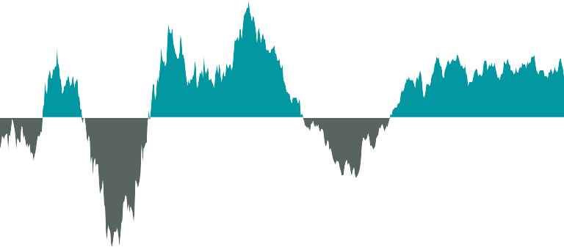
25%
20%
15%
U.S. Outperformance
Avg. 5.4%
Annualized
10%
5%
?
International Outperformance
0%
-5%
Avg. 9.2% Annualized Avg. 7.3% Annualized
Avg. -12.0%
Annualized
Avg. -3.7%
-10% Annualized
Avg. -4.6%
Annualized
-15%
-20%
-25%
1979 1982 1985 1988 1991 1994 1997 2000 2003 2006 2009 2012 2015 2018 2021 2024
History shows the geographic leadership tends to persist for longer than investors appreciate.
The United States has been in the driver’s seat since the Global Financial Crisis, although a turning point may be near.
History shows the geographic leadership tends to persist for longer than investors appreciate.
The U.S. has been in the driver’s seat since the Global Financial Crisis, although a turning point may be near.

Slide 55
Top 10 Companies by Market Value at Decade End
1980 | 1990 | 2000 | 2010 | 2020
IBM | NTT | Microsoft | Exxon | Apple
AT&T | Bank of Tokyo | GE | PetroChina | Microsoft
Exxon | Industrial Bank of Japan | NTT Docomo | Apple | Alphabet
Standard Oil | Sumitomi Mitsui | Cisco | BHP Billiton | Amazon
Schlumberger | Toyota | Walmart | Microsoft | Facebook
Shell Oil | Fuji Bank | Intel | ICBC | Alibaba
Mobil | Dai-Ichi Kangyo Bank | NTT | Petrobras | Berkshire Hathaway
Eastman Kodak | IBM | Exxon | China Construct. Bank | Tencent
Atlantic Richfield | UFJ Bank | Lucent | Royal Dutch Shell | JPMorgan
GE | Exxon | Deutsche Telecom | Nestle | Visa
The largest companies in the world have rarely held onto their leadership position for prolonged periods in the past.
With U.S. companies currently dominating the list, history suggests the potential for a stronger international showing in the coming decade.
The largest companies in the world have rarely held onto their leadership position for prolonged periods in the past.
With U.S. companies currently dominating the list, history suggests the potential for a stronger international showing in coming decade.

Slide 56
Avg. 10-Year Annualized Total Return vs. S&P 500
14%
12%
10%
8%
6%
4%
2%
0%
-2%
-4%
-6%
S&P 500 10-Year Annualized Return Below 6%
All Periods (1971 – Present)
12.1%
2.0%
-2.6%
-3.3%
MSCI EAFE (Developed) MSCI Emerging Markets MSCI EAFE (Developed) MSCI Emerging Markets
Hit Rate: 94% Hit Rate: 100% Hit Rate: 41% Hit Rate: 32%
Although the U.S. has outperformed international equities historically, investors have been rewarded for holding non-U.S. stocks during periods of softer U.S. performance.
- Although the U.S. has outperformed international equities historically, investors have been rewarded for holding non-U.S. stocks during periods of softer U.S. performance.

Slide 57
22%
20%
18%
18.6%
Tesla Meta
16.8%
Weight in MSCI ACWI
16%
Alphabet
China
14%
12%
Amazon
France
10%
Microsoft
Canada
8%
6%
Nvidia
United Kingdom
4%
2%
Apple
Japan
0%
Magnificent 7*
Country Weights
The weight of the Magnificent 7 in the ACWI is greater than the combined weight of Japan, the United Kingdom, Canada, France, and China.
- The weight of the Magnificent 7 in the ACWI is now nearly equivalent to the combined weight of Japan, the U.K., China, France, and Canada.

Slide 58
2x
1x 0x
Long-term Average P/E Ratio | Current P/E Ratio
MSCI ACWI ex-U.S. 13.1x S&P 500 15.9x | 13.3x 20.2x
MSCI ACWI ex-U.S. Minus S&P 500 NTM P/E Ratio
-1x
-2x
+1 Std. Dev.: -0.7x
-3x
Average: -2.8x
-4x
-5x
-1 Std. Dev.: -5.0
-6x
Current:
-6.8x
-7x
-8x
-9x
2003 2005
2007
2009
2011
2013
2015
2017
2019
2021
2023
International equities remain cheap relative to U.S. stocks even after strong 1Q25 outperformance.
- Although U.S. equities typically trade at a premium, international stocks are currently at their cheapest relative valuation in over two decades.

Slide 59
U.S. dollar cycles have historically lasted ~16 years with a potential inflection point having been reached in 2022.
- U.S. dollar cycles have historically lasted ~16 years with a potential inflection point having been reached in 2022.

Slide 60
10%
8%
Dollar’s Impact on Asset Classes Since 1974
6.9
7.8
Quarterly Total Return
6%
4.4
4%
3.1
2%
1.8
0.6
0%
-2%
-1.5
-2.5
-4%
S&P 500 Total Return
Investment-Grade Bonds
Average When Dollar is Up
MSCI EAFE
Average When Dollar is Down
MSCI EM (Since 2001)
International equities have tended to outperform during periods of dollar weakness.
-International equities have tended to outperform during periods of dollar weakness.

Slide 61
-The economic recovery is continuing to unfold. How long will it last until the next recession arrives?
-This deck will cover the most important things you need to know from an asset allocation perspective and a simple concept to help make you a better investor

Slide 62
Year | Panic Attacks | S&P 500 Max Drawdown | Cumulative S&P 500 Price Return*
1999 | Y2K | -12.1% | 378.5%
2000 | Tech Bubble Bursts | -17.2% | 300.3%
2001 | September 11th, 2001 Recession | -29.7% | 345.5%
2002 | Final Tech Bubble Flush, Corporate Scandals (Worldcom) | -33.8% | 412.3%
2003 | Iraq War | -14.1% | 568.5%
2004 | Oil Price Breakout | -8.2% | 429.0%
2005 | Hurricane Katrina | -7.2% | 385.3%
2006 | Fed Culminates Hiking Cycle | -7.7% | 371.2%
2007 | Subprime Cracks Emerge | -10.1% | 314.7%
2008 | Global Financial Crisis, Bank Failures, Auto Bailouts | -48.8% | 300.6%
2009 | Global Financial Crisis Culminates | -27.6% | 551.2%
2010 | European Debt Crisis, Flash Crash | -16.0% | 427.5%
2011 | S&P Downgrades U.S. Debt, Greek Debt Writedowns | -19.4% | 367.7%
2012 | Euro Crisis, Second Greek Bailout | -9.9% | 367.7%
2013 | Taper Tantrum | -5.8% | 312.4%
2014 | Ebola | -7.4% | 218.2%
2015 | Chinese Slowdown, Yuan Devaluation, Deflation Scare | -12.4% | 185.7%
2016 | Brexit, Global Negative Rates | -10.5% | 187.8%
2017 | North Korea Tensions Escalate | -2.8% | 162.7%
2018 | Trade Wars, Short Vol Unwind | -19.8% | 120.0%
2019 | Repo Crisis, Yield Curve Inversion | -6.8% | 134.6%
2020 | COVID-19 Pandemic | -33.9% | 82.0%
2021 | COVID-19 Variants, Chinese Regulatory Crackdown | -5.2% | 56.6%
2022 | Russian Invasion of Ukraine, Fed's Hawkish Pivot | -25.4% | 23.4%
2023 | Regional Bank Crisis, Debt Ceiling Drama | -10.3% | 53.2%
2024 | Inflation Scare, Sahm Rule Triggered | -8.5% | 23.3%
A look at some key historical events and how they effected the S&P 500

Slide 63
9.7%
7.6%
6.2%
3.7%
3.4%
2.6%
2.4%
U.S. Stocks | REITs | International Equities | Homes Investment Returns | Average Investor | Inflation | Government- Related Bonds
Average Investor
20-year annualized returns from key events to illustrate how they may have affected certain sectors in comparison to the average investor.

Slide 64
50%
40%
30%
20%
10%
Median Annualized Total Return
+15.9%
0%
-10%
Median Intra-Year
Price Decline
-10.0%
-20%
-30%
-40%
-50%
1983 1985 1987 1989 1991 1993 1995 1997 1999 2001 2003 2005 2007 2009 2011 2013 2015 2017 2019 2021 2023
S&P 500 Calendar Year Total Return S&P 500 Largest Intra-Year Price Decline (%)
A look at historical volatility within the S&P 500

Slide 65
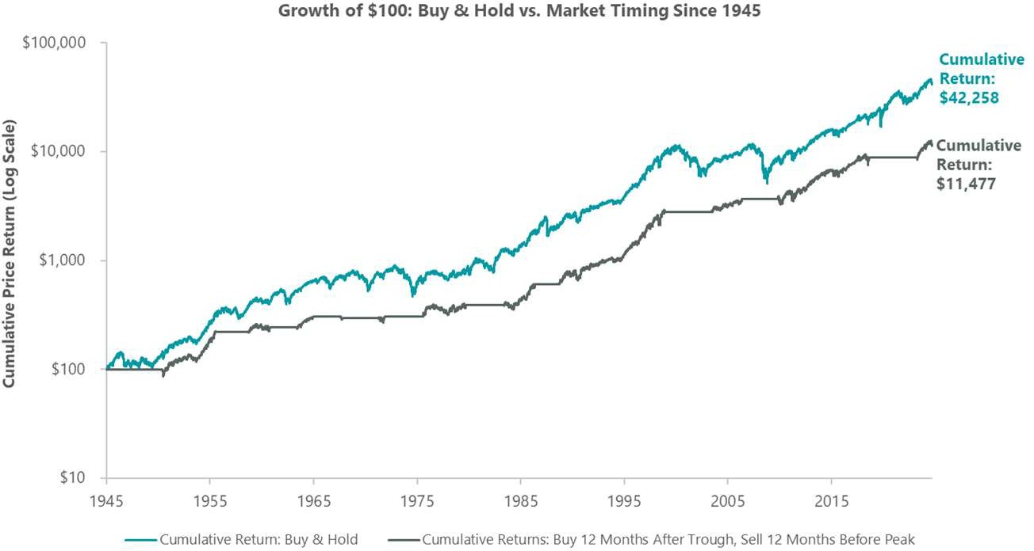
Since 1945, an investor that consistently sold 12 months prior to a market peak and bought back 12 months after the trough was worse off overall than a buy-and-hold investor.
-Since 1945, an investor that consistently sold 12 months prior to a market peak and bought back 12 months after the trough was worse off overall than a buy-and-hold investor.

Slide 66
20%
15%
15.2%
13.8%
13.7%
S&P 500 Annualized Return
10%
10.8%
10.2%
11.0%
11.7%
5%
6.9%
0%
-5%
-4.0%
-5.6%
-10%
Nixon (1969-74)
Ford (1974-77)
Carter (1977-81)
Reagan (1981-89)
Bush Sr. Clinton Bush Jr. Obama (1989-93) (1993-2001) (2001-09) (2009-17)
Trump Biden (2017-21) (2021-25)
# of Recessions: | 2 | 0* | 1 | 1 | 1 | 0 | 2 | 0* | 1 | 0
Historically, the U.S. equity market has performed well under both Democratic and Republican administrations.
The only two presidents who witnessed negative stock market performance during their terms had the misfortune of being bookended by recessions.
Historically, the U.S. equity market has performed well under both Democratic and Republican administrations.
The only two presidents who witnessed negative stock market performance during their terms had the misfortune of being bookended by recessions.

Slide 67
$1,000,000
$433,013
$100,000
$10,000
$1,000
1944 1952 1960 1968 1976 1984 1992 2000 2008 2016 2024
Democratic President Republican President
Historically, the equity market has moved higher irrespective of which party occupies the Oval Office.
Growth of $1,000 in S&P 500 (Price Only, Log Scale)
- Historically, the equity market has moved higher irrespective of which party occupies the Oval Office.

Slide 68
38
36
34
32
30
28
26
24
22
20
18
16
14
12
10
8
6
4
2
0
36
1928
1933
1935
1936
1938
1943
1945
1950
1951
1954
1955
1958
1961
1963
1967
1975
1976
1980
1982
1983
1985
1989
1991
1995
1996
1997
1998
1999
2003
2009
2013
2017
2019
2021
2023
2024
26 Negative Years
71 Positive Years
Positive 73% of the time since 1928
Years
21
1942
1944
1949
1952
1959
1964
1965
1968
1971
1972
1979
1986
1988
1993
2004
2006
2010
2012
2014
2016
2020
14
1929
1932
1934
1939
1946
1953
1962
1966
1969
1977
1981
1990
2000
2018
14
1947
1948
1956
1960
1970
1978
1984
1987
1992
1994
2005
2007
2011
2015
6
1930
1931
1937
1974
2002
2008
<-20%
6
1940
1941
1957
1973
2001
2022
-20% - -10%
-10% - 0% 0% - 10%
S&P 500 Annual Total Return Ranges
10% - 20%
>20%
Since 1926, S&P 500 total returns have been in positive territory 73% of the time.

Slide 69
BEA: Bureau of Economic Analysis
Bloomberg US Aggregate Bond Index: an unmanaged index of U.S. investment-grade fixed-income securities.
Bloomberg US Corporate Investment Grade Bond Index: an unmanaged index of U.S. investment-grade corporate bond securities.
Bloomberg Global Aggregate Total Return Index: measure of global investment grade debt from a multitude of local currency markets. This multi- currency benchmark includes treasury, government-related, corporate and securitized fixed-rate bonds from both developed and emerging markets issuers.
CPI (Consumer Price Index): measure of the average change in U.S. consumer prices over time in a fixed market basket of goods and services as determined by U.S. Bureau of Labor Statistics.
EPS (Earnings per Share): the portion of a company's profit allocated to each outstanding share of common stock.
Fed (Federal Reserve Board): the U.S. central bank, responsible for policies designed to promote full economic growth, full employment, and price stability.
GDP: Gross Domestic Product
GFC (Great Financial Crisis): the severe economic and market downturn experienced in 2007-2008.
Hit Rate: Metric that measures the percentage of successful outcomes relative to the total number of opportunities.
Home Sales Median Price: measures the price at which half of existing homes sold for more and half sold for less.
MSCI All Country Asia Index: unmanaged index of large and mid cap stocks across Developed Markets countries and Emerging Markets countries in Asia.
MSCI EM Index: unmanaged index of large- and mid-cap stocks in 27 emerging market countries.
MSCI Europe Index: unmanaged index of large- and mid-cap stocks across 15 Developed Markets (DM) countries in Europe.
MSCI EAFE Index: unmanaged index of equity securities from developed countries in Western Europe, the Far East, and Australasia.
MSCI Germany Index: unmanaged index of large- and mid-cap stocks across the German market. MSCI Japan Index: unmanaged index of large- and mid-cap stocks across the Japanese market. MSCI UK Index: unmanaged index of large- and mid-cap stocks across the UK market.
MSCI USA Index: unmanaged index of US large- and mid-cap equity securities.
NAREIT All-Equity REITS Total Return Index: free-float-adjusted market capitalization weighted index that includes all tax qualified REITS listed in the NYSE, AMEX and NASDAQ National Markets.
NFIB (National Federation of Independent Business): a U.S. small business advocacy association, representing over 350,000 small and independent business owners.
NFIB Small Business Optimism Index: measure of small business sentiment produced by the National Federation of Independent Business based on its monthly survey of small business owners.

Slide 70
P/E Ratio: Price/Earnings ratio
PMI: Purchasing Manager’s Index
Russell 1000 Index: a subset of the Russell 3000 Index that includes approximately 1,000 of the largest companies in the U.S. equity universe.
Russell 1000 Growth Index: unmanaged index of large-cap stocks chosen for their growth orientation.
Russell 1000 Value Index: unmanaged index of large-cap stocks chosen for their value orientation.
Russell 2000 Index: unmanaged index of small-cap stocks.
Russell 2000 Growth Index: unmanaged index of small-cap stocks chosen for their growth orientation.
Russell 2000 Value Index: unmanaged index of small-cap stocks chosen for their value orientation.
Russell Mid Cap Index: unmanaged index consisting of the 800 smallest companies in the Russell 1000 Index.
Russell Mid Cap Growth Index: unmanaged index of mid-capitalization U.S. equities that exhibit growth characteristics.
Russell Mid Cap Value Index: unmanaged index of mid-capitalization U.S. equities that exhibit value characteristics.
S&P MidCap 400 Index: unmanaged index of 400 US mid-cap stocks
S&P 400 Growth Index: unmanaged index of mid-cap stocks having higher price-to-book ratios relative to the S&P 400 MidCap as a whole.
S&P 400 Value Index: unmanaged index of mid-cap stocks having lower price-to-book ratios relative to the S&P 400 MidCap as a whole.
S&P 500 Growth Index: unmanaged index of large-cap stocks selected based on sales growth, the ratio of earnings change to price and momentum.
S&P 500 Value Index: unmanaged index of large-cap stocks selected based on the ratios of book value, earnings, and sales to price.
S&P 600 Index: unmanaged index of 600 US small-cap stocks
S&P 600 Growth Index: unmanaged index of US small-cap growth stocks, selected based on sales growth, the ratio of earnings change to price, and momentum.
S&P 600 Value Index: unmanaged index of US small-cap value stocks, selected based on ratios of book value, earnings, and sales to price.
S&P 500 Index: Unmanaged index of 500 stocks that is generally representative of the performance of larger companies in the U.S.
Yield Curve: Comparison of interest rates at a point in time of bonds with equal credit quality but different maturity dates.
YoY: Year Over Year
U.S. Treasurys: Direct debt obligations issued and backed by the "full faith and credit" of the U.S. government. The U.S. government guarantees the principal and interest payments on U.S. Treasuries when the securities are held to maturity. Unlike U.S. Treasury securities, debt securities issued by the federal agencies and instrumentalities and related investments may or may not be backed by the full faith and credit of the U.S. government. Even when the
U.S. government guarantees principal and interest payments on securities, this guarantee does not apply to losses resulting from declines in the market value of these securities.

Slide 71
Name and Position
Josh Jamner CFA
Director, Senior Investment Strategy Analyst
Industry Experience
ClearBridge Tenure
Education, Experience and Professional Designations
16 years • Joined ClearBridge in 2017
Member of the CFA Institute
RBC Capital Markets - Assistant Vice President, Associate Strategist - U.S. Equity
Bessemer Trust - Assistant Vice President, Client Portfolio Analyst
BA in Government from Colby College
Jeffrey Schulze CFA
Managing Director, Head of Economic and Market Strategy
20 years • Joined ClearBridge in 2014
Member of the CFA Institute
Lord Abbett & Co., LLC – Portfolio Specialist
BS in Finance from Rutgers University

Slide 72
“Anatomy of a Recession” is a trademark of ClearBridge Investments, LLC. ClearBridge October 1, 2001. Canada: Issued by Franklin Templeton Investments Corp., 200 King Investments, LLC is a subsidiary of Franklin Resources, Inc. Street West, Suite 1500 Toronto, ON, M5H3T4, Fax: (416) 364-1163, (800) 387-0830, This material is intended to be of general interest only and should not be construed as www.franklintempleton.ca. Offshore Americas: In the U.S., this publication is made
individual investment advice or a recommendation or solicitation to buy, sell or hold any security or to adopt any investment strategy. It does not constitute legal or tax advice. This material may not be reproduced, distributed or published without prior written permission from Franklin Templeton.
available by Franklin Templeton, One Franklin Parkway, San Mateo, California 94403- 1906. Tel: (800) 239-3894 (USA Toll-Free), (877) 389-0076 (Canada Toll-Free), and Fax: (727) 299-8736. U.S. by Franklin Templeton, One Franklin Parkway, San Mateo, California 94403-1906, (800) DIAL BEN/342-5236, franklintempleton.com. Investments are not FDIC insured; may lose value; and are not bank guaranteed.
The views expressed are those of the investment manager and the comments, opinions Issued in Europe by: Franklin Templeton International Services S.à r.l. – Supervised by
and analyses are rendered as at publication date and may change without notice. The underlying assumptions and these views are subject to change based on market and
the Commission de Surveillance du Secteur Financier - 8A, rue Albert Borschette, L-1246 Luxembourg. Tel: +352-46 66 67-1 Fax: +352-46 66 76. Poland: Issued by Templeton
other conditions and may differ from other portfolio managers or of the firm as a
Asset Management (Poland) TFI S.A.; Rondo ONZ 1; 00-124 Warsaw. Saudi Arabia:
whole. The information provided in this material is not intended as a complete analysis Franklin Templeton Financial Company, Unit 209, Rubeen Plaza, Northern Ring Rd,
of every material fact regarding any country, region or market. There is no assurance
Hittin District 13512, Riyadh, Saudi Arabia. Regulated by CMA. License no. 23265-22.
that any prediction, projection or forecast on the economy, stock market, bond market Tel: +966-112542570. All investments entail risks including loss of principal investment
or the economic trends of the markets will be realized. The value of investments and the income from them can go down as well as up and you may not get back the full amount that you invested. Past performance is not necessarily indicative nor a guarantee of future performance. All investments involve risks, including possible loss of principal. Active management does not ensure gains or protect against market declines.
Any research and analysis contained in this material has been procured by Franklin
amount. South Africa: Issued by Franklin Templeton Investments SA (PTY) Ltd, which is an authorized Financial Services Provider. Tel: +27 (21) 831 7400 Fax: +27 (21) 831 7422. Switzerland: Issued by Franklin Templeton Switzerland Ltd, Stockerstrasse 38,
CH-8002 Zurich. United Arab Emirates: Issued by Franklin Templeton Investments (ME) Limited, authorized and regulated by the Dubai Financial Services Authority. Dubai office: Franklin Templeton, The Gate, East Wing, Level 2, Dubai International Financial Centre, P.O. Box 506613, Dubai, U.A.E. Tel: +9714-4284100 Fax: +9714-4284140. UK:
Templeton for its own purposes and may be acted upon in that connection and, as Issued by Franklin Templeton Investment Management Limited (FTIML), registered such, is provided to you incidentally. Data from third party sources may have been used office: Cannon Place, 78 Cannon Street, London EC4N 6HL. Tel: +44 (0)20 7073 8500. in the preparation of this material and Franklin Templeton ("FT") has not independently Authorized and regulated in the United Kingdom by the Financial Conduct Authority. verified, validated or audited such data. Although information has been obtained from Australia: Issued by Franklin Templeton Australia Limited (ABN 76 004 835 849)
sources that Franklin Templeton believes to be reliable, no guarantee can be given as to (Australian Financial Services License Holder No. 240827), Level 47, 120 Collins Street,
its accuracy and such information may be incomplete or condensed and may be subject Melbourne, Victoria 3000. Hong Kong: Issued by Franklin Templeton Investments (Asia)
to change at any time without notice. The mention of any individual securities should
Limited, 62/F, Two IFC, 8 Finance Street, Central, Hong Kong. Japan: Issued by Franklin
neither constitute nor be construed as a recommendation to purchase, hold or sell any Templeton Investments Japan Limited. Korea: Issued by Franklin Templeton Investment
securities, and the information provided regarding such individual securities (if any) is
Trust Management Co., Ltd., 3rd fl., CCMM Building, 101 Yeouigongwon-ro,
not a sufficient basis upon which to make an investment decision. FT accepts no liability Yeongdeungpo-gu, Seoul, Korea 07241. Malaysia: Issued by Franklin Templeton Asset
whatsoever for any loss arising from use of this information and reliance upon the comments, opinions and analyses in the material is at the sole discretion of the user.
Management (Malaysia) Sdn. Bhd. & Franklin Templeton GSC Asset Management Sdn. Bhd. This document has not been reviewed by Securities Commission Malaysia.
Products, services and information may not be available in all jurisdictions and are Singapore: Issued by Templeton Asset Management Ltd. Registration No. (UEN)
offered outside the U.S. by other FT affiliates and/or their distributors as local laws and 199205211E, 7 Temasek Boulevard, #38-03 Suntec Tower One, 038987, Singapore. regulation permits. Please consult your own financial professional or Franklin
Templeton institutional contact for further information on availability of products and services in your jurisdiction.
Brazil: Issued by Franklin Templeton Investimentos (Brasil) Ltda., authorized to render
Please visit www.franklinresources.com to be directed to your local Franklin Templeton website.
Copyright © 2025 ClearBridge Investments, LLC. All rights reserved.
investment management services by CVM per Declaratory Act n. 6.534, issued on AOR BPBN 03/25

