Slide 1
The hidden costs of aging
The important conversations you need to have about care and housing expenses
This material should be regarded as educational information on health care and is not intended to provide specific advice. If you have questions regarding your particular situation, you should contact your healthcare provider and/or legal or tax advisors.
Notes:
Thank you for joining me today to discuss The Hidden Costs of Aging.
I want to acknowledge up front that I understand how uncomfortable it can be to talk about health problems associated with aging. We obviously all know that there may be physical or mental problems as we get older, but that doesn’t make it easier to discuss.
But this topic is too important to push off to a later date or to ignore all together. So we have enlisted the help of The Center for Innovative Care in Aging at the Johns Hopkins University School of Nursing to get started.

Slide 2
Retirement in theory
Retirement
Wealth Transfer
What are some unexpected events that might get in the way?
Chat
Notes:
Slide objective: build awareness of events which impact retirees.
It's exciting to think of a retirement pursuing a bucket list of travel, adventures and hobbies and then leave a healthy estate to loved ones.
But the reality is, most people will not travel such a straight line.
[click mouse]:
Ask learners to respond via CHAT: what are some unexpected events that might get in the way?

Slide 3
Retirement in reality
In-home Support
In-home
Remodeling
Health
Crisis
Retirement
Health
Crisis
Skilled
Nursing
Wealth Transfer
Unexpected
Expenses
Market
Correction
Market
Correction
In-home
Health Care
In-home
Remodeling
Assisted
Living
Unexpected
Expenses
Notes:
Slide objective: review unexpected events that might arise.
Unexpected and unwanted problems can, and often do, arise that disrupt your clients’ long-term financial plans.
The more you know about those potential problems, the more you can do to help them prepare.
Let’s focus on how an unexpected event such as a health problem, could affect your plan.
A health problem could be a gradual deterioration in mental or physical function. It could be a chronic illness such as Alzheimer’s disease, arthritis, or cardiovascular disease. Or it could be a full-blown crisis such as a stroke or cancer.
Each of these health scenarios would have consequences for an individual, for their spouse, for their family . . . and for their finances.
We are going to touch on expenses later, but I what I want you to see right now is that there are costs associated with aging. For illustrative purposes, if an unexpected event or health problem requires you to bring an aide into your home, it COULD cost thousands of dollars. And this might be an annual expense over 5 or 10 or even 15 years – meaning it can have a significant impact on a person’s overall wealth. The same rings true for in-home modifications to accommodate deteriorating mobility or companion care.
I’m going to assume that these health and housing risks and expenses are not really surprising to you all.

Slide 4
Changing the narrative
Retirement Spending
No-Go Years (age 86 to 100+)
During this period, it may be more difficult to maintain the same active lifestyle.
Slow-Go Years (age 76 to 85)
A less active lifestyle with some “Go-Go” years remaining.
Go-Go Years (age 65 to 75)
Active lifestyle focused on family, friends, travel, hobbies and bucket list.
Time
Notes:
Slide objective: Spending will likely increase as clients age.
Many people assume they will spend much more each year of their “Go-Go Years”, when they are younger, healthier and most active. The chances are, spending will continue to increase as one ages into their “Slow-Go” years and even more in their “No-Go Years”.

Slide 5
Agenda
1
Profile of Aging
2
Care and Housing Considerations
3
Formulate a Plan
Notes:
That is why we created this program. We want to help you better understand how to plan for an unexpected event, including what housing and care options you have so that you can age with dignity.
So with all of that in mind, let’s get started.
[click mouse]:
The first thing I’d like to do today is give you a sense of what seniors look like now and give you a big picture view of how care and housing situations change with age.
[click mouse]:
Then we will review choices you may face and the important considerations associated with each.
[click mouse]:
And lastly, we will discuss formulating a plan of your own.

Slide 6
1 | Profile of aging
Notes:
Let’s being by discussing our first section, Profile of Aging.

Slide 7
True or False
1
22% of population will be 65+ by 2040.
2
TRUE
A 65-year-old can expect to live an additional 17 - 20 years, on average.
3
80% of older adults are living with one chronic disease.
Notes:
Slide objective: build engagement.
Ask learners to respond via CHAT. Which of these statements are true?
[click mouse]: and recap
All of these are true. The term “seniors” covers a large and changing group, so I want to take a closer look at who we are talking about. ​

Slide 8
The over 65 segment is growing
2020
55.7 mil
10,000
17% of population
Each day almost
65
80.8 mil
¹
2040
baby boomers reach the age of
22% of population
Source: 2021 Profile of Older Americans: ACL, Nov 2022 1. AARP. This number is expected to continue into the 2030s.
For illustrative and discussion purposes only.
Notes:
Slide objective: The over 65 segment is growing.
By 2040, all the baby boomers will have moved into the senior ranks, at which time over 22% of the population will be over 65. 40% increase in just 12 years.
[click mouse]:
To put these numbers in perspective, 10,000 Americans cross that line every day.
It is clear that the over 65 segment is growing.

Slide 9
Women are outliving men
The 85+ group will likely include considerably more women than men
65+
Women are more likely than men of the same age to be widowed.
65+
Sources: 2021 Profile of Older Americans: ACL, Nov 2022.
For illustrative and discussion purposes only.
Notes:
Slide objective: women are more likely than men of the same age to be widowed.
Let’s look at life expectancy – while life expectancy had decreased slightly, from 78.8 years in 2019 to 77 years in 2020, women are outliving men.
[Click]
As you can see here, a 65-year-old woman can expect to live an additional 19.8 years, on average vs. a 65-year-old man who can expect to live an additional 17 years, on average.
In 2020 there were 30.9 million women age 65 and older and 24.8 million men. That’s 124 women for every 100 men. At age 85 and older, that ratio increased to 176 women for every 100 men.
[Click]
Women are more likely than men of the same age to be widowed.
At age 65, 34% of women are widowed, compared with 12% of the men. The numbers are even higher at age 85+.
You may want to keep these facts in mind when helping clients prepare. Financial professionals will want to have a strong relationship with both husbands and wives and, if possible, the extended family in order to be of most service.

Slide 10
More Americans are living with chronic illness
80%
of older adults are living with one chronic disease
77%
have at least two chronic diseases
Source: www.agingstats.gov. For illustrative and discussion purposes only
Notes:
Slide objective: More Americans are living with chronic illness.
Living longer sounds good, but we need to remember that aging naturally effects health.
80% of older adults are living with one chronic disease, while more than 3 out of 4 have at least two.
These health issues will impact how and where a person lives.

Slide 11
Residence in full-service facilities increases with age
65+
3%
At 85, the percentage of Medicare beneficiaries who reside in long-term care facilities more than triples to 15%
85+
Source: 2020 Older Americans – Key Indicators of Well – Being
For illustrative and discussion purposes only.
Notes:
Slide objective: residents in full-service facilities increases with age.
Take a look at this chart, you can see that residence in full-service facilities increases with age.
When you analyze the senior population starting at age 65, the vast majority live at home in a traditional community.
[click mouse]:
But as the second bar shows, by age 85 the percent of people who reside in long-term care facilities more than triples to 15%.

Slide 12
CHAT QUESTION
What aging statistic resonates most with you and why?
Notes:
Ask learners to respond via chat, “what aging statistic resonates most with you and why?

Slide 13
FOOD FOR THOUGHT
“If you don’t make a plan, a plan will be made for you”
Notes:
Slide objective: review the key takeaways from this section.
What does all this data mean for you?
It means that you have a greater chance of living well into your 80s. But that longer life doesn’t guarantee good health for all the years.
Most people will likely need some sort of assistance while aging, whether that is assistance with daily living activities or something more.
It is never too soon to understand the risks, allocate assets to cover expenses and begin developing a plan to age with control and dignity. Because if you don’t have a plan, a plan will be made for you.

Slide 14
2 | Care and housing considerations
Notes:
Now let’s talk about the care and housing options you can consider.

Slide 15
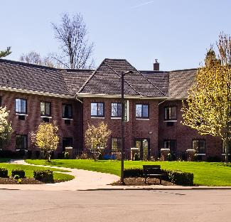
Housing as you age
Aging in place
55+ independent living communities
Continuing care retirement communities
Assisted living
Skilled nursing
For illustrative and discussion purposes only.
Notes:
Slide objective: introduce care and housing considerations.
It is important to be familiar with the most common options, as you have no way of knowing if or when you might have health problems and need assistance. By knowing the options, you can develop a plan that includes your preferences for various scenarios.
[click mouse] to reveal each housing option.
Transition:
Given the choice, the vast majority of people would rather remain in their own homes for the rest of their lives, so I am going to spend the most time discussing this option with you all.

Slide 16
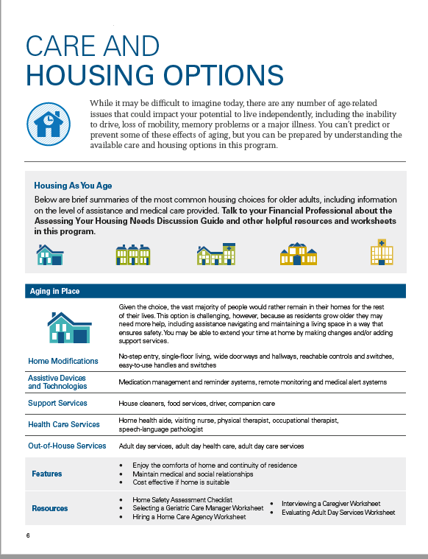
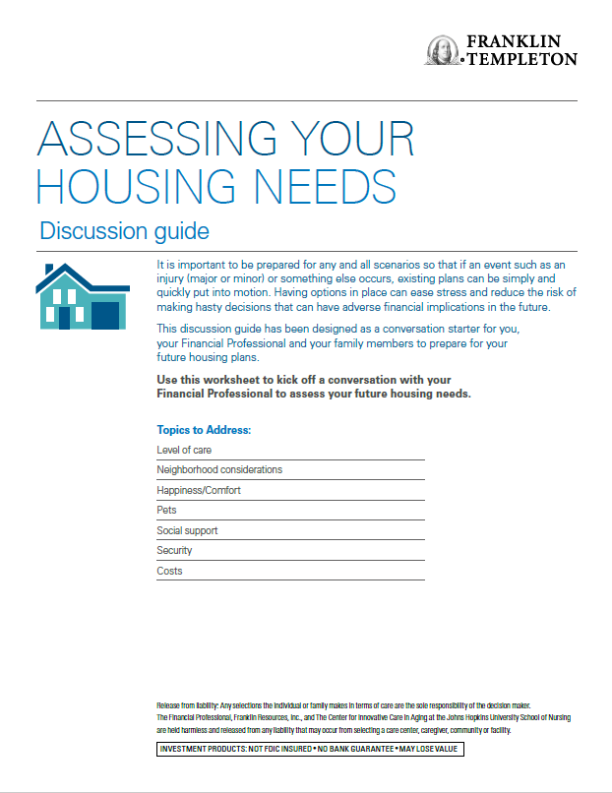
Resources
Care and Housing Brochure
Assessing Your Housing
Needs Guide
For illustrative and discussion purposes only.
Notes:
Slide objective: introduce resources available for their housing needs discussion.
But before we discuss the most common housing option, I want to share two resources.
Our Care and Housing Options brochure discusses features of each common housing option.
And our Assessing Your Housing Needs Discussion Guide can help you identify which is right for you.
It covers level of care, neighborhood considerations, happiness and comfort, pets social support, security and cost considerations for future housing needs.
Feel free to open this on your desktop or download. We will be referencing parts of this guide throughout the rest of the presentation.

Slide 17
Aging in place
Staying in one’s home safely, independently and comfortably
For illustrative and discussion purposes only.
Notes:
Slide objective: describe why people choose to age in place.
Aging in Place is defined as staying in one’s home safely, independently and comfortably. It is easy to understand why most people want to age in place.
They want to maintain their independence and privacy and stay close to friends and doctors. In addition, staying at home can be considerably less expense than moving somewhere that provides care.
But staying at home can be challenging as people age.
Let’s look at some issues you will need to think about when considering this option.

Slide 18
Aging in place
Family considerations
Proximity of family
Availability of family
Commitment to aging in place
For illustrative and discussion purposes only.
Notes:
Slide objective: having family nearby is helpful.
Many people find it more feasible to age in place if they have family nearby, so that people who know and love them can check on them and provide help.
[click mouse]:
But even if family does live close, you need to think about how available they are and how suitable they are for the task. For example, someone who works long hours or travels for work may not be around enough to help. Or if a family member has health issues of their own, they may not be a good choice.
[click mouse]:
In addition, you will need to consider how willing their family is to support their decision to age in place.
This is why it is so critical to involve family in drafting your plan. Your family may need to clearly understand your wishes in order to commit to supporting them.

Slide 19
Aging in place
Lifestyle considerations
Ability to perform activities of
daily living
Home modifications
Assistive devices and technology
For illustrative and discussion purposes only.
Notes:
Slide objective: lifestyle considerations.
People can also take steps to accommodate their home so that it is more suitable for aging in place.
Professionals judge a person’s ability to live independently by how well they can perform activities of daily living, or ADLs. These tasks include preparing and eating meals, bathing, dressing and managing medications.
An inability to perform some or all of these activities doesn’t mean a person must leave their home, but it does mean they may need to make modifications to their home and/or bring in support services.
Home modifications can be expensive, but they can also be necessary to accommodate aging people with deteriorating health. These modifications would bring a home into Universal Design Standards, which include single floor living, wide hallways and doorways to permit wheelchairs or walkers, light switches and other controls at lower levels, ramps at exterior entries and grab bars in the tub and shower.
It can also be very helpful to employ technology to enable someone to stay in their home. These assistive devises could include things like Nest cameras or Life Alert bracelets. Of course, there are always new products coming on to the market so we can’t offer a comprehensive list, but these tools can be extremely useful.

Slide 20
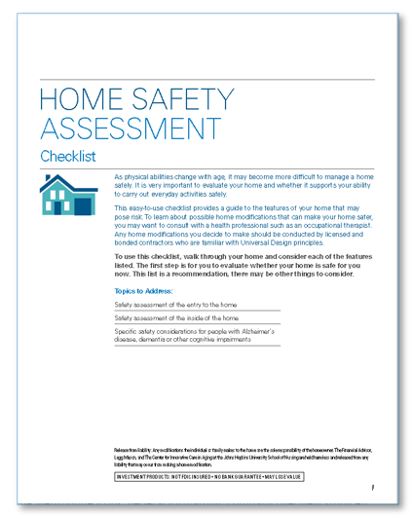
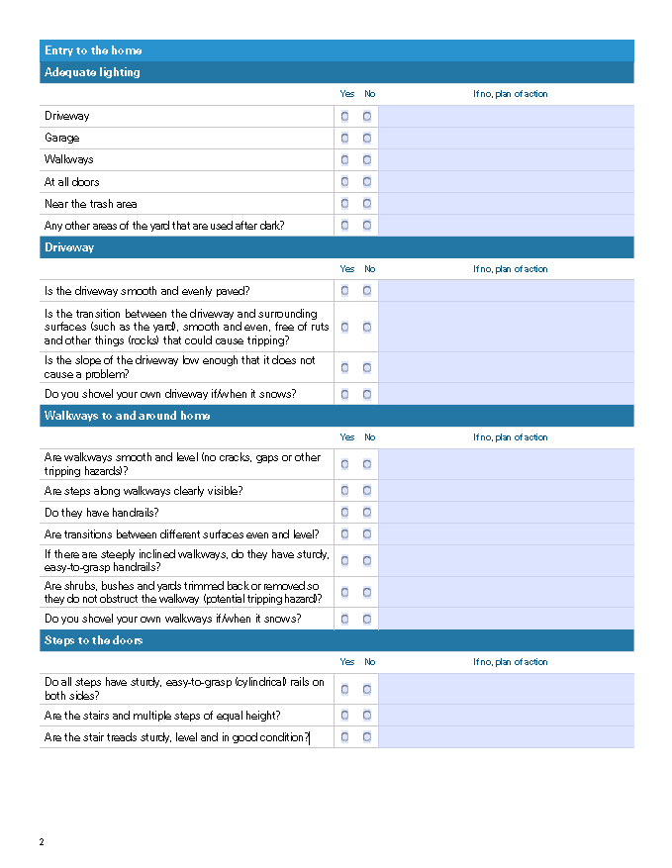
Resources
Home Safety Assessment Worksheet
For illustrative and discussion purposes only.
Notes:
Slide objective: introduce resources available for home safety assessment.
I can provide you with a helpful Home Safety Assessment sheet that you can hold on to and use when it is time to evaluate you or your spouse’s abilities and needs.
The checklist guides an individual through the home, identifying the unsafe features and creating a plan for modifications.
Many people find it useful to refer to this list when buying a home in retirement and then others pull the sheet out regularly as they age to see how they are coping as their health and abilities change.

Slide 21
Aging in place
Health care considerations
Geriatric
care managers
Home
care services
Adult
day care services
Schedules appointments and interacts with health care providers and insurers
Private agencies that provide a variety of medical and non-medical services for in-home patient care
Social activities with skilled services from social workers, therapists and nurses, etc.
Social
services
Companion
care services
Help with identifying and finding the appropriate care after a hospital stay
Non-medical staff hired by the hour to provide companionship and comfort to individuals who cannot be left at home alone
For illustrative and discussion purposes only.
Notes:
Slide objective: healthcare considerations
People who choose to age in place and have made the necessary home modifications may still need more support, either medical or non-medical.
A good place to start the process may be by consulting with a geriatric care manager. These professional are usually licensed nurses or social workers who specialize in geriatrics. They are trained to conduct assessments and recommend solutions. They can also be critical resources when family is not nearby, coordinating with health care providers and making regular in-home visits. While they can be a particularly helpful resource for Aging in Place, geriatric care managers can also help evaluate other living arrangement and housing options.
If the person who remains in their home needs ongoing medical support, there are a variety of health professionals who will provide in-home, including a home health aide, a visiting nurse, a physical therapist, and an occupational therapist. Again, a geriatric care manager can be extremely helpful in helping to identify needs, find professionals and manage services.
Many people living at home with health issues may also need help with non-medical activities. In this case they will want to consider in-home support services such as a housekeeper, food services, a driver and companion care services.
Before we move on, I want to take a minute here to talk about the weight that falls on a spouse when a partner has health issues and the couple opts to age in place. Being a caregiver is an emotionally and physically exhausting job, even with the support services we’ve just reviewed. Many spouses have found much needed time to deal with their own health and wellbeing by bringing their partner to an adult day care facilities. These organizations can provide skilled services but can also offer the caregiver necessary periods of relief.

Slide 22
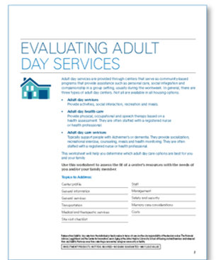
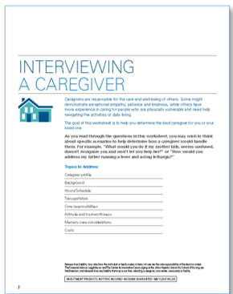
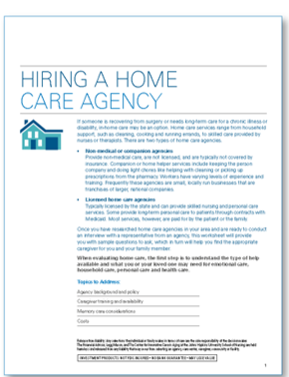
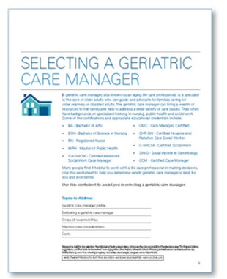
Resources
Home Support Services Worksheets
For illustrative and discussion purposes only.
Notes:
Slide objective: introduce resources available for home support services.
I am happy to provide you with resources that will help you understand the process of finding and hiring support services, including a geriatric care manager.
These overviews have proven to be a valuable resource for individuals who have no prior experience with this complex process.

Slide 23
Aging in place
Financial considerations
 | Hourly | Daily | Monthly | Annual | Year-Over-Year Increase
Homemaker Services | $26 | $156 | $4,680 | $56,160 | 10.64%
Home Health Aide Services | $27 | $162 | $4,860 | $58,320 | 12.50%
Adult Day Health Care | * | $78 | $1,638 | $19,56 | 5.41%
Source: Genworth Cost of Care 2021 Survey. Based on 6 hours per day, 30 days per month. For illustrative and discussion purposes only.
Notes:
Slide objective: financial considerations
The financial considerations around aging in place can be difficult to estimate because people require or elect different services.
For example, some people may need to make a substantial up-front payment to modify their home for aging. Others may have purchased a home that already had the necessary features.
As for ongoing costs, this chart provides some estimates for homemaker services, such as housekeeping and cooking, for in-home health aide and for adult day health care.
You can see that combining a few services could run over $100,000 a year, and based on the change over the last year, we can assume these prices will continue to rise.
I’ve just given you a lot of information on aging in place to absorb. I am going to provide a more high-level overview of the other care and housing options so we will move through the rest of the presentation a bit faster. And provide you with a list of resources at the end.

Slide 24
Housing as you age
Aging in place
55+ independent living communities
Continuing care retirement communities
Assisted living
Skilled nursing
For illustrative and discussion purposes only.
Notes:
Slide objective: review aging in place and re-introduce other options.

Slide 25
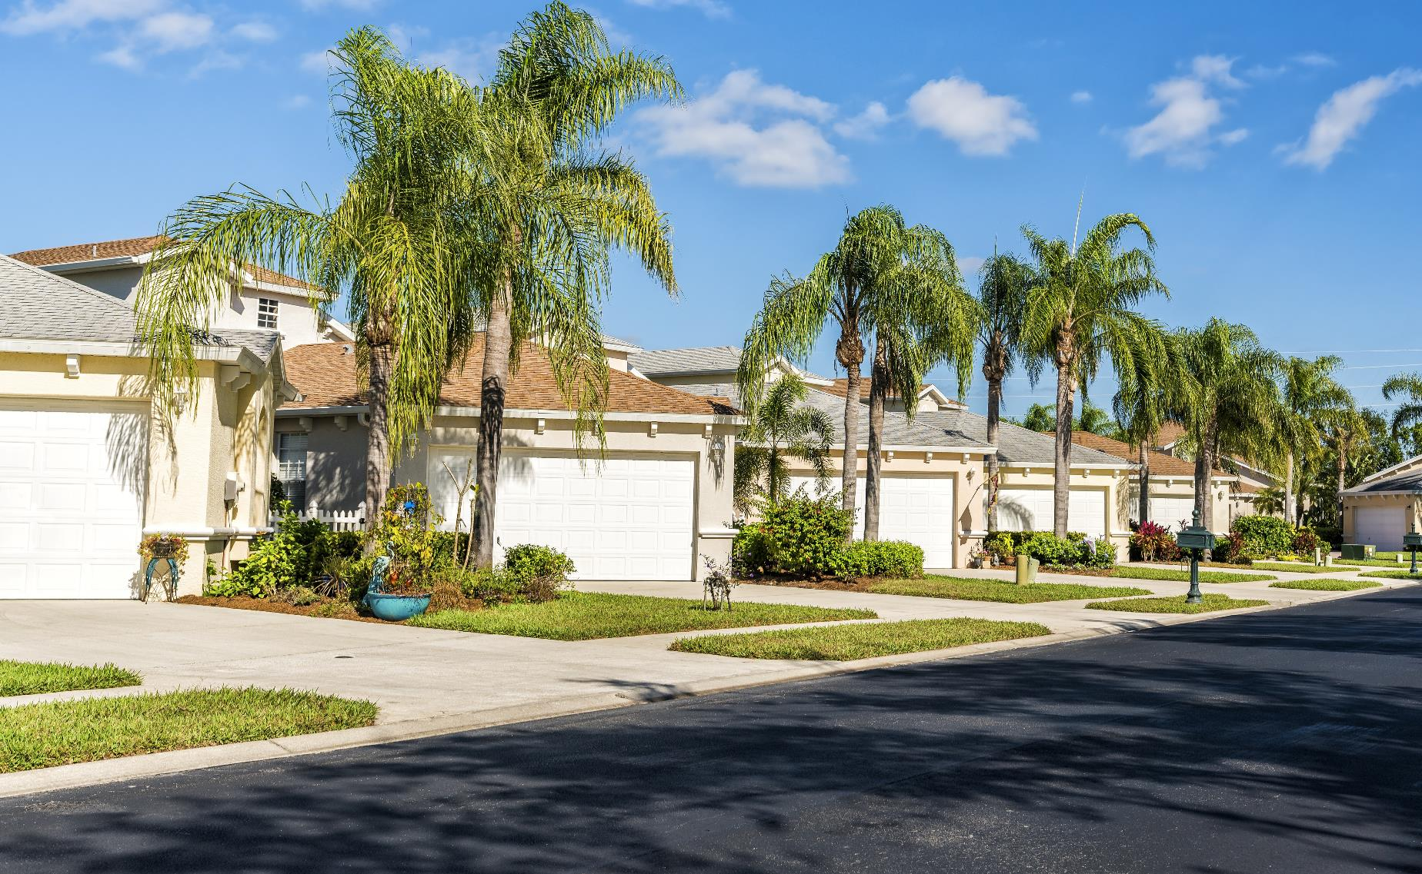
55+ independent living community
Offers relatively maintenance-free homes or apartments for independent, active singles or couples
Medical services nearby
Access to range of amenities and social activities
Opportunity to engage with others at same stage of life
Estimated Monthly Costs: $1,500- $10,000
For illustrative and discussion purposes only.
Notes:
Slide objective: describe why people choose a 55+ Independent Living Community.
A 55+ Independent Living Community would meet Janey and Joe’s lifestyle.
Individuals who are in generally good health may choose to leave their home and move to a 55+ Independent Living Community. These communities offer relatively maintenance-free homes or apartments for independent, active singles or couples.
The communities allow residents the freedom to live on their own while engaging with others of the same age. They also offer access to amenities and social activities that can promote physical and mental health.
The cost to live in this type of community varies greatly. The annual costs are tied to the type of dwelling your client buys, the location of the community and the services offered within the community.
What they don’t offer, however, is on-site medical care. Residents can bring in non-medical support like a companion service, but they won’t have immediate access to doctors, nurses or other medical professionals.
Facilitator Note: Reference the housing brochure to provide more details on considerations.
Additional talking points:
In terms of family, it provides a good choice for couples who have different non-medical needs. For example, if one person is losing mobility and needs a walker or wheelchair, they could still live independently with a more able-bodied spouse.

Slide 26
Continuing care retirement communities
Ability to stay in place as medical needs increase- from independent living to assisted living to skilled nursing
May include lifestyle amenities such as pools and fitness centers
Estimated Monthly Costs: $900-$10,500 Entry Fee: $100,000 - $500,000
For illustrative and discussion purposes only.
Notes:
Another option is a Continuing Care Retirement Community, or CCRC as they are called, are them most comprehensive of all housing options.
These communities can be very attractive for people who are currently living independently but want to settle in and put down roots in a place where they can have their medical needs met as those needs increase. (aging in place). While residents must be able to live independently when they move in, there is on-site expertise to care for their physical and mental needs as they change.
These communities often offer lifestyle amenities and support services that senior's value. Services that could include meals, housekeeping, transportation and on-site medical care and may include lifestyle amenities such as pools and fitness centers.
Given the breadth of support and health care services provided this type of care is obviously going to be costly.
Based on research, there are 3 types of contracts. The average entry fees range from approximately $100,000 to $500,000 and the monthly living fees from $900 to over $10,500 for pay-as-you-go’ type agreement.
Additional Facilitator Notes:
Specifically, the Continuing Care Retirement Community can provide some valuable peace of mind for family members who are worried about you, especially as these communities tend to provide around-the-clock security.

Slide 27
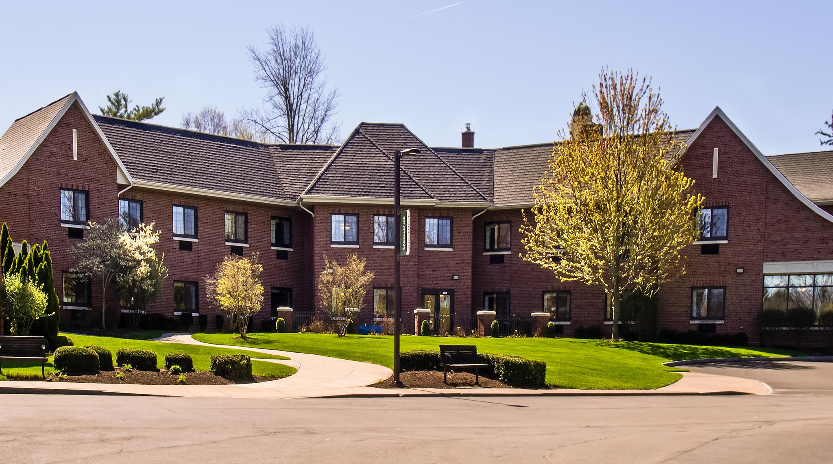
Assisted living facilities
Attractive for people who need some assistance with daily activities but do not require skilled medical care
Services may include meals, housekeeping, transportation and on-site medical care
Ability to stay in place as medical needs increase
Estimated monthly costs: $4,500
Source: Genworth Cost of Care 2021 Survey. For illustrative and discussion purposes only.
Notes:
Slide objective: describe why people choose an assisted living facility.
When someone requires more assistance with daily activities but not necessarily skilled medical care, they may choose to move to an Assisted Living Facility.
This type of facility has proven particularly desirable for couples where one person is having mobility issues – a difficult problem to manage without support services.
Assisted Living Facilities provide a supportive living environment, allowing family members to know their loved one is getting the daily help they require. In addition, these facilities encourage social engagement and activities, including clubs and outings.
Importantly, most also deliver health care supervision, meaning they have medical professionals come in or provide transportation to nearby medical sites.

Slide 28
Skilled nursing facilities
For people requiring on-site skilled medical care, including nurses, physical and occupational therapist and doctors
Highest level of medical care on-site
Increased security to protect patient safety
Ability to serve patients with memory care issues
Estimated monthly costs: $7,650 - $8,700
Source: Genworth Cost of Care 2021 Survey. For illustrative and discussion purposes only.
Notes:
Slide objective: describe why people choose skilled nursing facilities.
For people requiring on-site skilled medical care, including nurses, physical and occupational therapists and doctors
A Skilled Nursing Facility offers the highest level of medical care on-site. It also offers the most comprehensive support option for residents with memory issues, including Alzheimer’s disease dementia and other cognitive impairments. Residents receive 24-hour care, including closer supervision and facility security.
For people requiring on-site skilled medical care, including nurses, physical and occupational therapists and doctors.
Here are some things you will need to consider regarding a Skilled Nursing Facility.
For family, this may be a necessary choice in order to get the level of daily, ongoing care needed for their loved one – a level they themselves can’t provide.
The on-site medical care and staff specifically trained to deal with memory issues are usually the main determinate for people considering this option.
This 24-hour skilled care is costly, as reflected in the average annual cost of this option.
The Genworth 2019 Cost of Care Survey is a great resource for estimating the national hourly, monthly and annual cost for many of the services provided in this discussion.
Cost are estimated to be between $7,500 to $8.500 a month depending on semi –private room vs. private room.

Slide 29
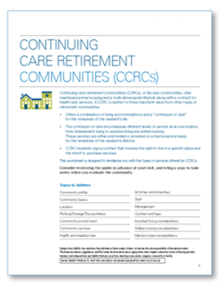
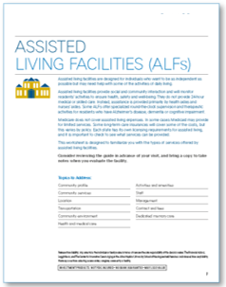
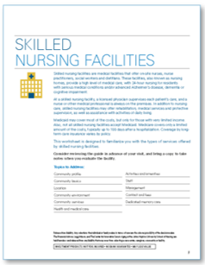
Resources
Housing Options Worksheets
For illustrative and discussion purposes only.
Notes:
Slide objective: introduce resources available for home options.
To help you understand the pros and cons of these last 4 choices I can offer an overview sheet on each. The sheets review the features and considerations we’ve talked about today and also offer additional sources you can access to get more information specific to your health needs and your location.
And that is a point I want you to leave here with an understanding that health and housing options is complicated. Today’s discussion and the materials I’ve mentioned are a starting point, not the end game.

Slide 30
3 | Formulate a plan

Slide 31
Formulate a plan
Speak to a Financial Professional
Determine your wishes
Identify specific resources and facilities
Take action
Document your wishes
For illustrative and discussion purposes only.
Notes:
Let’s end today by talking about what you can do next to develop your care and housing plan.
One of the first things you should do is speak with your financial professional to ensure that you have sufficient assets to cover various late-in-life care and housing scenarios. Talk to them about every aspect of these future expenses, including your retirement savings total, liquidity management, the impact of inflation on future expenses, an annual spending budget, an asset allocation strategy and estate planning.
With this financial understanding you can determine your care and housing wishes for various scenarios. Do your due diligence in this step, pursing additional information through friends, family and the many professional resources available, including our worksheets. The worksheets will help you articulate care and housing priorities and preferences, as well as consider how your wishes will impact your intergenerational financial plan.
It is also a good idea to build a list of resources and specific facilities, before you are dealing with an actual health issue. Yes, things could change by the time you need assistance, but you will at least have a place to start. Identifying a geriatric care manager can be a critical part of this list as these professionals are trained to make service and housing recommendations for short and long-term needs.
With all of this information in hand you will be ready to develop a plan for your care and housing options. I highly recommend that sooner, rather than later, you involve your family in your plan. Things can be very stressful and confusing when someone falls suddenly ill or gradually reaches a point of needing daily help. It will be extremely helpful if you have a plan in advance and that your family is informed and supportive.
And when you have figured out what you or you and your partner want, be sure to document your wishes and share that document with others. Keep this plan with related documents, including your financial and estate plan, power of attorney, will and other instructions.

Slide 32
Resources
Care and Housing Brochure
Assessing Your Housing Needs Guide
Home Safety Assessment Worksheet
Home Support Services Worksheets
Housing Options Worksheets
For illustrative and discussion purposes only.
Notes:
Here are just a few of the resources that could be very helpful as you formulate your plan. The Hidden Cost of Aging brochure summarizes what we’ve covered today. The Hidden Cost of Aging workbook contains the various worksheets to use while you plan and the “Your Records and Roles Organizer” can be used as an aid for intergeneration planning. It provides tools for discussing roles and responsibilities and how to have productive family meeting.
I’m happy to provide you with these materials in hard copy or digitally, if you are interested.

Slide 33
Key takeaways
Population is living longer which increases the need for careful retirement planning.
Keep in mind the impact that the different housing options might have on family, lifestyle, health care and finances.
Review steps you can take today to formulate a plan.
For illustrative and discussion purposes only.

Slide 34
FOOD FOR THOUGHT
“The time to repair the roof is when the sun is shining”- John F. Kennedy
For illustrative and discussion purposes only.
Notes:
Thank you for your time today. I am happy to answer any questions.

Slide 35
QUESTIONS?

Slide 36
Important legal information
This material should be regarded as educational information on health care and is not intended to provide specific advice. It does not constitute legal or tax advice. If you have questions regarding your particular situation, you should contact your legal or tax advisors. The information provided in this material is not intended as a complete analysis of every material fact regarding any country, region or market.
All investments involve risks, including possible loss of principal. Stock prices fluctuate, sometimes rapidly and dramatically, due to factors affecting individual companies, particular industries or sectors, or general market conditions. Special risks are associated with foreign investing, including currency fluctuations, economic instability and political developments.
Investors should carefully consider a fund’s investment goals, risks, charges and expenses before investing. To obtain a summary prospectus and/or prospectus, which contains this and other information, talk to your financial advisor, call us at (800) DIAL BEN/342-5236 or visit franklintempleton.com. Please carefully read a prospectus before you invest or send money.
Important data provider notices and terms available at www.franklintempletondatasources.com.
HCA-CLPPT

